Slide 1
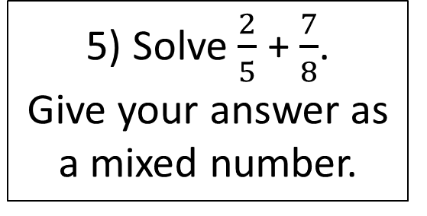
Starter
Solve:
5x + 3 = 2x + 15
4) Find the area of this shape:
2) Paulo and Rachel share £480 between them in the ratio 3:5. Rachel gives 15% of her money to her brother. How much does Rachel’s brother get?
8m
12m
5) Solve $\frac{2}{5}$ + $\frac{7}{8}$. Give your answer as a mixed number.
3) Without a calculator, solve: 324 x 6

Slide 2
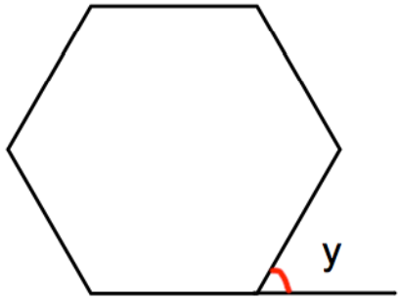
Averages
Learning Objectives
To be able to :
To be able to find values for the mean, median, mode & range.
To be able to calculate the estimated mean of grouped data.
A regular polygon has 12 sides. Work out the size of each interior angle.
Shown is a regular hexagon.
Work out the size of each exterior angle.

Slide 3
Averages and Range
Activity
Reaction Time Test – https://www.justpark.com/creative/reaction-time-test/
Find the mean, median, mode and range of the data collected.

Slide 4

Your turn…
1) James has a spinner that has sections labelled 1 to 5. He spins the spinner 10 times. Here are his scores.
1 4 4 2 3 4 5 1 4 1
Work out the mean, median, mode and range.
2) Miss Jones gives her class a test. The test is out of 40 marks. Here are their scores.
29 20 35 32 38 32
Work out the mean, median, mode and range.
The pass mark for the test is 75%. How many students passed the test?
Shown below are five cards which are arranged in order from smallest to largest.
The range of the cards is 6. The median of the cards is 7. The mean of the cards is 8.
Work out the 4 missing numbers.

Slide 5
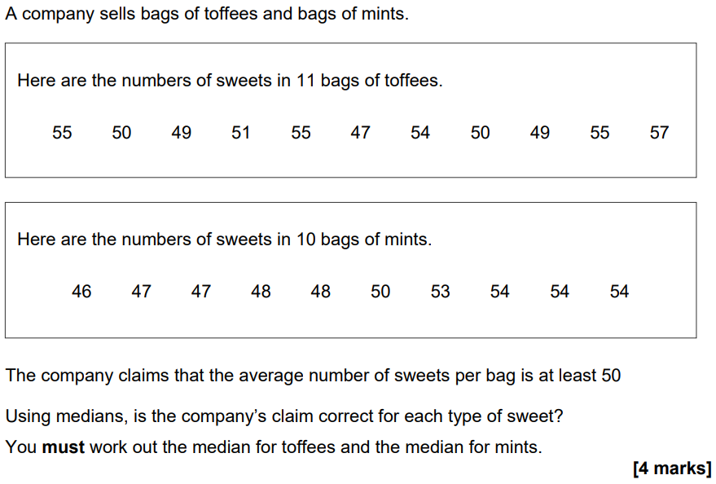


Slide 6
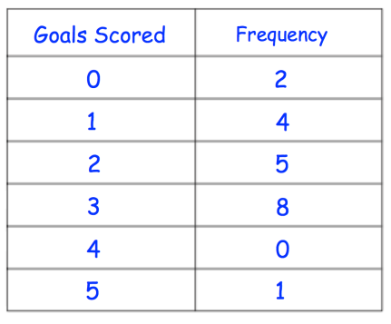
Finding the Mean from a Frequency Table
Work out the mean for the frequency table below.

Slide 7
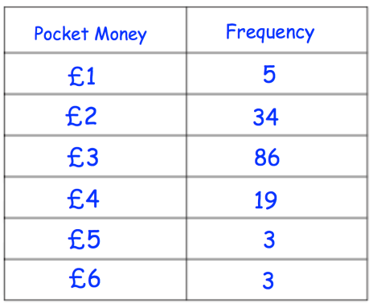
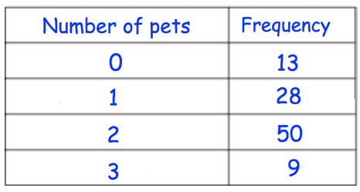
Your turn…
Work out the mean for the frequency table below.
Work out the mean for the frequency table below.

Slide 8
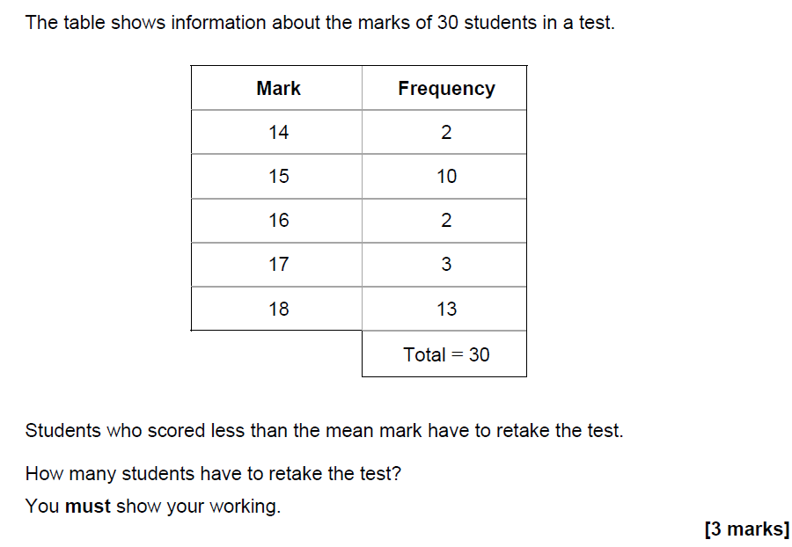

Slide 9
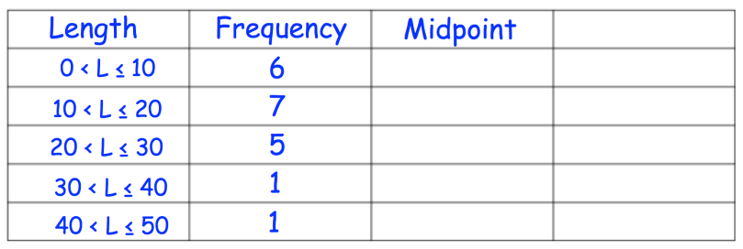
Estimated Mean
Work out an estimate of the mean for the frequency table below.

Slide 10
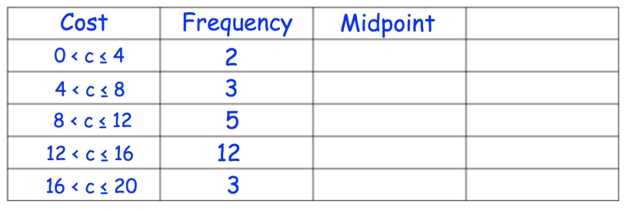
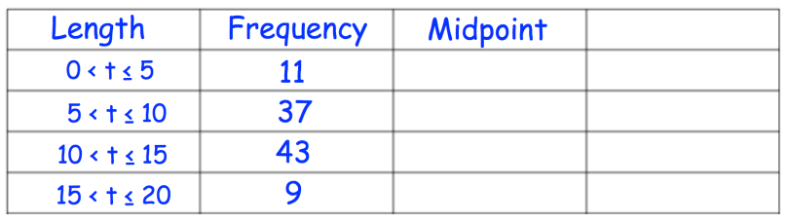
Your turn…
Work out an estimate of the mean for the frequency table.
Work out an estimate of the mean for the frequency table.

Slide 11
