Slide 1
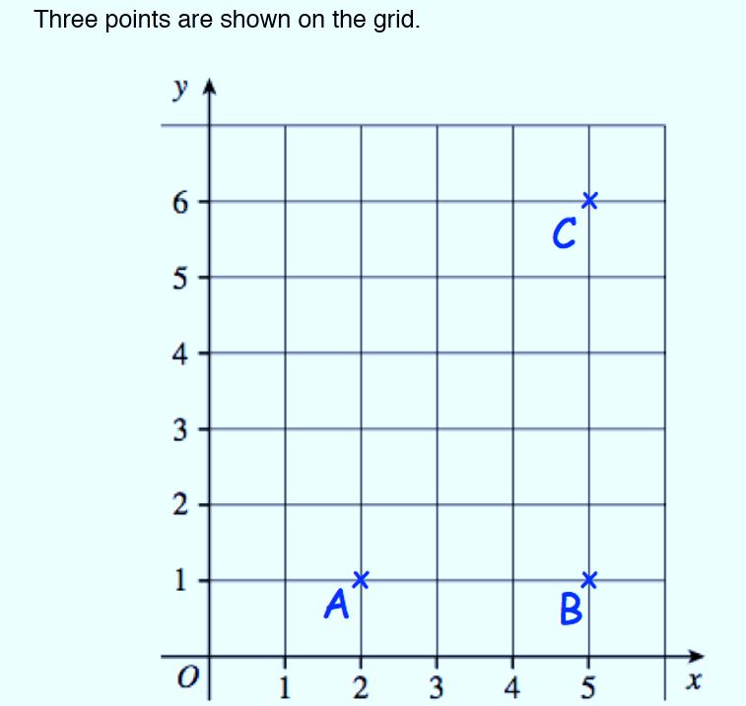

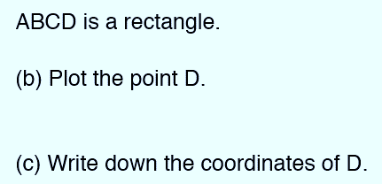
2-D and 3-D Shapes
Learning Objectives
To be able to
Understand and use common 2D representations of 3D objects
Draw 3D shapes to include plans and elevations and their 2D nets

Slide 2
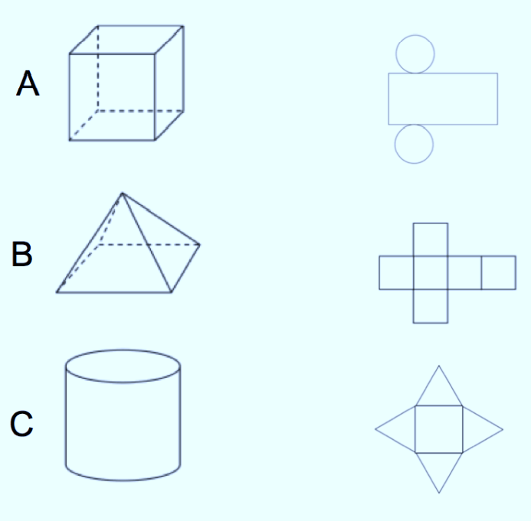
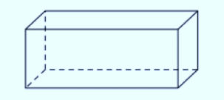
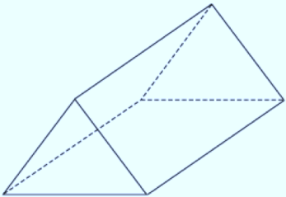
STARTER
Cuboid
Match the nets
How many faces does a cuboid have?
How many edges does a cuboid have
How many vertices does a cuboid have
Pyramid
How many faces does a cuboid have?
How many edges does a cuboid have?
How many vertices does a cuboid have?

Slide 3
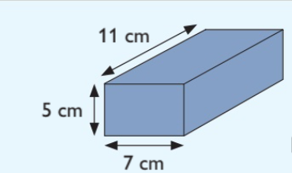
DRAWING NET FOR CUBOID
How would you draw a net for the cuboid on the right.

Slide 4
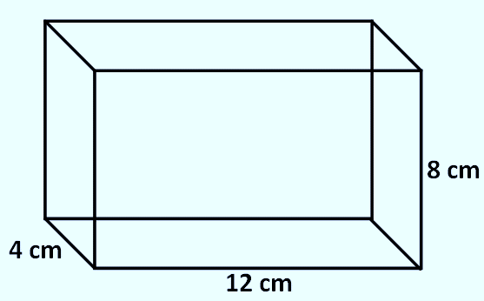
Your turn…
Draw the net of the following cuboid:
Faces = …………
Vertices = ………..

Slide 5
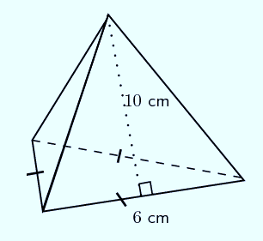
DRAWING NET FOR PYRAMID
A triangle-based pyramid is drawn on the right.
The base is equilateral and the sides are isosceles.
Draw a net for this pyramid.
11cm

Slide 6
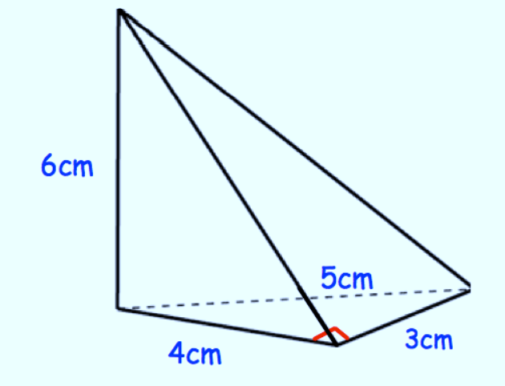
Your turn…
Draw the net of the following pyramid:
Where is its Vertex?
How many faces?

Slide 7
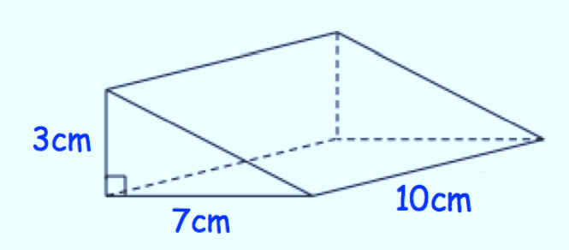
Your turn…
Draw the net of the following triangular prism:
Is this shape a prism?
Explain why?

Slide 8
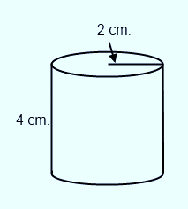
DRAWING NET FOR CYLINDER
Draw a net of the cylinder on the right.
How many faces?
Where is its width, length, height
depth, base ?

Slide 9
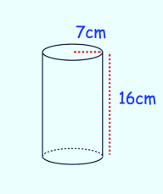
Your turn…
Draw the net of the following cylinder:

Slide 10
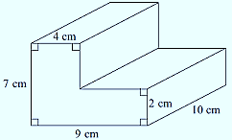
Plans and Elevations are 2D Drawings of 3D Shapes
What would the plan of this shape look like?
If you’re looking at it from the front, it’s called the front elevation (or front view).
If you’re looking at it from the side,
It’s called the side elevation ( or side view).

Slide 11
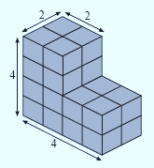
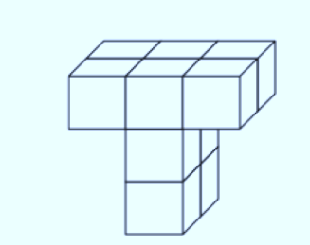
Your turn…
Draw the plan elevation, the side elevation and the front elevation for these shapes.
1)
2)

Slide 12
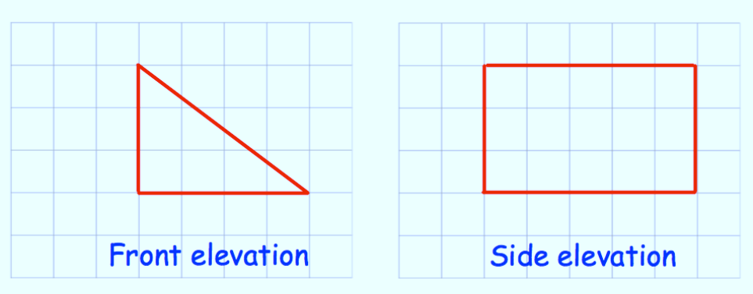
Plans and Elevations are 2D Drawings of 3D Shapes
Here are front and side elevations of a solid shape.
Draw the plan view.
Draw a sketch of the solid shape.

Slide 13
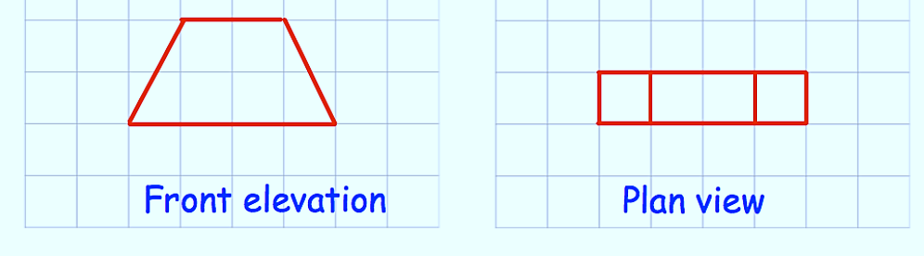
Your turn…
Here are the front elevation and plan view of a solid shape.
Draw the side elevation.
Draw a sketch of the solid shape.

Slide 14
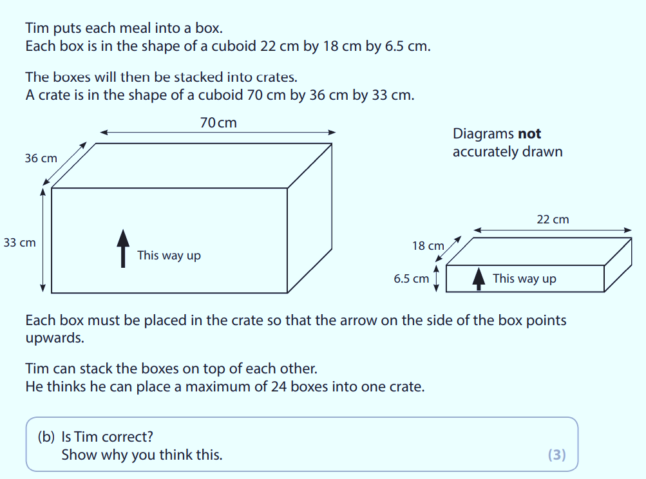

January 2017

Slide 15
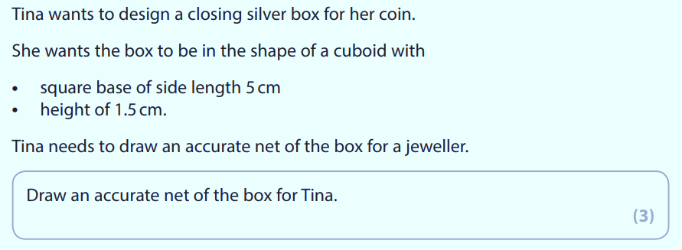
January 2018

Slide 16
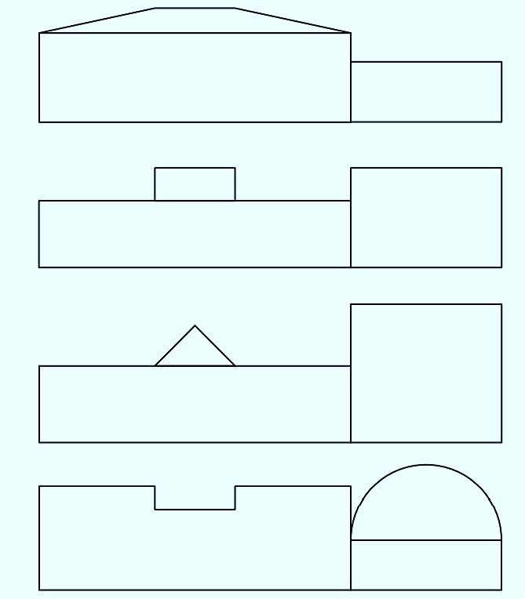

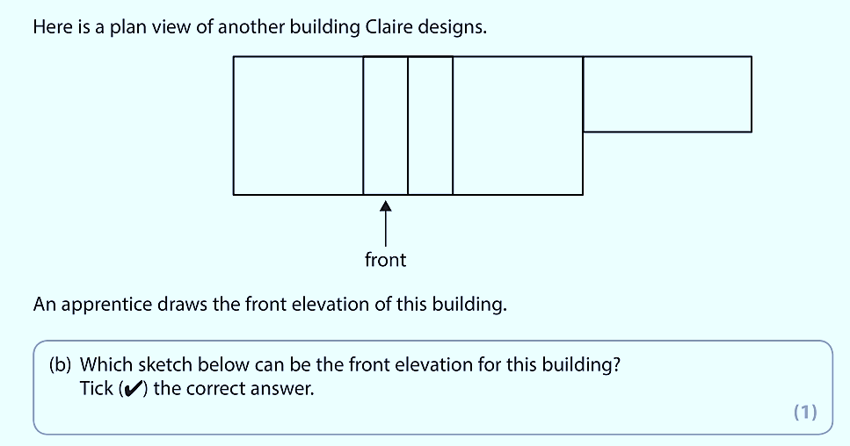
Practice Set 2

