Slide 1
Common Mistakes
Algebra

Slide 2
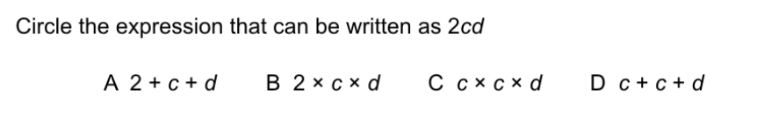
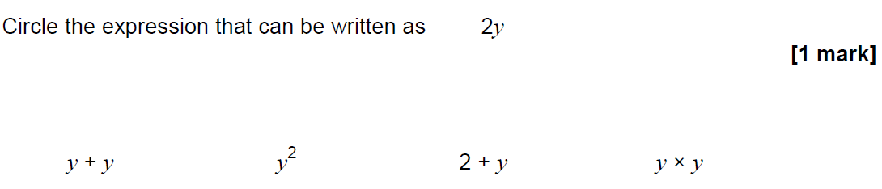
Paper 2 Question 2 - mathswatch
Paper 2 June 2018

Slide 3
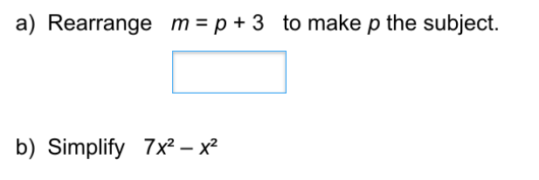
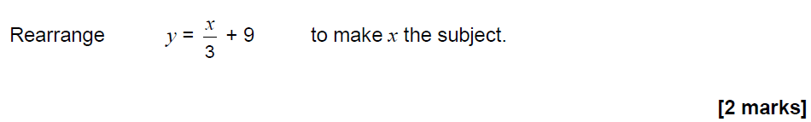
Paper 2 Question 9 - mathswatch
Paper 2 June 2017

Slide 4
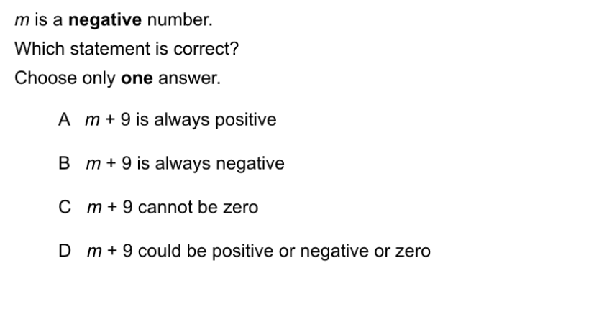
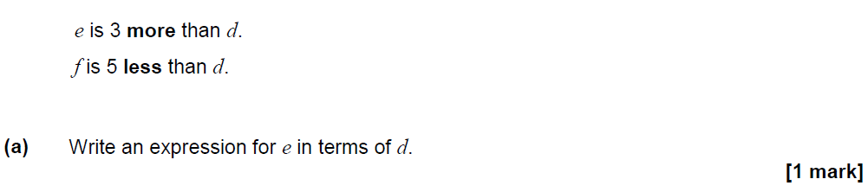
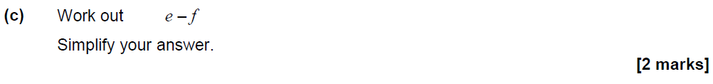
Paper 2 Question 16 - mathswatch
Paper 2 June 2018

Slide 5
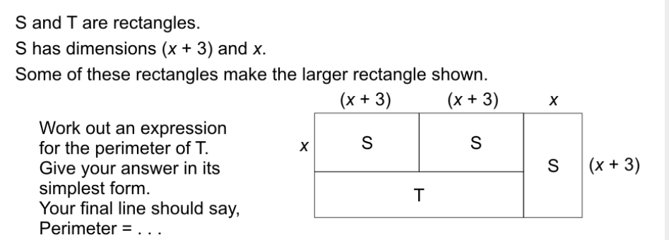
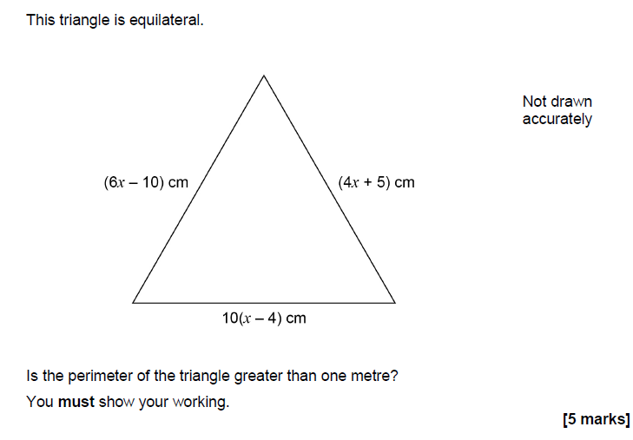
Paper 2 Question 19 –
mathswatch
Paper 2 Nov 2018

Slide 6
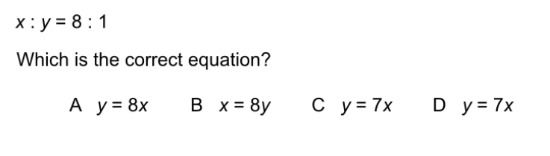
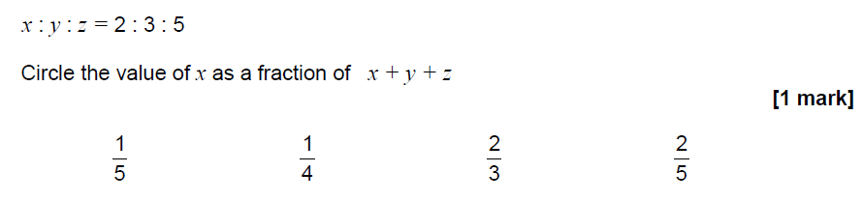
Paper 2 Question 20 - mathswatch
Paper 2 PP set 4

Slide 7
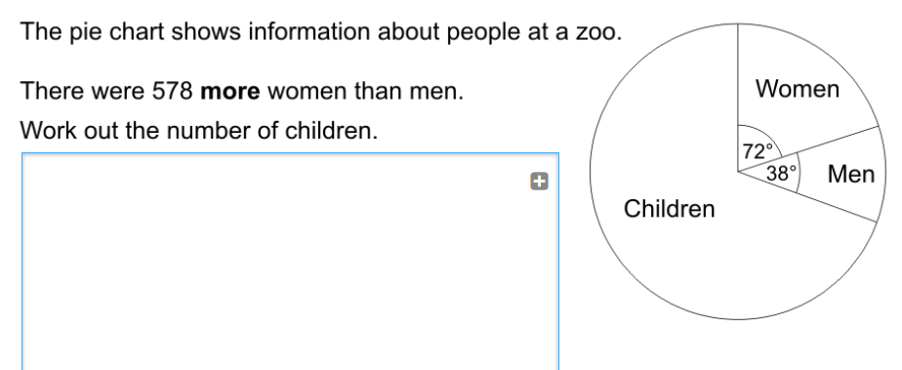
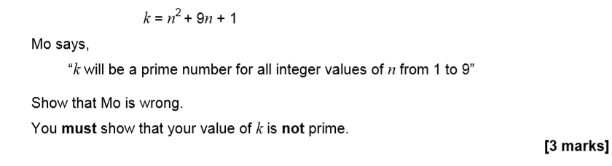
Paper 2 Question 28
Paper 3 Nov 2018

Slide 8
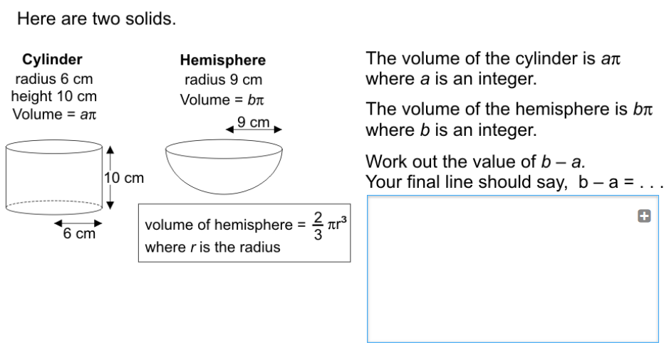
Paper 1 Question 28
Notes:
This is a hard question – I would only go through this with students who are aiming for a grade 5

