Slide 1
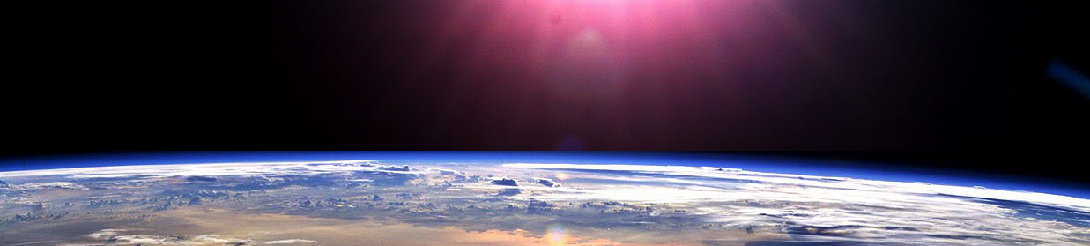
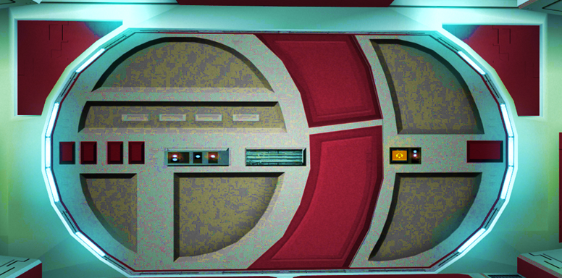


Slide 2

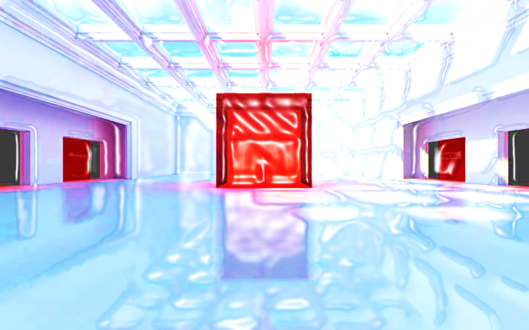





FRACTIONS L1 / L2

Slide 3



















Course Content: Choose your topic …
Whole Number and Functions
place
value
negative
numbers
add and
subtract
multiply
divide
round
numbers
ratio
scale
fraction
decimal
numbers
percent
percent
decimal
fraction
MATHS L1 to L2
Parts of a whole
metric
measure
imperial
measure
perimeter
area
volume
formulae
bodmas
charts
data
averages
prob-
ability
Measure and Shape
Handling Data

Slide 4





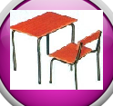







Home Revision Progress Check 1 Video/Discuss Vocab / jobs Lesson Activities Quizzes Topic Answers Progress Check 2 Cont. Learning
Topic Introduction : Fractions
This topic introduces and explores the way in which we can create values that show how much we have when we have less than one, or part of something. This is an old Egyptian method using two digits telling you how many pieces one whole amount has been cut up into and also how many of those pieces you have.
You will learn how to use these two numbers, how they look in pictures, their uses, how to keep it simple by using the smallest numbers possible to show your fractional amount and how to calculate using fractions.
Get really good at this topic as future topics rely lots on fractions. You will also need to remember how to divide as fracturing really just means dividing.
Choose an icon to select where to start
F R A C T I O N S

Slide 5
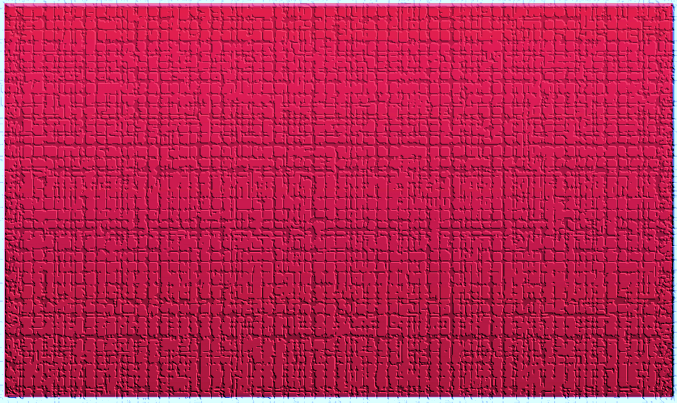

Warm up Exercise 1
Lets start today by revising ! Complete the above sums and multiplication grid

Slide 6
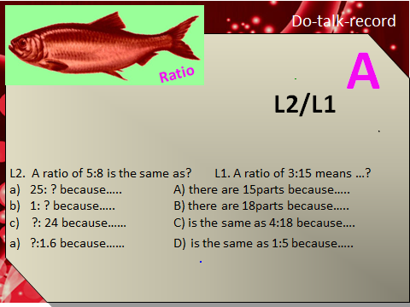
Warm up Exercise 2

Slide 7
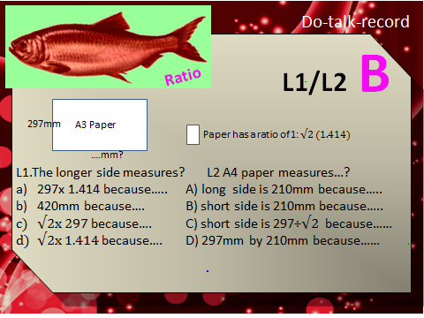
Warm up Exercise 3

Slide 8
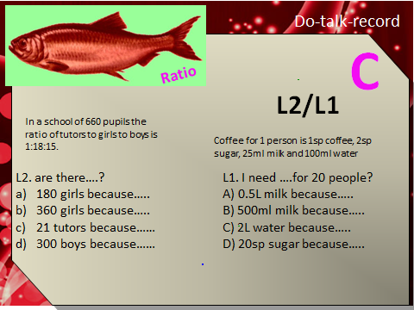
Warm up Exercise 4

Slide 9

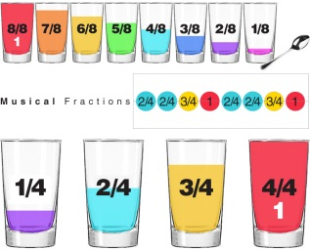
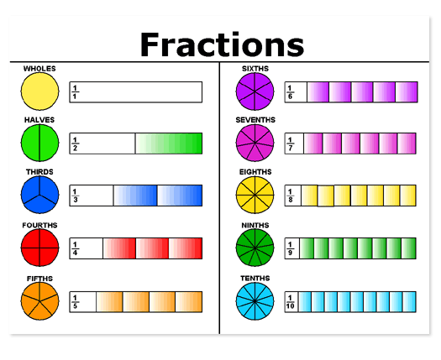
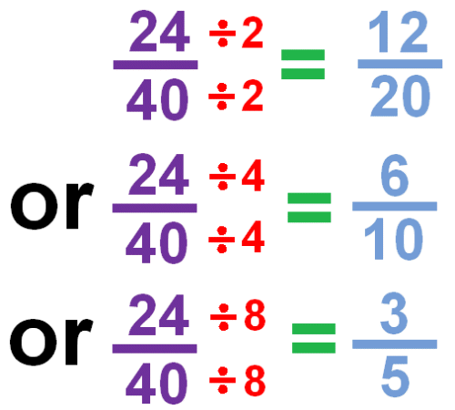
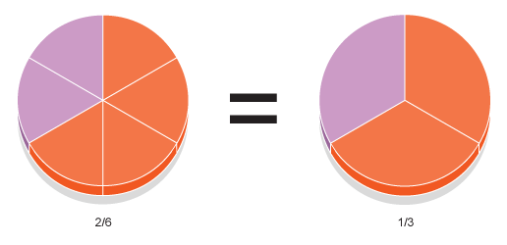
7
Progress Checker 1
W
What do you already know about Fractions ? What did you learn during the week? Examples….
How would you rate your skills with fractions ?
Excellent ability
Good ability, but working to improve
Ok, making a start but I know I have lots to still learn
The date I started studying : My aims are…
A Write a fraction using digits and relate to a real life object, item, score etc…
B Change a fraction to an equivalent or simplest form
C Find a fraction of a value and calculate using fractions (+, -, x, / )

Slide 10

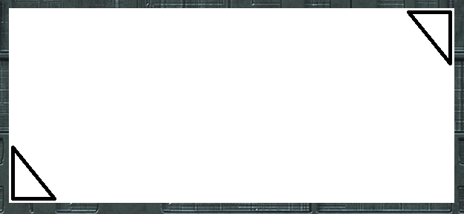
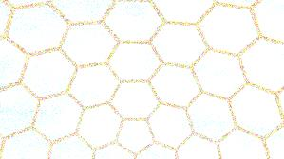

Introductory Video and Discussion
KHTU.
Can you divide up a fraction into even smaller pieces ?
How do you change from one fraction to another ?
When do we use fractions ?
Is using fractions better or worse than other number systems ?
What do the top and bottom numbers mean in a fraction ?
Can you add/subtract/multiply/divide one fraction with another ?
Watch the introductory video and then discuss the above
Your thoughts..

Slide 11

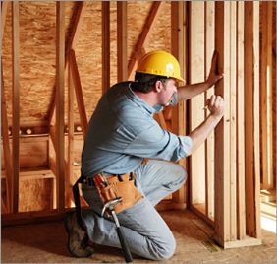

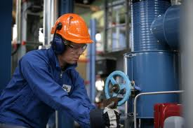
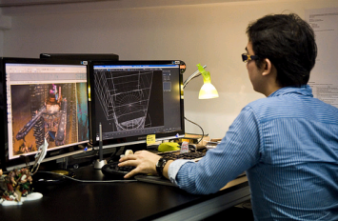

Vocabulary and Jobs
Fraction
Divide
Split
Factor/Factorise
Numerator
Denominator
Equivalent
Simplify
Part
Portion
Whole
These are the words you will be using in this topic
Accountants
Builders
Scientists
Engineers
Chef
Retail
Researcher
Game designer
Carpenter
…. Can you think of more?
…………………………………
…………………………………

Slide 12
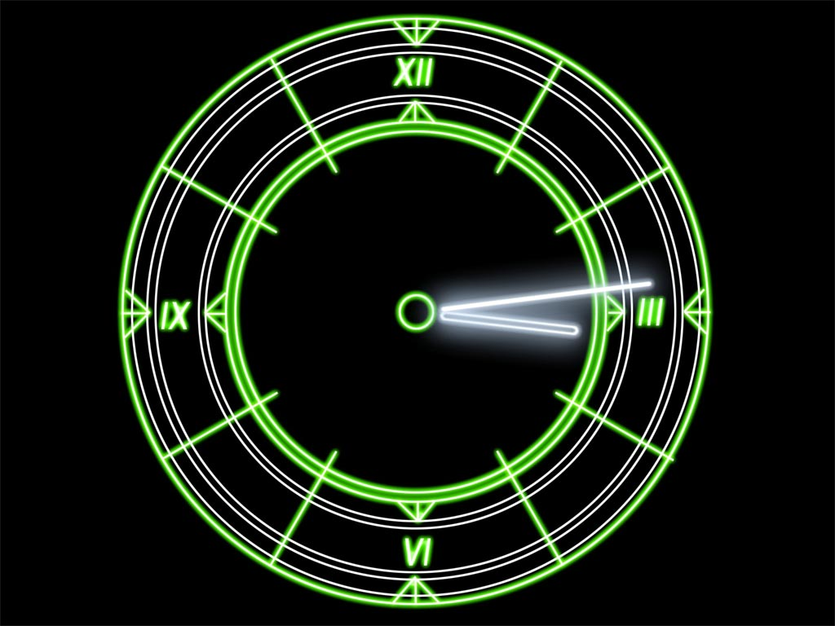
Lesson: Concept Activity
Draw a circle
Divide it up into 24
hours of the day
Work together to write the name of each slice of the clock as a fraction of the whole 24 hours
Can you simplify?
Can you show how to add/subtract/
Multiply or divide up the slices?

Slide 13
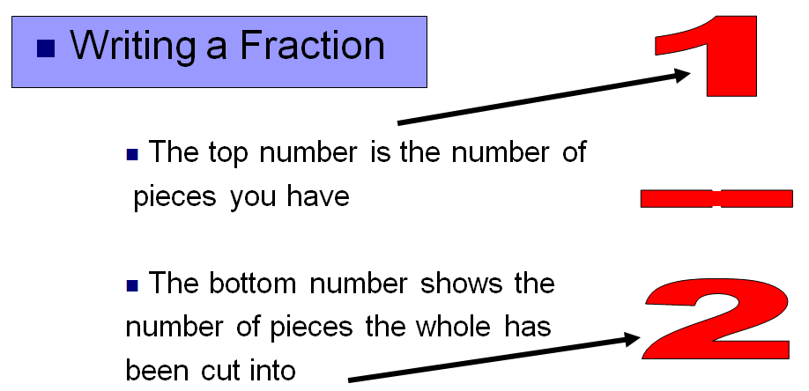
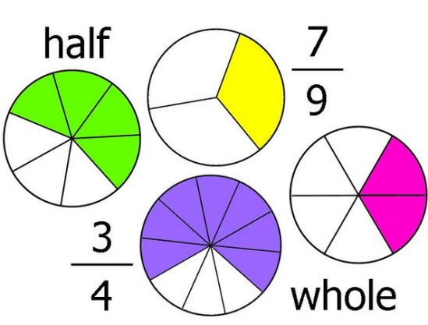
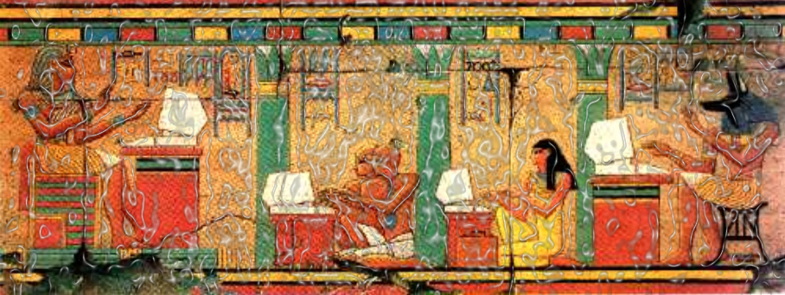
Lesson: Main Teach 1
Fraction Rule 1 –
The Egyptians invented this number
system to help them build the pyramids!
It is a simple system where you count up
all of the ‘items’ you have (called the WHOLE
amount) and write this number under a line.
Then you count up the PARTS you have out
of the whole amount and write this number
on top of the line. There…..you have a fraction!
Numerator
Fraction examples !
Denominator

Slide 14
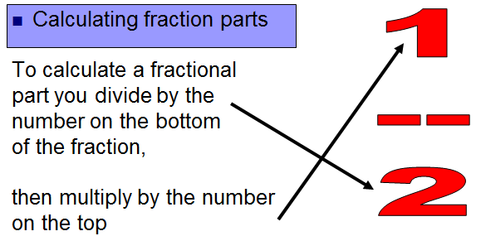
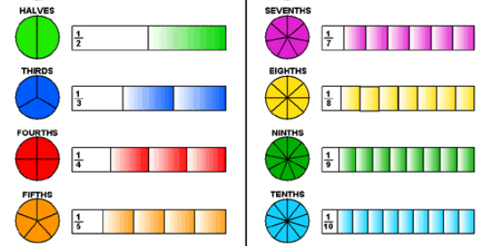
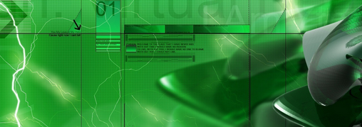
Lesson: Main Teach 2
Fraction Rule 2 –
As fractions are just about cutting things
up they are just another way of saying
‘dividing’.
Therefore, the number on the bottom of the
fraction shows the number parts you are
dividing the whole amount into.
When finding a fraction of a value such as
a third of a sum of money, a third means
‘divide by three’.
The top number is how many of those pieces
you want, so once you have found one piece
just multiply that value by the top number.
Half of £60
Third of 90m
Quarter of 16 people
Three fifths of a day

Slide 15
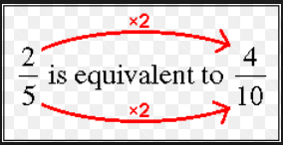
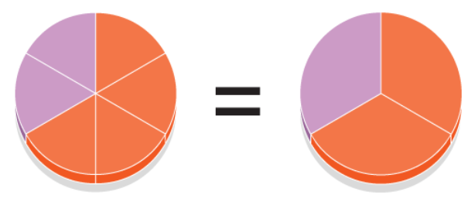
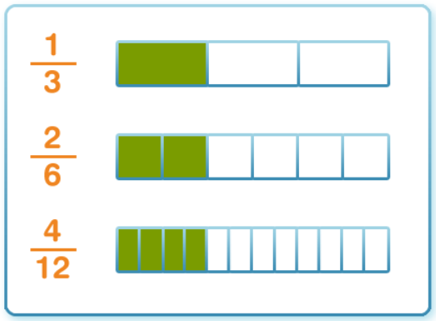
Lesson: Main Teach 3
Fraction Rule 3 –
To simplify/change a fraction look back at the
lesson on ‘RATIOS’
The top and bottom numbers both change by
a factor (in the topic of ratios is called SF).
Find a factor of both the top and bottom
numbers of the fraction and either multiply or
divide both numbers by this factor
4
2
6
3
These fractions
are all the
same size
Here you divide both
numbers by 2

Slide 16

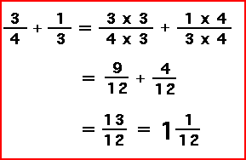

Lesson: Main Teach 4
Fraction Rule 4 – Adding/Subtracting
Fractions a)
To add and subtract fractions first you
need to see if they are the ‘same’ fraction size.
This means you need to look at both fractions
bottom numbers and see if they are the same
number.
Addition and subtraction of fractions of the
same size is easy, just add or subtract the top number
of one fraction to the other !!
If the fractions are different sizes (ie the bottom
numbers are different) you will need to make them
both the same by using ‘RULE 3’ to change them. Then
you can add or subtract them.

Slide 17

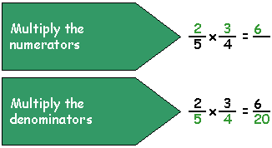
Lesson: Main Teach 5
Level 2
Fraction Rule 5 – Multiplying Fractions
To multiply a fraction by another its easy !!
Just multiply the top numbers of both fractions to
produce the top number of the answer. Then
multiply the bottom numbers of both fractions to
produce the new bottom number in the answer.
That’s it, easy !!
Don’t forget that ‘whole’ numbers can become
fractions, just divided by 1.

Slide 18
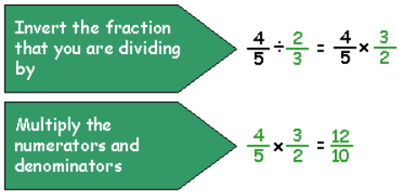

Lesson: Main Teach 6
Fraction Rule 6 – Dividing Fractions
To divide a fraction by another there is a
‘strange’ rule which gets you to ‘flip’ the
fraction you are dividing by upside down
and then just use ‘RULE 5’ to multiply
instead!!
Level 2

Slide 19
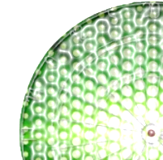
Lesson: Try out
Block 1 : Watch tutor led demo (in class or on video)
Try these, 1) Write one half in digits…………………………………………….. 2) Write two thirds in digits………………………………………………….
3) Write three quarters in digits…………………………………………….. 4) Write a tenth in digits…………………………………………………………
5) Write four fifths in digits………………………………………………………. 6) Write one and a half in digits………………………………………………………
Block 2 : Watch tutor led demo (in class or on video)
Try these, 7) Simplify 4/8 ………………………………… 8) Simplify 10/30……………………………………………………
9) Simplify 14/52…………………………………………………. 10) Write this mixed number in top heavy form 1 2/5 …………………………
11) Write this top heavy fraction as a mixed number 14/12 12) Find ¾ of 200
13) Find 1/5 of 300 14) Put in order, highest first 2/5, 3/7, 6/10
Block 3 : Watch tutor led demo (in class or on video)
Try these, 15) Add ½ + ¾ ……………………………………………………. 16) Add 6/5 + 2/10 …………………………………………………
17) Subtract ¾ from 7/8 ………………………………………….. 18) Subtract 2/3 from 8/9 …………………………………………………….
19) Convert all these fractions into twelfths 1/3 , 2/4 , 7/6
20) Multiply 4/5 by 7/8
21) Multiply 1 and ½ by 2 and 3/7
Divide 10/4 by ½
Divide 3 and 1/3 by 9/2
Level 2

Slide 20
Lesson: Websites and links
http://www.freewebs.com/weddell/equivalent.swf
fractions and equivalent fractions
http://www.mathsisfun.com/fractions_addition.html
Add/Sub fractions, 3 different ways
to solve on a web page!
fractions games
http://themathgames.com/
fraction website with explanations
and examples of fraction rules
http://www.aaamath.com/fra.htm
http://www.bgfl.org/bgfl/custom/resources_ftp/client_ftp/ks2/maths/fractions/
fraction basics visuals using pizza
Another website with fraction
help
http://www.mathsisfun.com/fractions-menu.html
Visualisations of fractions and
equivalent fractions
http://nlvm.usu.edu/en/nav/category_g_1_t_1.html
Variety of fraction games
http://www.math-play.com/math-fractions-games.html

Slide 21
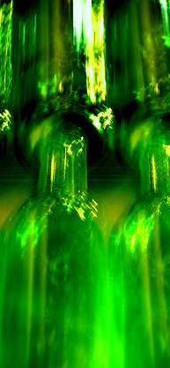
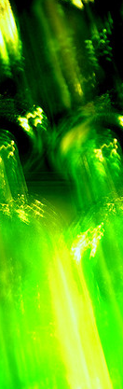
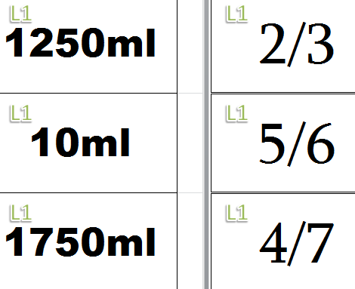
Lesson: Activity A
Match the cards to the correct height on the bottles. 1) try finding the amount of liquid at the fraction amount 2) try writing the fraction in a different way 3) try adding/subtracting one amount to another 4) try multiplying or dividing a fractional amount by another

Slide 22
CREATE YOUR FRACTIONS BELOW
+
-
X
/

Slide 23
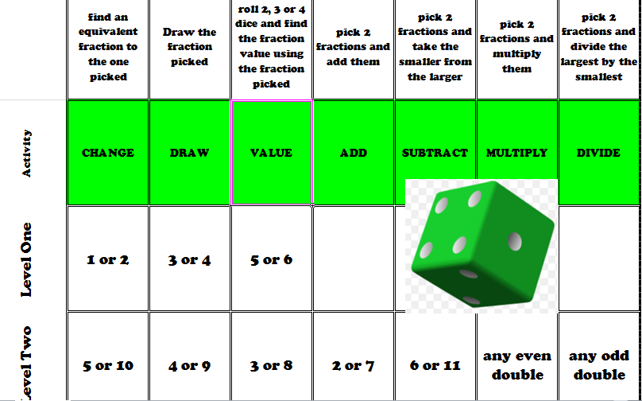
Lesson: Activity B
Level 2

Slide 24
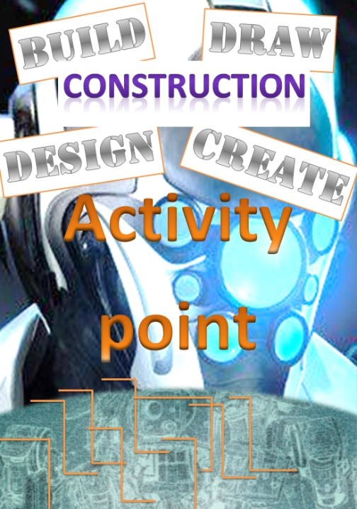
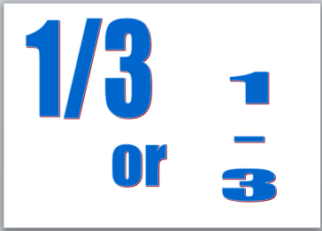

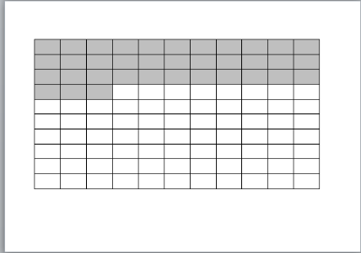
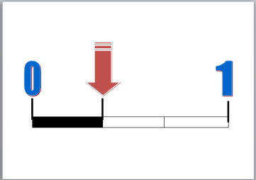
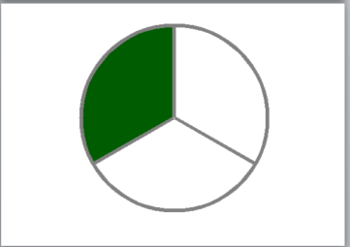
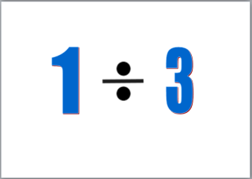
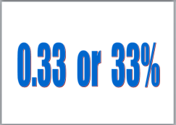
Lesson: Activity C
Design a Fractions Poster !
Cut out a fraction circle
Put the fraction circle on the poster
Write the fraction in different ways
Ext: show visually using one or more fraction circles how to ‘Add’ ‘Subtract’ ‘Multiply’ ‘Divide’ fractions

Slide 25
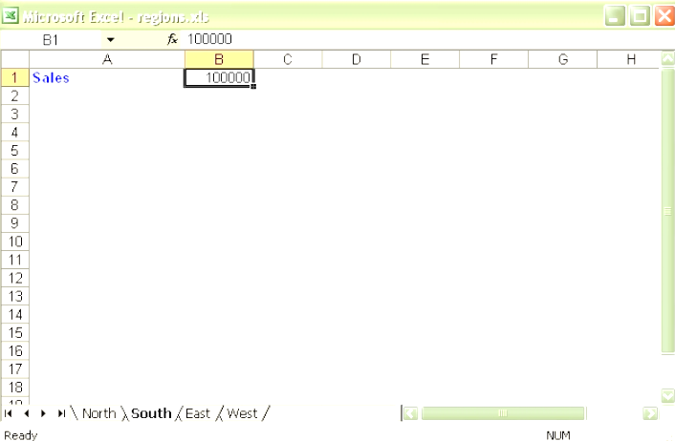

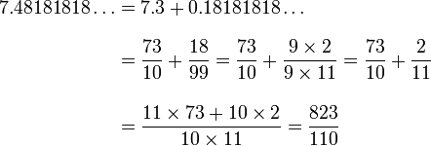
Lesson: Activity D
Use a spreadsheet to produce formulae that will :
1 Find equivalent fractions
Add and subtract fractions together
Multiply fractions or divide them
Find a fraction of another value
Level 2

Slide 26

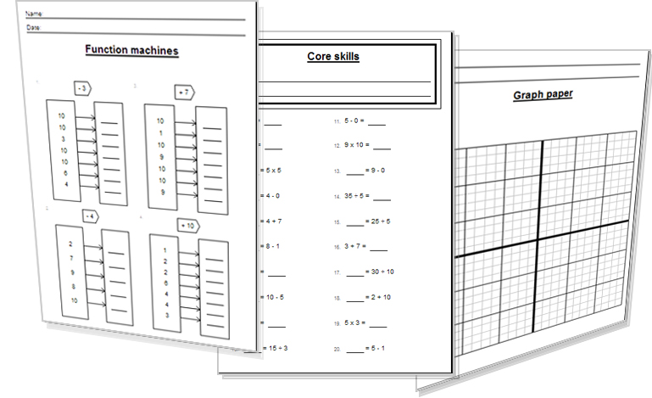
Lesson: Activity D
Try a variety of written practice
Worksheets
Workbooks
Practice Exam Papers
Maths Problems

Slide 27

Lesson: Practice – just the numbers
D Simplify the following
8/10
2/4
14/16
90/100
1K/1M
40/60
5/15
20/60
7/56
77/88
E Convert these mixed fractions into top heavy fractions
3 ½
1 4/5
2 ¾
5 2/3
3 7/9
F Convert these top heavy fractions into mixed fractions
18/7
29/4
5/3
A Write the answer as a fraction
One cut into three =
One split into five =
One divided by ten =
One cut into seven =
One divided by fifteen =
Two cut into three =
Four divided by six =
Eight split into nine =
Ten cut into twenty =
Six divided into one hundred =
B Find fractions of a value
Find half of 20
1/3 x 60
4/5 of £100
1/7 x 210kg
1/10 of 1K
2/3 of 18
1/8 x 240
3/6 of 40
1/15 x 45
7/9 of 63
C Complete the following fraction sums
Add ½ and ¼
Add ¾ and 3/8
Add 2/3 and 7/9
Add 2/5 and 3/10
Add 4/6 and 15/18
Subtract 1/3 from 5/6
Subtract 2/5 from 9/10
Subtract 19/20 from 99/100
Subtract ¾ from 16/20
Subtract 4/7 from 17/21
Multiply 8/10 and 2/3
Multiply 2/7 and 2/8
Multiply 4/5 and 1/11
Multiply 3/8 and 2/5
Multiply 6/1 and 20/1
Multiply 1/5 and 1/7
Divide 2/3 by 1/6
Divide 1/5 by 2/3
Divide 8/9 by ½
Divide 3 and 2/4 by 4/5
Divide 3/7 by 10/1K
Level 2
Level 2

Slide 28

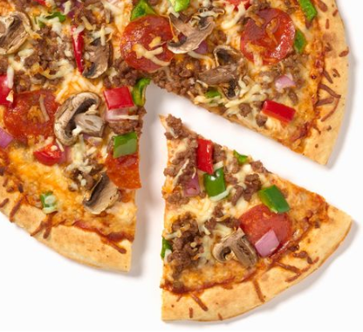
Lesson: Practice – Word Problems
Q1 I watched a film lasting two and a half hours straight after watching another that was on for an hour and a quarter. What is the total viewing time for the two movies together?
Q2 A fifth of a plane journey was disturbed by turbulence. The flight was for four and a half hours. How long did the turbulence last?
Q3 Firemen worked on a fire in a building that spread to a quarter of its 840 rooms. How many rooms did not catch fire?
Q4 Two and a half pizzas were used at a party. Each pizza was cut into eighths. How many eighths were able to be cut from the two and a half pizzas?
Q5 A survey had 79 people out of a hundred give a positive score for a hotel. Using a suitable approximation and an equivalent fraction, give the hotel a rating out of five stars.
Q6 A large tractor tyre turns a full turn and travels 3m along the ground. How many turns does it take for the wheel to travel 10 and a half metres?
Level 2

Slide 29
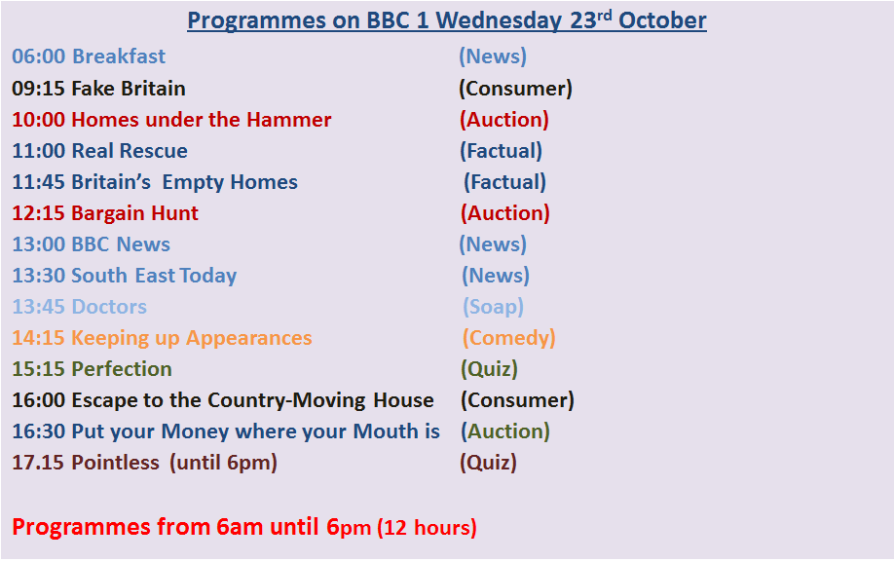

Lesson: Practice – Making it Functional 1
BB

Slide 30
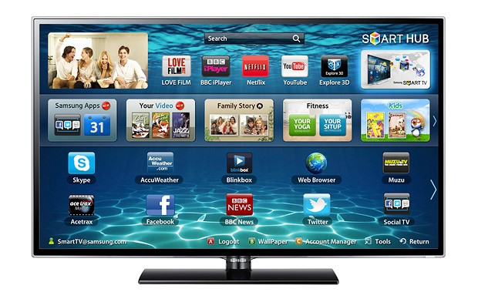
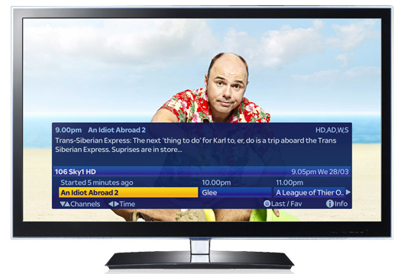

Lesson: Practice – Making it Functional 2
BB
1) What fraction of the day’s tv hours (out of 12 hours) are ‘News’ programmes?
You watch ‘Perfection’ each week for 5 weeks on the same day. Find the total number of hours watching this programme showing your workings as multiplication of fractions and leave your answer as a fraction.
a) Write down the number of hours ‘Fake Britain’ is on for as a fraction of an hour
b) Show, using division of fractions, how long each part of the programme is on for if there
are 2 five minute advert breaks in the programme time.
Draw a pie chart to show the TYPES of programmes available to watch on Oct 23rd showing the
fraction of each slice of the pie

Slide 31
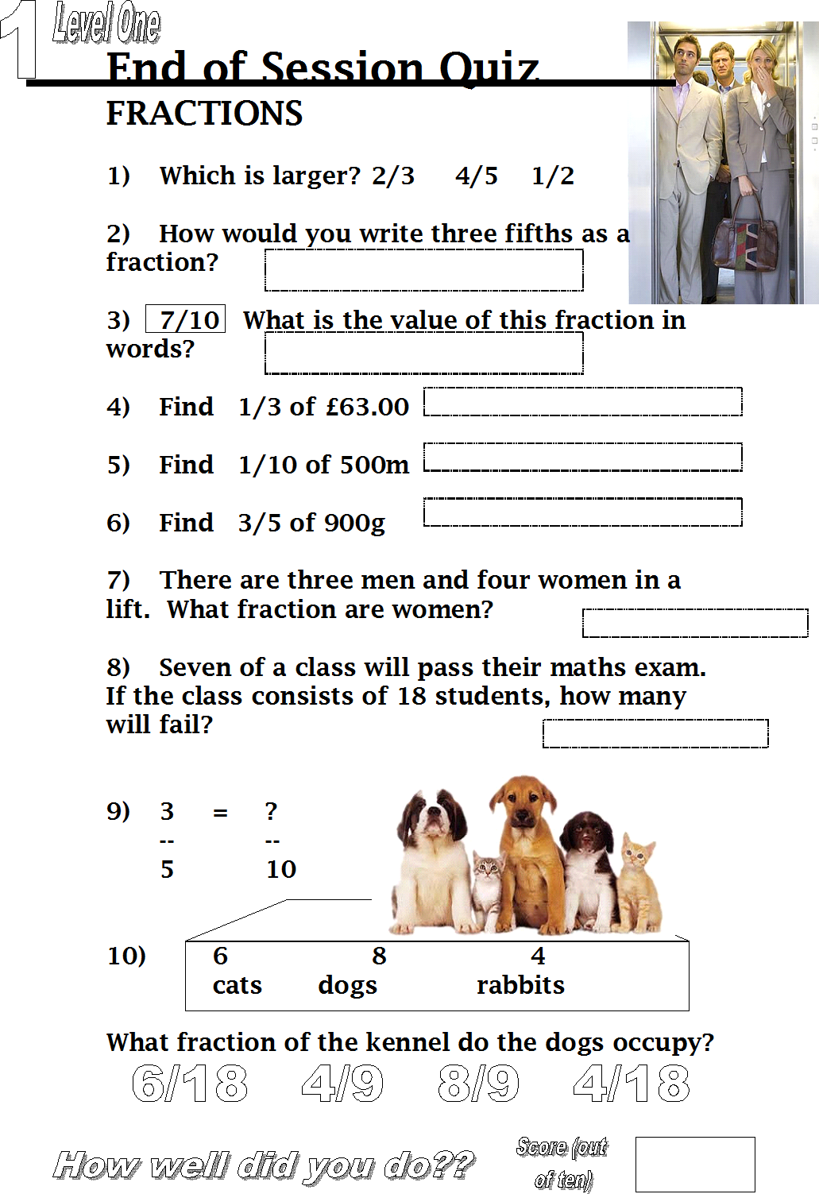
Quiz to assess LEVEL 1

Slide 32

Quiz to assess LEVEL 2

Slide 33
TOPIC ANSWERS 1
Block 1
½
2/3
¾
1/10
4/5
1 ½
½
1/3
7/26
7/5
1 1/6
150
60
6/10, 3/7, 2/5
7/4
14/10 or 7/5
1/8
2/9
4/12, 6/12, 14/12
28/40 or 14/20 or 7/10
51/14
20/4 or 10/2 or 5
20/27
C Complete the following fraction sums
3/4
9/8
13/9
7/10
27/18
3/6 or 1/2
5/10 or 1/2
4/100
1/20
5/21
16/30 or 8/15
4/56 or 1/14
4/55
6/40 or 3/20
120
1/35
12/3 or 4
3/10
16/9
35/8
300/7
A Write the answer as a fraction
1/3
1/5
1/10
1/7
1/15
2/3
4/6
8/9
10/20
6/100
B Find fractions of a value
10
20
£80
30kg
100
12
30
20
3
49

Slide 34

TOPIC ANSWERS 2
D Simplify the following
4/5
1/2
7/8
9/10
1/1000
2/3
1/3
1/3
1/8
7/8
E Convert these mixed fractions into top heavy fractions
7/2
9/5
11/4
17/3
34/9
F Convert these top heavy fractions into mixed fractions
2 4/7
7 1/4
1 2/3
Word Problems
2 ½ + 1 ¼ = 3 ¾
1/5 x 4 ½ = 1/5 x 9/2 = 9/10 of an hour
¾ x 840 rooms = 630 rooms
2 ½ pizzas / 1/8 = 5/2 x 8/1 = 40/2 = 20 slices can be cut
79/100 is nearly 80/100 = 8/10 = 4/5 rating
10 ½ metres / 3 meters = 21/2 / 3/1 = 21/2 x 1/3 = 21/6 turns (or 3 and ½ turns)
Making it Functional
½ hour out of 12 hours is… 1/24
¾ hour x 5 days = 15/4 hours or 3hrs ¾
a) ¾ hour
b) 2 breaks means 3 parts to the programme
So… ¾ hour is divided by 3…. ¾ x 1/3 = 3/12 or ¼ hour each part
4) Pie chart opposite…

Slide 35



TOPIC ANSWERS 2
9a
11

Slide 36
7
Progress Checker 2
W
What do you now know about Fractions ? What did you learn during the session? Examples….
How would you now rate your skills with fractions ?
Excellent ability
Good ability, but working to improve
Ok, making a start but I know I have lots to still learn
The date I finished studying : My aims were…
A Write a fraction using digits and relate to a real life object, item, score etc…
B Change a fraction to an equivalent or simplest form
C Find a fraction of a value and calculate using fractions (+, -, x, / )

Slide 37


Continuing to Study and Learn
What else can you do to help yourself to learn and practice? Here are ten suggestions, record which you do each week and also record your progress.
Internet websites
Repeat the lesson, make notes, organise a folder, revise
Own maths workbook
Study together with a friend or family member
Finish activities in this book
Complete class handouts or tasks
Practice exams / past papers
Use maths skills learnt at home or at work in real situations
Play games
Experiment yourself, try new things ask yourself questions
Try making a graph of number of practice methods you use against your progress score in each topic. Are you showing more practice gives better results?

