Slide 1
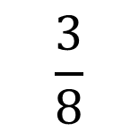
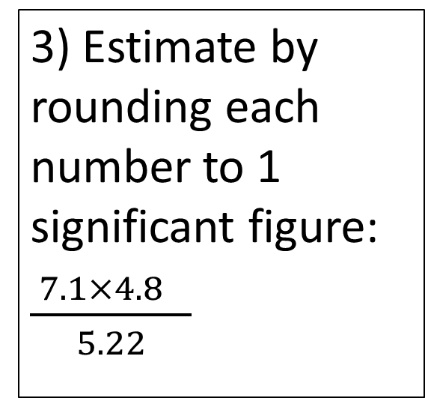


Starter
1a) 34 x 11
b) 3.4 x 1.1
2) A baby giraffe born at 110kg has increased in weight by 35%
What does it weigh now?
3) Estimate by rounding each number to 1 significant figure: $\frac{ 7.1×{4.8}^{}}{5.22}$
374
3.47
148.5kg
7
4) 5 friends go on a coach trip. The total cost of the trip is £112. Work out the cost for each person.
6) What is +
$$\frac{3}{8}$$
$$\frac{7}{24}$$
$\frac{2}{3}$
19 : 31

Slide 2
Rat:o
Learning Intent
To be able to :
Use ratio notation, including reduction to simplest form
Divide a given quantity into two parts in given part A : part B or
Write ratios in the form 1:n
What do we know about ratio
How confident are on a scale of 1 – 10

Slide 3
Simplify
Jayden and Abbie share a bag of 52 sweets. Jayden has 16 sweets, and Abbie has the rest. Find the ratio of Jayden’s sweets to Abbie’s sweets, giving your answer in its simplest form.
4 : 9
5 : 3
Write the ratio 1m : 60 cm in its simplest form.
Casey makes a smoothie by mixing half a litre of cranberry juice with 100 millilitres of yoghurt. Write the amount of blueberry juice to yogurt in its simplest form.
5 : 1

Slide 4
Your turn…
Write these ratios in their simplest form.
10p : £1
20 mm : 6 cm
2 weeks : 7 days
18 mins : 1 hour
30 cm : 2 m
1 m : 150 mm
1. Emma’s mass is 54 kg. Her award-winning pumpkin has a mass of 6000g. Find the ratio of the pumpkin’s mass to Emma’s mass in its simplest form.
2. The icing for some cupcakes is made by mixing 1.6 kg of icing sugar with 640g of butter. Find the ratio of butter to icing sugar in its simplest form.
1:10
1:3
1:9
2:5
2:1
3:10
3:20
20:3

Slide 5

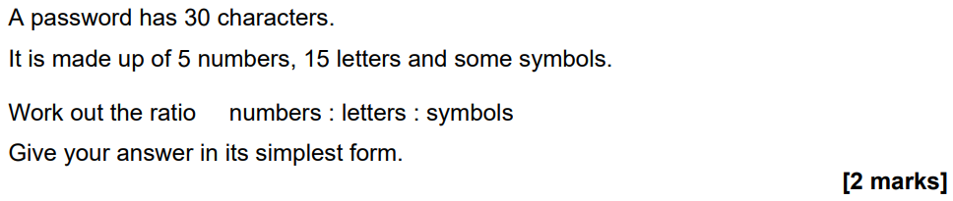
November 21 Paper 1
1 : 3 : 2

Slide 6
Simplify to 1:n
Simplify the ratio 4:8 in the form 1:n
Divide both sides of the ratio by 4
1 : 2
Simplify the ratio 5:3 in the form 1:n
Divide both sides of the ratio by 5
1 : 0.6

Slide 7
Your turn…
Write down the following ratios in the form of 1 : n.
6 : 18
5 : 25
4 : 27
10 : 54
12 : 63
1 : 3
1 : 5
1 : 6.75
1 : 5.4
1 : 5.25

Slide 8
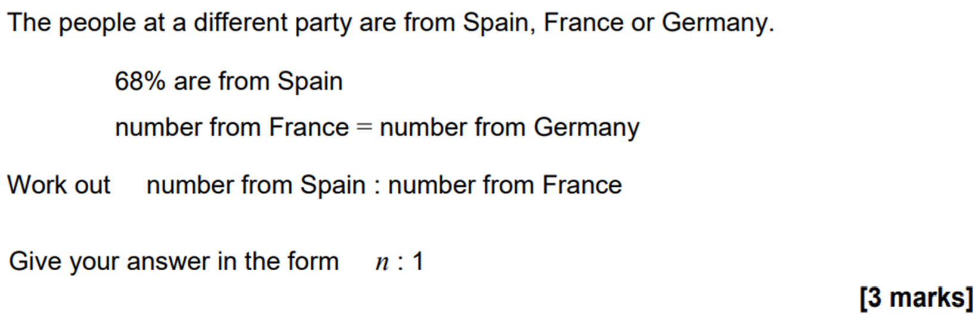
June 22 Paper 2
68 : 16
4.25 : 1

Slide 9
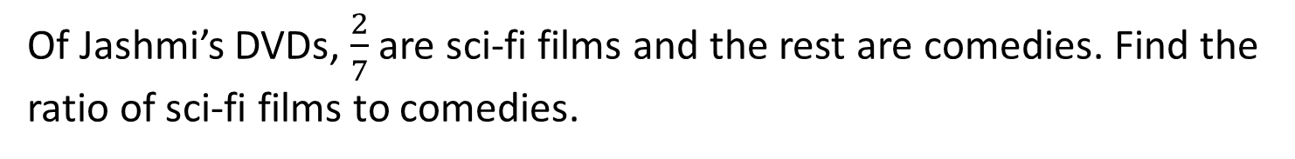
Ratios and Fractions
A box of doughnuts contains jam doughnuts and chocolate doughnuts in the ratio 3 : 5. What fraction of the doughnuts are chocolate flavoured?
Of Jashmi’s DVDs, $\frac{2}{7}$ are sci-fi films and the rest are comedies. Find the ratio of sci-fi films to comedies.

Slide 10




Your turn…
1. In a bag of red sweets and green sweets, $\frac{1}{3}$ are red. Find the ratio of red to green sweets.
2. Al watched $\frac{3}{10}$ episodes in a series. Find the ratio of episodes he watched to the ones he didn’t.
3. $\frac{1}{8}$ of some counters are red, $\frac{5}{8}$ are blue and the rest green. Find the ratio of red to blue to green.
1. A tiled floor has blue and white tiles in the ratio 9 : 4. What fraction of the tiles are blue?
2. In a tournament the number of home wins and draws were in the ratio 7 : 2 What fraction of the games were draws?
3. Amy’s sock drawer has spotty, stripy and plain socks in the ratio 5 : 4 : 1. What fraction are stripy?
$\frac{9}{13}$
1:2
$\frac{2}{9}$
3:7
$\frac{4}{10}$
1:5:2

Slide 11
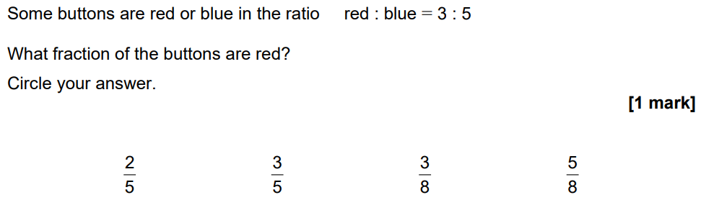
November 21 Paper 2

Slide 12
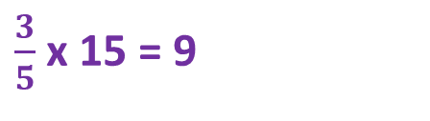
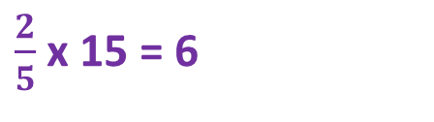


Dividing in a Given Ratio
$\frac{2}{5}$x 15 = 6
Share £15 in the ratio 2:3
$\frac{3}{5}$x 15 = 9
$\frac{1}{6}$x 66 = 11
Share £66 in the ratio 1:5
$\frac{5}{6}$x 66 = 55

Slide 13
Your turn…
1. The angles in a triangle are in the ratio 2 : 1 : 3. Find the sizes of three angles.
2. The four angles in a quadrilateral are in the ratio 1 : 5 : 2 : 4. Calculate the sizes of all four angles.
3. A rope is cut into three pieces in the ratio 2 : 1 : 4. The third piece is 22cm longer than the first piece. What is the length of the second piece?
1. Find the largest share when each amount below if divided in the given ratio.
£30 in the ratio 1 : 4
42g in the ratio 4 : 2
150kg in the ratio 3 : 7
2. There are 121 dogs at a show. For every 11 dogs at the show, 9 are male. How many male and how many female dogs are at the show?
60:30:90
£24
28g
105kg
30:150:60:120
99:22
11cm

Slide 14
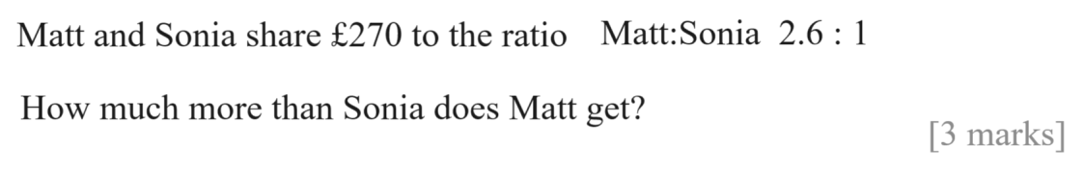
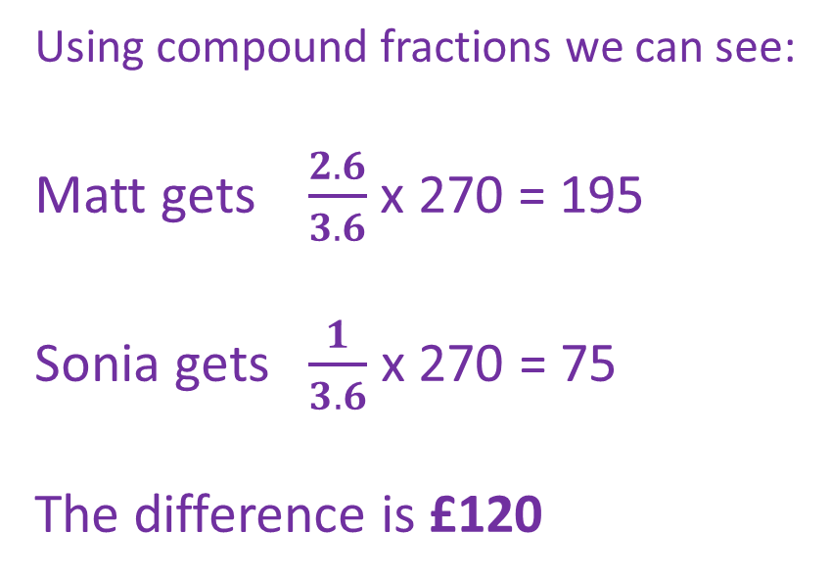
November 21 Paper 3
Using compound fractions we can see:
Matt gets $\frac{2.6}{3.6}$ x 270 = 195
Sonia gets $\frac{1}{3.6}$ x 270 = 75
The difference is £120

Slide 15
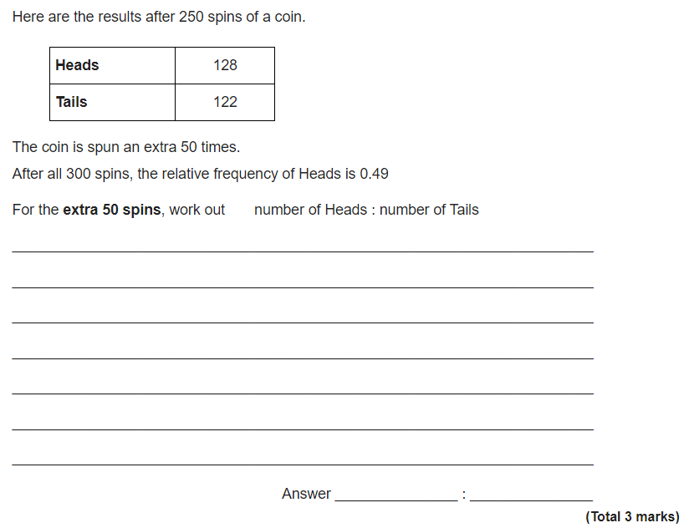
H = 300 x 0.49 = 147
147-128 = 19
Of the 50 extra spins H = 19 so…
T = 31
19 : 31

