Slide 1
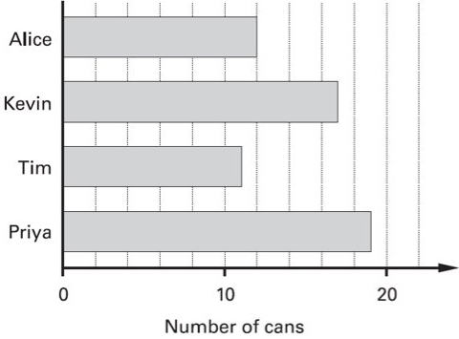
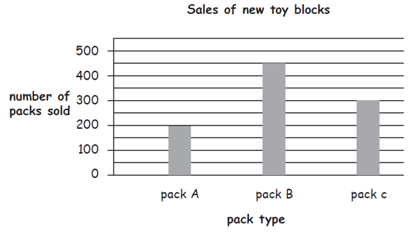
Recap
Interpret information
Extract information
Alice’s target is to collect 30 cans. How many more does she need to reach her target?
Represent information
2) How many packs have been sold in total?
3) People were asked about how many bathrooms they had in their house. 30 people had 1 bathroom. 21 people had 2, 5 people had 3 and 7 people had 4 bathrooms. Use this information to complete a frequency table.
Number of bathrooms | Frequency

Slide 2
Charts, Graphs and Data
Learning Objectives
To be able to :
Represent discrete data in tables, diagrams and charts including pie charts and bar charts, pictograms and tally charts
Group discrete data and represent grouped data graphically

Slide 3

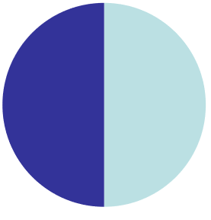
Pie charts
One half is 180°
Half = 2
Sharing between 2
One whole is 360°
Whole = 1

Slide 4
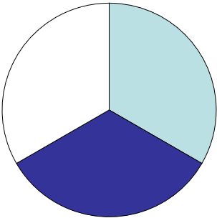
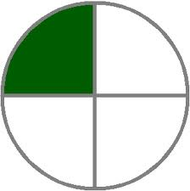
Pie charts
One third is 120°
Third = 3
Sharing between 3
One quarter is 90°
Quarter = 4
Sharing between 4

Slide 5
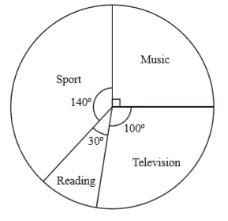
Pie charts
In a survey, some students were asked what their favourite leisure activity was.
Their answers are used to draw this pie chart
a) Write down the fraction of students who answered “Music”.
b) 18 students chose Music
Work out the number of students who took part in the survey

Slide 6
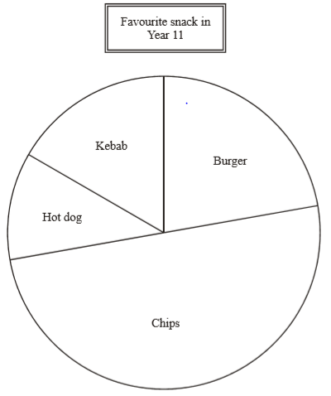
Your turn….
Sandra carries out a survey of 90 college students and their favourite snack.​
What percentage is chips?
How many students chose chips?
20 students chose burger and 15 students chose
Kebab. How many chose hot dog?

Slide 7
Drawing Pie charts
Draw a pie chart to show the favourite colour of 60 students
Colour | Frequency
Red | 17
Green | 8
Blue | 21
Yellow | 3
Other | 11
Total | 60
Working | Angle
17 x 6° | 102°
8 x 6° | 48°
21 x 6° | 126°
3 x 6° | 18°
11 x 6° | 66°
60 x 6° | 360°
There are 60 people in this survey. To show these results in a pie chart we need to share 360° between 60 people.
360°÷ 60 = 6°
Each person gets 6° of the pie chart.

Slide 8
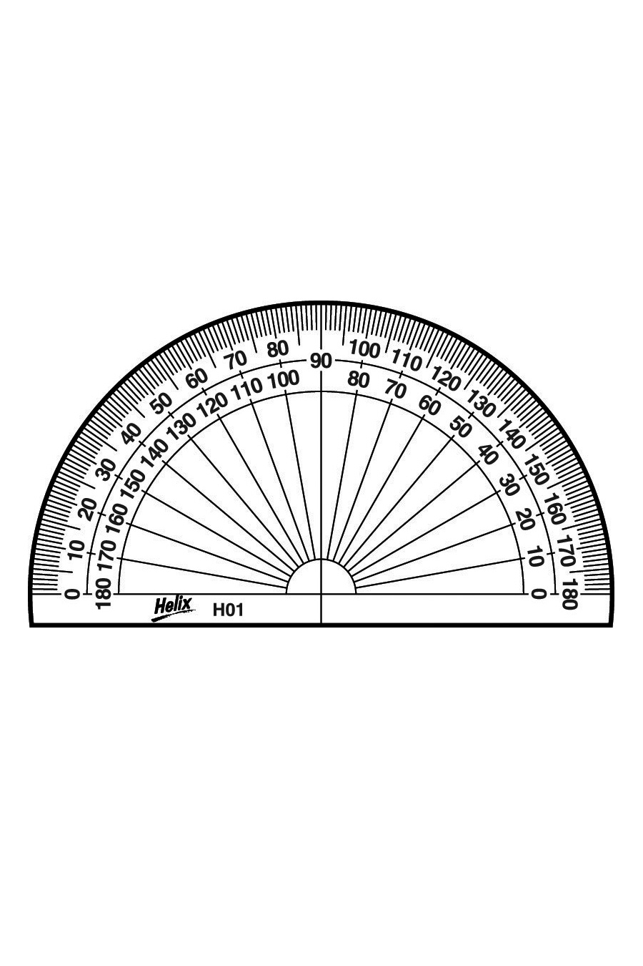
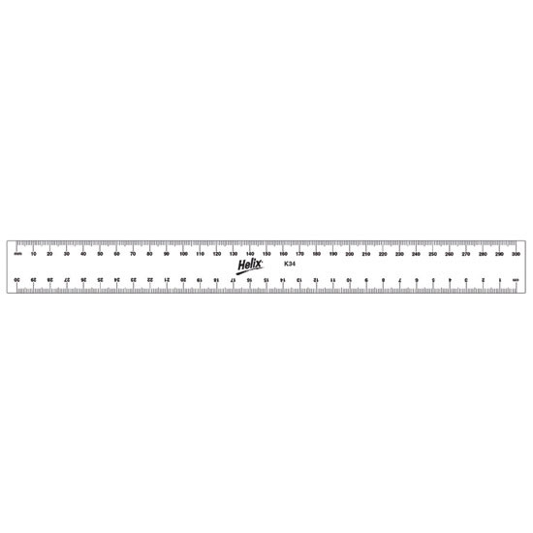
Drawing Pie charts
Draw a pie chart to show the favourite colour of 60 year 7 pupils
Colour | Angle
Red | 102°
Green | 48°
Blue | 126°
Yellow | 18°
Other | 66°
Total | 360°
Green
Red
Blue
Other
Yellow

Slide 9
Drawing Pie charts
Draw a pie chart to show the favourite colour of 60 year 7 pupils
Colour | Angle
Red | 102°
Green | 48°
Blue | 126°
Yellow | 18°
Other | 66°
Total | 360°
Green
Red
Blue
Other
Yellow

Slide 10

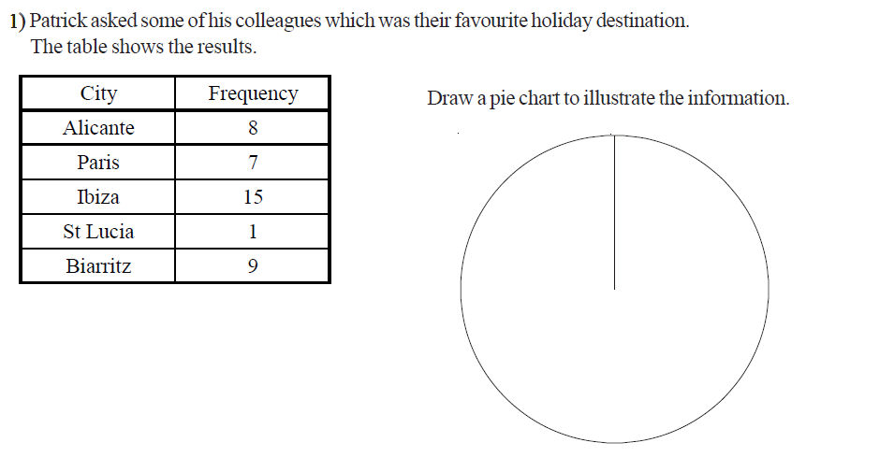
Exam style questions
Patrick asked some students which was their favourite holiday destination. The table shows the results.
Draw a pie chart to illustrate the information
Working
Angle

Slide 11
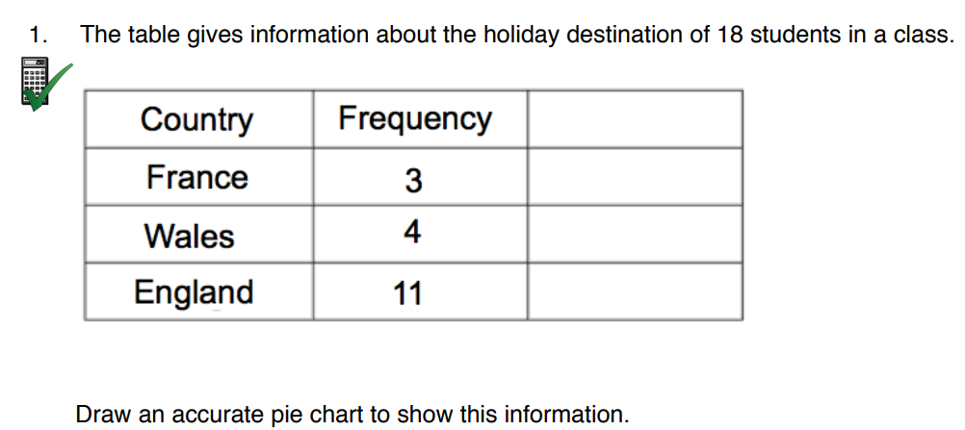

Slide 12
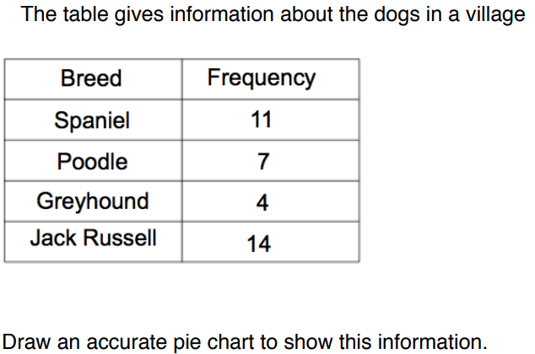

Slide 13
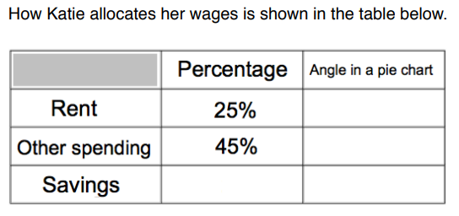
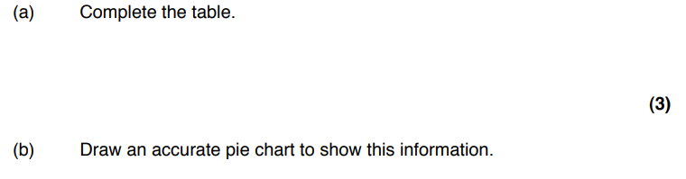

Slide 14
