Slide 1
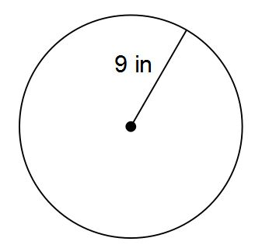
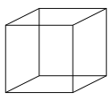
Standard Form
Learning Objectives
To be able to :
Calculate with and interpret standard form
1) Find the area of this triangle.
2) Find the area and
circumference of this circle.
3) Find the Surface Area
of this shape.
3cm
5cm
8cm

Slide 2
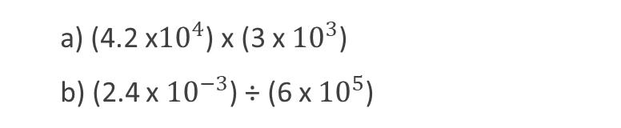
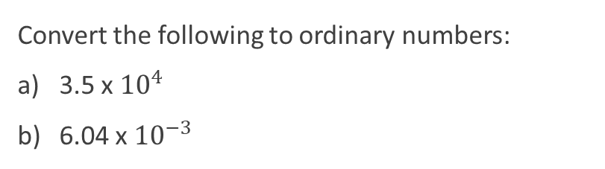
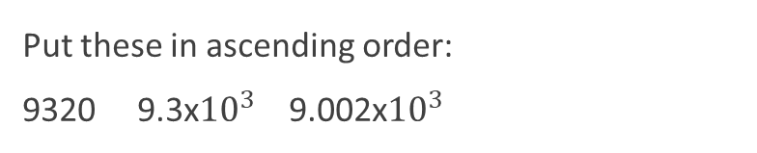
Starter
Standard Form to Ordinary
Ordinary to Standard Form
Convert the ordinary numbers to standard form:
1,034,000
0.000078
Convert the following to ordinary numbers:
3.5 x ${10}^{4}$
6.04 x ${10}^{−3}$
Multiplying and Dividing
Ordering Standard Form
a) (4.2 x${10}^{4}$) x (3 x ${10}^{3}$)
b) (2.4 x ${10}^{−3}$) ÷ (6 x ${10}^{5}$)
Put these in ascending order:
9320 9.3x${10}^{3}$ 9.002x${10}^{3}$

Slide 3
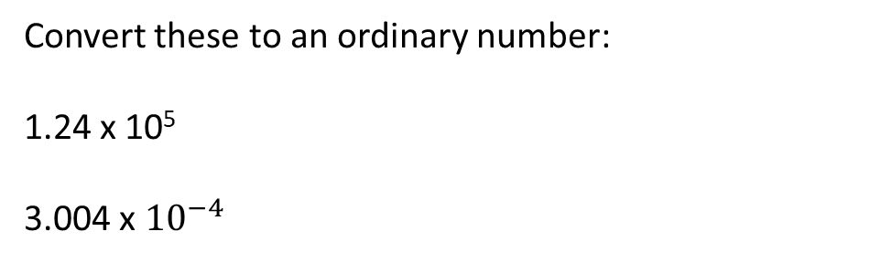
Converting From Standard Form
Convert these to an ordinary number:
1.24 x 10⁵
3.004 x ${10}^{−4}$

Slide 4


Your Turn…
Write the following as an ordinary number:
3 x ${10}^{6}$
4 x ${10}^{2}$
9.4 x ${10}^{4}$
8.8 x ${10}^{5}$
3.56 x ${10}^{−4}$
4.23 x ${10}^{−2}$
7.20 x ${10}^{0}$
Write these in descending order:
3.4 x ${10}^{−4}$, 0.034, 0.00034 x 10
A lift can carry a total amount of 1814kg. Benji weighs 8.5 x ${10}^{4}$ and Hugo weighs 93kg. How much more weight can the lift take?

Slide 5
Converting Ordinary Number to Standard Form
Converting these numbers into standard form:
931,000,000
0.0043

Slide 6
Your Turn…
Mr Holland has 2500kg of rice.
Write 2500kg in grams. Give you answer in standard form.
One grain of rice weighs 0.03g. Write the weight of one grain of rice in standard form.
How many grains of rice are there in 2500kg of rice. Give your answer in standard form.
Write these numbers in standard form:
250
1100
350
48,000
5,900,000
0.075
0.00078
0.07070

Slide 7
Multiplying and Dividing Standard Form
(2 x 10³) x (7 x 10⁴)
4 x 10⁵
8 x 10⁻²

Slide 8
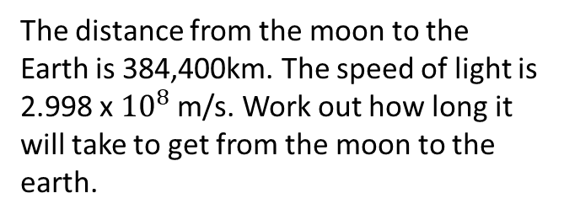

Your Turn…
1) (8 x ${10}^{7 }) ÷$ (8 x ${10}^{4})$
2) (7 x ${10}^{10 })$x (5 x ${10}^{9})$
3) (4 x ${10}^{12 }) ÷$ (5 x ${10}^{5})$
4) (6 x ${10}^{−9 })$x (3 x ${10}^{4})$
5) (9 x ${10}^{−2 })$x (8 x ${10}^{−3})$
6) (1.5 x ${10}^{−5 }) ÷$ (3 x ${10}^{−3})$
The distance from the moon to the Earth is 384,400km. The speed of light is 2.998 x ${10}^{8}$ m/s. Work out how long it will take to get from the moon to the earth.

Slide 9

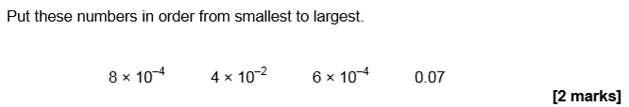
June 2018 Paper 1

Slide 10
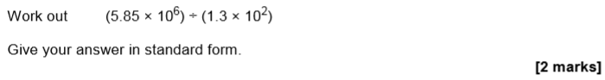
Practise Paper Set 3 Paper 3

