Slide 1
Starter
4) Michael has 40p Dennis has 80p How much money should Dennis give Michael so that they have the same amount
1) 15 × 0
2) 100 − 41 = 30 + ?
5) Emma has a bag of 20p coins and Daisy has a bag of 50p coins. Both bags have the same amount of money inside. There are six 50p coins in Daisy’s bag. How many 20p coins are there in Emma’s bag?
3) Michael has 40p Dennis has 80p How much money should Dennis give Michael so that they have the same amount

Slide 2
NUMBER
Learning Objectives
To be able to :
Read, write, order and compare large numbers (up to one million)
Multiply and divide whole numbers and decimals by 10, 100 and 1000
Use multiplication facts and make connections with division facts
Calculate the squares of one digit and two digit numbers

Slide 3
Read & Write
Read and write the following as a number:
a) One thousand, five hundred and sixty
b) Eight hundred and forty one thousand and ten
Read and write the following in words:
46,750
2,050,980

Slide 4
Your Turn…
1. Read and write the following as a number:
Three hundred and forty
Seven hundred and five
One thousand, eight hundred and four
Eight thousand, and one
2. Read and write the following in words:
a) 250
b) 406
c) 7,300
d) 6,010
e) 11, 006

Slide 5
Ordering Numbers
Order these numbers from lowest to highest:
85 63 107 390 15 99 64 8
Order these numbers from lowest to highest:
250,000 3,690 452,300 42,567 212,311 56,000 2,303,900

Slide 6
Your Turn…
Order these numbers from lowest to highest:
a) 35 16 11 72 8 22
b) 762 73 286 128 100 86
c) 350,456 304,862 290,007 290,700 327,543
Order these numbers from highest to lowest:
a) 86 444 94 110 53 21
b) 787 354 106 34 74 487
c) 2,380,008 2,309,888 2,209,566 2,200,654

Slide 7
Multiplying Numbers By 10,100,1000
2. Multiply by 100:
40
0.03
1. Multiply by 10:
5
0.25
3. Multiply by 1000:
3
0.6

Slide 8
Your Turn…
Multiply the following by 10:
a) 30
b) 500
c) 0.60
d) 0.08
e) 1.04
Multiply the following by 100:
905
86
4
0.004
1.0002
3. Multiply the following by 1000:
5
28
0.1
0.09
4.0025

Slide 10
Dividing Numbers by 10, 100 and 1000
Divide by 10:
75
8.5
Divide by 100:
578
87,458
Divide by 1000:
90,873
50

Slide 11
Your Turn…
Divide the following by 10:
a) 30
b) 500
c) 0.60
d) 0.08
Divide the following by 100:
905
86
4
0.004
3. Divide the following by 1000:
5
28
0.1
0.09

Slide 12
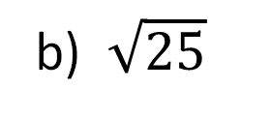

Square Numbers & Square Roots
Calculate the square number of:
8
12
2. Calculate the square root of:
$a) \sqrt{16}$
b) $\sqrt{25}$

Slide 13
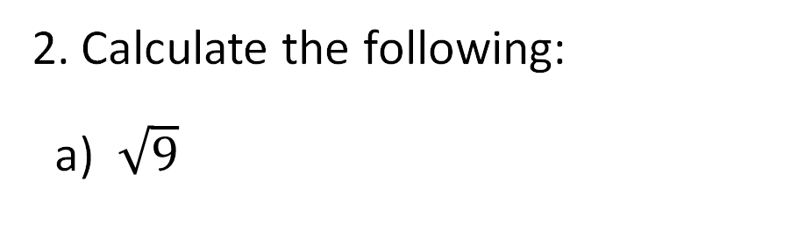
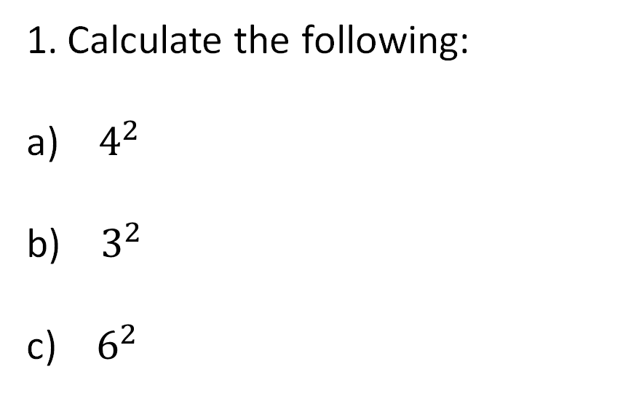
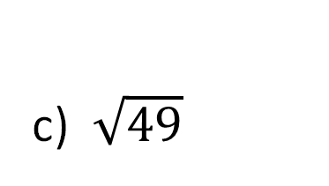
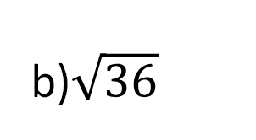
Your Turn…
Calculate the following:
a) $4^{2}$
b) $3^{2}$
c) $6^{2}$
Calculate the following:
a) $\sqrt{9}$
b)$\sqrt{36}$
c) $\sqrt{49}$

Slide 14

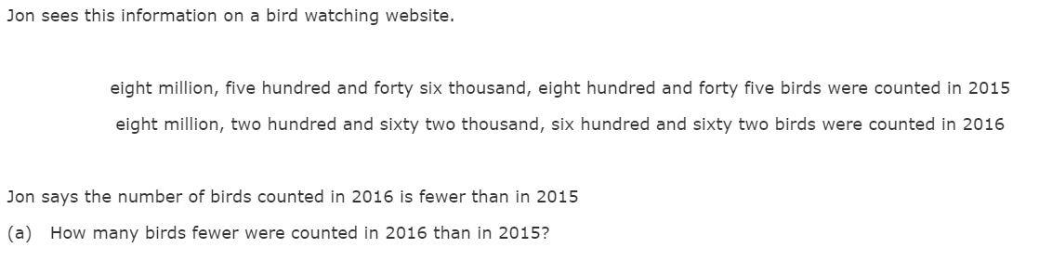
FSM01/01, May 2017
[2 marks]

Slide 15



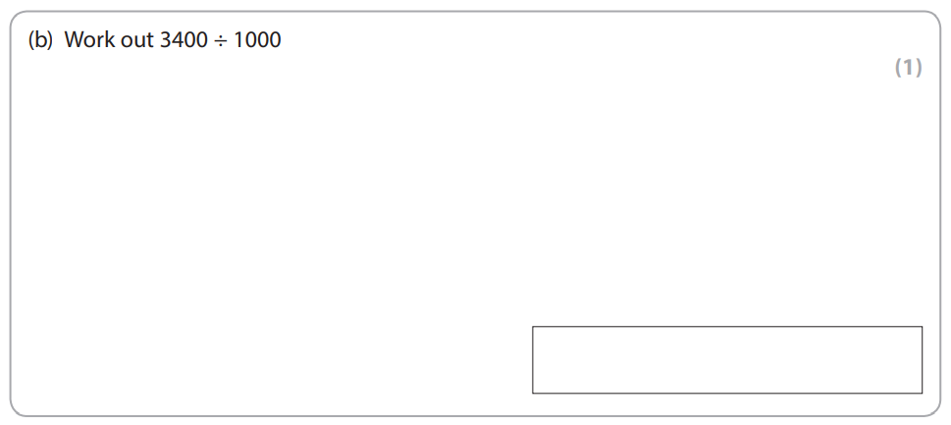
[1 mark]

Slide 16
Q1 What is 897 rounded to the nearest ten?
Q4 I share £20 between 5 of my friends. How much does each get?
Q2 I go to the local shop twice a week for 5 weeks. Every time I go, it costs me £23. How much does it cost me altogether??
Q5 Coffee costs 30p each and cakes cost £2. I buy five coffees and eight cakes. How much does it cost?
Q3 A number pattern goes 10.5,15,19.5…
What are the next two numbers?

Slide 17
ESTIMATING & ROUNDING
Learning Objectives
To be able to :
Approximate by rounding to a whole number or to one or two decimal places
Estimate answers to calculations using fractions and decimals
Recap
Read and write as a number:
Forty six thousand, two hundred and seventy one
3. 45 + 380
4. 4 x 42
5. 56 ÷ 2
2. Divide 350 by 10

Slide 18
ROUNDING
Round to the nearest 10:
34
895
Round to the nearest 100:
a) 764
b) 3122
Round to the nearest 1000:
7,218
87,683
Round to the nearest whole number:
78.8
3458.50

Slide 19
Your turn…
Round to the nearest 10:
56
495
8,734
23,568
Round to the nearest 100:
a) 60
b) 310
c) 589.2
d) 7,364
Round to the nearest 1000:
721
8,222
17
2819.38
Round to the nearest whole number:
78.8
35.55
873.9
72.1
921.86
288,038.12

Slide 20
ESTIMATING
In a gift shop, Candles cost £1.49 each, estimate how many 4 would cost?
Ellie wants to buy the following items:
One pair of Jeans £14.95
Two tops, at a cost of £8.90 each
Three pairs of socks, at a cost of £0.99 a pair
Work out the estimated cost

Slide 21
Your turn…
1. Estimate:
290 + 405
b) 3,008 – 811
31 x 2.10
5,890 x 3
2. Jack wants to buy 2 cinema tickets, one for himself and one for his friend. Each ticket costs £9.15.
Estimate how much both tickets will cost.

Slide 22



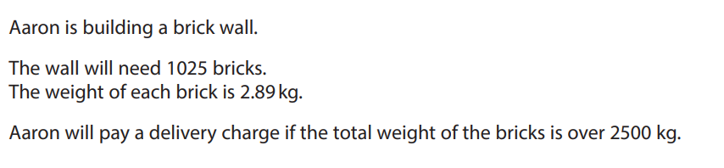

[ 3 marks]

Slide 23


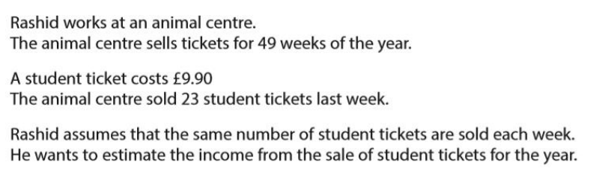
[3 marks]

