Slide 1
Starter
Use your prior knowledge of sketching quadratics using a table of values to complete the transformations investigation.

Slide 2
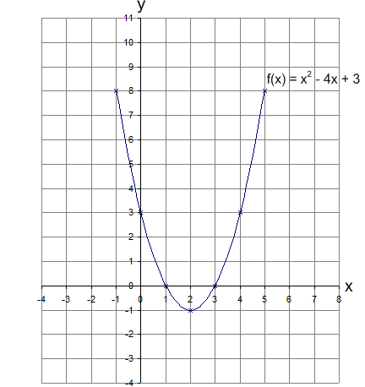
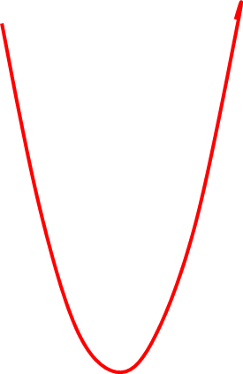
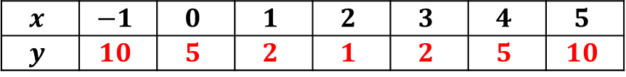
a) $f\left(x\right)+2=x^{2}−4x+5$
$$x$$ | $$−1$$ | $$0$$ | $$1$$ | $$2$$ | $$3$$ | $$4$$ | $$5$$
$$y$$ | $$10$$ | $$5$$ | $$2$$ | $$1$$ | $$2$$ | $$5$$ | $$10$$
2 units higher

Slide 3
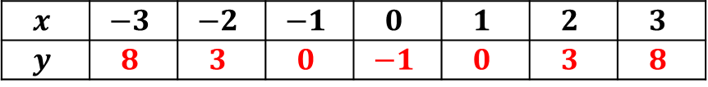
b) $f\left(x+2\right)=x^{2}−1$
$$x$$ | $$−3$$ | $$−2$$ | $$−1$$ | $$0$$ | $$1$$ | $$2$$ | $$3$$
$$y$$ | $$8$$ | $$3$$ | $$0$$ | $$−1$$ | $$0$$ | $$3$$ | $$8$$
2 units left

Slide 4
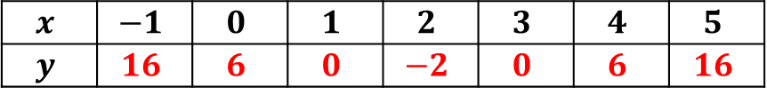
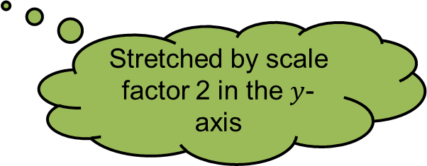
c) $2f\left(x\right)={2x}^{2}−8x+6$
$$x$$ | $$−1$$ | $$0$$ | $$1$$ | $$2$$ | $$3$$ | $$4$$ | $$5$$
$$y$$ | $$16$$ | $$6$$ | $$0$$ | $$−2$$ | $$0$$ | $$6$$ | $$16$$
Stretched by scale factor 2 in the $y$-axis

Slide 5
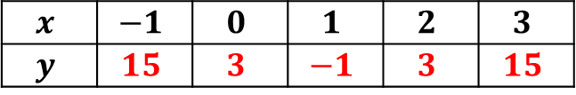

d) $f\left(2x\right)={4x}^{2}−8x+3$
$$x$$ | $$−1$$ | $$0$$ | $$1$$ | $$2$$ | $$3$$
$$y$$ | $$15$$ | $$3$$ | $$−1$$ | $$3$$ | $$15$$
Stretched by scale factor ½ in the $x$-axis

Slide 6
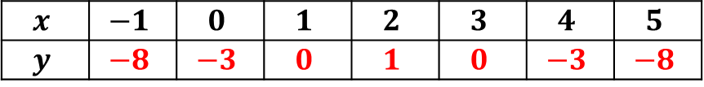

e) -$f\left(x\right)={−x}^{2}+4x−3$
$$x$$ | $$−1$$ | $$0$$ | $$1$$ | $$2$$ | $$3$$ | $$4$$ | $$5$$
$$y$$ | $$−8$$ | $$−3$$ | $$0$$ | $$1$$ | $$0$$ | $$−3$$ | $$−8$$
Reflected in the $x$-axis

Slide 7
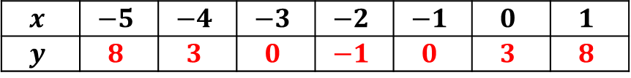

f) $f\left(−x\right)=x^{2}+4x−3$
$$x$$ | $$−5$$ | $$−4$$ | $$−3$$ | $$−2$$ | $$−1$$ | $$0$$ | $$1$$
$$y$$ | $$8$$ | $$3$$ | $$0$$ | $$−1$$ | $$0$$ | $$3$$ | $$8$$
Reflected in the $y$-axis

Slide 8
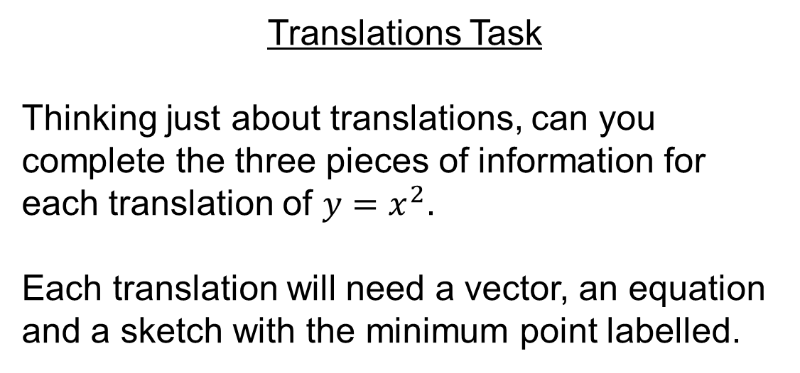
Translations Task
Thinking just about translations, can you complete the three pieces of information for each translation of $y=x^{2}$.
Each translation will need a vector, an equation and a sketch with the minimum point labelled.

Slide 9
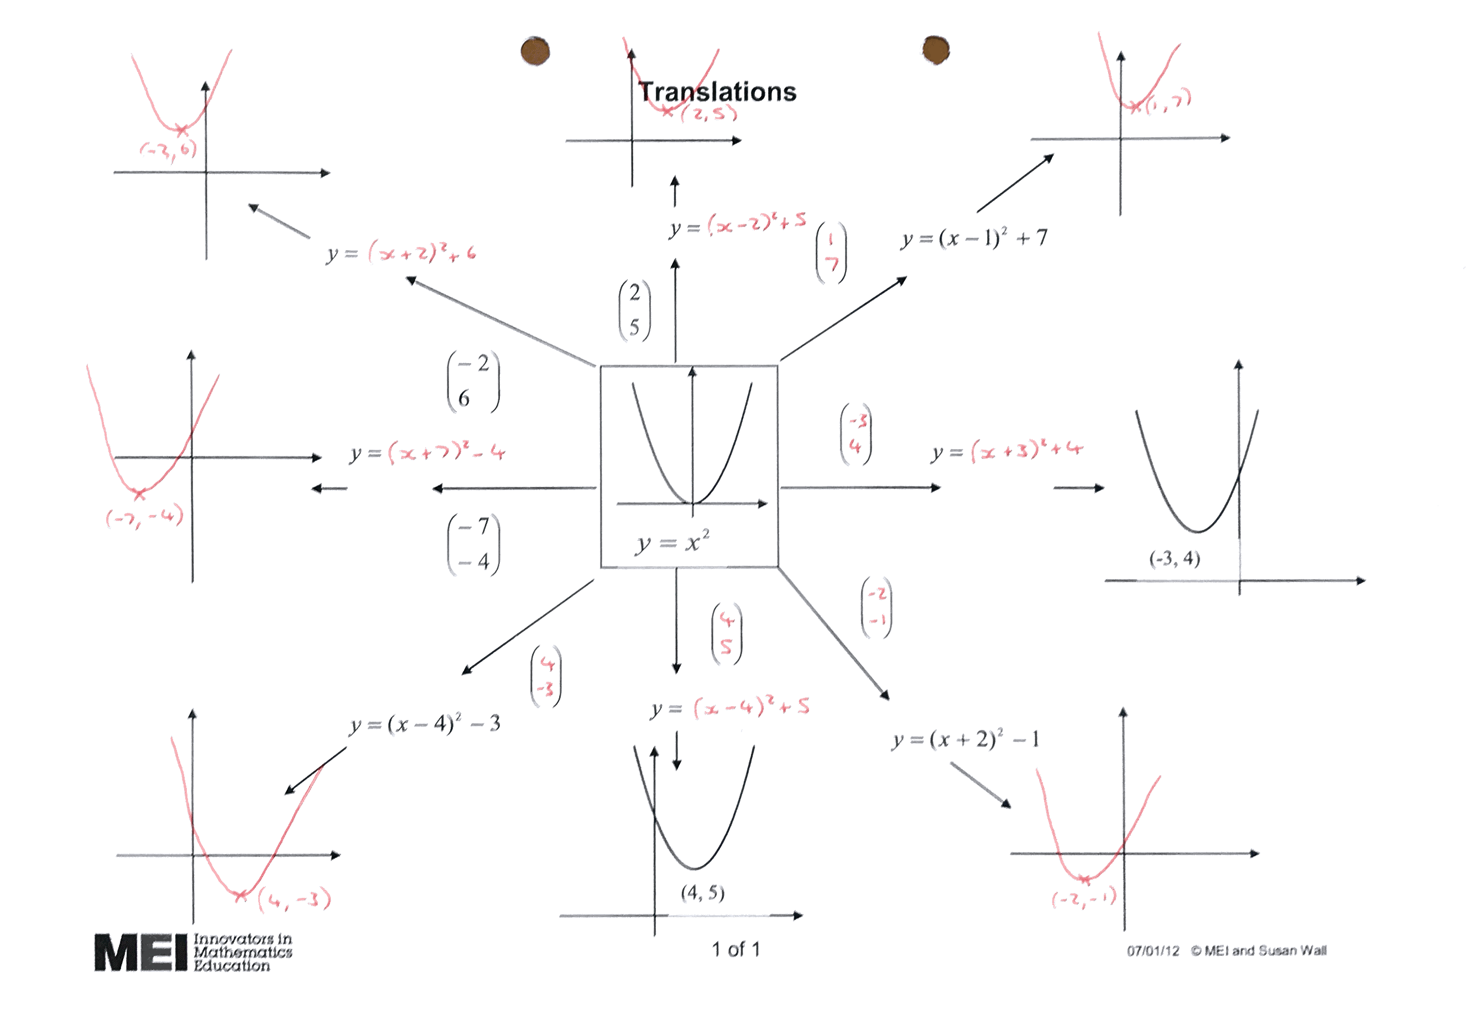
Answers

Slide 10
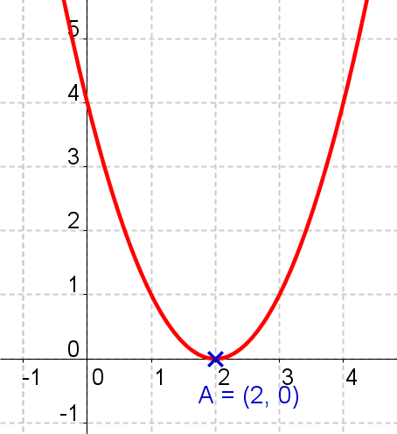
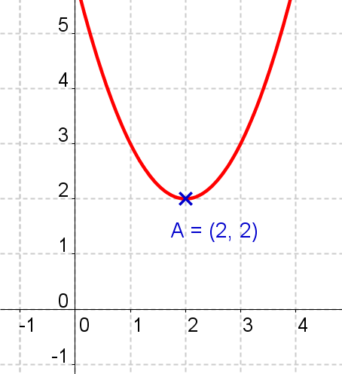
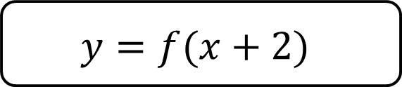
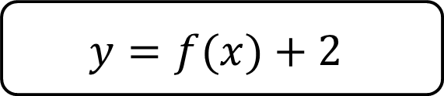
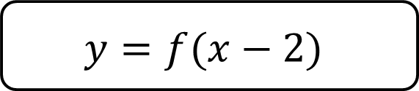
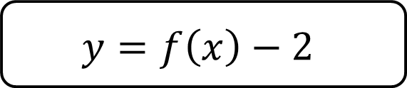
A
$$y=f(x)+2$$
B
$$y=f\left(x\right)−2$$
C
$$y=f(x+2)$$
D
$$y=f(x−2)$$

Slide 11

A
$$y=f(x)+2$$
B
$$y=f\left(x\right)−2$$
C
$$y=f(x+2)$$
D
$$y=f(x−2)$$

Slide 12
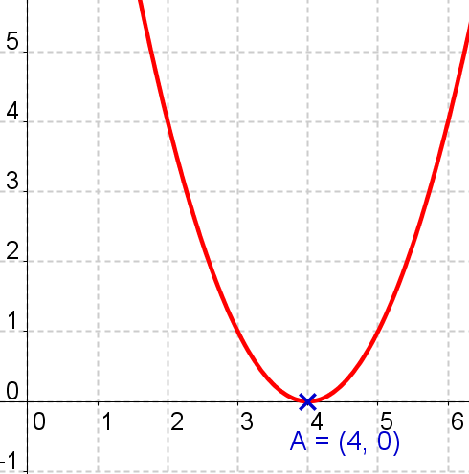
A
$$y=f(x)+2$$
B
$$y=f\left(x\right)−2$$
C
$$y=f(x+2)$$
D
$$y=f(x−2)$$

Slide 13

A
$$y=f(x)+2$$
B
$$y=f\left(x\right)−2$$
C
$$y=f(x+2)$$
D
$$y=f(x−2)$$

Slide 14
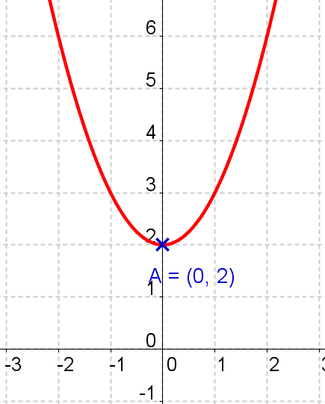
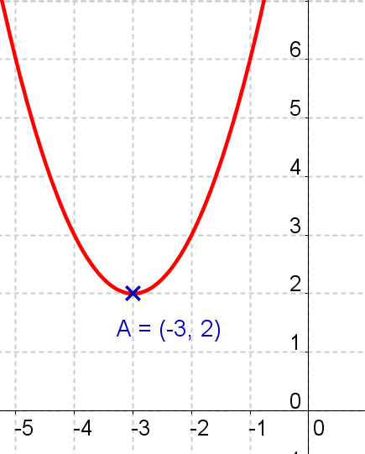
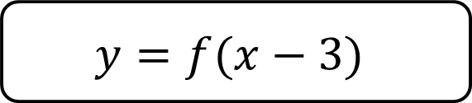
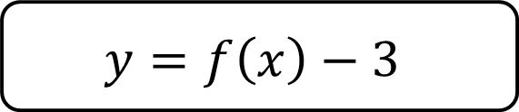
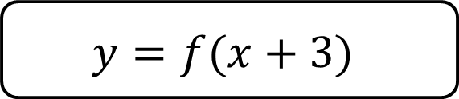
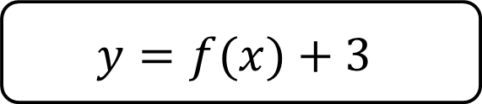
A
$$y=f(x)+3$$
B
$$y=f\left(x\right)−3$$
C
$$y=f(x+3)$$
D
$$y=f(x−3)$$

Slide 15

A
$$y=f(x)+3$$
B
$$y=f\left(x\right)−3$$
C
$$y=f(x+3)$$
D
$$y=f(x−3)$$

Slide 16
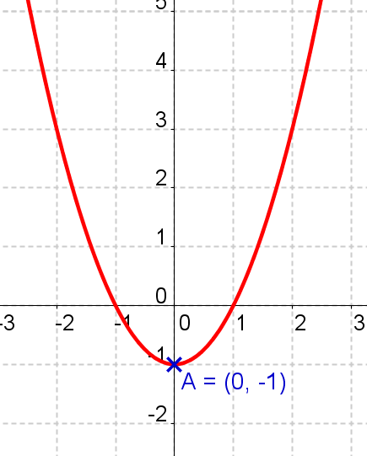
A
$$y=f(x)+3$$
B
$$y=f\left(x\right)−3$$
C
$$y=f(x+3)$$
D
$$y=f(x−3)$$

Slide 17

A
$$y=f(x)+3$$
B
$$y=f\left(x\right)−3$$
C
$$y=f(x+3)$$
D
$$y=f(x−3)$$

Slide 18
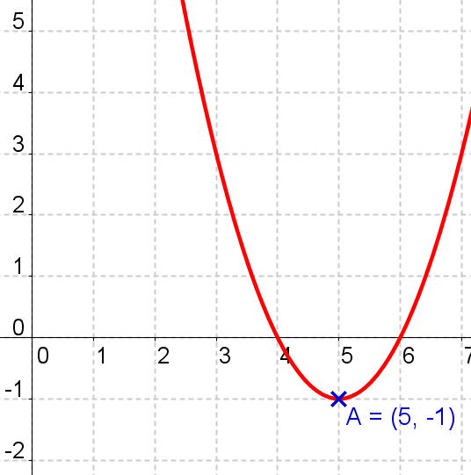
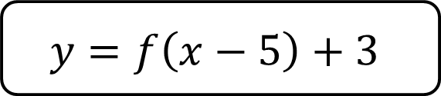
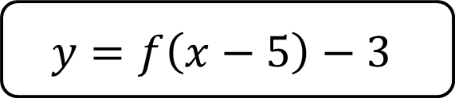
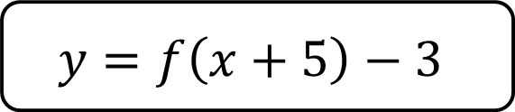
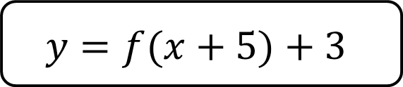
A
$$y=f(x+5)+3$$
B
$$y=f\left(x−5\right)−3$$
C
$$y=f\left(x+5\right)−3$$
D
$$y=f\left(x−5\right)+3$$

Slide 19
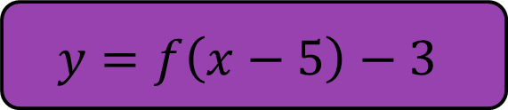
A
$$y=f(x+5)+3$$
B
$$y=f\left(x−5\right)−3$$
C
$$y=f\left(x+5\right)−3$$
D
$$y=f\left(x−5\right)+3$$

Slide 20
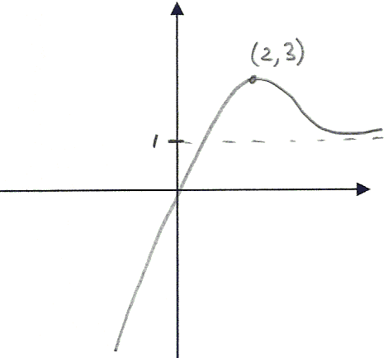
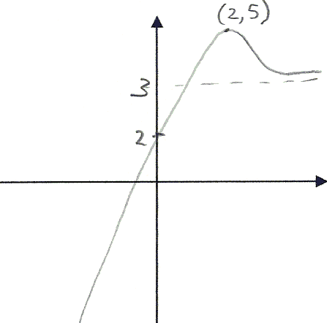
A
$$y=f(x)+2$$
B
$$y=f\left(x\right)−2$$
C
$$y=f(x+2)$$
D
$$y=f(x−2)$$

Slide 21
A
$$y=f(x)+2$$
B
$$y=f\left(x\right)−2$$
C
$$y=f(x+2)$$
D
$$y=f(x−2)$$

Slide 22
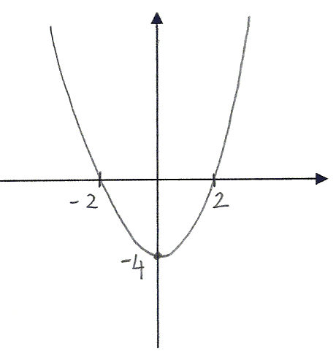
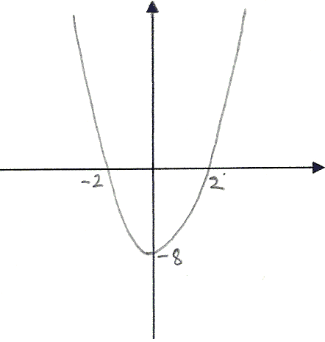




A
$$y=f(2x)$$
B
$y=f\left(\frac{1}{2}x\right)$
C
$$y=2f(x)$$
D
$y=\frac{1}{2}f(x)$

Slide 23

A
$$y=f(2x)$$
B
$y=f\left(\frac{1}{2}x\right)$
C
$$y=2f(x)$$
D
$y=\frac{1}{2}f(x)$

Slide 24
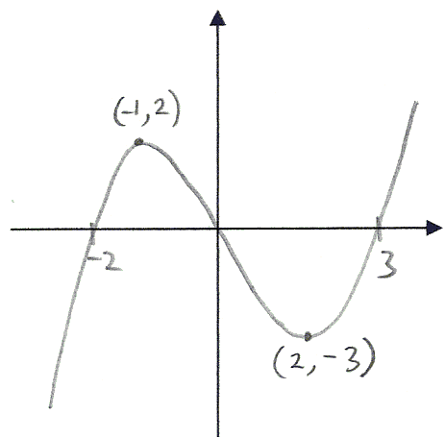
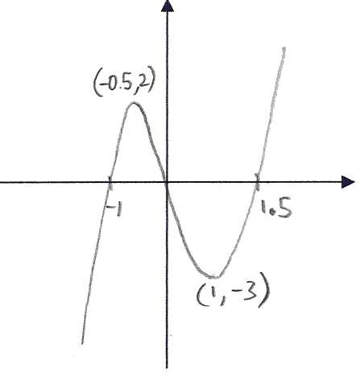
A
$$y=f(2x)$$
B
$y=f\left(\frac{1}{2}x\right)$
C
$$y=2f(x)$$
D
$y=\frac{1}{2}f(x)$

Slide 25

A
$$y=f(2x)$$
B
$y=f\left(\frac{1}{2}x\right)$
C
$$y=2f(x)$$
D
$y=\frac{1}{2}f(x)$

Slide 26
Group Activity
Sort the equations to represent the correct transformations.
Use graphing software (eg. Geogebra, Desmos, Autograph…) to help you if you are unsure.

Slide 27
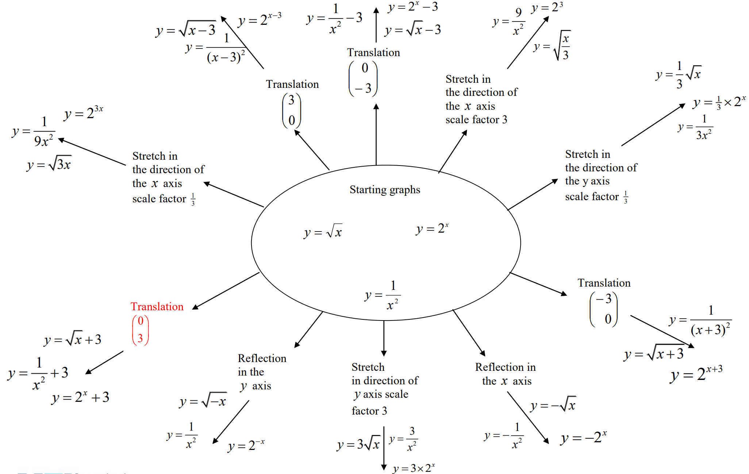
Answers

