Slide 1
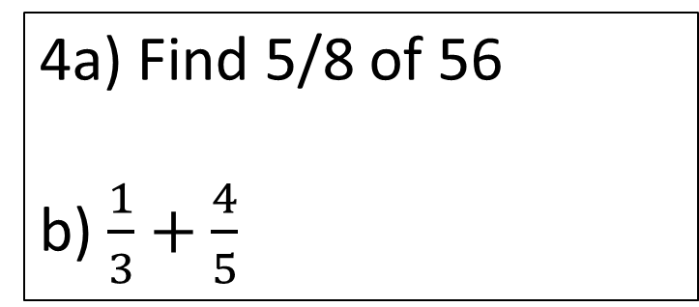
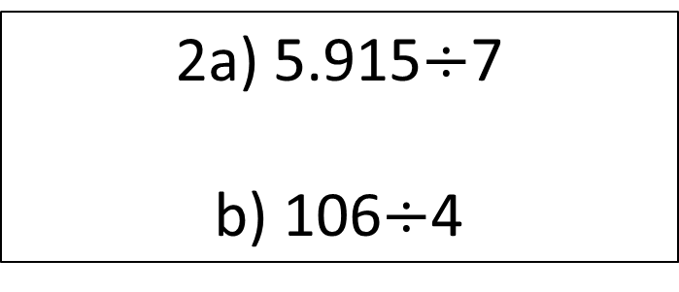
Starter
1a) Share 480 in the ratio 3:5
b) Gareth and Hayley share money in the ratio 4:3. Gareth receives £200. How much does Hayley receive?
3a) Simplify 3x+5+4x+7
b) Expand 5(2x+6)
4a) Find 5/8 of 56
b) $\frac{1}{3}+\frac{4}{5}$
2a) 5.915$÷$7
b) 106$÷$4

Slide 2
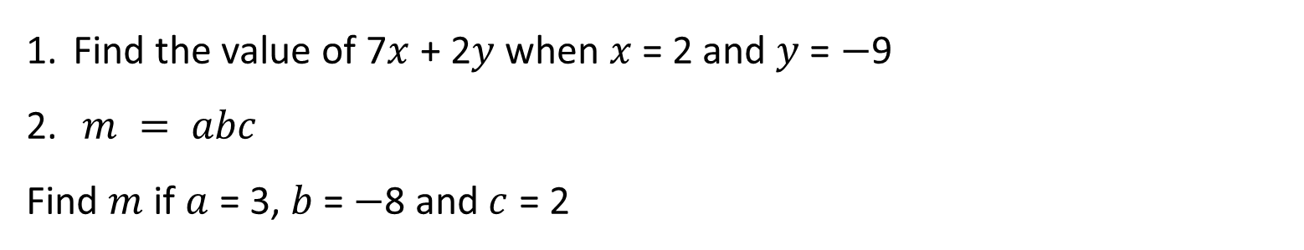
INTRODUCTION TO LINEAR EQUATIONS AND INEQUALITIES
Learning Objectives
To be able to :
Solve linear equations on one unknown algebraically. Including those with the unknown on both sides of the equation
Solve linear inequalities in one variable
Represent the solution set on a number line
Find the value of 7$x$ + 2$y$ when $x$ = 2 and $y$ = $−$9
$m = abc$
Find $m$ if $a$ = 3, $b$ = $−$8 and $c$ = 2

Slide 3


Solving Linear Equations
$x+11=19$
$x−8=23$
$3x=18$
$\frac{x}{5}=20$
$$2w−1=13$$

Slide 4




Your turn…
7$x$ = 21
$\frac{t}{3}$ = 12
2$e$ + 6 = 18
8$w$ + 4 = 20
10$y$ – 3 = 24
18 – 4$a$ = 2
4(2$y$ + 7) = 20
3($y$ + 4) = 24
x = 3
t = 36
e = 6
w = 2
y = 2.7
a = 4
y = -1
y = 4
x = 18
x = -6
$\frac{4+2x}{5}$ = 8
$\frac{6−4x}{10}$ = 3

Slide 5

November 2018 Paper 1
November 2018 Paper 3
November 2020 Paper 2

Slide 6
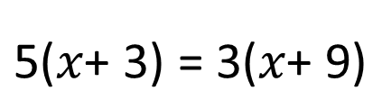

Solving Linear Equations
$$\text{4}x\text{+ 1 = 2}x\text{+ 7}$$
$$\text{5(}x\text{+ 3) = 3(}x\text{+ 9)}$$

Slide 7
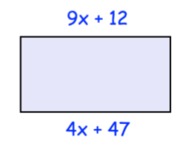

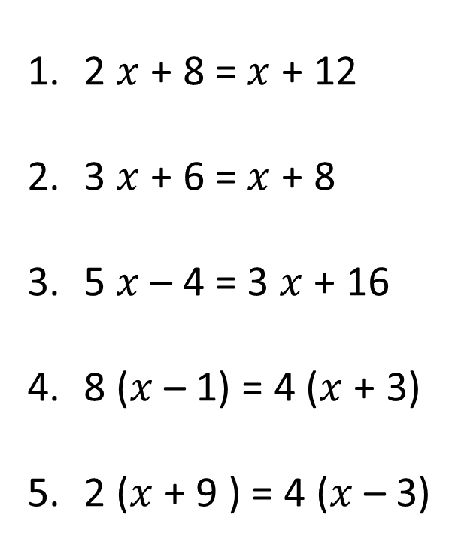
Your turn…
2 $x$ + 8 = $x$ + 12
3 $x$ + 6 = $x$ + 8
5 $x$ – 4 = 3 $x$ + 16
8 ($x$ – 1) = 4 ($x$ + 3)
2 ($x$ + 9 ) = 4 ($x$ – 3)
Shown is a rectangle
a) Explain why 9 $x$ +12 = 4 $x$ + 47
b) Find $x$
x = 4
x = 1
x = 5
x = 15
Opposite sides are equal
x = 7
x = 10

Slide 8
November 2017 Paper 2

Slide 9
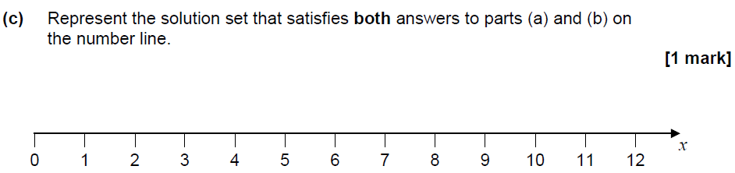
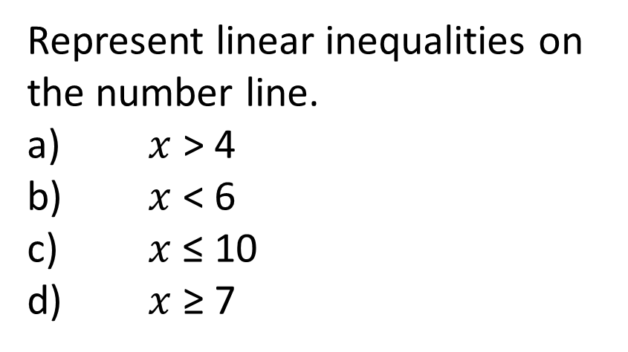
Linear Inequalities on a Number Line
Represent linear inequalities on the number line.
$x$ > 4
$x$ < 6
$x$≤ 10
$x$ ≥ 7

Slide 10
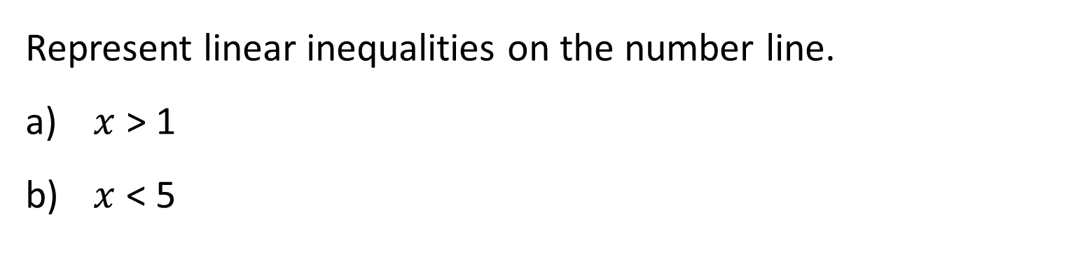
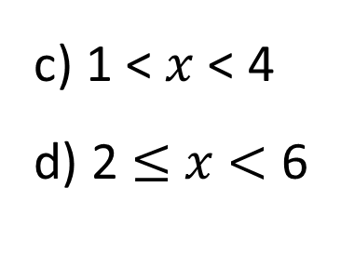
Your turn…
Represent linear inequalities on the number line.
$x$ > 1
$x$ < 5
c) 1 < $x$ < 4
d) 2 $≤$ $x$ $<$ 6

Slide 11
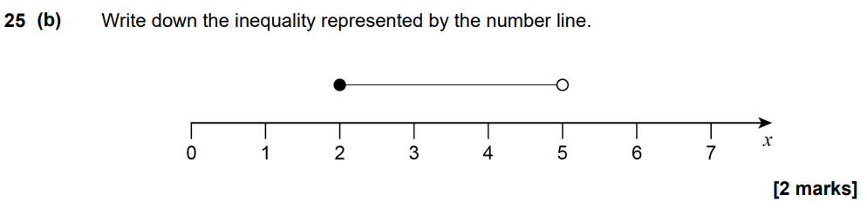
November 2017 Paper 2

Slide 12
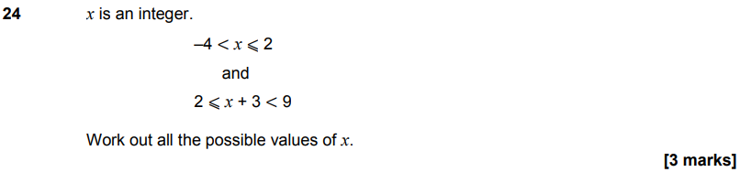
June 2019 Paper 1

Slide 13
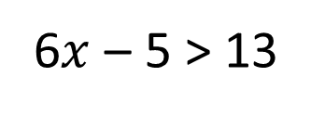

Solving Linear Inequalities
$$\text{5}x \text{+ 1 < 11}$$
6$x$ – 5 > 13

Slide 14
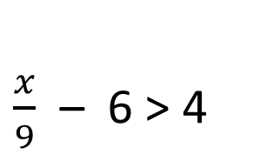

Your turn…
2 $x$+ 1 < 9
3 $x$ – 5 > 16
4 $x$ + 8 < 32
5 $x$ – 2 > 68
5.
x < 5
x > 7
x < 6
x > 14
x > 90
$\frac{x}{9}$ – 6 > 4

Slide 15
November 2018 Paper 3

Slide 16
November 2017 Paper 2

