Slide 1
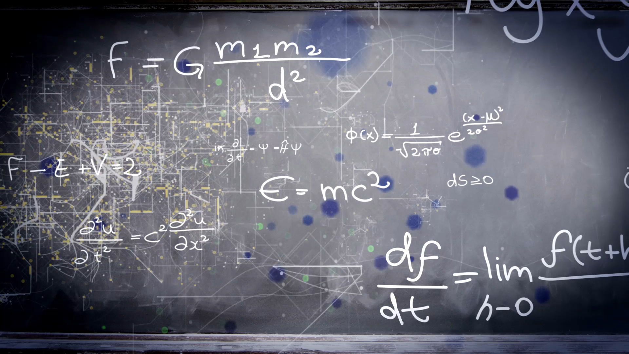
Rearranging Equations
Extra Practice

Slide 2
