Slide 1
Percent
- To be able to work out percentages of amounts and express one amount as a percent of another
- To be able to calculate percentage change (any size increase and decrease), and original value after percent change
Recap
Recap
A car uses petrol at a rate of 30 miles per gallon. How many gallons will it take to travel 170 miles?
It takes 4 people 2 days to paint a wall. How many days would it take if there were 8 people?

Slide 2
Finding the Percent of an amount
A=amount
P=percent
A ÷ 100 x P = or A x P ÷ 100 = or A x P =
100
This will find 1%
This will find the percent you are looking for

Slide 3
Find the percent
Find
12% of 785
24% of 567
52% of 347
34% of 674
43% of 657
61% of 387 Give all answers to 1dp

Slide 4
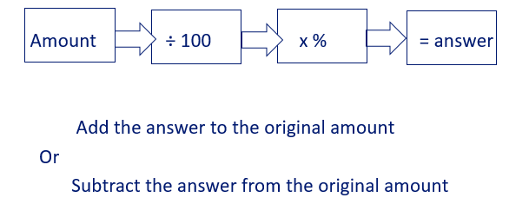
Find percent increase and decrease
So to increase 530 by 20%
530 ÷ 100 x 20 = 106
530 + 106 = 636
So to decrease 530 by 20%
530 ÷ 100 x 20 = 106
530 - 106 = 424

Slide 5
A multiplier increase is the 100% + % increase as a decimal
5 % increase
1.005
10 % increase
1
15 % increase
1.15
½ % increase
1.1
No change
1.05

Slide 6
A multiplier increase is the 100% - % increase as a decimal
0.5
1 % decrease
0.965
0.85
3.5 % decrease
1
15 % decrease
50 % decrease
0.99
No change

Slide 7
Find percent increase using a multiplier
If you want to increase something by 20% you are making your answer 100% + 20% = 120%
120 % as a decimal is 1.2
So to increase 530 by 20%
530 x 1.2 = 636

Slide 8
Find percent decrease using a multiplier
If you want to decrease something by 20% you are making your answer 100% - 20% = 80%
80 % as a decimal is 0.8
So to decrease 530 by 20%
530 x 0.8 = 424

Slide 9
Use your preferred method to answer these questions
Increase £560 by 25%
Increase £600 by 52%
Increase £580 by 24%
Decrease £550 by 78%
Decrease £460 by 44%
Decrease £790 by 58%

Slide 10
Find the percent of change
Percents can be used to describe a change.
Percent of change is the amount of change to the original amount.
amount of change
original amount
percent change =

Slide 11
Example
Find what the percent increase or decrease is when the amount changes from £16 to £12.
This is percent decrease.
£16 – £12 = £4 First find the amount of change.
4
amount of decrease
= 0.25 as a decimal
= 25%
original amount
16
From £16 to £12 is a 25% decrease.

Slide 12
Find what the percent increase or decrease is when the amount changes from £15 to £20.
This is percent increase.
£20 – £15 = £5 find the amount of change.
5
15
1
3
amount of increase
= 0.3333333
=
=
original amount
≈ 33 % increase
From £15 to £20 is a 33% increase.

Slide 13
Practice
Find the percent of change from:
£80 to £100
£500 to £425
£60 to £550
£480 to £275
£560 to £950
£480 to £380

Slide 14
Practice
In a survey taken two weeks ago, 146 students said they would vote for Megan for class president. Today 163 students said they would vote for her. What was the approximate percent increase in the number of students voting for Megan?
Jeff weighs 144 pounds now, but last year he weighed 180 pounds. What is his percent decrease?

Slide 15
Finding the original amount/reverse percent
NA=new amount
P=percent
OA= original amount
NA ÷ p x 100 = or NA x 100 ÷ p = or A x 100 =
p
This will find 1%
This will find the original amount

Slide 16
Finding the original amount/reverse percent
This amount has been reduced by 28% what was the original amount?
525 is the reduced amount, so it is 100%-28% = 72% of the original
525 ÷ 72% x 100% = 729.16666 ≈ 729

Slide 17
Finding the original amount/reverse percent
This amount has been increased by 36% what was the original amount?
480 is the increased amount, so it is 100%+36% = 136% of the original
480 ÷ 136% x 100% = 352.94117 ≈ 353

Slide 18
Practice
Find the original amounts when:
646 has been increased by 60%
480 has been decreased by 45%
550 has been increased by 38%
950 has been decreased by 45%
520 has been increased by 22%
1000 has been decreased by 35%
Give all answers to the nearest whole number

Slide 19
Exam questions
Tim starts a catering business.
He finds this advert
What percent have the cards been reduced by?
250 Business cards
Was £14.70
Now £7.50

Slide 20
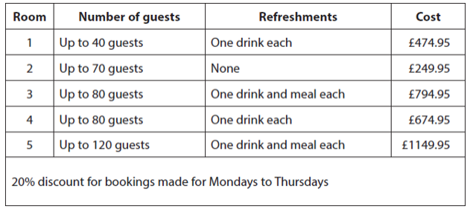
Exam questions
Brenda is organising a party for 60 guests.
She wants to provide each guest with a drink and a meal and spend as little as possible.
She books the room for a Monday. How much discount will Brenda get?
Booking a venue

Slide 21
Plenary
Special offer
4 nights for the price of 3
Double room
2170 South African Rand per night
James finds a hotel to book for 6 nights
in Cape Town. The hotel has an offer for
the time they are staying.
James books one double room for 6 nights. At the time of booking he pays a deposit of 15%. He will pay the rest when he arrives.
How much will he pay when he arrives at the hotel?
Booking a hotel room

