Slide 1




Slide 2








Slide 3



















Course Content: Choose your topic …
Whole Number and Functions
place
value
negative
numbers
add and
subtract
multiply
divide
round
numbers
ratio
scale
fraction
decimal
numbers
percent
percent
decimal
fraction
MATHS L1 to L2
Parts of a whole
metric
measure
imperial
measure
perimeter
area
volume
formulae
bodmas
charts
data
averages
prob-
ability
Measure and Shape
Handling Data

Slide 4











Home Revision Progress Check 1 Video/Discuss Vocab / jobs Lesson Activities Quizzes Topic Answers Progress Check 2 Cont. Learning
Topic Introduction : Formula
A formula is a set of instructions that you can follow such as a recipe or health and safety instructions. In maths formulas are written using letters of the alphabet and symbols. Numbers are often not used as we do not yet know their values. ‘x’s and ‘y’s are very often used as unknown quantities until we go and read off the value, measure them or find out how many, much or far!
Formulas can be manipulated and combined, simplified and altered. You will be dealing with simple formulas that are given to you in this topic, replacing letters with numbers and solving, however this is a very important topic in your maths studies if you are thinking of taking your studies higher. Concentrate hard and have fun ..!
Choose an icon to select where to start
F O R M U L A

Slide 5



Warm up Exercise 1
Lets start today by revising ! Complete the above sums and multiplication grid

Slide 6


Warm up Exercise 2
Bubble maths
2:6
-1.86
+7.03
Calculate the instruction on the central number
3.142
Round to 1dp
x5
/0.314
/10

Slide 7

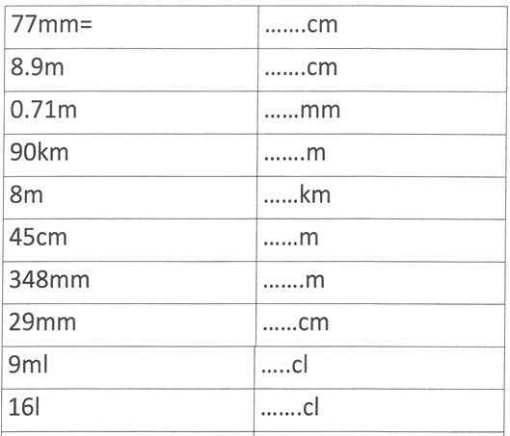
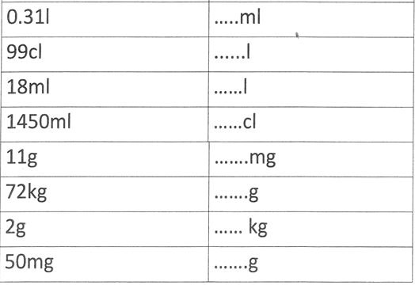
Warm up Exercise 3

Slide 8




Progress Checker 1
W
What do you already know about Formulae?
How would you rate your skills in using formulae ?
Excellent ability
Good ability, but working to improve
Ok, making a start but I know I have lots to still learn
My aims for today are…
A State what a formula is and when they are useful
B Read and write formulae using letters and symbols
C Replace formulae unknown values with numbers and solve to find answers to problems

Slide 9


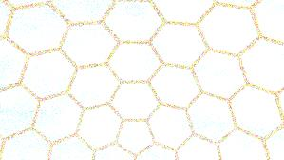

Introductory Video and Discussion
KHTU.
Why do we write formulae and what uses do we have for them ?
How do you know what the letters in a formula mean ?
What does ‘ rearranging a formula ‘ mean ?
Are formulae the same as equations ?
How do you know what numbers to put into a formula ?
Does it matter what order you do the sums in a formula ?
Watch the introductory video and then discuss the above
Your thoughts..

Slide 10


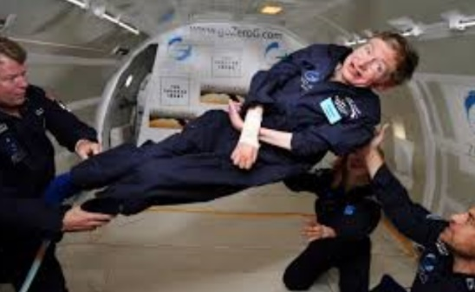



Vocabulary and Jobs
Formula
Rearrange
Simplify
Solve
Replace
Substitute
Unknown
Variable
Constant
Brackets
Factorise
Equation
These are the words you will be using in this topic
Mathematicians
Scientists
Statisticians
Computer Programmers
Analysts
Government
Pension
Mortgage/Banks
Engineer
Cosmologist
…. Can you think of more?
…………………………………
…………………………………

Slide 11

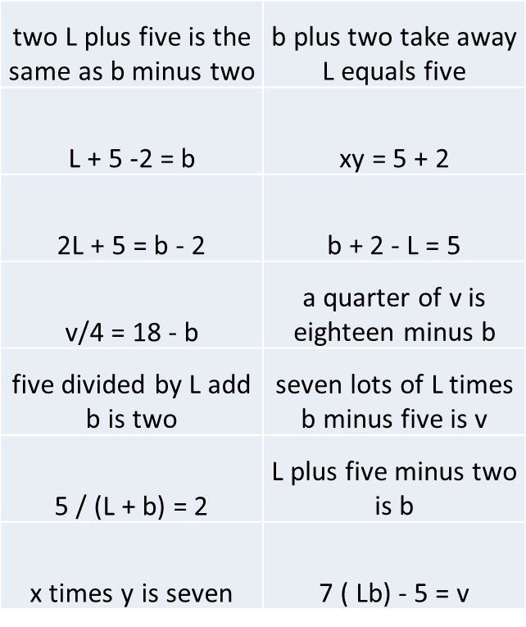
Lesson: Concept Activity
Match up the formulae with cards that describe what they mean.

Slide 12

Lesson: Main Teach 1
1….. What are Formulae?
Formulae are a set of instructions telling you what to do with some numbers once you have them.
eg.. £20 x d + £30 = C
Here ‘d’ means days and ‘C’ means cost.
The formula says… times the number of days by £20
then add the number 30
this gives you the cost
This tells you what to do before you even know the number of days
This could be a formula for working out the cost of hiring a car for some days..

Slide 13


Lesson: Main Teach 2
2….. Solving formulae
STEP 1
WRITE DOWN THE FORMULA eg… 8 L + G – 70 = X
STEP 2
PUT THE NUMBERS YOU KNOW INTO eg when L = 3, and G = 5
THE FORMULA 8 (3) + 5 – 70 = X
STEP 3
SOLVE TO FIND THE VALUES YOU WANT eg… 8 x 3 + 5 – 70 =
24 + 5 – 70 =
29 – 70 = -41 = X

Slide 14
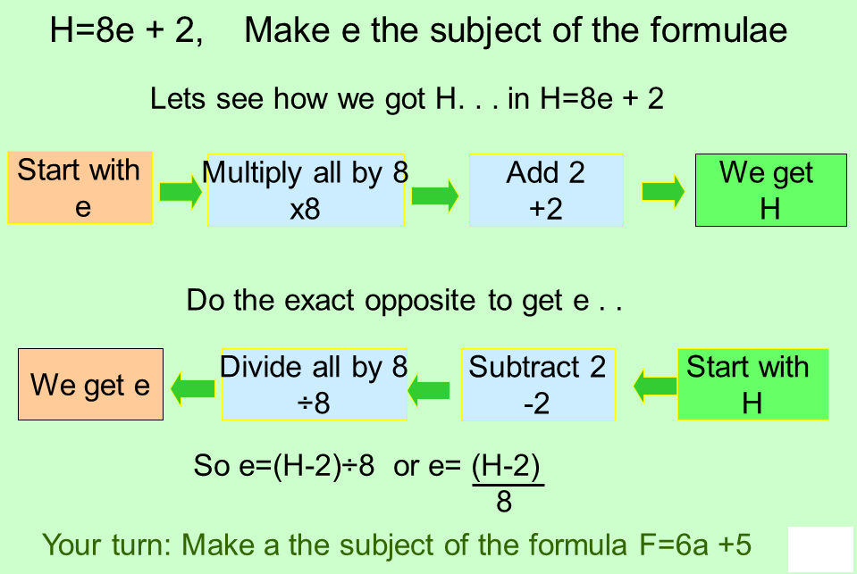

Lesson: Main Teach 3
3….. Rearranging formulae
This is about swapping the letters and numbers around to different sides of the equals sign to let you find values in your formula

Slide 15
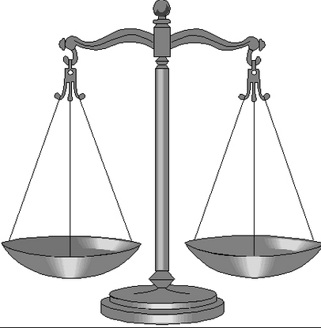
Lesson: Main Teach 4
3….. Rearranging formulae
The reverse of adding is subtracting
=
-5
+5
The reverse of subtracting is adding
+8.2
-8.2
=
The reverse of multiplying is dividing
=
/4
x4
The reverse of dividing is multiplying
when moving numbers to the other side
of an equals, you reverse the function
/9
=
x9

Slide 16
Lesson: Try out
Block 1 : Watch tutor led demo (in class or on video)
Try these, 1) If A + 3 = 10, find A 2) What is ‘b’ if 10 b = 90
3) 3C = 15, what is C ? 4) 9 / a = 7 – 4 what is ‘ a ‘ ?
Block 2 : Watch tutor led demo (in class or on video)
Try these, 5) 10 ( X – 3 ) = 20, find X 6) 9/5 C + 32 = F when C = 10.. What is F ?
7) 6 W L = 1/3 B, when W = 1 and L = 2 what is B? 8) 0.5 ( XY) = 7, X = 2, Y = ?
Block 3 : Watch tutor led demo (in class or on video)
Try these, 9) 2 x ² = 20 10) E = ½ v C ² + 8 rearrange to make C the subject
11) 5 (T +7) / S = U make T the subject 12) 80 a c x = √b make c the subject

Slide 17
Lesson: Websites and links
http://www.homeschoolmath.net/teaching/equations-1.php
Using balance scales to visualise formulae
Brilliant manipulative tool on a balance
scale to solve formulae
http://www.mathsisfun.com/algebra/add-subtract-balance.html
Terms and the basics of what formulae are
http://www.mathsisfun.com/algebra/equation-formula.html
Questions to solve using balance scales,
helps you write your own formulae
http://www.bgfl.org/bgfl/custom/resources_ftp/client_ftp/ks2/maths/weigh/1a.htm
Timed question game with various levels
of difficulty
http://www.shodor.org/interactivate/activities/AlgebraQuiz/
Website full of free printable worksheets on solving and rearranging formulae
http://www.math-drills.com/algebra.shtml
Page of basic maths formulas, most of them used on L1/L2 course
http://www.basic-mathematics.com/basic-math-formulas.html

Slide 18

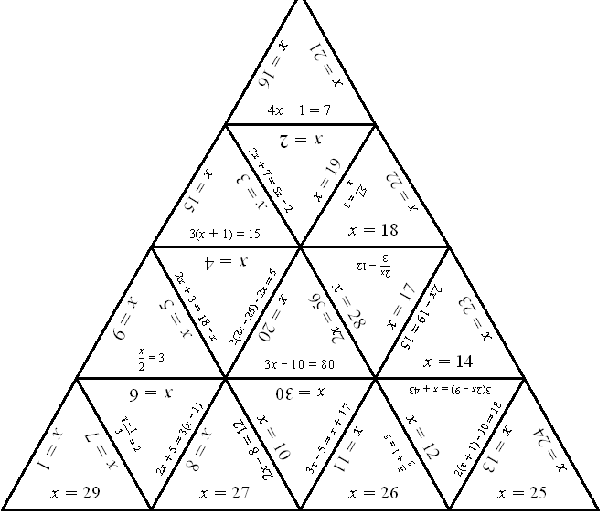
Lesson: Activity A
Tasia Puzzle
Work together to fit all the pieces together
If you complete the easy one,.. Can you do the harder??

Slide 19

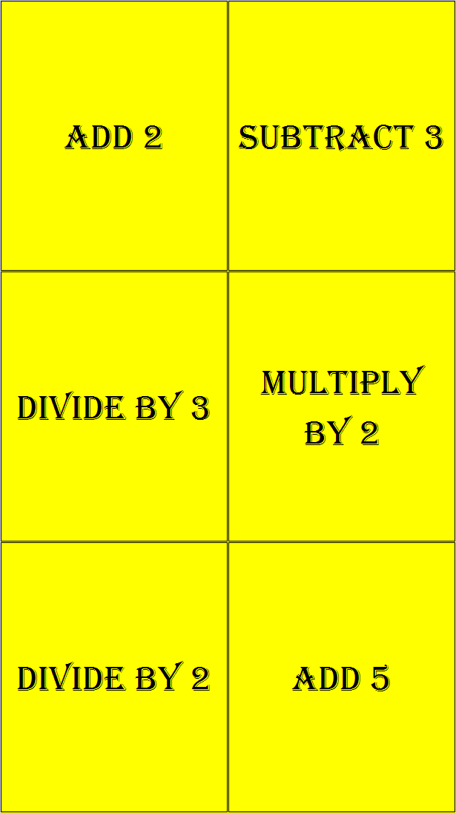
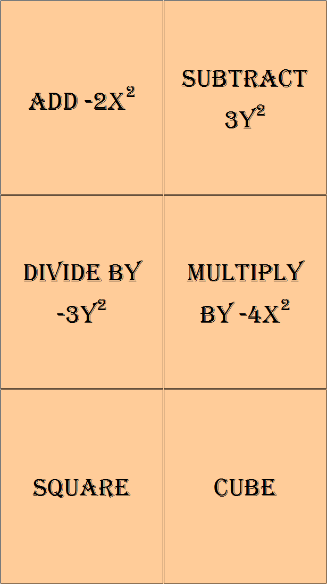
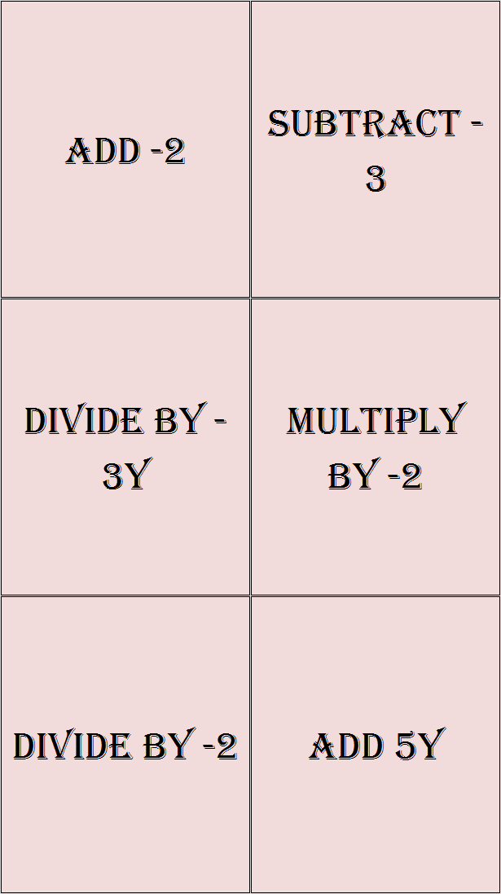
Lesson: Activity B
Use the cards to create your own formulae and race each other to solve !!
Write down any number, place a card to the right of it, then write an equals sign
Make the other side of the equals balance
Swap equations and solve each others before the other player to win a point
First to 10 points wins !!
Extension:
Try building formulae using the Harder Sets of cards

Slide 20



Lesson: Activity C
Computer based activity - SCREEN CAST O MATIC
Create your own video !
Using screen cast o matic software, make your own video to share and save for your own revision detailing how to write and solve formulae
Film yourself demonstrating…
How to write formulae
How to replace letters with numbers and solving
How to rearrange formulae

Slide 21

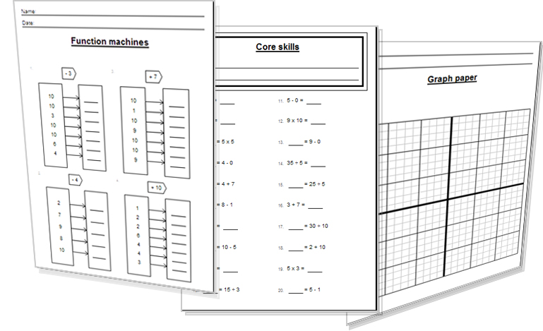
Lesson: Activity E
Try a variety of written practice
Worksheets
Workbooks
Practice Exam Papers
Maths Problems

Slide 22
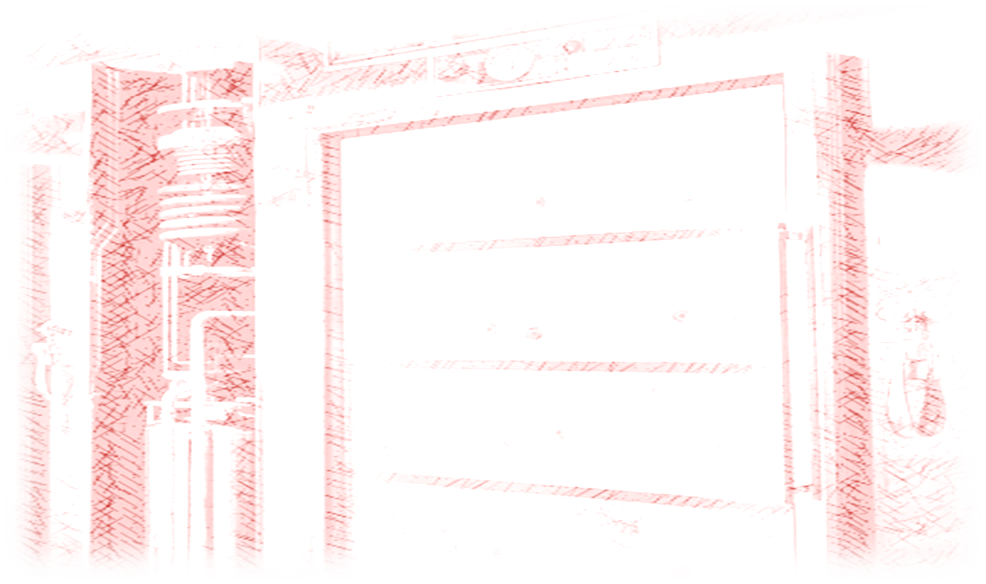
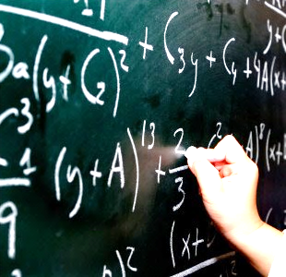
Lesson: Practice – just the numbers
Solve the equations to
find the value of x
x +4 =10
2x – 6 = 14
X / 7 = 40
9x – 2 = 30
19 – x = 15
x + 3x = 20
(5+x) / 2 = 8
13 x = 26 – 4
40 x – 3 = 10
16 = x + 9 (4)
Solve to find y
2y = 19
5 + y = 2
3) 30 / y = 10
25 – y = 20
y + y = 5
y / 10 – 2 = 15
8y – 2y = 0.4
6 (y + 8 ) = 50
4.2 + 8.3y = 100
- (4 + y ) = - 2
Rearrange so x is the subject
X + 7 = c
4x ( y ) = 9 L
x/2 = 9
4 ( x / 2 ) y = 1
Tx + 3 = C
6) x² = y – 2
6x + 20 = x
( x + 4)/50 = W
100y + 50 = -3x
9 x B = t / x
Rearrange to make x the subject
4 x ² = 9
(x² + 3) /10= 15
Yx² – 4 = 0
-2 ( 5x²) + 3 = -8
4UV/x² = 100

Slide 23
Lesson: Practice – word problems
Q1 A carpet is priced a ‘N’ square metres multiplied by ‘P’ the price per metre plus £200 fitting fee. Write a formula to find ‘T’ the total cost using N and P variables.
Q2 A sum of money ‘I’ is put into a bank and left for ‘Y’ years and receives ‘P’ percentage each year. Write a formula to show the amount in the bank ‘T’ after a number of years.
Q3 A temperature is converted from Celsius ‘C’ to Fahrenheit ‘F’ using the formula F= (9/5 C) + 32. Find F when C is 28.
Q4 The formula for mixing a cocktail is that half is filled with ‘J’ juice plus ‘A’ alcohol and the rest ‘S’ soda. Find the total amount of liquid in the drink ‘D’ by writing a formula.
Q5 The weight limit in an lift is worked out by using the formula … 100N + 200 = T where ‘N’ is the number of people that the lift can safely carry and ‘T’ is the total weight limit of the lift. If the total weight limit ‘T’ is 1100 Kg, work out how many people can be safely carried.
Q6 The final speed ‘v’ an object reaches when falling due to gravity is given as v² = u² + as Find the starting speed ‘u’ when v=20, the acceleration ‘a’ = 9.8 and the distance fallen (s) is 20.41m

Slide 24
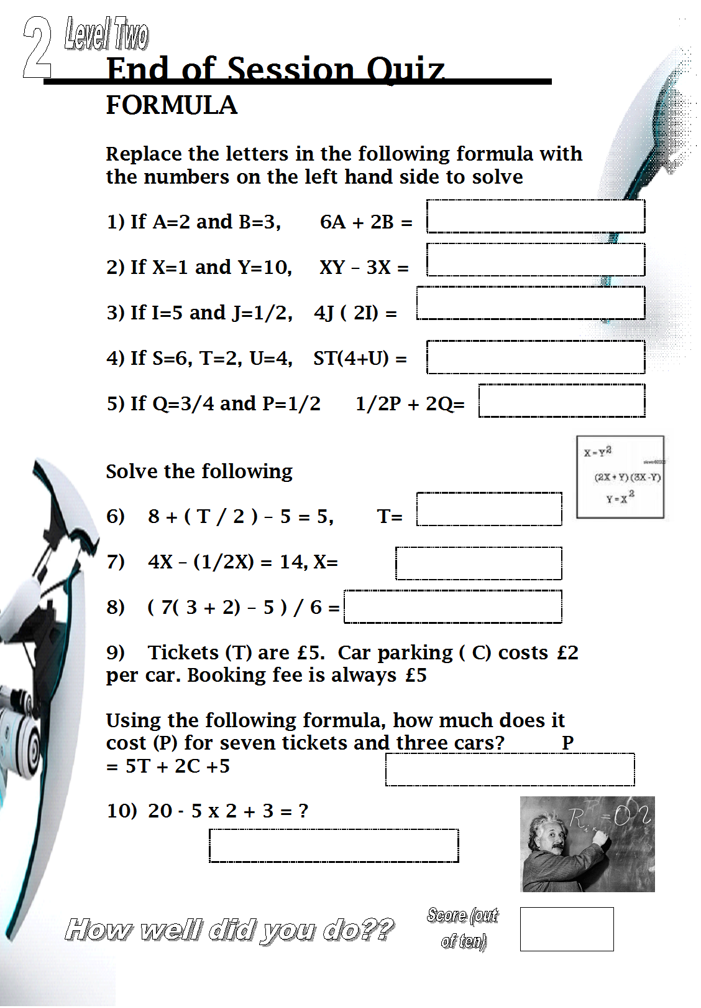

End of Session Quiz LEVEL 2

Slide 25

TOPIC ANSWERS 1
Lesson Practice – Just the Numbers
X = 6
X = 10
X= 280
X=
X=
X=
X=
X=
X=
X=

Slide 26
TOPIC ANSWERS 2
9a Lesson Practice,

Slide 27
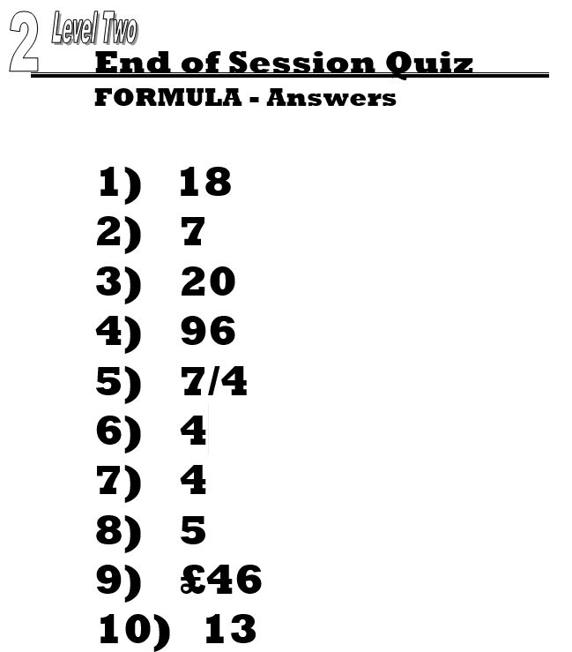
TOPIC ANSWERS 3

Slide 28
Progress Checker 2
W
What do you now know about Formulae? WHAT DID YOU LEARN? Write an example..
How would you now rate your skills in using formulae ?
Excellent ability
Good ability, but working to improve
Ok, making a start but I know I have lots to still learn
My aims for today Date: were…
A State what a formula is and when they are useful
B Read and write formulae using letters and symbols
C Replace formulae unknown values with numbers and solve to find answers to problems

Slide 29


Continuing to Study and Learn
What else can you do to help yourself to learn and practice? Here are ten suggestions, record which you do each week and also record your progress.
Internet websites
Repeat the lesson, make notes, organise a folder, revise
Own maths workbook
Study together with a friend or family member
Finish activities in this book
Complete class handouts or tasks
Practice exams / past papers
Use maths skills learnt at home or at work in real situations
Play games
Experiment yourself, try new things ask yourself questions
Try making a graph of number of practice methods you use against your progress score in each topic. Are you showing more practice gives better results?

