Slide 1
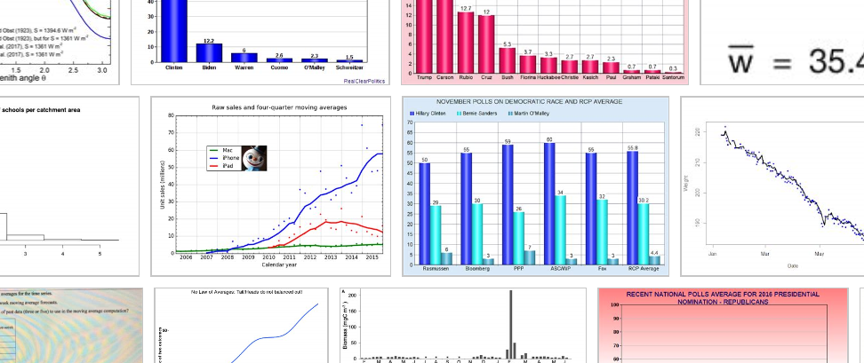
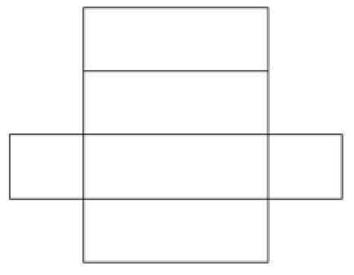
Averages
Learning Objectives
To be able to :
Calculate the median and mode of a set of quantities
Estimate the mean of a grouped frequency distribution from discrete data
Use the mean, median, mode and range to compare two sets of data
The diagram shows a net of a solid.
Write down the name of the solid.
The net has one line of symmetry. Draw the line of symmetry on the diagram.
Write down how many faces the solid has.
Write down how many vertices the solid has.
Write down how many edges the solid has.

Slide 2
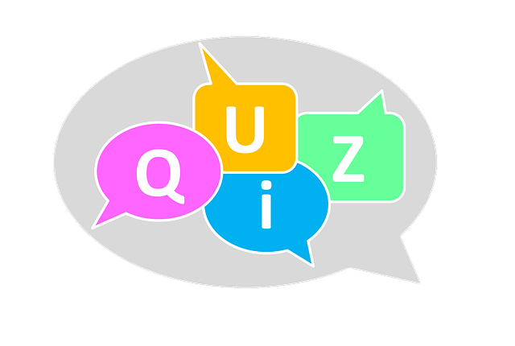
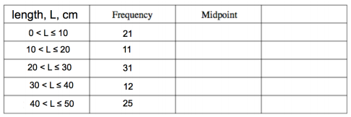
STARTER
Mean
Range
A football team played six games. Here are the number of goals they scored in each game:
6 0 3 2 2 5
Work out the mean number of goals scored.
The number of points that Randalstown Rugby Club scored in eight matches are:
24 17 19 35 9 43 15 30
Work out the range of the number of points scored.
Median
Estimated Mean
Simone records the number of minutes she spends on her mobile phone over 7 days.
8 5 13 6 24 19 10
Find the median.
The table below shows the length of 100 fish from a local river.
Mode
Miss Jones gives her class a test. The test is out of 40 marks. Here are their scores.
31 29 20 35 32 38 32
Work out the mode.
Calculate an estimate of the mean length of the fish.
Notes:
To check understanding of topics being covered in the lesson. Some classes will know how to do majority of these, therefore you can skip some bits out and spend time on what your students need help with the most.

Slide 3
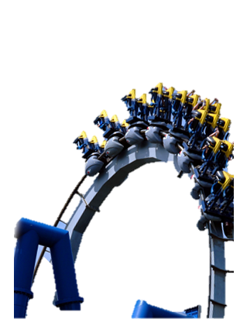
Averages and Range
Work out the averages and range for the following data:
(a)
7, 6, 2, 3, 1, 9, 5, 4, 8
(b)
4, 7, 1, 3, 5, 6, 6, 8
Mode =
Mode =
Median =
Median =
Mean =
Mean =
Range =
Range =

Slide 4

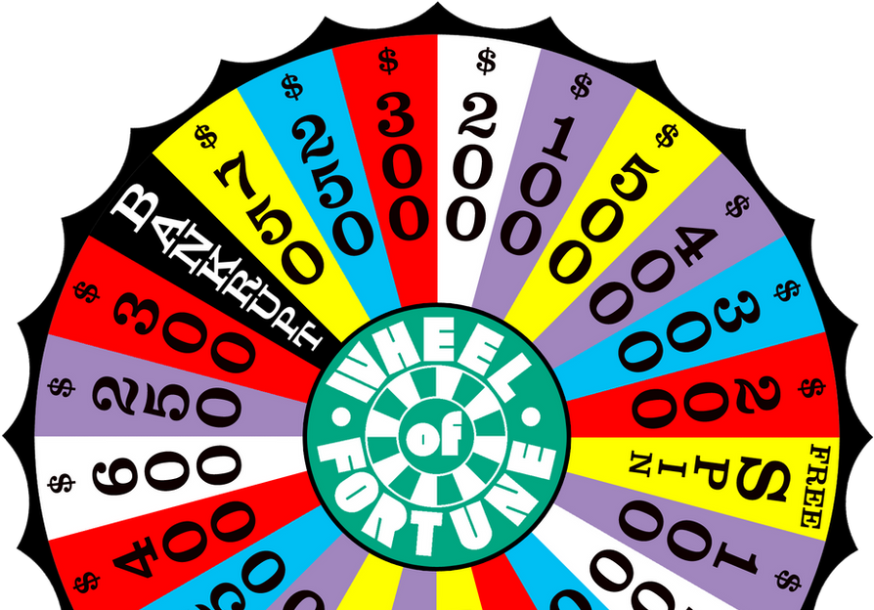
Your turn…
James has a spinner that has sections labelled 1 to 5. He spins the spinner 10 times. Here are his scores.
4 4 2 3 4 5 1 4 1
Find the mode.
Work out the mean.
Work out the range.
Here are the ages of 9 children at a birthday party.
10 12 13 10 11 14 15 10 12
Find the mode.
Find out the median.
Work out the range.
Work out the mean.
This Photo by Unknown Author is licensed under CC BY
This Photo by Unknown Author is licensed under CC BY-NC-ND

Slide 5
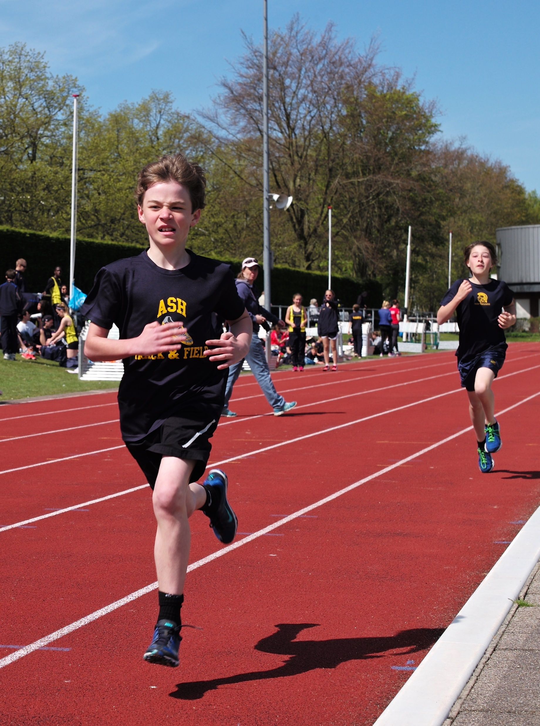
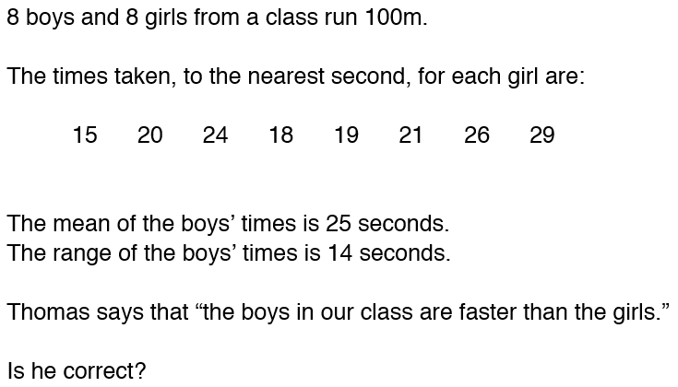
Comparing Two Sets of Data

Slide 6
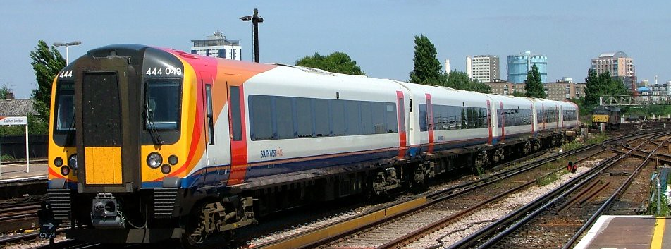
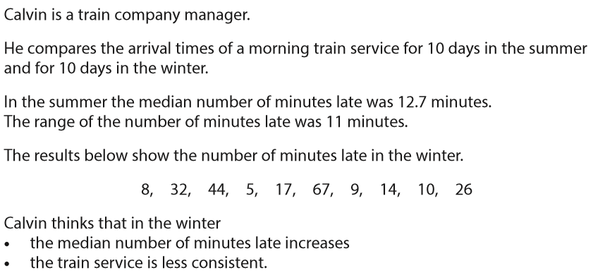

Your turn…
This Photo by Unknown Author is licensed under CC BY-SA

Slide 7
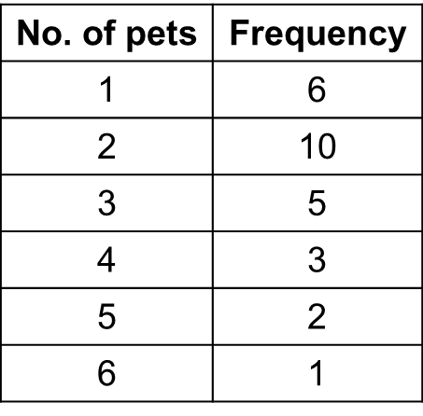
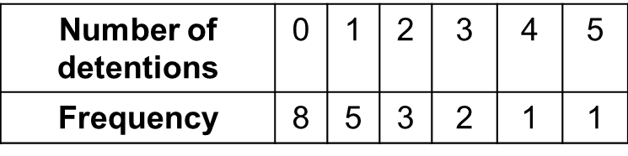
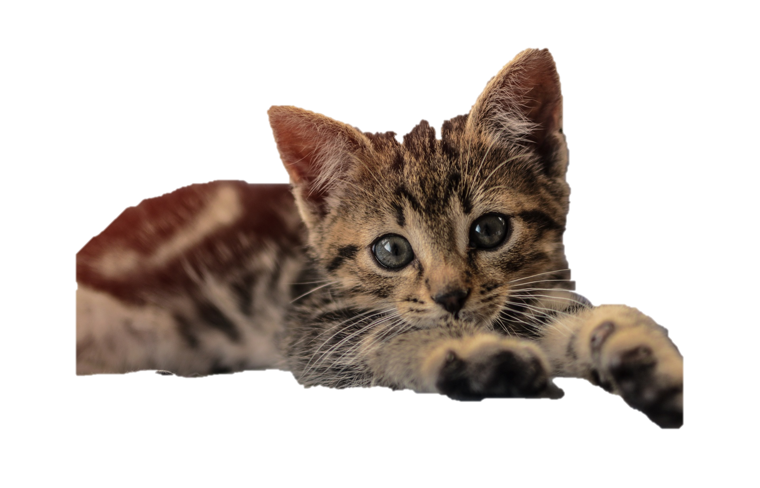
Finding the Mean from a Frequency Table
Work out the mean from the frequency tables below:
(a)
(b)

Slide 8
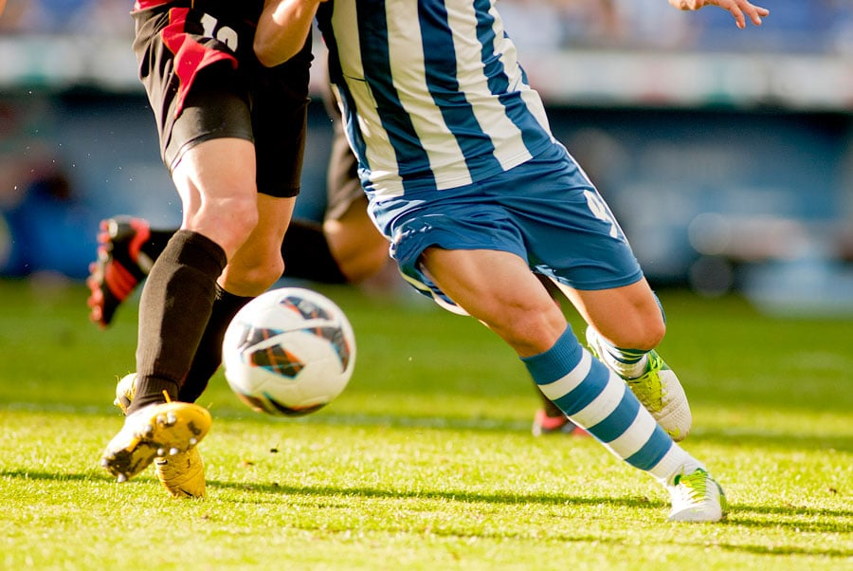
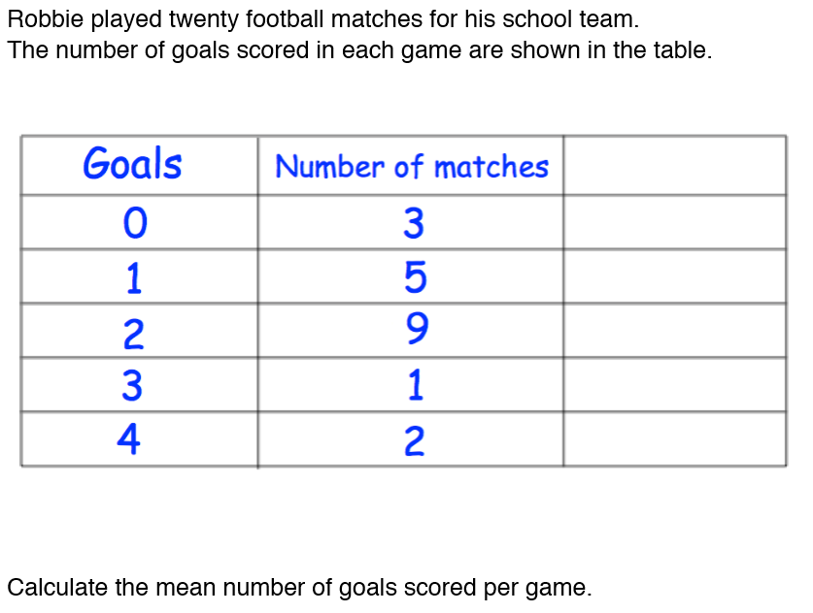
Your turn…
This Photo by Unknown Author is licensed under CC BY-NC-ND

Slide 9
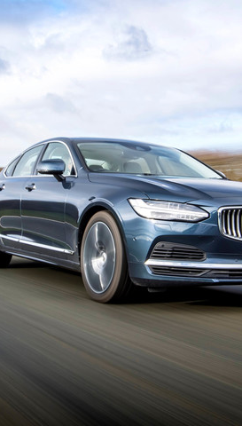
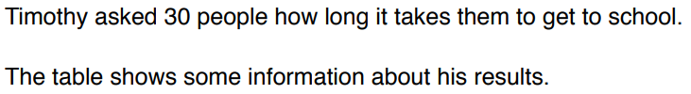
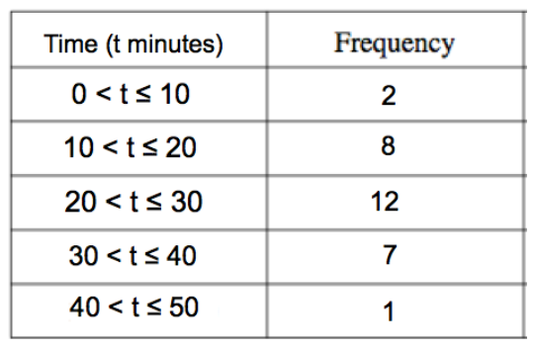
Estimated Mean

Slide 10
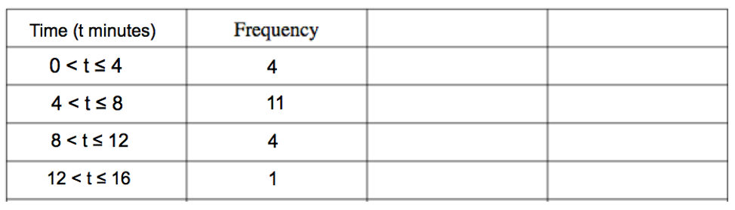

Your turn…
This Photo by Unknown Author is licensed under CC BY-NC-ND

Slide 11

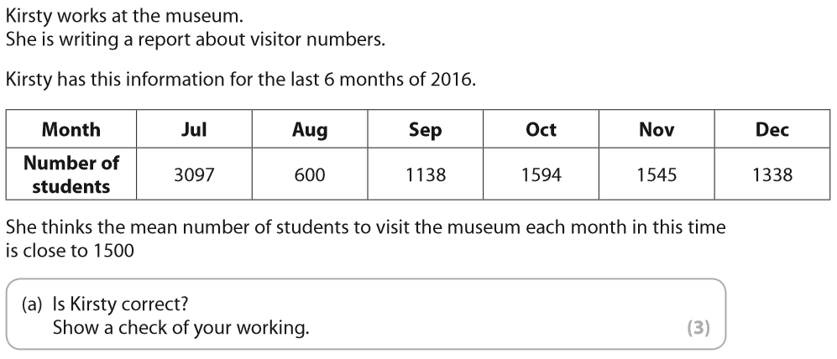

Slide 12
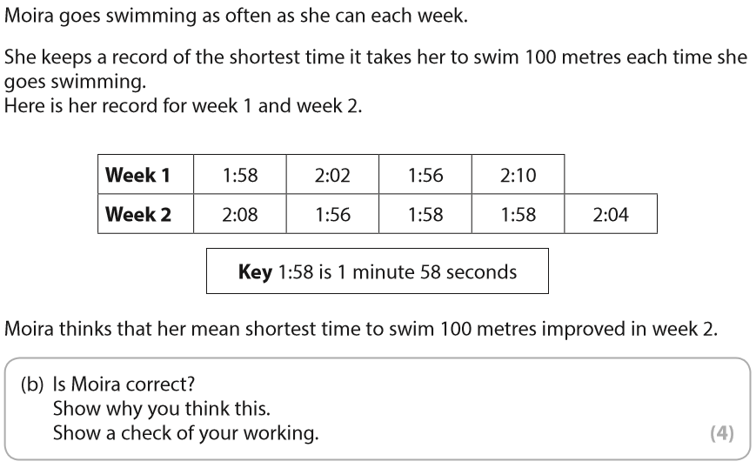
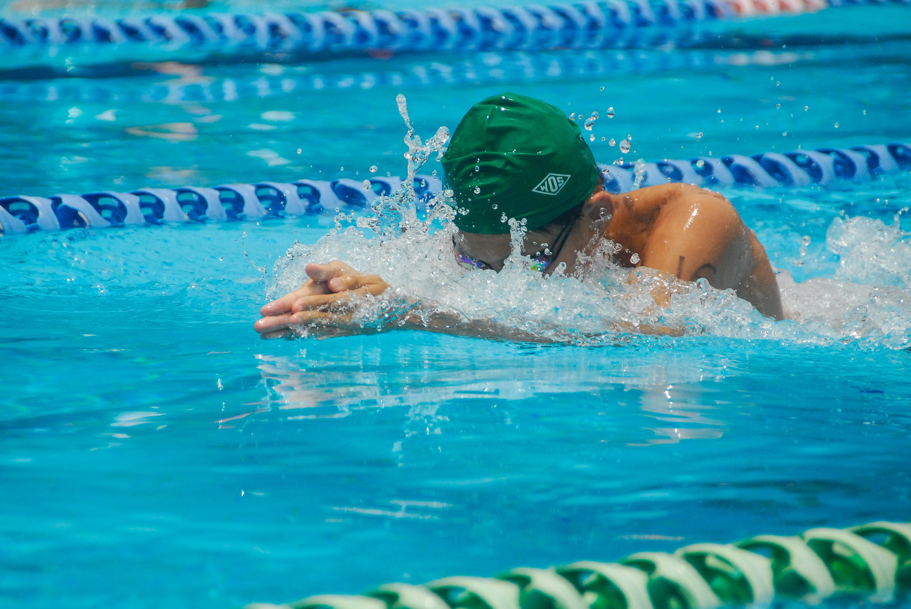

Slide 13
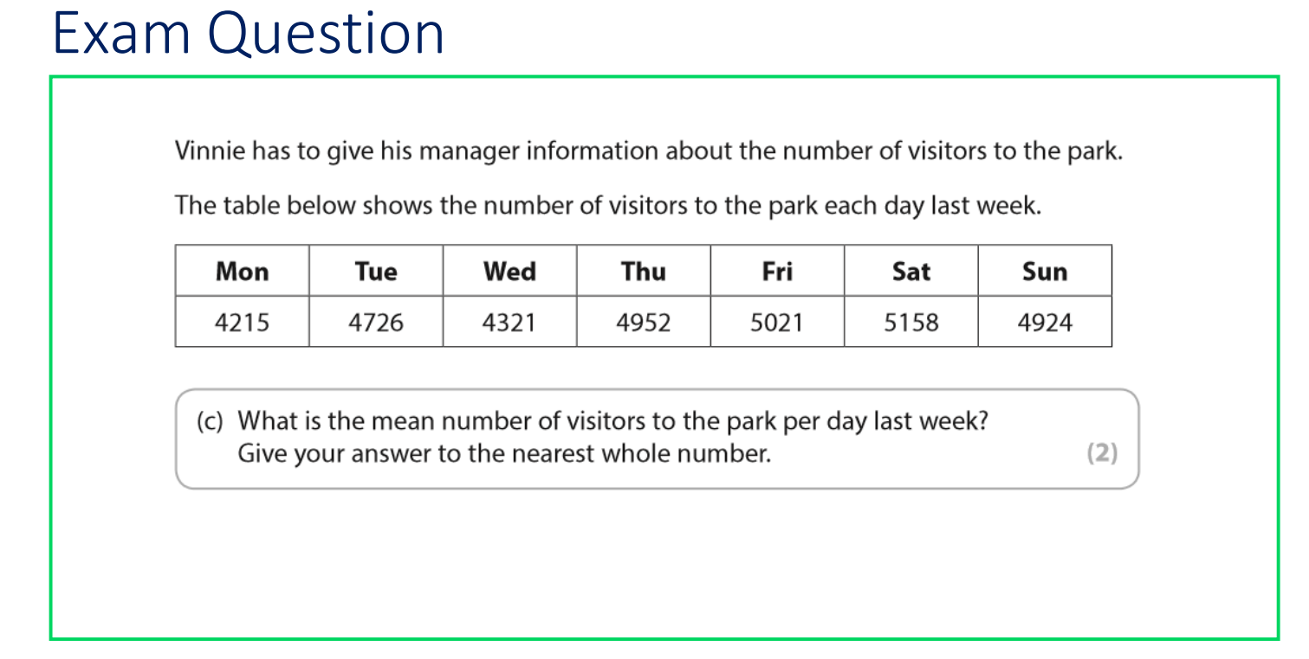

Slide 14
