Slide 1
SUBSTITUTION
Learning Objectives
To be able to :
use given information to write a formula
substitute values into formulae and expressions
interpret simple expressions as functions with inputs and outputs
-3 x -4
4 x -5
-2 x -1 x -2
-6 x -7 x 2
(6 + 5) x -3

Slide 2
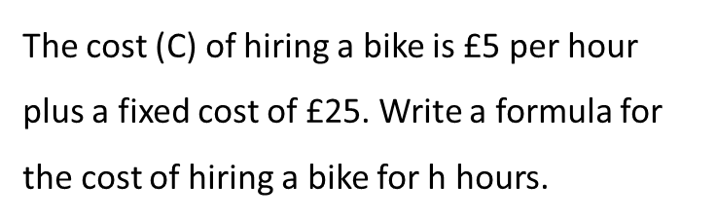

STARTER
Substitution
Writing Formula
$$If x=4 and y=3, find z when:$$
$z=x+2$
$z=y−1$
$z=x+y$
$z=3y$
The cost (C) of hiring a bike is £5 per hour plus a fixed cost of £25. Write a formula for the cost of hiring a bike for h hours.

Slide 3
WRITING FORMULA
Claudia owns f films. Barrow owns twice as many films as Claudia.
How many films does Barry own?
How many films do Claudia and Barry own in total?
How many films would they own in total if they each gave away 3 of their films?

Slide 4
Your turn…
has £18 in the bank. He gets a job and is paid £8 for every hour he works. Assuming he spends nothing, write a formula for the amount of money (£M) Alf will have after he has worked for h hours.
The instructions for cooking a goose are to cook for 50 minutes per kg, plus 25 minutes. Write a formula to find the time (t minutes) to cook a goose weighing n kg.
Write a formula for the cost (£C) of having t trees cut down if it costs p pounds per tree plus a fixed amount of £30.

Slide 5
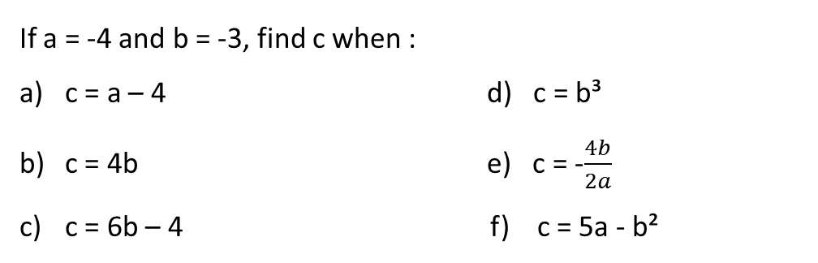
SUBSTITUTION
If a = -4 and b = -3, find c when :
c = a – 4 d) c = b³
c = 4b e) c = -$\frac{4b}{2a}$
c = 6b – 4 f) c = 5a - b²
Theo decides to play a game of crazy golf. The cost of hiring crazy gold equipment, £C, is a fixed price of £3 plus 8p for every minute of use. For g minutes of crazy golf this can be written as the formula C = 0.08g + 3.
Theo plays for 2 hours and 30 minutes. How much will hiring the equipment cost him?

Slide 6
Your turn…
Give all answers to 2 decimal places.
Use the formula v = u + at to find v if :
u = 3, a = 7 and t = 5
u = 12, a = 17 and t = 15
u = 2.3, a = 4.1 and t = 3.4
u = 5.25, a = 9.81 and t = 4.39
Find the volumes (V cm³) of the cylinders below to 2 decimal places, using the formula on the left.
r
3cm
h
V = πr²h
8cm
11cm
5cm

Slide 7

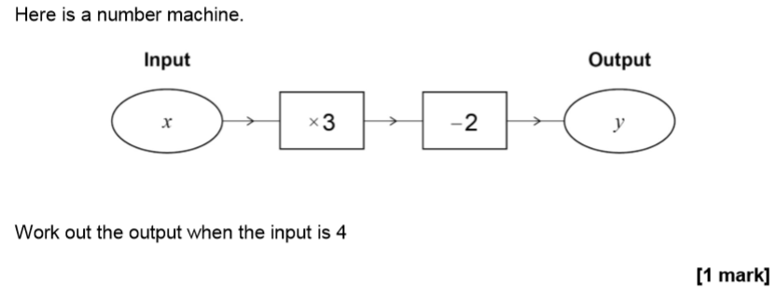

June 2017 Paper 3

Slide 8
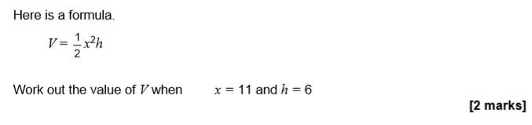
Practise Paper Set 1 Paper 1

