Slide 1

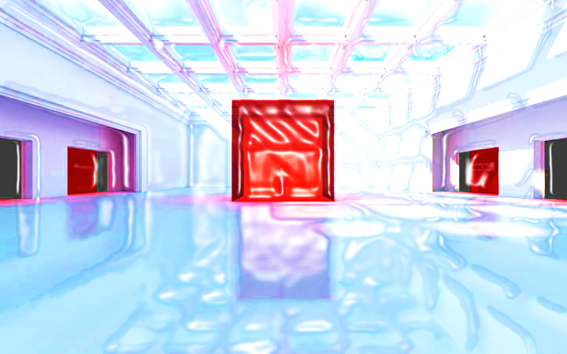
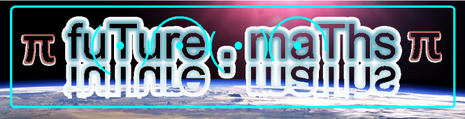




Whole Number and Functions
05 . Rounding

Slide 2



















Course Content: Choose your topic …
Whole Number and Functions
place
value
negative
numbers
add and
subtract
multiply
divide
round
numbers
ratio
scale
fraction
decimal
numbers
percent
percent
decimal
fraction
MATHS E3 to L2
Parts of a whole
metric
measure
imperial
measure
perimeter
area
volume
formulae
bodmas
charts
data
averages
prob-
ability
Measure and Shape
Handling Data

Slide 3





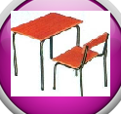







Home Revision Progress Check 1 Video/Discuss Vocab / jobs Lesson Activities Quizzes Topic Answers Progress Check 2 Cont. Learning
1
Topic Introduction : Round and Estimate
The maths process of rounding a number changes it so less place values are used. This means the number is no longer the real value it should be, but that’s ok in lots of real life situations. With less place values in a number it is easier to say, write and use in calculations. Rounding is not guessing however and there is a clear rule you will need to follow when rounding numbers.
After rounding a value the new number is called an ‘approximate’ value to its original. If you now use these new approximate values in a sum you will only get ‘estimates’. Getting this terminology correct, especially in exam questions, is very important.
Choose an icon to select where to start
Round and Estimate

Slide 4
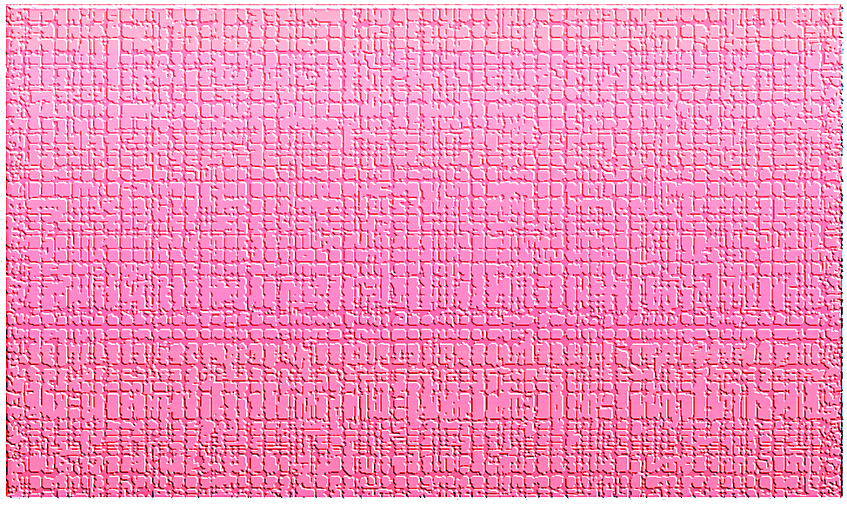


Revision Exercises 1
2
Lets start today by revising ! Complete the above sums and multiplication grid

Slide 5
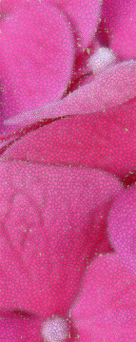

Revision Exercises 2
3

Slide 6
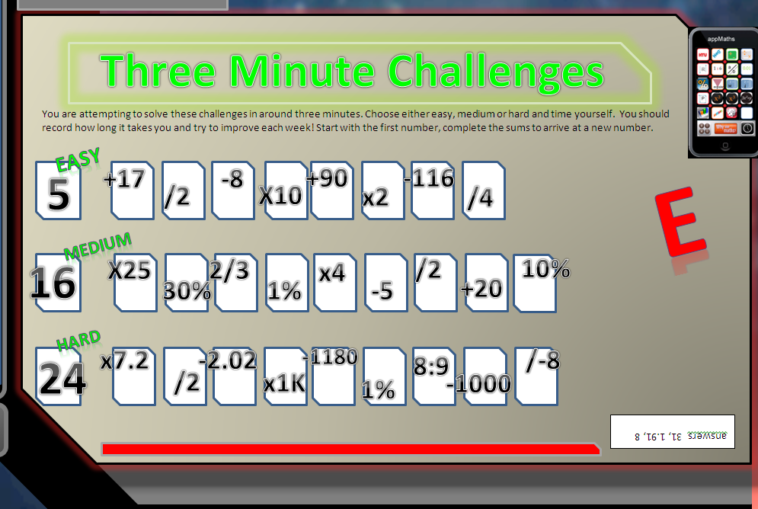

Revision Exercises 3
4

Slide 7

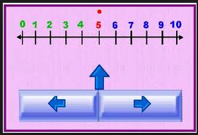
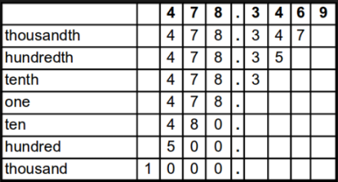
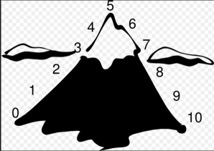
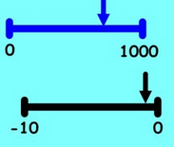
Progress Checker 1
5
What do you already know about Rounding ?
How would you rate your skills in Rounding Numbers?
Excellent ability
Good ability, but working to improve
Ok, making a start but I know I have lots to still learn
My aims for today are…
A Correctly round numbers to a given or chosen place value including large numbers
B Use rounded numbers in calculations to produce estimations
C Recognise terms such as round, approximate, estimate, actual…

Slide 8
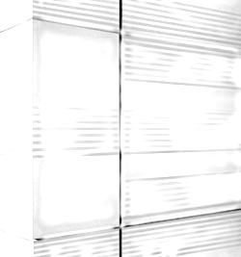
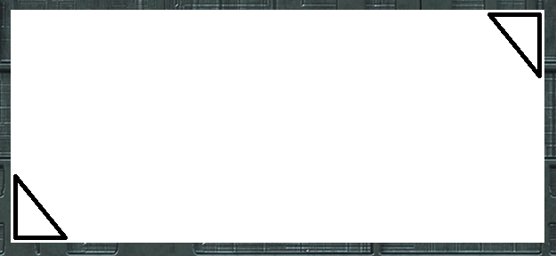
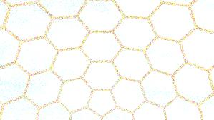

Introductory Video and Discussion
6
KHTU.
What is the best method for rounding ?
After rounding a number can you figure out what the original number was ?
When can we round numbers and when shouldn’t we ?
How does rounding make things easier ?
Can you round fractions, decimals, percentages ?
How do you know what place value to round to ?
Watch the introductory video and then discuss the above
Your thoughts..

Slide 9
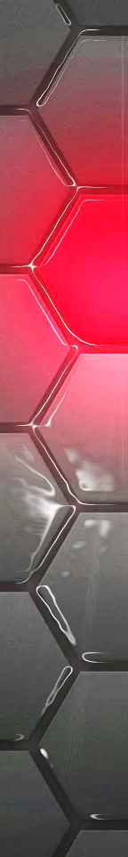
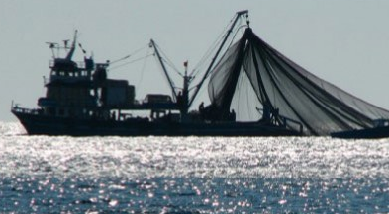
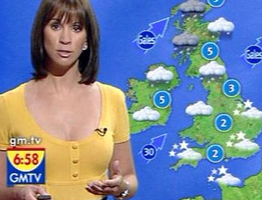
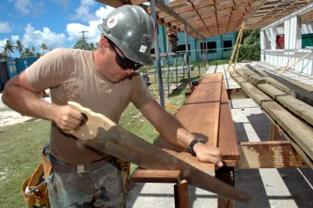
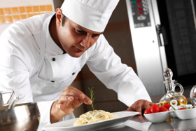
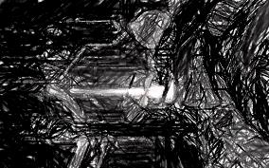
Vocabulary and Jobs
7
Round
Approximate
Estimate
Place Value
Almost
Around
About
Nearly
Half/Halfway
Rounding up
Rounding down
These are the word s you will use in this topic
Accountant
Government Stats
Builder
Newspaper
Chef
Manager
Weather
Fisherman
…. Can you think of more?
…………………………………
…………………………………

Slide 10
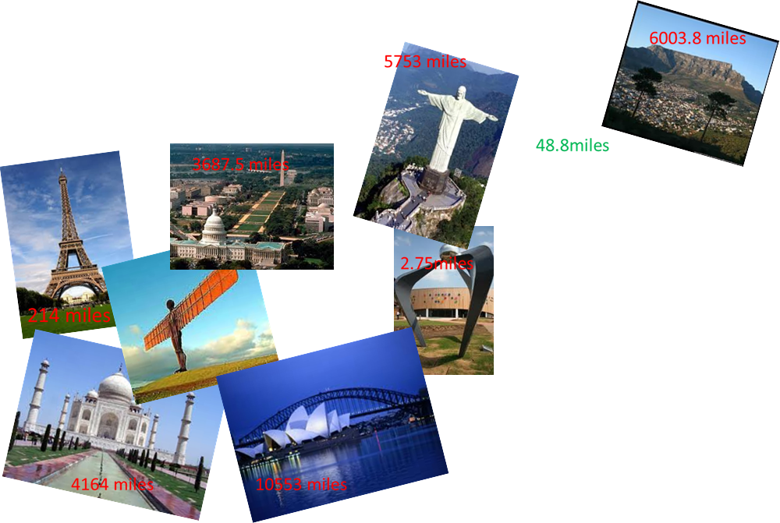
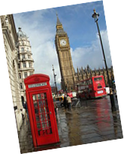

Lesson: Concept Activity
8
Around the world in 180 minutes
In Pairs: Turn these distances into numbers that you can more easily communicate. Be prepared to share your ideas with the group when you have finished.

Slide 11
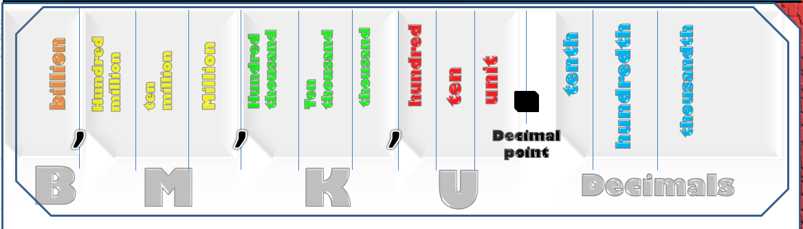
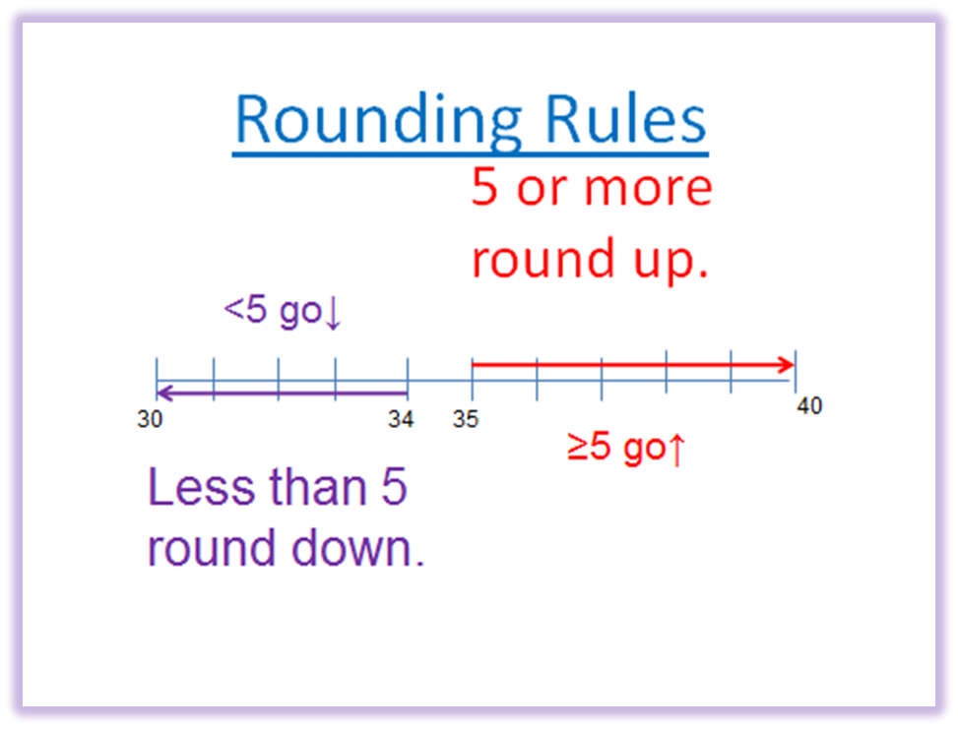
Lesson: Main Teach
9
What you need to know to round
Ensure you have learnt your place values
Find the place value you want to round to
Round up or down the next place value
Put zeros in all other columns to the right
Rounding rule
· 5 or more round up (≥5 ↑)
· less than 5 round down (<5↓)

Slide 12
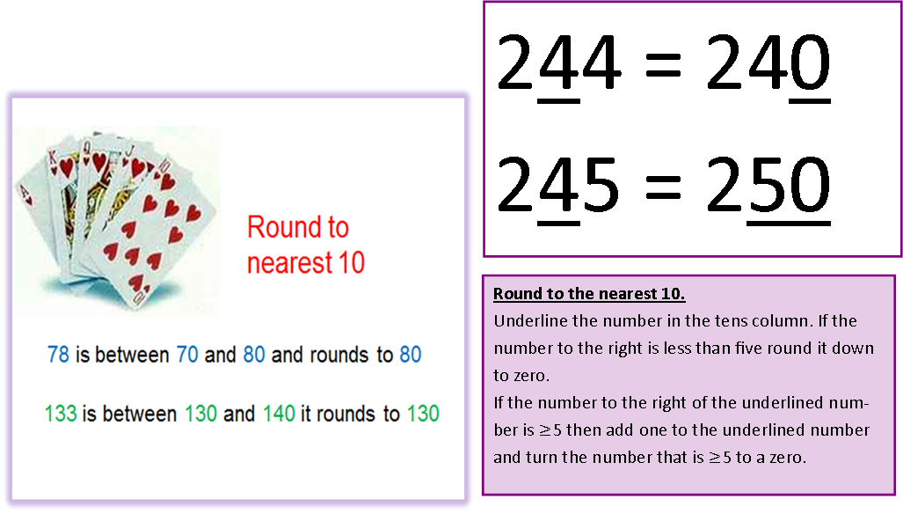

Lesson: Main Teach
10
How to round up or down
http://www.youtube.com/watch?v=3afU6JQG15I
http://www.youtube.com/watch?v=3afU6JQG15I

Slide 13
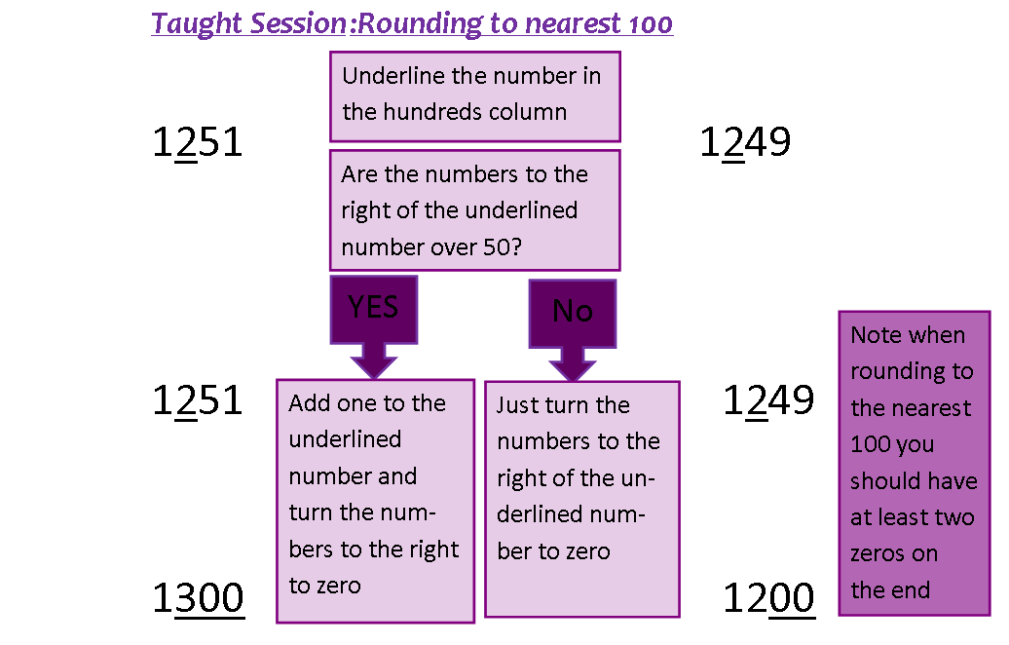

Lesson: Main Teach
11

Slide 14
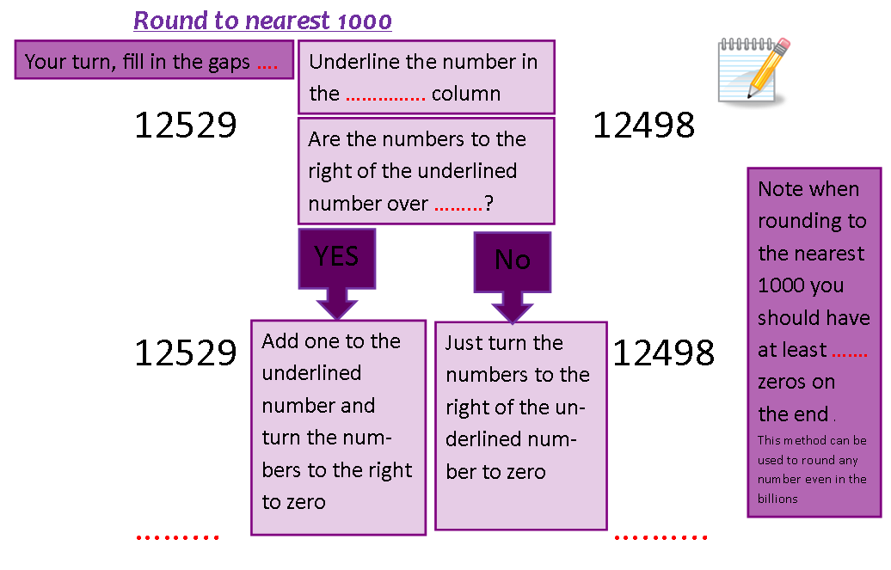
Lesson: Main Teach
12

Slide 15
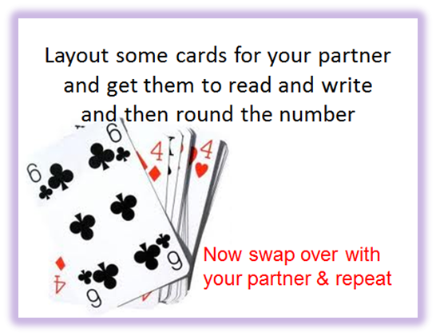
Lesson: Main Teach
13
Record answers on data collection sheet
Cards | Rounded to | Written rounded number

Slide 16

Lesson: Try out
14
Block 1 : Watch tutor led demo (in class or on video)
Try these, 1) 84 rounded to nearest 10…………………… 2) 55 rounded to nearest 10……………………
3) 16 rounded to nearest 10………………….. 4) 492 rounded to nearest 100……………………
5) -227 rounded to nearest 100……………….. 6) 4520 rounded to the nearest 1000……………….
Block 2 : Watch tutor led demo (in class or on video)
Try these, 7) 96,250 rounded to the nearest 10,000
8) 545,953 rounded to the nearest 100,000
9) 63,450,000 rounded to the nearest Million
10) 8.4 M rounded to the nearest Million
11) -14,700,000 rounded to the nearest Million
Block 3 : Watch tutor led demo (in class or on video)
Try these, 12) 8,329,000,000 rounded to the nearest billion
13) 4.7B rounded to the nearest billion
14) -0.541 B rounded to the nearest billion
15) 2,800M rounded to the nearest billion

Slide 17
Lesson: Websites and links
15
Rounding using a number line to visualise
http://www.oswego.org/ocsd-web/games/Estimate/estimate.html
Use a ‘dart board’ type game to create rounding questions or solve
http://www.kiwikidsnews.co.nz/games/2013/02/02/dart-board-rounding/
Rounding to 100 on a number line
http://mathszone.webspace.virginmedia.com/mw/rounding/nearest100.swf
Play ‘Pac Man’ and chase down the ghosts while rounding to the nearest million !
http://www.sheppardsoftware.com/mathgames/round/mathman_round_millions.htm
A sheet of rounding to 1000 questions to try
http://www.teachrkids.com/examples/rounding.asp?count=10&round_type=4&min_val=1000&max_val=99999
Hangman rounding of numbers in 1000’s
http://www.quia.com/hm/41141.html
A short help guide on rounding decimals and rounding examples to try
http://www.cimt.plymouth.ac.uk/projects/mepres/book8/bk8i4/bk8_4i5.htm
Two pages of rounding from 10 to billion
http://www.sinclair.edu/centers/tlc/pub/handouts_worksheets/mathematics/DEV085/1_whole_numbers/085_rounding_whole_numbers_2.pdf
The BBC website with large numbers, significant figures and decimals
http://www.bbc.co.uk/schools/gcsebitesize/maths/number/roundestimaterev5.shtml

Slide 18
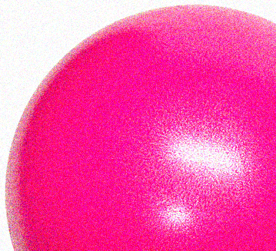
Lesson: Practice – just the numbers
16
Round to the nearest 10
6
17
54
95
163
498
1,552
18,239
Round to the nearest 10K
14K
29K
355K
959K
-15.5K
267.8K
Round to the nearest 10M
84M
125M
-659M
45.5M
Round to the nearest 100
124
698
245
555
-1,659
189,250
454,545
-330
Round to the nearest 100K
250K
932K
80.6K
-455K
960.4K
-105K
Round to the nearest 100M
483M
257M
70.3M
-888M
Round to the nearest 1000
4,050
5,506
96,174
-233,495
88,955
-14,507
222,222
0.485 K
Round to the nearest 10,000
43,152
89,504
-22,333
-150,555
9,000
0.042M
Round to the nearest 100,000
464,379
-816,540
0.73M
665K
Round to the nearest 10 Billion
14 B
39 B
55 B
8.6 B
-5 B
231 B
789 B
-55 B

Slide 19
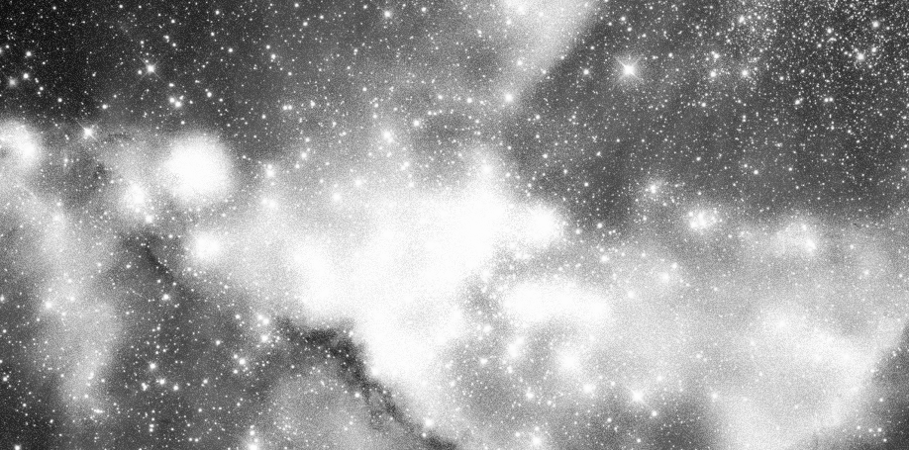
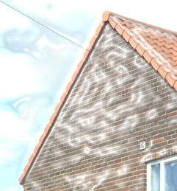

Lesson: Practice – word problems
17
Mike wants to get a quick estimate of how much a loft conversion will cost him. The prices are shown. Find a quick estimate for the three values. £10,852 building materials £3,211 labour £1,955 fixture and fittings.
Which of the following house prices could be rounded to £140,000? £145,000
£134,500
£137,400
An average galaxy has approximately 100 B stars in it. When rounded to the nearest 100 billion what would be the lowest number of stars in a galaxy? clue….(what is the lowest number when rounded that rounds up to 100B) ?
A new car is priced at £15,959. To the nearest ten thousand pounds what is the approximate price of the car?
There are 1000ml in a one litre bottle of water. I use 6,525 ml of water to mix some concrete. To the nearest ‘whole’ bottle, how many bottles of water were needed in the concrete mix?
A company paid out two payments £1,365,000 and £472,900 . What is an estimated total of the two payments to the nearest hundred thousand pounds?

Slide 20
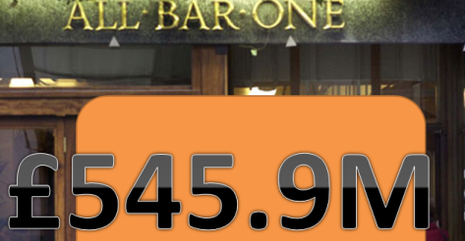
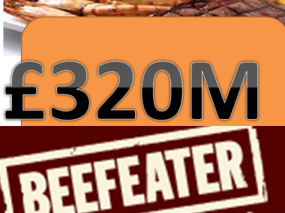
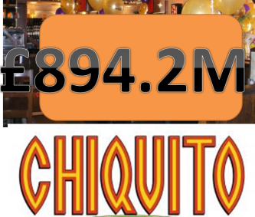
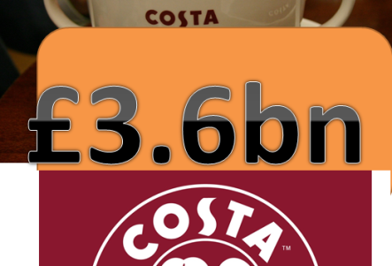
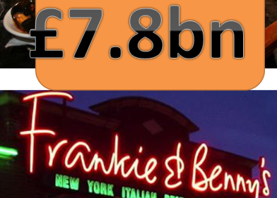

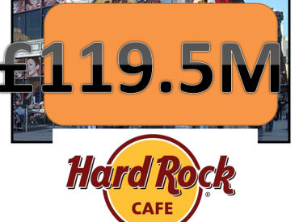
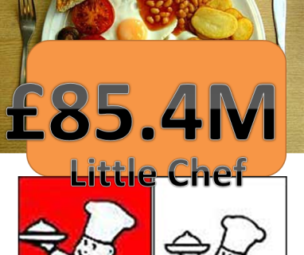
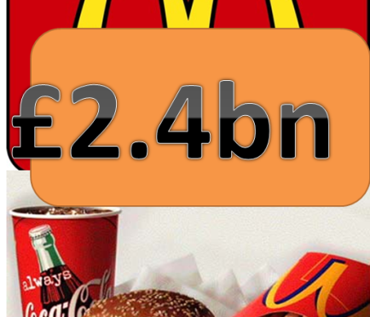
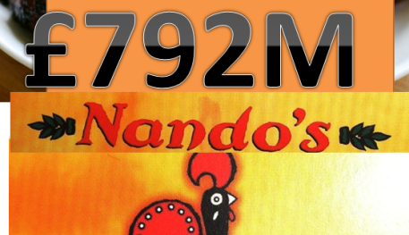
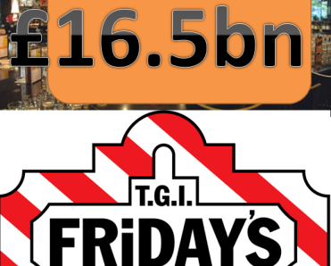
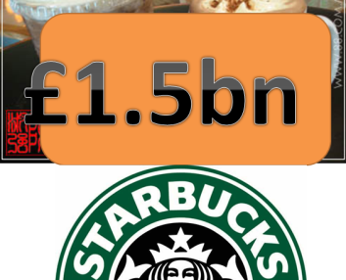
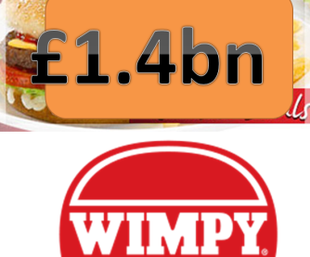
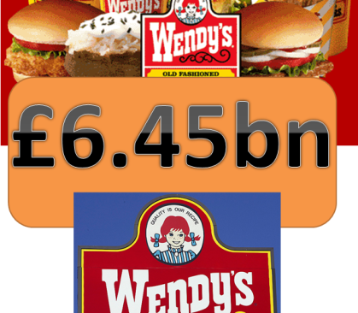
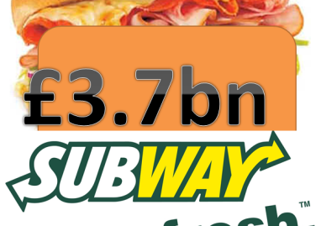
11 Lesson: Practice – Making it Functional
18
Y

Slide 21
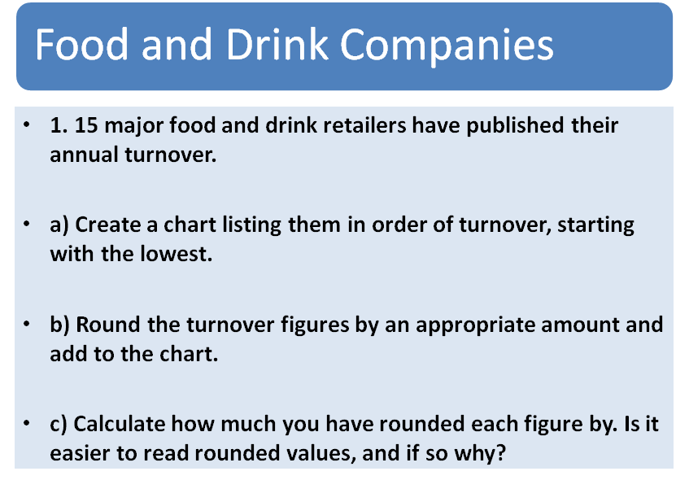
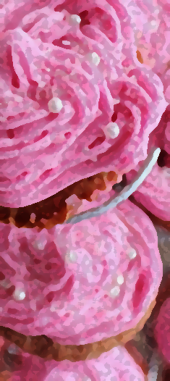
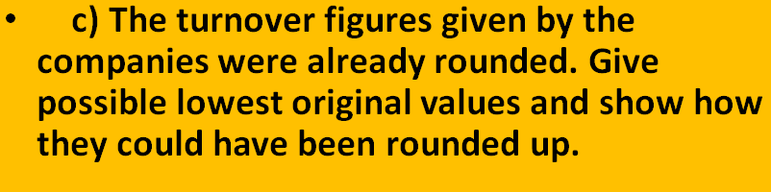
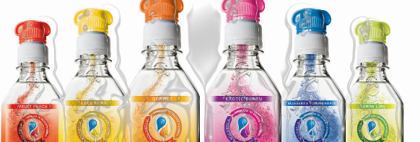
11 Lesson: Practice – Making it Functional
19
Y
L1 or L2

Slide 22
13 – TOPIC ANSWERS
20
Round to the nearest 10
10
20
50
100
160
500
1,550
18,240
Round to the nearest 10K
10K
30K
360K
960K
-20K
270K
Round to the nearest 10M
80M
130M
-660M
50M
Round to the nearest 100
100
700
200
600
-1,,700
189,300
454,500
-300
Round to the nearest 100K
300K
900K
100K
-500K
1000K or 1M
-100K
Round to the nearest 100M
500M
300M
100M
-900M
Round to the nearest 1000
4,000
6,000
96,000
-233,000
89,000
-15,000
222,000
0
Round to the nearest 10,000
40,000
90,000
-20,000
-150,000
10,000
0.04M or 40,000
Round to the nearest 100,000
500,000
-800,000
0.7M or 700,000
700K
Round to the nearest 10 Billion
14 B
39 B
55 B
8.6 B
-5 B
231 B
789 B
-55 B
Word Problems
£10k or £11k building materials £3k or £3100 labour £2k fixture and fittings.
Total could be 10k +3k +2k= 15k or reasonable combination or above values
£137,400
50B stars would round up to 100B (note 49,999,999,999 would round down to 0B to the nearest 100B !)
£20,000
7 bottles are required to the nearest whole bottle
£1,400,000 + £500,000 = £1.9 M or £1,900,000

Slide 23
Progress Checker 1
21
What do you now know about Rounding ?
How would you now rate your skills in Rounding Numbers?
Excellent ability
Good ability, but still working to improve
Ok, made a start but I know I have lots to still learn
My aims for today were…
A Correctly round numbers to a given or chosen place value including large numbers
B Use rounded numbers in calculations to produce estimations
C Recognise terms such as round, approximate, estimate, actual…

Slide 24
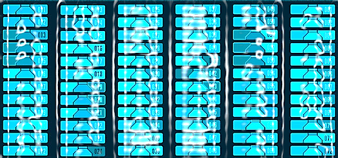

15 Continuing to Study and Learn
22
What else can you do to help yourself to learn and practice? Here are ten suggestions, record which you do each week and also record your progress.
Internet websites
Repeat the lesson, make notes, organise a folder, revise
Own maths workbook
Study together with a friend or family member
Finish activities in this book
Complete class handouts or tasks
Practice exams / past papers
Use maths skills learnt at home or at work in real situations
Play games
Experiment yourself, try new things ask yourself questions
Try making a graph of number of practice methods you use against your progress score in each topic. Are you showing more practice gives better results?

