Slide 1
Scale
Learning Objectives
- To calculate actual dimensions from scale drawings and create a scale diagram given actual measurements
Recap
Calculate 25% of £360
Calculate 5% of 420kg
Calculate 20% of £955
Calculate 47% of £360
Calculate 27% of 420kg
Calculate 99% of £955

Slide 2
Scales – What are they?
A scale drawing is a way of accurately drawing very big or very small objects on paper. All the dimensions are reduced or increased in the same way using the scale.
The scale is a ratio that tells you what dimension in the drawing means in real life. For example, the scale 1:10 means that 1cm in a drawing is equal to 10cm in real life.

Slide 3
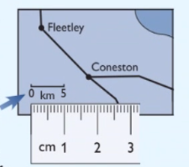
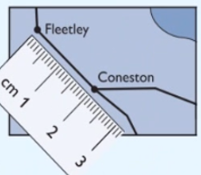
Discussion 1
The map on the right is a scale drawing.
What is the real life distance between Fleetley and Coneston in km?
The scale shows the distance on the map that is equal to 5km in real life. Use a ruler to measure the line. It’s 1cm long. This means that 1cm on the map is equal to 5km in real life.
Now measure the distance between Fleetley and Coneston on the map. It’s 2cm.
Use the scale to convert the distance on the map to the distance in real life.
1cm = 5km, so 2cm = 2 x 5km = 10km

Slide 4
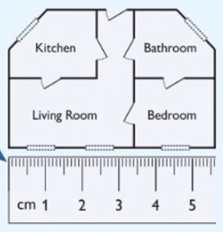
Discussion 2
You may need to measure a distance in one unit and then convert it to a more sensible unit after using the scale.
Trevor is buying a new flat. The diagram shows the layout of the rooms. It has a scale 1:150.
What is the width of the living room in metres?
Use a ruler to measure the width of the living room on the diagram – it’s 3.4cm.
Use the scale to find the real life width.
The scale is 1:150, so 1cm on the diagram is 150cm in real life, and 3.4cm on the diagram is 150 x 3.4cm = 510cm in real life.
3) Finally, convert you answer from centimetres to metres.
The Living room has a width of 510 ÷ 100 = 5.1m.

Slide 5
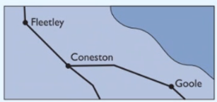
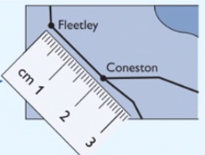
Discussion 3
The map on the right is a scale drawing. The real life distance between Fleetley and Coneston is 10km.
What is the scale used to draw this map?
Give your answer as a ratio.
You’re told the real life distance, so you need to measure the same distance on the map. This is 2cm.
Both measurements must be the same units, so convert the real life distance to cm:
Real life distance = 10km = 10 000m = 1 000 000cm
3) Write the scale as a ratio and simplify
Map distance : real life distance = 2 : 1 000 000
= 1 : 500 000

Slide 6
Practice questions
1) Kai is walking in the countryside.
He uses a map to find the distance to the nearest village.
The distance on the map is 3.4cm. The map has the scale 1:100 000.
What is the actual distance to the village in kilometres?
3) A model is to be made of a new college building which is 120m in length. The suggested scale is 1:250. How long will the model be?
2) A house was drawn using a scale of 1:100. The main bedroom is 4cm long on the scale plan. How long is the main bedroom?

Slide 7
Creating a scale
A rectangle has a height of 1.5m and a width of 0.75m. Draw the rectangle on the grid using the scale 1:25. Each grid square is 1cm².
The grid is in cm, so first convert the dimensions of the rectangle to cm:
real life height = 1.5 x 100 = 150cm
real life width = 0.75 x 100 = 75cm
2) The scale 1:25 means that 1cm on the grid should represent 25 cm in real life.
The drawing will be smaller than the real thing, so you need to divide by 25 to get the drawings dimensions.
Drawing height = 150 ÷ 25 = 6cm
Drawing width = 75 ÷ 25 = 3cm
Your scale drawing should look like this:
1cm
1cm

Slide 8
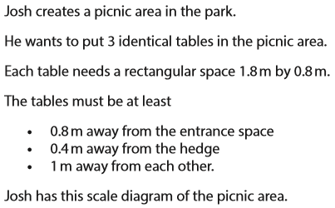
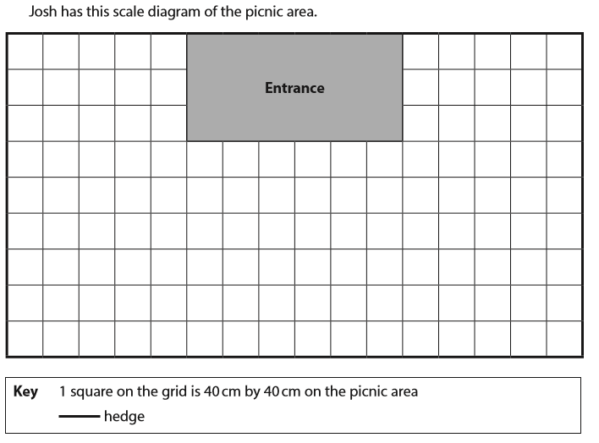

Exam questions
FSM02/01, June 2018

Slide 9
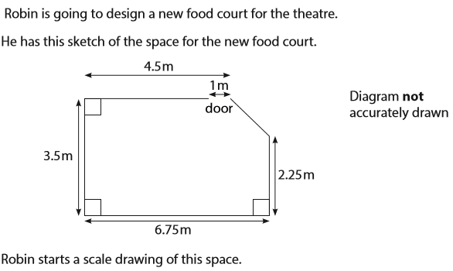
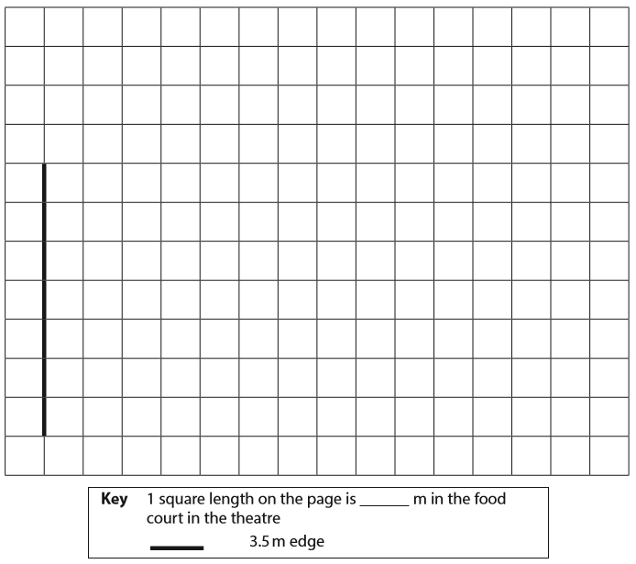

Exam questions
FSM02/01, May 2018

Slide 10
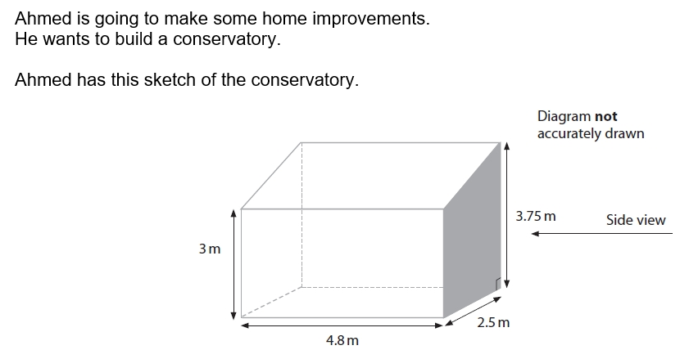
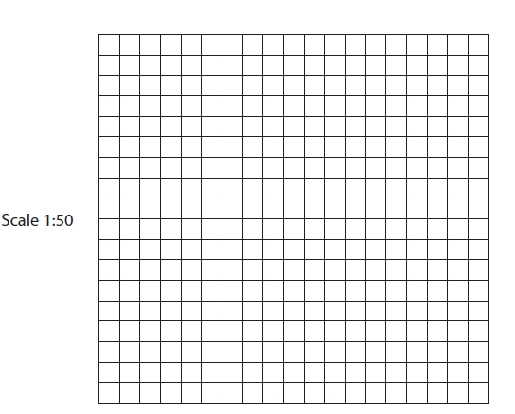
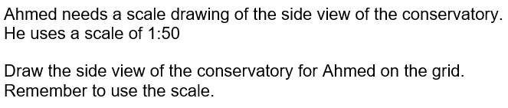
Exam questions
Use squared paper to draw the below table
FSM02/01, July 2016

Slide 11
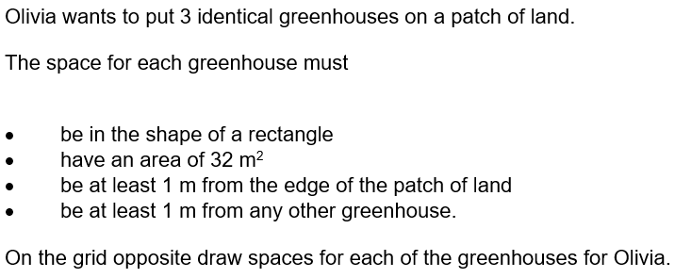
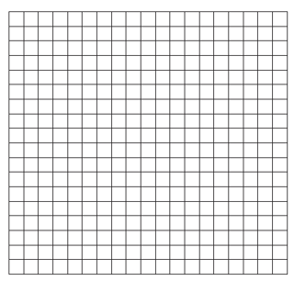

Exam questions
*Use squared paper with 1 square equal to 50cm by 50cm on the patch of land.
FSM02/01, Feb 2017

Slide 12
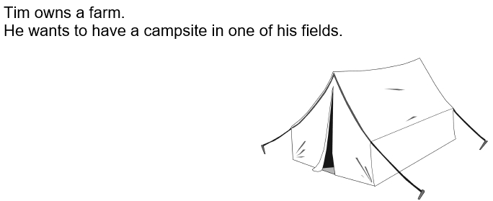
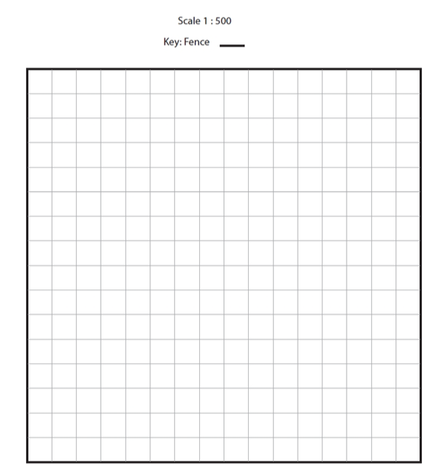
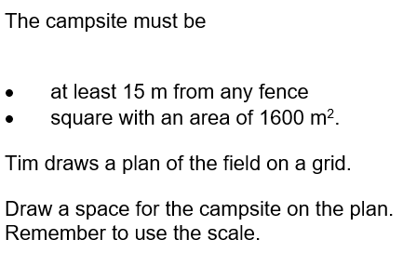

Exam questions
FSM02/01, Jan 2016

Slide 13
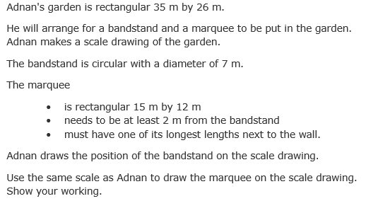
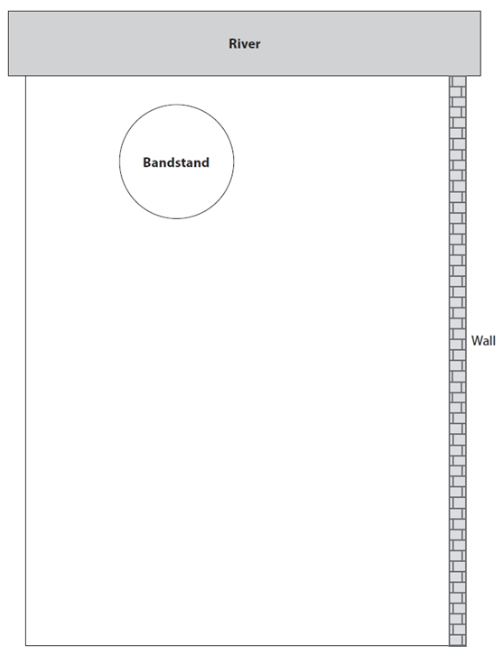

Plenary
FSM02/01, June 2016

