Slide 1
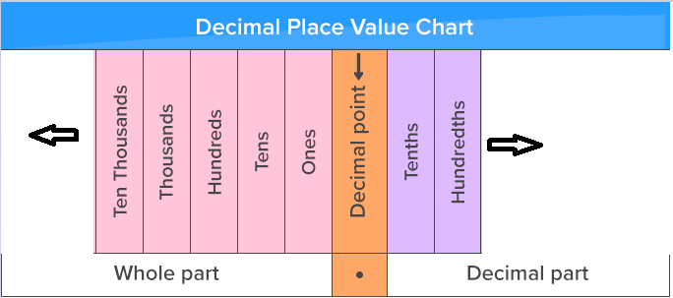
Starter Can you write the next column names to the right and left? Can you write the value fourteen thousand, nine hundred and seven point five onto the table in the correct place?

Slide 2
L1 Week 3 – Numbers and Multiples
Learning Objectives:
Read, write, order and compare numbers to one million
Multiply numbers by 10, 100, 1000
Recognize multiplication facts, square numbers and division
None this week
Recap

Slide 3
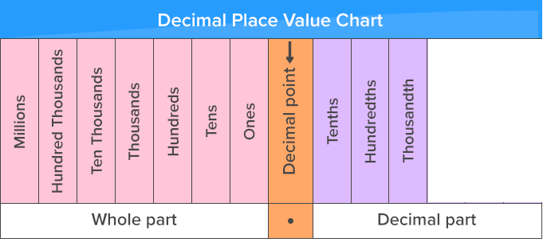
Place value grid recap – check your knowledge

Slide 4
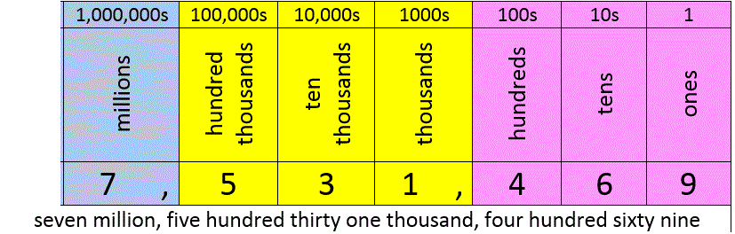
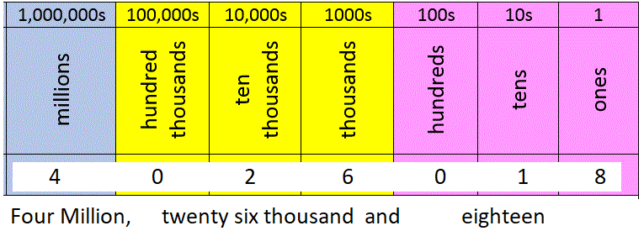
Reading and Writing Large Numbers

Slide 5
Section A) Practice – writing numbers
1) Write 458,029 in words
2) Write ‘Eight million, and ninety-seven thousand' in digits
3) Place in order, highest value first
283,911 0.284M 280K
4) Write 111,010 in words
5) Write in full, zero point five five million using digits
6) Expand in full a) 2.9M b) 1.703K c) 0.098M

Slide 6
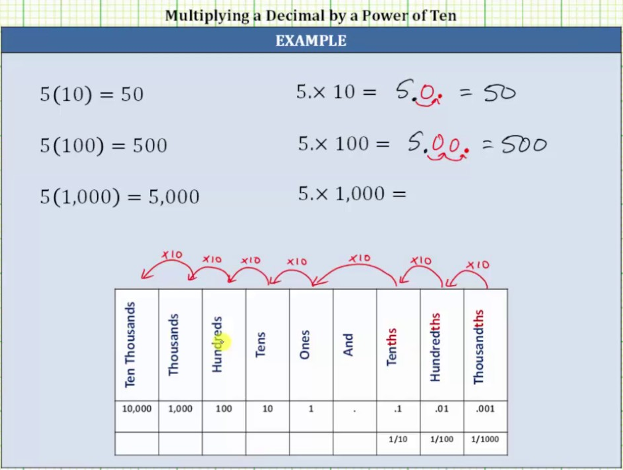
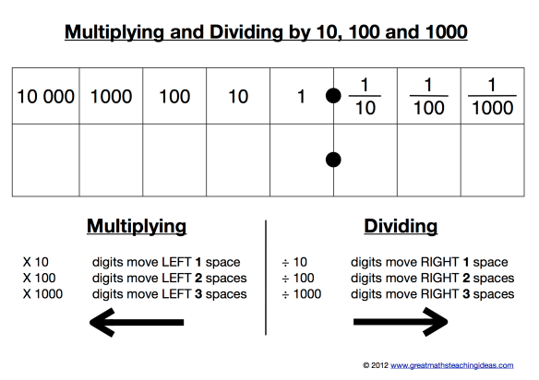

Slide 7
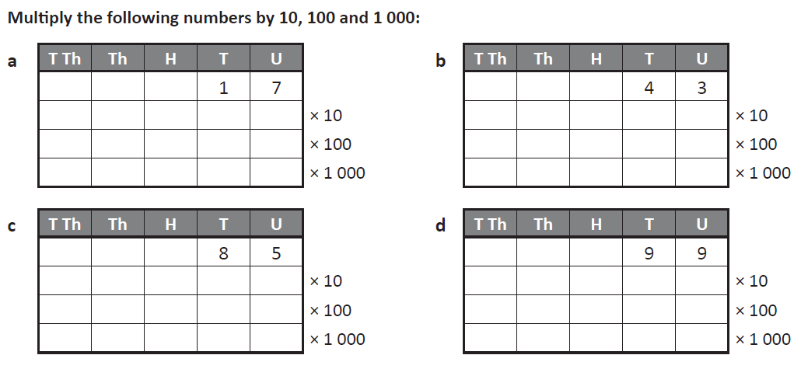
Section B) Practice – Multiply by 10, 100 or 1000

Slide 8
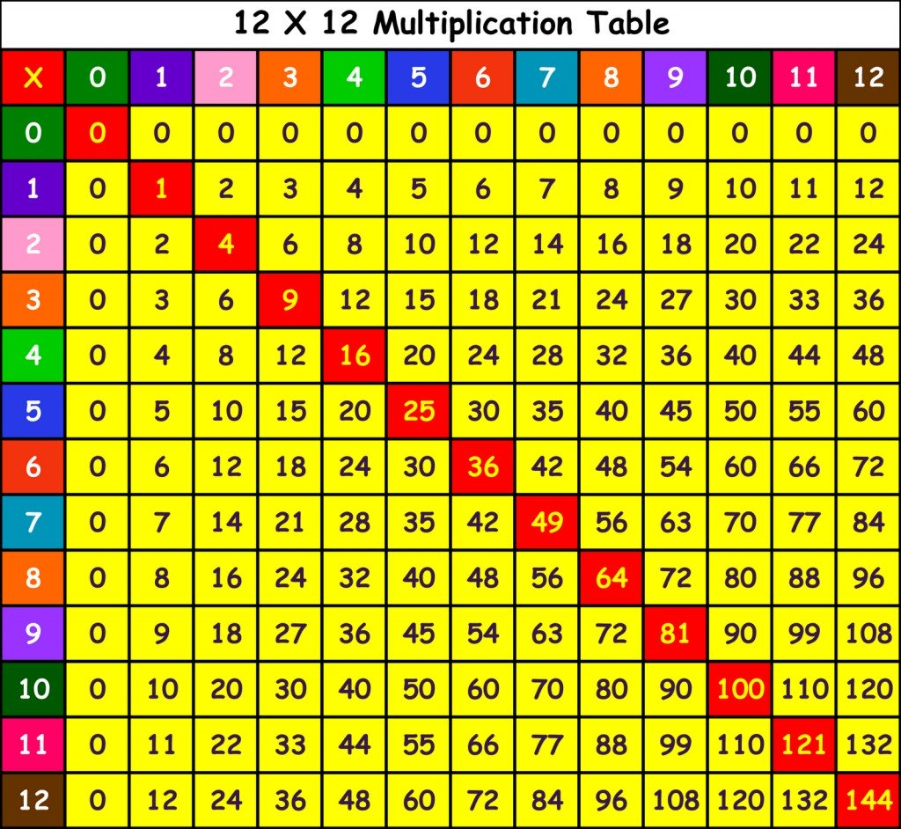
Multiplication facts – X table grid

Slide 9
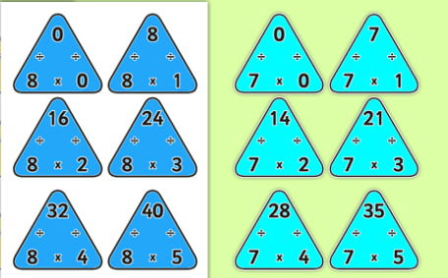
Multiplication triangles – Connecting Division
These triangles show how multiplication and division are connected.
7 x 2 is 14 but also
14 / 2 is 7
This layout can be useful in the topic of ‘Compound Measures’

Slide 10

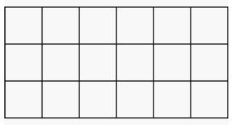
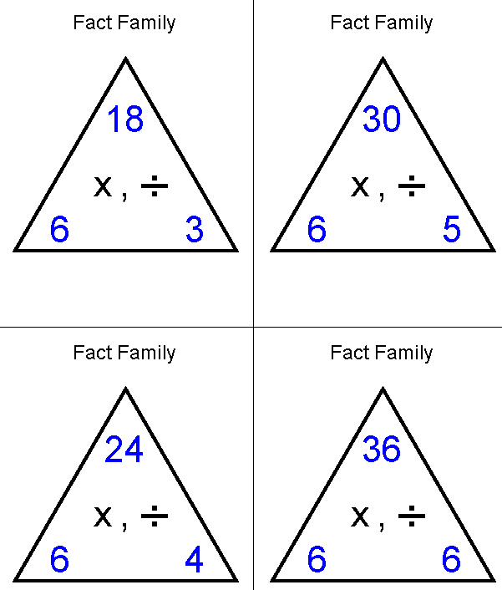
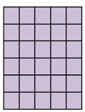
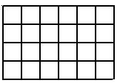
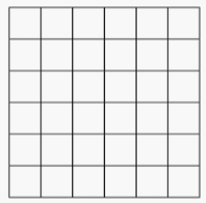
Writing multiplication and division sums
6 x 3 = 18
18 ÷ 3 = 6
18 ÷ 6 = 3
6 x 5 = 30
30 ÷ 6 = 5
30 ÷ 5 = 6
6 x 4 = 24
24 ÷ 6 = 4
24 ÷ 4 = 6
6 x 6 = 36
36 ÷ 6 = 6

Slide 11
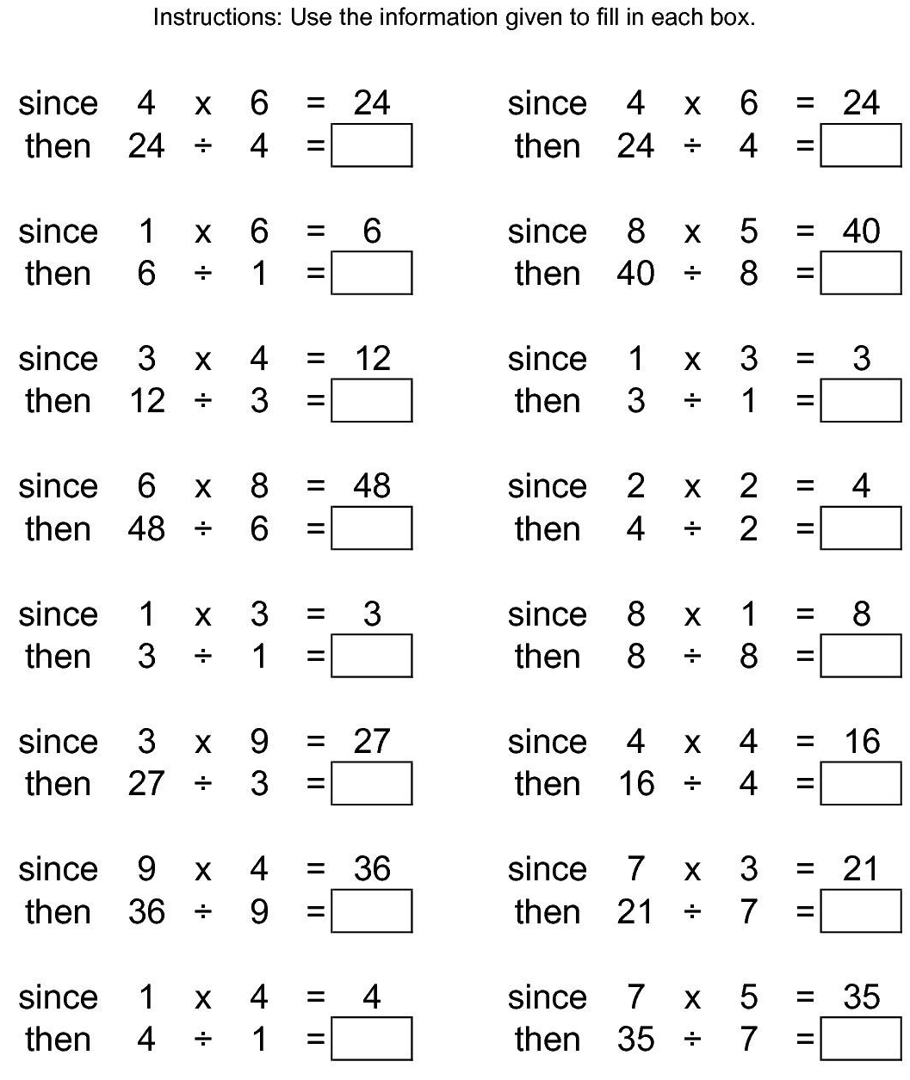
Section C) Practice – writing mult/div sums

Slide 12
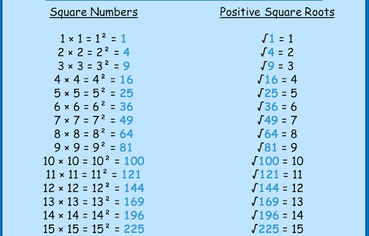
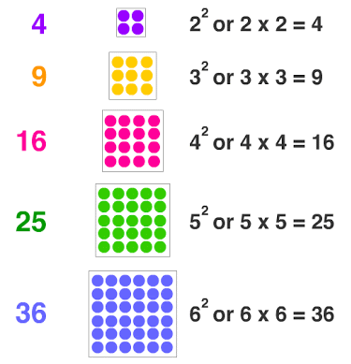
Square numbers and roots of squares

Slide 13
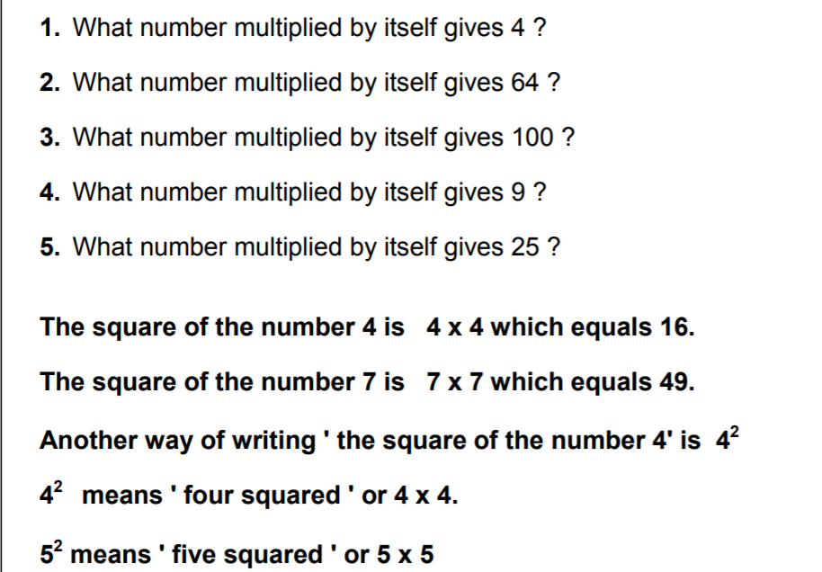
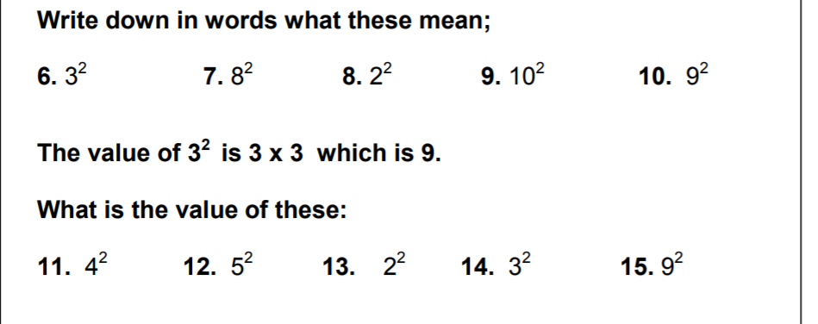
Section D) Practice –Square numbers

Slide 14
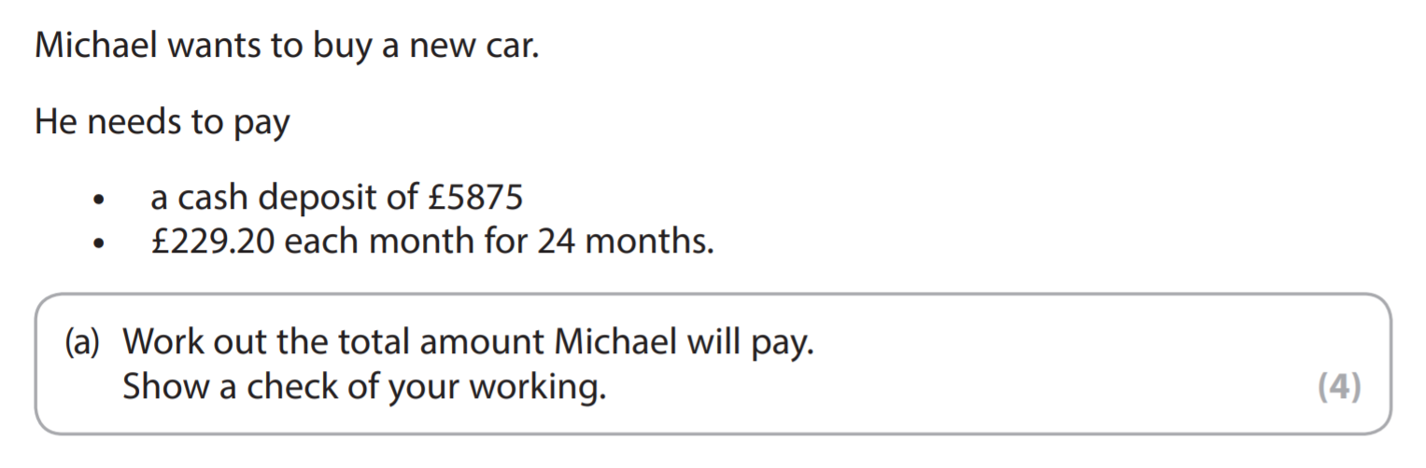
Section E) Exam Style Questions
1)

Slide 15
Section E) Exam Style Questions
2)
a) Calculate 13² (1)

Slide 16
Section E) Exam Style Questions
3)
The table shows new investments received by a company. Each investment will be processed in order of its value, first is the lowest.
Sort the investments in order of size.
Investor A | Investor B | Investor C | Investor D | Investor E
£18,056 | £0.023M | 10 payments of £7,500 | Three hundred thousand pounds | £18.6K

