Slide 1

Algebraic Formulae
Creating and using formulae

Slide 2
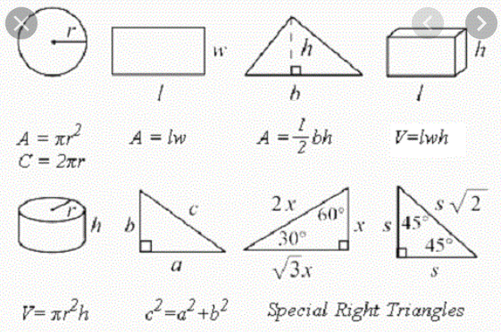
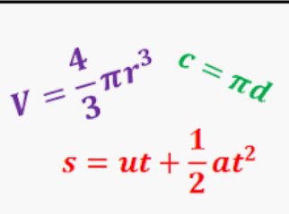
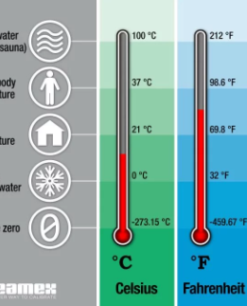

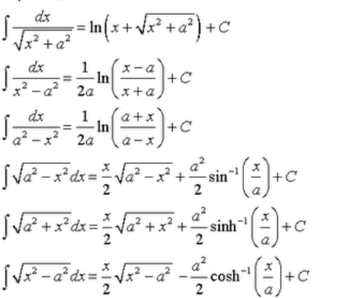



Slide 3
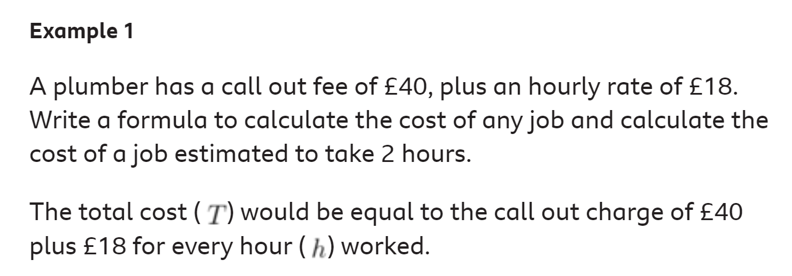


Slide 4

STEP BY STEP
1) Find all the variables and decide on their sign
2) Start with an initial variable and consider the order in which to create the formula
3) Add in all the variables in the correct order
4) Add an equals and a letter for the answer
5) TEST THE FORMULA WITH VALUES

Slide 5

T
H
18
40

Slide 6
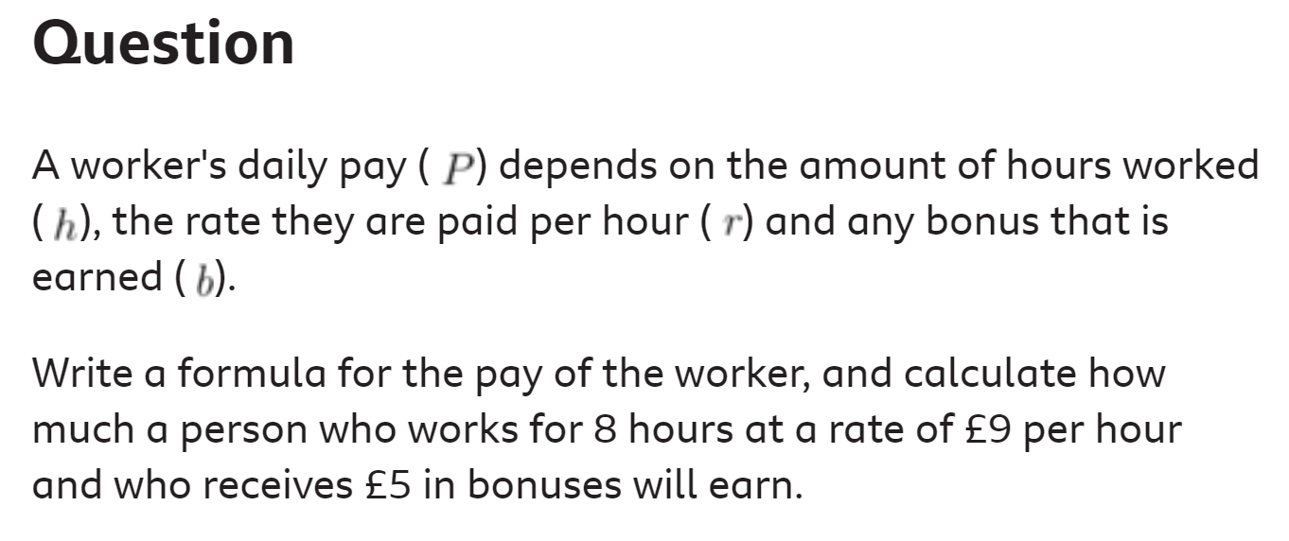


Slide 7
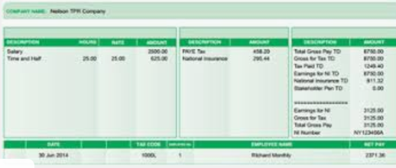

Slide 8


Slide 9

Test Question: ..
Write a formula for totaling the price of C coffees and T teas when adding a 20% VAT charge to find the P price paid

Slide 10
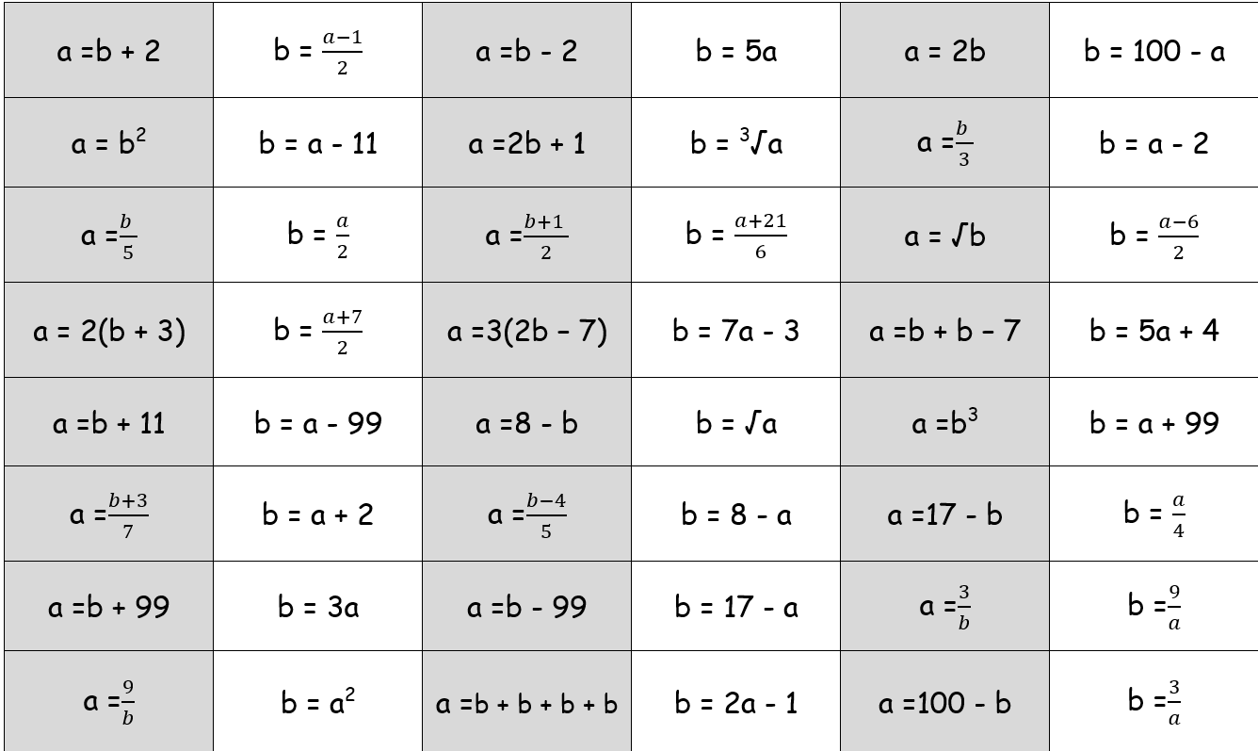

Slide 11

EQUATIONS
Solving Equations

Slide 12

Solving Equations:..
T = I + 24m T=£410 I=£50
Step by Step…
1) Write down the equation
2) Replace anything you know, letters with numbers
3) Must be only one letter the rest numbers
4) Rearrange until the letter is on its own (using +
- x /)
5) Solve by ‘doing the sum’ on one side to reveal the value of the letter

Slide 13
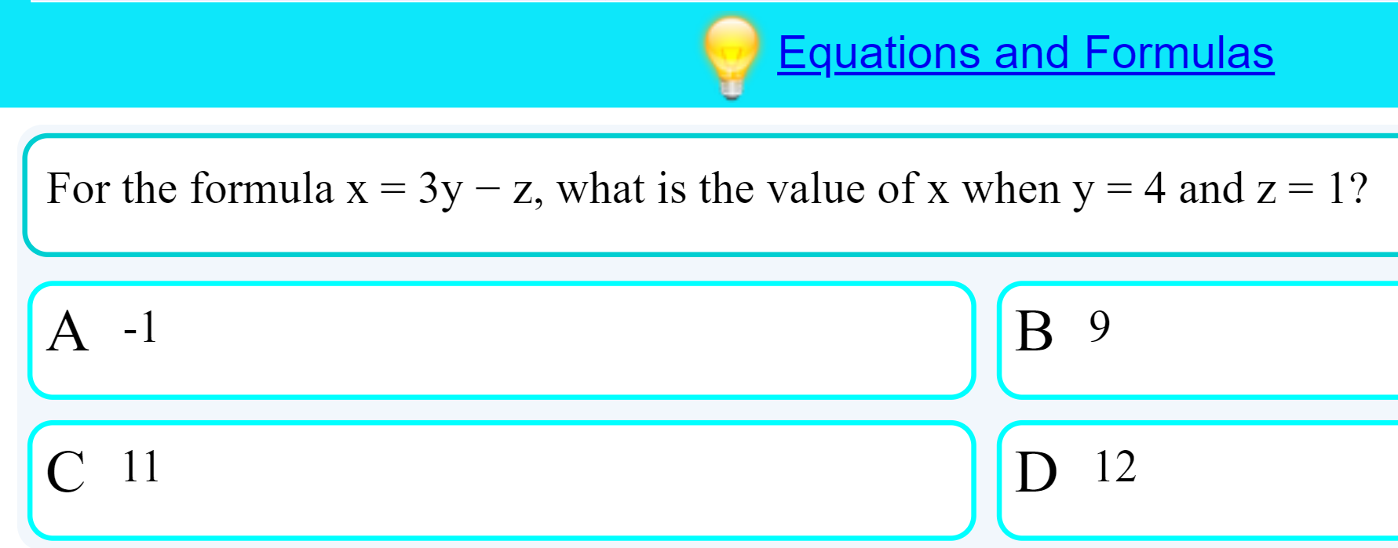

Slide 14
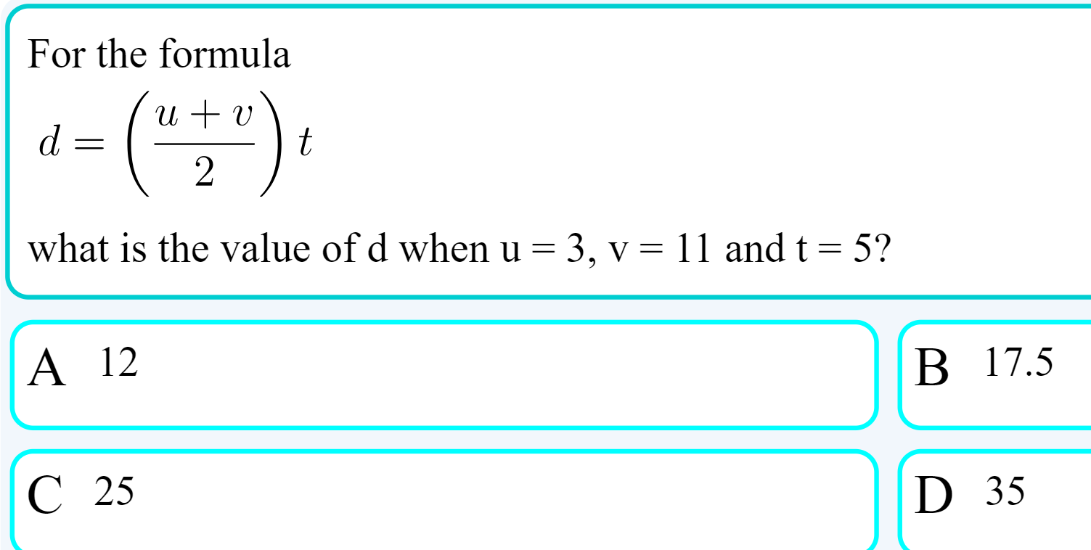

Slide 15
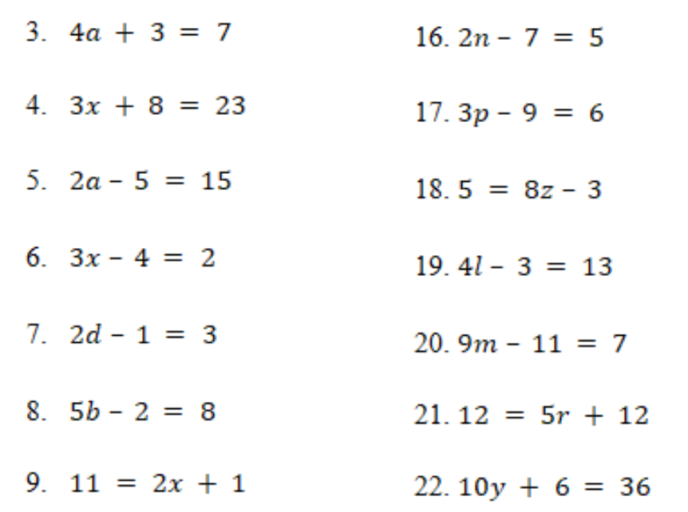
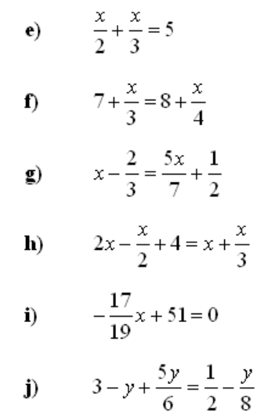
Starters
Further

Slide 16
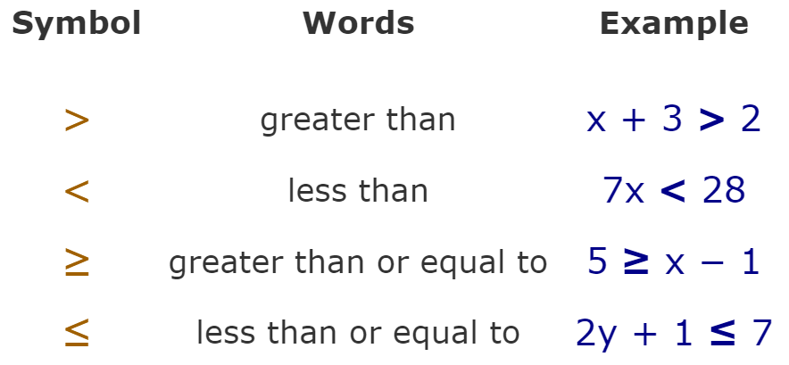

INEQUALITIES - SOLVING

Slide 17
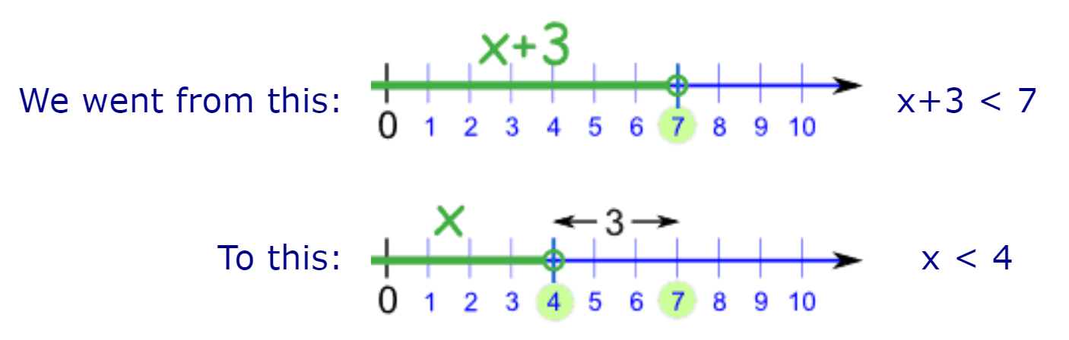

Slide 18
