Slide 1
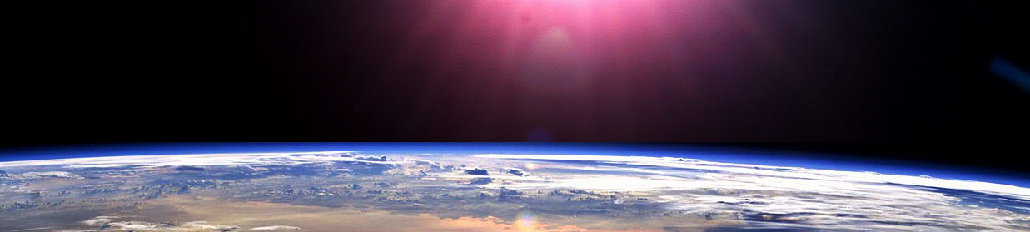
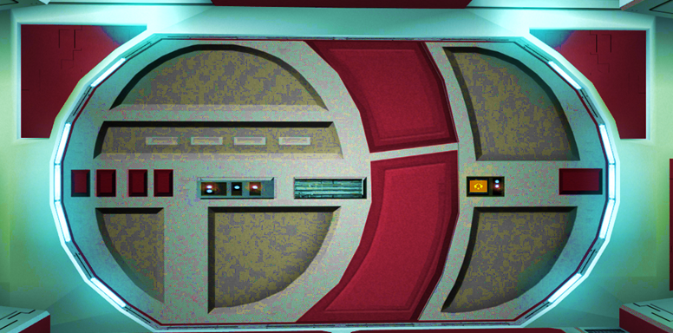


Slide 2

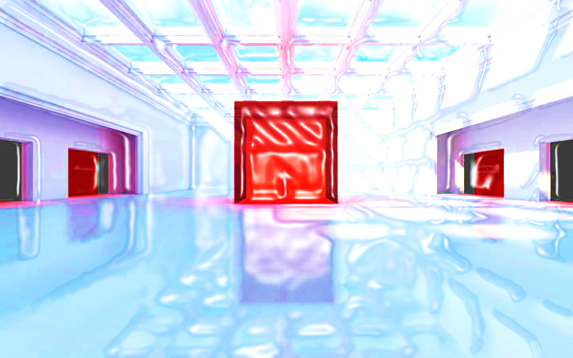
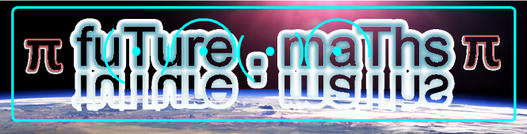
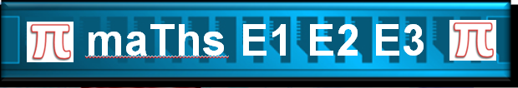



Metric Measurements

Slide 3



















Course Content: Choose your topic …
Whole Number and Functions
place
value
negative
numbers
add and
subtract
multiply
divide
round
numbers
ratio
scale
fraction
decimal
numbers
percent
percent
decimal
fraction
MATHS L1 to L2
Parts of a whole
metric
measure
imperial
measure
perimeter
area
volume
formulae
bodmas
charts
data
averages
prob-
ability
Measure and Shape
Handling Data

Slide 4
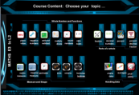




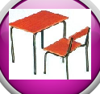






Home Revision Progress Check 1 Video/Discuss Vocab / jobs Lesson Activities Quizzes Topic Answers Progress Check 2 Cont. Learning
Topic Introduction : Metric Measurements
The metric system is the attempt to use science to produce a set of standard units for measurements that people can agree on and use. These new measurement units should replace the old ones that were created over hundreds and thousands of years where civilisations across the world developed and formed their own and different measurement units and equipment based on a large variety of objects and items.
When you have a very large amount or only a tiny fraction of a unit, it can be useful to change the unit to a different one, this keeps the number small or avoids using decimal amounts. To do this you will need to learn a set of Latin prefixes that replace the names of the place values so ensure you check out this topic first!
Choose an icon to select where to start
Metric
Measurements

Slide 5


Warm up Exercise 1
Lets start today by revising ! Complete the above sums and multiplication grid

Slide 6
Warm up Exercise 2
/1000 | /100 | /10 | NUMBER | X10 | X100 | X1000
 |  |  | 365
 |  |  | 2567
 |  |  | 23
 |  |  | 98765
 |  |  | 9
 |  |  | 4.5
 |  |  | 67.4

Slide 7
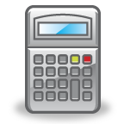
Warm up Exercise 3
Bubble maths
1:3
Calculate the instruction on the central number
-31
x7
17
x100
Round to nearest 10
+34
/5

Slide 8

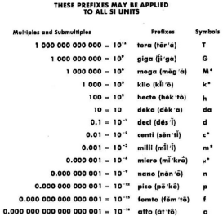
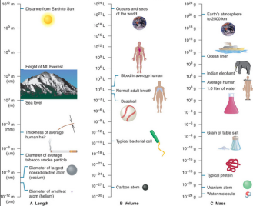
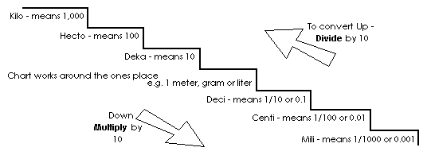
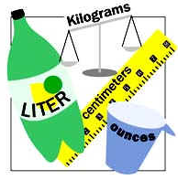
Progress Checker 1
W
What do you already know about Metric Measures ? What did you learn during the week? … examples…
How would you rate your skills in using metric measures?
Excellent ability
Good ability, but working to improve
Ok, making a start but I know I have lots to still learn
The date I started studying : My aims for today ( tick those that apply )
A To recognise the correct metric units for lengths, weights and capacity measurements
B Replace place value names with Latin prefixes
C Convert one metric unit to another to solve practical problems

Slide 9

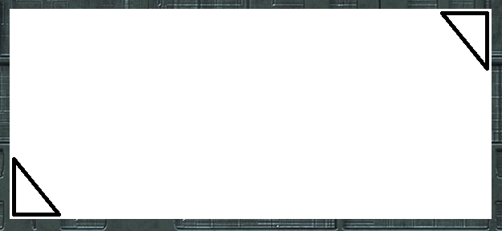
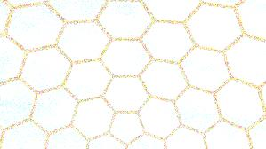
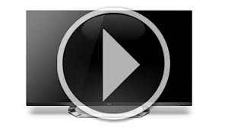
Introductory Video and Discussion
KHTU.
How is the metric system of measure different to other systems ?
Why do we have more than one unit of measure eg. mg, kg
Is there an easy way of converting between different units ?
What is a ‘Conversion table’ and where do you find them ?
What is the largest unit you can think of, or the smallest ?
Do all countries use the metric system ?
Watch the introductory video and then discuss the above
Your thoughts..

Slide 10
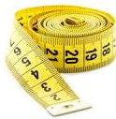
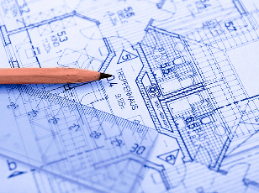
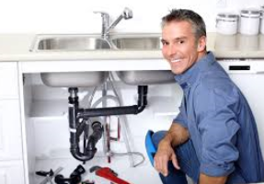
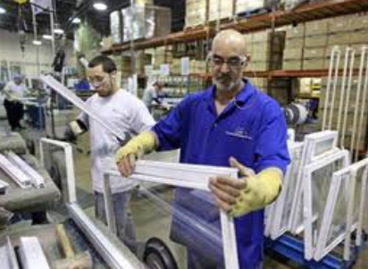
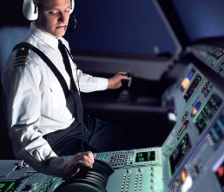

Vocabulary and Jobs
Unit
Deca
Kilo
Milli
Centi
Deci
Litre
Metre
Gram
Convert
Ratio
Measure
Metric
These are the words you will be using in this topic
Builder
Architect
Designer
Plumber
Electrician
Sports
Pilot
Manufacturer
Carpet fitter
…. Can you think of more?
…………………………………
…………………………………

Slide 11
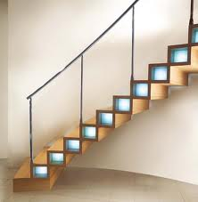
Lesson: Concept Activity
Put seven items on the table in front of you. Use a pen/pencil as your decimal point (position). Now move it in between the objects on the table.
1) What is in front of you? (on your left)
2) What is behind you? (on your right)
3) Which item are you standing next two (the first item to the left of you)
K
H
T
U
1/10
1/100
1/1000

Slide 12
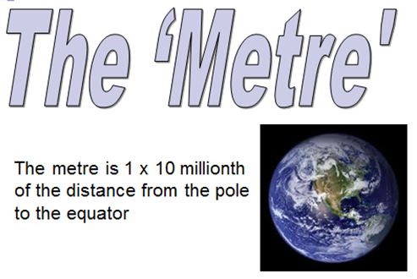
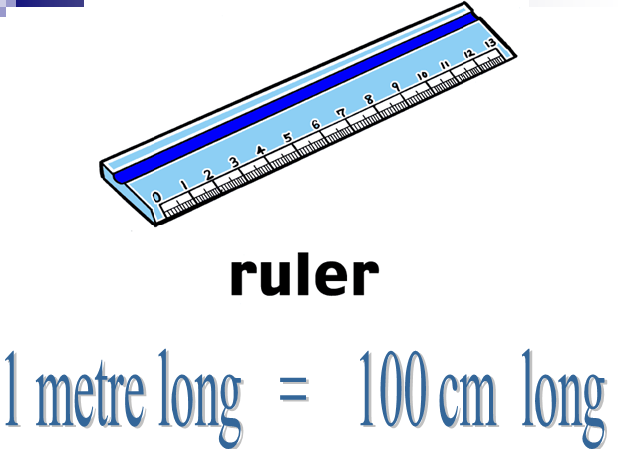
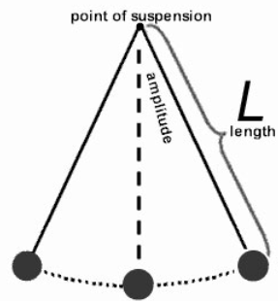
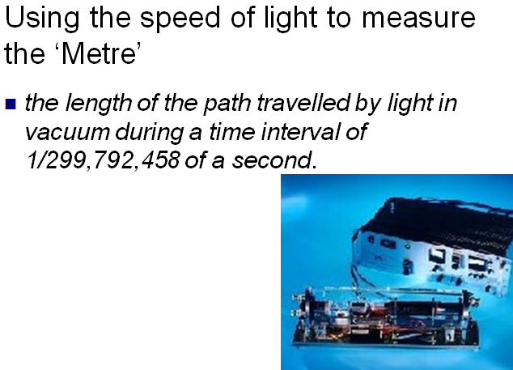
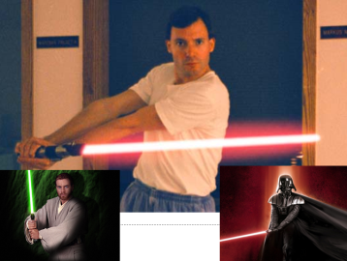
Lesson: Main Teach 1
a
A pendulum that
swings for 1 second in
a single direction has
a one metre length

Slide 13
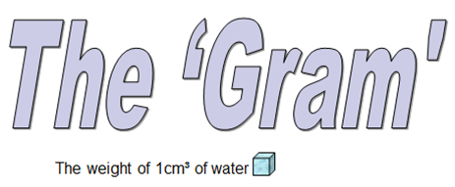
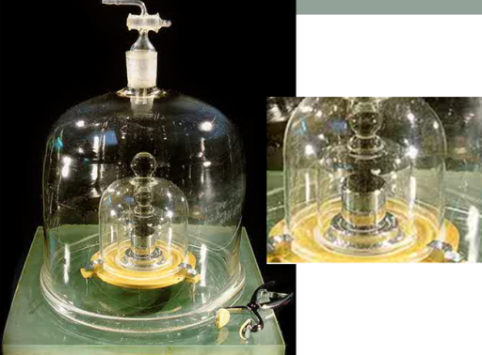
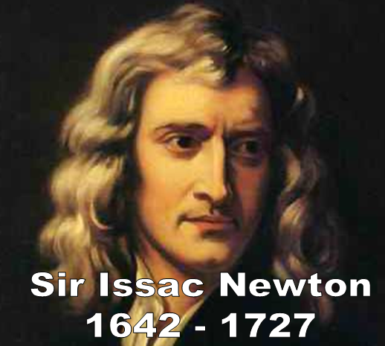
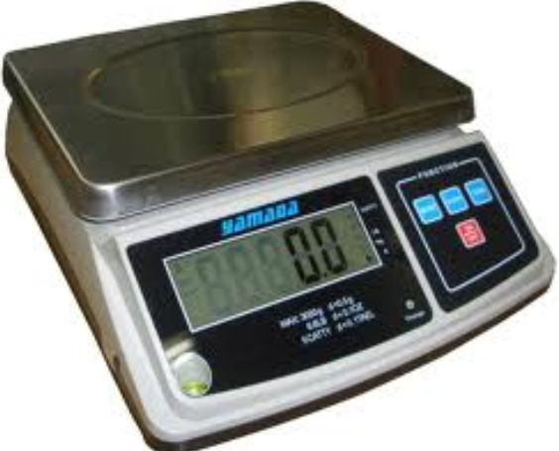
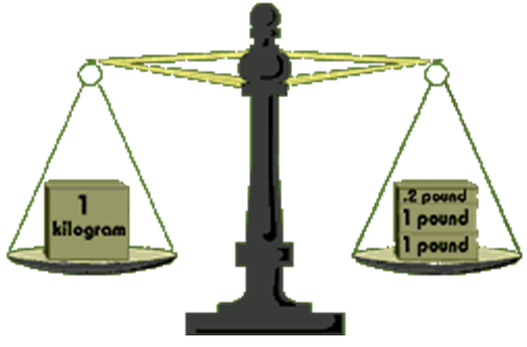
Lesson: Main Teach 2
a
The prototype ‘kilogram’ in
Paris
Discoverer of Gravity and that Mass is attracted to other mass in the universe

Slide 14
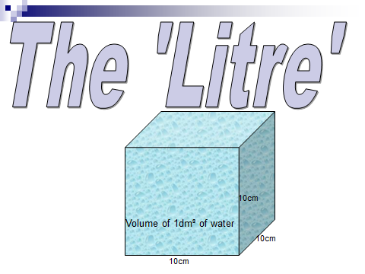
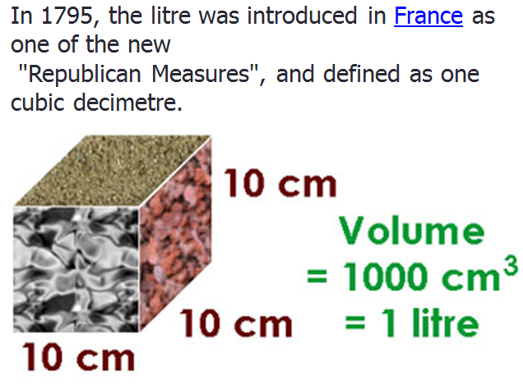
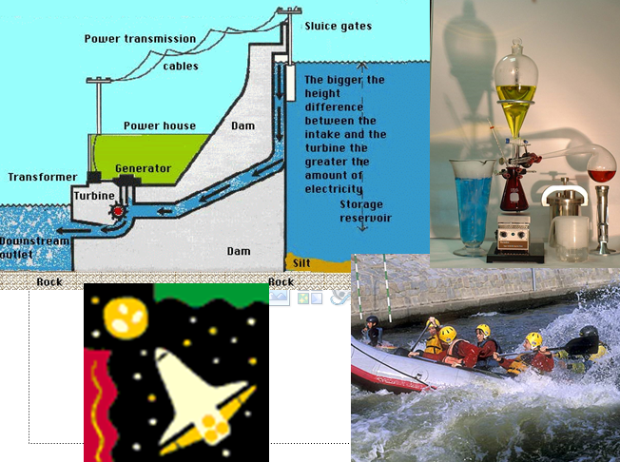
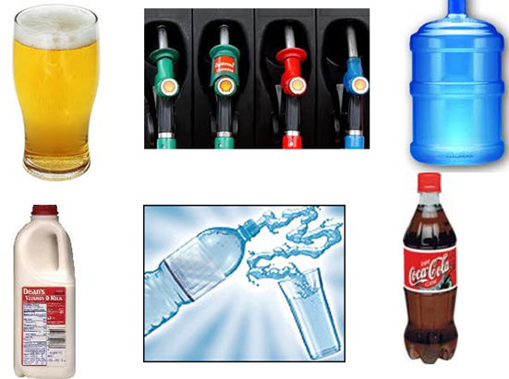
Lesson: Main Teach 3
a

Slide 15
Lesson: Main Teach 4
x1000
x100
x10
x1000
x1000
x1000
x1000

Slide 16

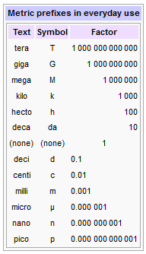
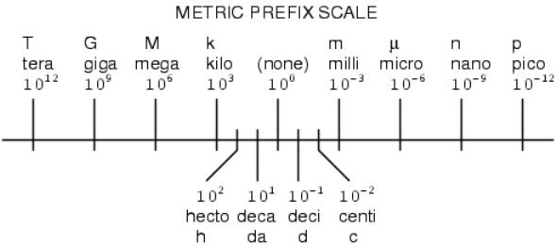
Lesson: Main Teach 5
These are the Latin Prefixes you will need to know and use to be able to convert within the Metric System of Measuring
Do you know any already ??
Where have you heard of them??
Why do we use them??
Which ones are used most commonly??
Level 2

Slide 17
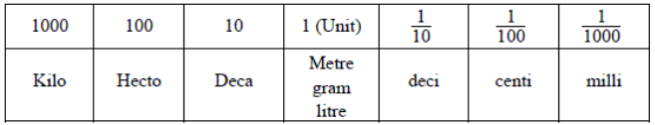


Lesson: Main Teach 6
The Metric System of Measures
thousand
ten
unit
tenth
hundred
hundredth
thousandth
Decimal
point
K
U
Decimals
Lets take what we already know about the names of the ‘Place Values’ and rename each column. We are going to use LATIN to rewrite each column starting with the units column. We then set up a table of the Latin names just like the place value table. When we write in the columns values for how much we have measured we will then be able to move to different columns to read other units very easily.
Latin prefixes
Important learning point: learn the names of each column Kilo, hecto, deca, unit, deci, centi, milli off by heart

Slide 18
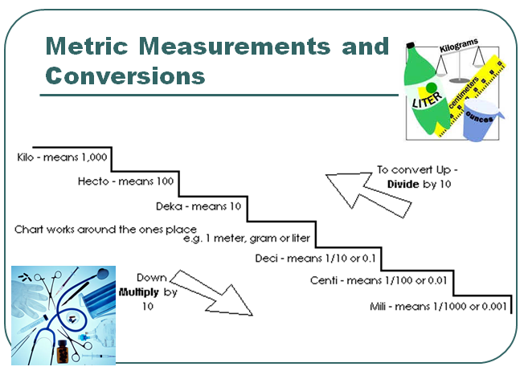
Lesson: Main Teach 7
On the table of metric units left, the unit is either METRE (the standard unit of metric length, GRAM (one of the units for weight) or LITRE (the standard unit of metric capacity). Placing values in different columns shows how many of each unit you have measured. Placing values in more columns means there is more than one way of reading the value
Eg
Lets take the unit to be METRE as we want to measure distance. In the unit column there is a ‘6’. This means we have measured six metres. Great so far…!!
Now, there is a ‘4’ in the tens column. What does that mean??
2
7
4
6
5
9
1
Well, we could say…. Four sets of ten metres + six metres = Forty six metres
Or we could say…. Four DEKA metres + six metres (another way is 4 . 6 Deka metres !)

Slide 19
Lesson: Main Teach 8
Continuing on…
on the left of the 4 and 6 is a 7
what do you have now??
You could say…. 7 4 6 metres
or you could say …. 7 4 . 6 deka metres
or you could say…. 7 . 4 6 hecto metres
I just depends on which STEP you are standing on !!
2
7
4
6
5
9
1
How many Kilo metres are there ??
Well….. on the km STEP there is a 2, great so we have 2 km……. but……. we also have all the other values on the right
So we actually have ….. 2 . 7 4 6 5 9 1 km

Slide 20
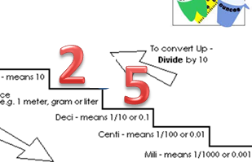
Lesson: Main Teach 9
Its all about moving a decimal point !
Here we have two and a half metres or 2.5 m
We want to change this to centimetres
Step 1) Set up the table of units to include the one you have (ie metres) and the one you want to move to (ie centimetres)
Step 2) Move the decimal point off the starting step (here it starts on the METRE step) and move it so it is next to and immediately on the right of the new unit (here it moves to CENTIMETRE)
Step 3) Read off you new value looking to the left and right of the decimal point inserting any ZEROS you need on empty place values
THAT’S IT YOU’RE DONE !!
2
5

Slide 21
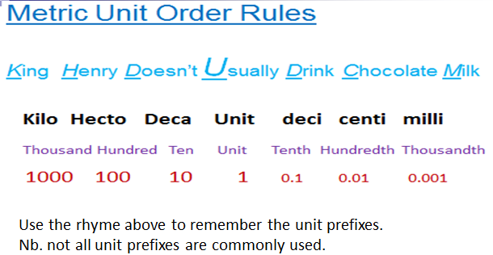
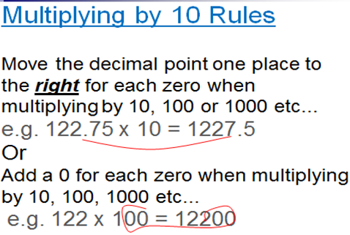
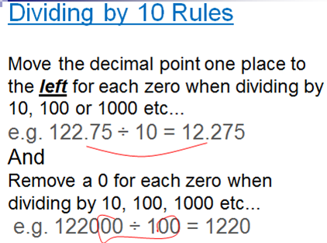
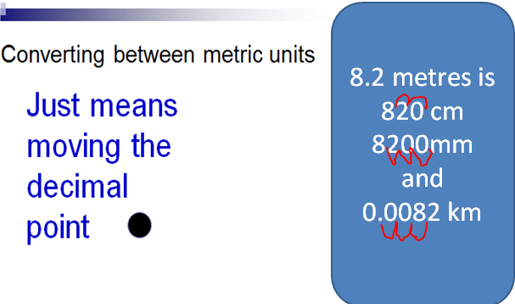
Lesson: Helpful Hints

Slide 22
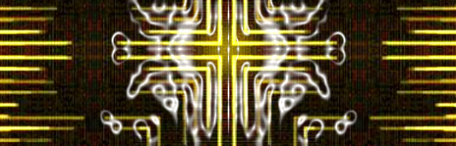
Lesson: Try out
Block 1 : Watch tutor led demo (in class or on video)
Try these, 1) Which is bigger? Kilometres or Millimetres 2) Which is smaller? Centilitres or Litres 3) Kilogram is a measure of capacity / length / weight ? 4) 1/1000 is …… Centi / Kilo / Milli
Block 2 : Watch tutor led demo (in class or on video)
Try these, 5) How many mg in a gram? 6) How many mm in a centimetre?
100cm = ………….. M 8) 1000m = ……………… KM 9) 1 Kg = ………………….. g 10) 1 L = ……………………. ml
convert 165g to kg 12) convert 0.55 litres into ml 13) convert 3.78 km into metres
Block 3 : Watch tutor led demo (in class or on video)
Try these, 14) convert 14 decimetres into cm 15) convert 0.23 hectograms into centigrams
16) convert 0.0406 km into mm 17) convert 0.00708 KL into ml

Slide 23
Lesson: Websites and links
A metric conversion website with online conversion formulae
http://www.metric-conversions.org/
A metric conversion website with tables and charts
http://convert.french-property.co.uk/
https://www.khanacademy.org/math/arithmetic/rates-and-ratios/metric-system-tutorial/v/conversion-between-metric-units
A video showing conversions between units
A webpage explaining how to move the decimal point to convert units
http://www.purplemath.com/modules/metric.htm
A game of speed matching two measures with the same value but different units
http://www.sheppardsoftware.com/mathgames/measurement/MeasurementMeters.htm
A you tube video with powerpoint presentation showing basics and conversions
http://www.youtube.com/watch?v=UyDMwnkeAwQ
Online posting a parcel game, measure the length and weight then read the table of prices
http://www.bbc.co.uk/schools/teachers/ks2_activities/maths/measures.shtml

Slide 24
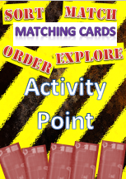
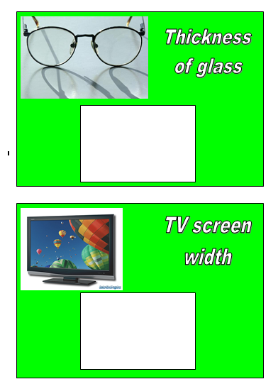
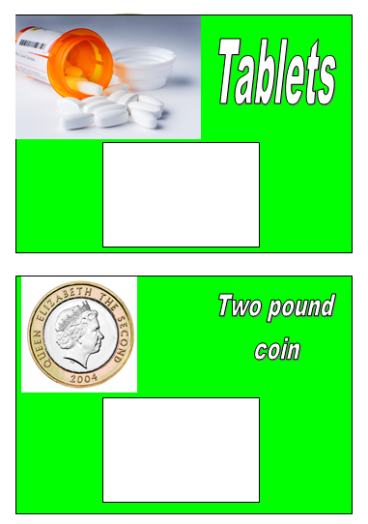
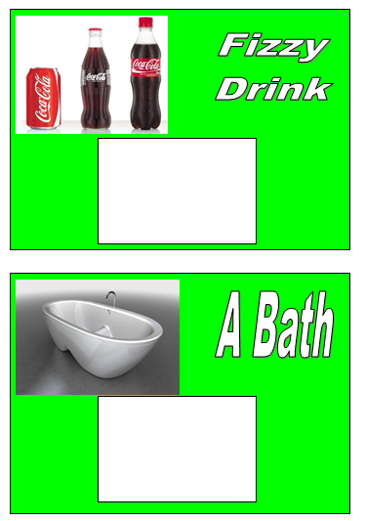
Lesson: Activity A – Matching cards
Match the cards to a value and unit
Write the values in a metric table
Convert each value to another more sensible unit !
Extension: Why would we change the units we use ??

Slide 25
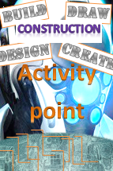

Lesson: Activity B – Build & Design
Pair up or in small groups help each other to take the measurements or look up on the computer. Afterwards, convert your measures into another sensible unit.

Slide 26




Lesson: Activity C - Compute
Computer based activity - create a metric conversion table using columns in a spreadsheet .
Use your metric table to help solve the problems in this book or activities during the session
Extension: can you create formulae that would convert one unit to another ??

Slide 27


Lesson: Activity D - Discussion
d
1)Take discussion cards
2) Discuss the questions asked
3) Find answers
4) Record learning for feedback

Slide 28






Lesson: Activity E - Game
Puzzle!!
Have a go creating
the metric table
from the puzzle
Pieces
Solve the tarsia
puzzle…!

Slide 29

Lesson: Activity E
Try a variety of written practice
Worksheets
Workbooks
Practice Exam Papers
Maths Problems

Slide 30
Lesson: Practice – just the numbers
Circle the largest unit
Kilogram, milligram
Centimetre, KM
Gram, KG
Millilitre, KL
Convert these lengths
30cm to ………..m
13mm to ………..cm
0.4m to ………….cm
14m to ……………km
0.56cm to …………….mm
0.1km to …………..cm
Convert these weights
11) 457g to ………….kg
900mg to …………..g
0.72 kg to ……………g
143mg to ……………g
250g to ………………kg
Convert these capacities
540 ml to ……………… L
0.28 KL to …………….. L
890 ml to …………….. L
5.49 L to ………………. ml
0.04 L to ………………. ml
Convert these measures
210g to ……………… hg
45 kg to ……………….. Mega grams
0.7 decimetres to …………. cm
1/8 litres to …………… ml
0.00463 Gigametres to …… km
Complete the sums
6 x 250 m = ………….. km
9 x 4 cm = …………… mm
7 x 390 g = …………….. kg
5 x 900 ml = ……….. L
Complete these sums
300 cm + 1200 cm = ……………… m
0.9 L – 600 ml = ………………. ml
2.4 km – 1800 m = …………………. km
5 g – 3400 mg = …………………… mg
840 ml + 0.2 L = …………………. cl
Complete these sums
0.2 kg / 4 = ……………………… grams
2.5 L / 5 = …………………….. ml
700 cm / 0.35 m =
120 mg / 0.06 g =
1,284,309 km / 1000 = ……….. m
Round the following measures
45.328m to nearest 10 cm
1.5459 kg to the nearest gram
0.9354 ml to 2dps
14.7 mm to the nearest cm

Slide 31
Lesson: Practice – word problems
Eight laps of a 400m race track is to be run. What is the total distance of the race in km ?
Rainfall fills a lake and makes it rise half a centimetre. Before the rainfall the lake had a reading on a flooding scale of 45mm, what is the new reading after the rainfall?
To check whether a Christmas tree will fit in a space, the height is measured. The tree is 180cm tall, but the gap was measured in metres as 1.95m. Will the tree fit in the gap ?
How many 450ml drinks can be made from a 2.5 litre bottle?
I want to add 375 g to my suitcase that already weighs 8.4kg. The weight limit I am allowed to carry on a plane trip is 10kg. Will I be able to add the extra weight to my suitcase?
A ton is 1000kg. A lorry is weighed in at 1.84 tons but should be no more than 1.5 tons. How many kilograms needs to be removed from the lorry to ensure it is not overweight?
A swimming pool has 600 kilolitres in it. Chlorine is to be added in the ratio that for every 1000 litre of swimming pool water you need 1 ml of chlorine. How many litres of water is in the swimming pool? How much chlorine needs to be added?

Slide 32

Lesson: Practice – Making it Functional 1
BB

Slide 33


Lesson: Practice – Making it Functional 2
Use the information on the previous page
a

Slide 34


Lesson: Practice – Making it Functional 2
Use the information on previous pages
a

Slide 35


End of Session Quiz LEVEL 1

Slide 36


End of Session Quiz LEVEL 2

Slide 37


TOPIC ANSWERS 1
Block 1 answers
1 kilometres
2 centilitres
Weight
Milli
Block 2 answers
Giga
Micro
1 M
1 km
1000g
1000ml
0.165 kg
550ml
3780m
Block 3 answers
140cm
2300cg
40,600mm
7,080ml
Just the numbers answers
Circle the largest unit
Kilogram
KM
KG
KL
Convert these lengths
0.3 m
1.3 cm
40 cm
0.014 km
5.6 mm
10000 cm
Convert these weights
11) 0.457 kg
0.9 g
720 g
0.143 g
0.25 kg
Convert these capacities
0.54 L
280 L
0.89 L
5490 ml
40 ml
Convert these measures
2.1 hg
0.045 Mega grams
7 cm
125 ml
4630 km
Complete the sums
1.5 km
360 mm
2.73 kg
4.5 L
Complete these sums
15 m
300 ml
0.6 km
1600 mg
104 cl
Complete these sums
50 grams
500 ml
20
2
1,284,309 m
Round the following measures
45.33 m
1.546 kg
0.94 ml
10 mm

Slide 38


TOPIC ANSWERS 2
Work problems Answers
3.2 km
50mm
Yes
5
Yes
340kg
600,000 litres
0.1 litres of chlorine

Slide 39
TOPIC ANSWERS – tutor quiz answers
Level One Quiz Answers
570 cm
10,400 g
29,400 m
400 cm
5.49 cm
0.15 km
200 mg
1000 litres
1.5 m
1.75 km
Level Two Quiz Answers
458,000cm
0.112 km
Giga, Mega Hecto, Deka, Centi, Micro
Kilometre
Microlitre
7328042.9mg
56.1mm
7.249035 kg
7,249.035 g
7,249,035,000 micrograms

Slide 40
Progress Checker 2
W
What do you already now know about Metric Measures ? What did you learn during the session? … examples…
How would you now rate your skills in using metric measures?
Excellent ability
Good ability, but working to improve
Ok, making a start but I know I have lots to still learn
The date I finished studying : Aims I achieved ( tick those that apply )
A To recognise the correct metric units for lengths, weights and capacity measurements
B Replace place value names with Latin prefixes
C Convert one metric unit to another to solve practical problems

Slide 41


Continuing to Study and Learn
What else can you do to help yourself to learn and practice? Here are ten suggestions, record which you do each week and also record your progress.
Internet websites
Repeat the lesson, make notes, organise a folder, revise
Own maths workbook
Study together with a friend or family member
Finish activities in this book
Complete class handouts or tasks
Practice exams / past papers
Use maths skills learnt at home or at work in real situations
Play games
Experiment yourself, try new things ask yourself questions
Try making a graph of number of practice methods you use against your progress score in each topic. Are you showing more practice gives better results?

