Slide 1

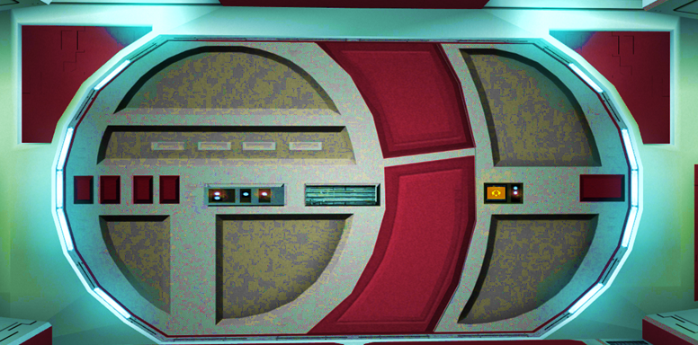


Slide 2

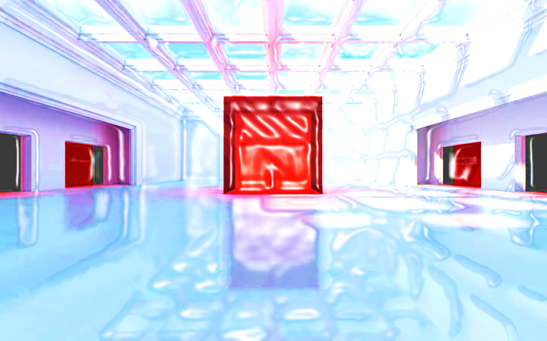





PERIMETERS OF 2D SHAPES

Slide 3



















Course Content: Choose your topic …
Whole Number and Functions
place
value
negative
numbers
add and
subtract
multiply
divide
round
numbers
ratio
scale
fraction
decimal
numbers
percent
percent
decimal
fraction
MATHS L1 to L2
Parts of a whole
metric
measure
imperial
measure
perimeter
area
volume
formulae
bodmas
charts
data
averages
prob-
ability
Measure and Shape
Handling Data

Slide 4





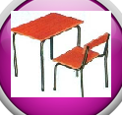





Home Revision Progress Check 1 Video/Discuss Vocab / jobs Lesson Activities Quizzes Topic Answers Progress Check 2 Cont. Learning
Topic Introduction : Perimeter
A perimeter measurement is a length around the outside edge of a shape, therefore make sure you have already studied the measurement topics before this one!
Easy perimeter lengths can be found if the edges of the shape you are measuring around have straight sides such as with squares and rectangles. There is more of a challenge when dealing with perimeters of curved edges such as circles. This is the first topic that introduces ‘Formula’, an excellent tool in maths like a set of instructions to follow that guides you in how to solve a problem.
You will also be introduced to a new maths symbol called ‘Pi’ which is used in the formulas to finding circular perimeters.
Choose an icon to select where to start
PERIMETER

Slide 5

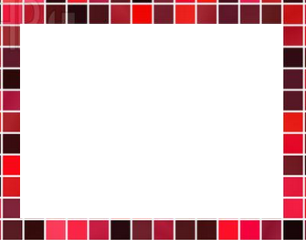

Warm up Exercise 1
Lets start today by revising ! Complete the above sums and multiplication grid

Slide 6

Warm up Exercise 2
Calculate the instruction on the central number
Bubble maths
3:5
-7.06
+37.8
693
Round to nearest 100
X0.7
/0.9
/100

Slide 7
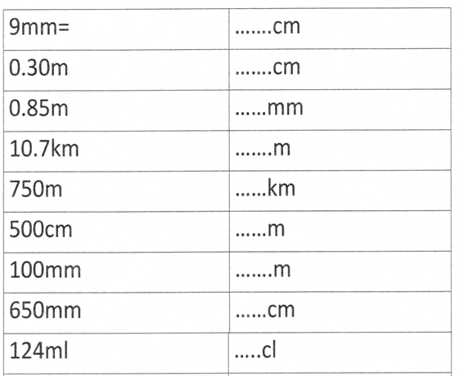

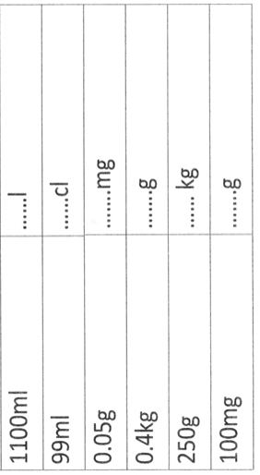
Warm up Exercise 3

Slide 8

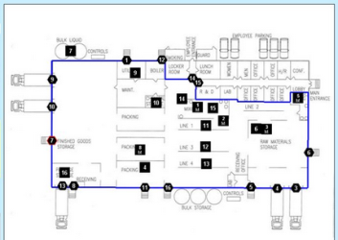
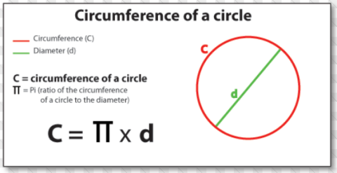
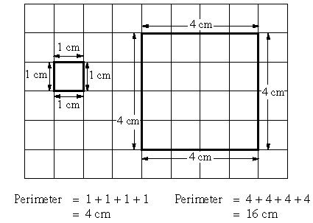
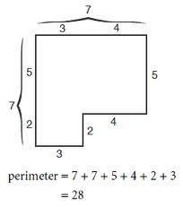
Progress Checker 1
W
What do you already know about Perimeters of 2D shapes ? What did you learn during the week?.. Show examples…
How would you rate your skills in Perimeters of 2D shapes ?
Excellent ability
Good ability, but working to improve
Ok, making a start but I know I have lots to still learn
The date is started studying this topic is: my aims of today’s session are (tick)…
A To find the perimeters of simple square and rectangular shapes (level 1)
B Find the perimeter (circumference) of a circle (level 2)
C Use perimeter formulae to solve practice problems

Slide 9

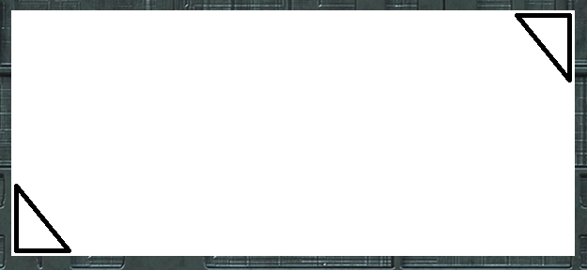
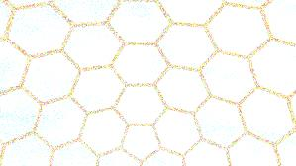

Introductory Video and Discussion
KHTU.
What is a perimeter measurement ?
Can you use both the Imperial and Metric systems to find perimeters ?
Are there any 2D shapes you cannot find a perimeter measurement of ?
Who would require the measurement of a perimeter and why ?
Which shapes are more difficult to find perimeters for ?
Can you find a perimeter of a 3D object ?
Watch the introductory video and then discuss the above
Your thoughts..

Slide 10

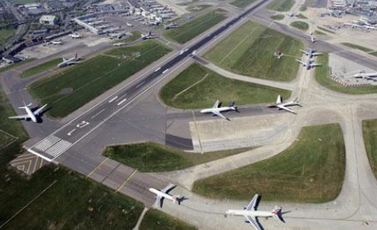
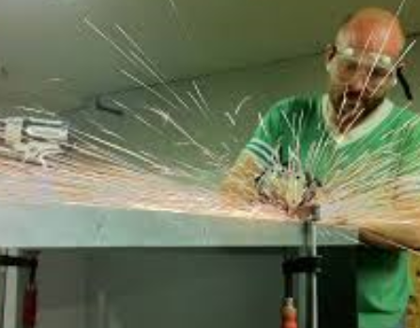



Vocabulary and Jobs
Perimeter
Total
Measure
Ruler
Distance
Enclose
Outside Edge
Surround
Add
Formula
Circumference
1 Dimension (linear)
Plane
These are the words you will be using in this topic
Builders
Police
Sports Arena
Airport
Architect/Planner
Gardener
Computer Game Designer
Road worker
Metal worker
…. Can you think of more?
…………………………………
…………………………………

Slide 11
Lesson: Concept Activity
Take a number of perimeter strips and build shapes using them.
Using the numbered lengths on the strips, can you work out the perimeters of the shapes you have built?
2
5
5
2
3
5

Slide 12
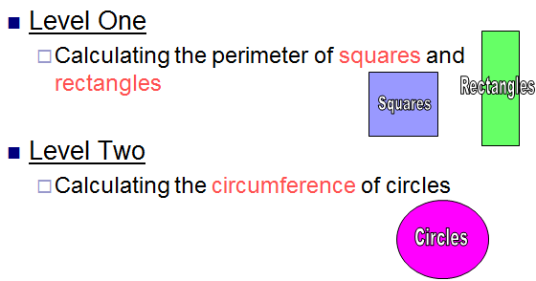

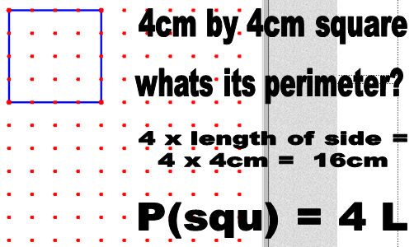
Lesson: Main Teach 1
To find the perimeter of a square..
Measure then add up all four
lengths around the outside edge of
the square
Put the unit you have used on the end of the number found
That’s it!!

Slide 13

Lesson: Main Teach 2
Perimeter of a square examples…
…. a square garden has a length of 13.8metres, how much fencing is needed to enclose the whole garden?
Answer…. as a square has 4 EQUAL sides, multiply one of the sides by 4.
so…. 13.8 metres x 4 = 55.2 m
The perimeter of the garden is 55.2 metres long !
… 52cm of ribbon is used to wrap a cube shaped present. The ribbon is tied around 4 sides, what is the length of ribbon on each side?
Answer…. this time we know the perimeter but want the length …. so divide the perimeter between the 4 sides… 52cm / 4 = 13cm
To find the perimeter of a square..
Measure then add up all four
lengths around the outside edge of
the square
Put the unit you have used on the end of the number found
That’s it!!
remember !

Slide 14
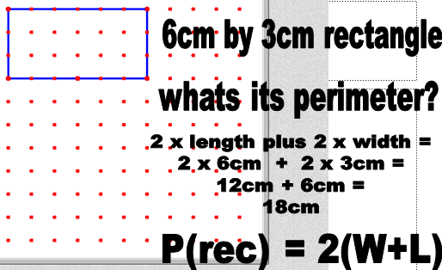

Lesson: Main Teach 3
To find the perimeter of a rectangles..
Measure then add up the two lengths and then the two widths of the rectangle
Add up all the lengths and widths together
The total of the four measurements is the Perimeter
That’s it!!
P = Perimeter
W = width
L = length
/ = divide
( ) = do this bit first !!

Slide 15
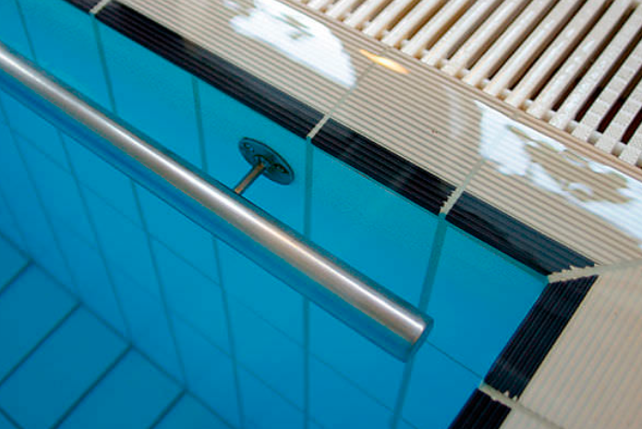
Lesson: Main Teach 4
Perimeter of a rectangles examples…
…. A rectangular swimming pool needs a hand rail around the outside edge. The pool is 20m long by 7m wide. How much hand rail is required?
Answer… add together two of the lengths then two of the widths.. 20+20+7+7 = 54m
… A rectangular plot of land is to be used for a building site and safety fencing to be placed around the outside edge. The land needs to be 250m long. There is 660m of fencing currently available. How wide can the plot of land be?
Answer… here we know the perimeter and need the width… so… 660 = 250+250+?+?
660-250-250 = ?+?, 160 = 2 x ?, 80 = W
L
W
W
L

Slide 16
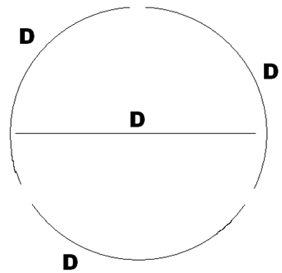
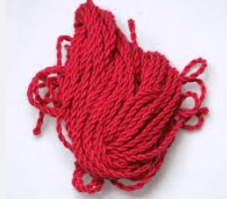
Lesson: Main Teach 5
Perimeter (Circumference) of Circles…
To find the distance around the outside edge
of a circle you cannot simply put a ruler on its
edge and add up !!
You need something like string and place it
round so it can be bent.
If you do this you will find that the total length
around the outside edge is about 3 x the length
of the distance across the middle of the circle.
The distance across the middle of a circle is called the DIAMETER.
So approximately Circumference = 3 x Diameter
try it yourself !!

Slide 17
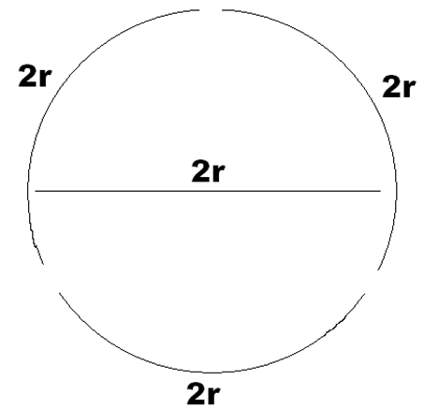
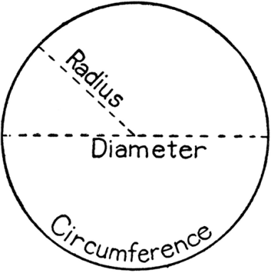

Lesson: Main Teach 6
Perimeter (Circumference) of Circles…
Another way of writing C=3xD is….
The diameter can also be seen to be double the distance from the centre of a circle to its edge
Diameter is 2 x RADIUS Radius = distance from middle of the circle to its edge
Therefore the circumference can also be found by saying C = 3 x 2 x r
2 x r is just the same as saying DIAMETER so the formulae are the same really !!

Slide 18
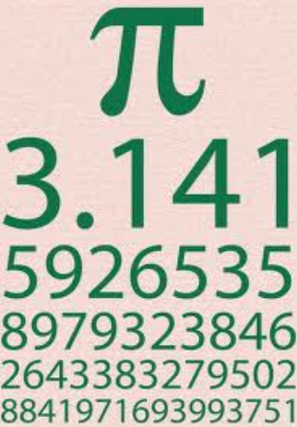
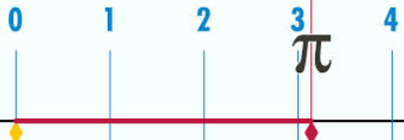
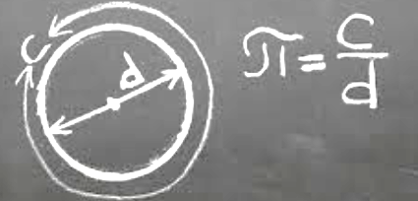
Lesson: Main Teach 7
Perimeter (Circumference) of Circles…
A more accurate measurement of the circumference of a circle can be found if you use a special number called PI ( this has he symbol π )
This replaces just the number 3 in the formula with 3.1 or 3.14 or 3.141 and on … adding more decimals and more accuracy in the calculation
This comes from the fact that 3 x diameter is not quite enough to find the whole distance around a circle and you need just a bit over 3 x to get all the way round
So the new formula we now have for finding circumferences of circles is C = π D
or C = 2 π r

Slide 19
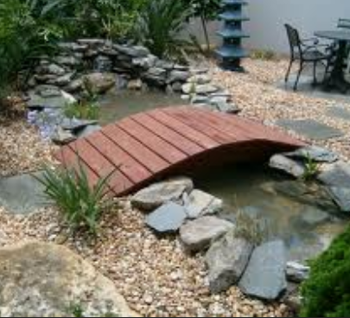
Lesson: Main Teach 8
Perimeter (Circumference) of Circles…
Examples..
I drive my car around a large, circular roundabout. The distance to the middle is 15m. How far is a complete circuit around the roundabout ?
Answer… using C = 2 π r, C = 2 x 3.14 x 15
C = 6.28 x 15, C = 94.2m
A small bridge crosses a pond through its middle. If the bridge is 7 feet long, how far is it all the way round the pond?
Answer… using C = π D, C = 3.14 x 7, C = 21.98 feet
C=3.14D
C=6.28r

Slide 20
Lesson: Try out
Block 1 : Watch tutor led demo (in class or on video) w=width, L=length, P=perimeter, C=circumference
Try these, 1) Square length 6m, Perimeter= ? 2) Rectangle with width 7m and length 8m, P = ?
3) 3 + 2 + 3 + 2 = ? 4) triangle with all sides 19cm long, P = ?
Block 2 : Watch tutor led demo (in class or on video)
Try these, 5) Perimeter of a square is 45m, L = ? 6) P = ?
7) P = ?
8) 4 + w + 4 + w = 12, w = ?
Block 3 : Watch tutor led demo (in class or on video)
Try these, 9) Circumference of a circle with radius 8m = ? 10) 2 π r = 31.4, r = ?
11) Diameter of a circle with circumference 9 ft = ? 12) Rearrange so P is the subject
8P – 2(3P) = π x
2cm
0.8cm
1.6 m
3 m
2 m
4 m

Slide 21
Lesson: Websites and links
http://en.wikipedia.org/wiki/File:Pi-unrolled-720.gif
shows why a circles length is 3x diameter
Perimeter shapes questions
http://www.cyram.org/Projects/perimetergame/
Perimeter website with formulae
http://www.mathsisfun.com/geometry/perimeter.html
Perimeter (and Area) website with how to guide and worked examples and questions
http://www.bgfl.org/custom/resources_ftp/client_ftp/ks2/maths/perimeter_and_area/index.html
A video to show how to find the circumference of a circle
http://video.about.com/math/How-to-Find-the-Perimeter-of-a-Circle.htm
Applet to explore circles, circumferences related to their radius
http://www.mathwarehouse.com/geometry/circle/interactive-circumference.php
A challenging perimeter problem
http://nrich.maths.org/7283
Short easy Squares and Rectangles intro
http://www.youtube.com/watch?v=DWM6TBCNAWg

Slide 22
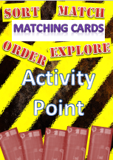


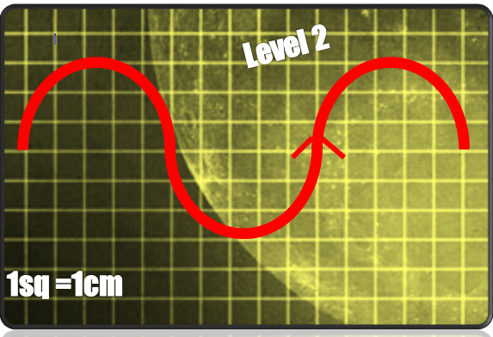
Lesson: Activity A – Match/Sort
Perimeter Match !
Match the computer terminals to the perimeter answers
Match the formulae when appropriate

Slide 23
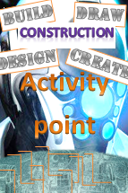



Lesson: Activity B – Build/Design
Pair Up
Choose A Perimeter To Draw And Game Board
Take A White Board Each And Pen
Both Draw Your Chosen Shape, Writing Relevant Measurement On It In The Correct Places
Pass You Board To The Other Player
Find The Perimeter Of The Shape Before The Other Player To Win A Point
Move Your Playing Piece Up The Formula Game Board
First To Get To The End Of The Game Board WINS !!

Slide 24

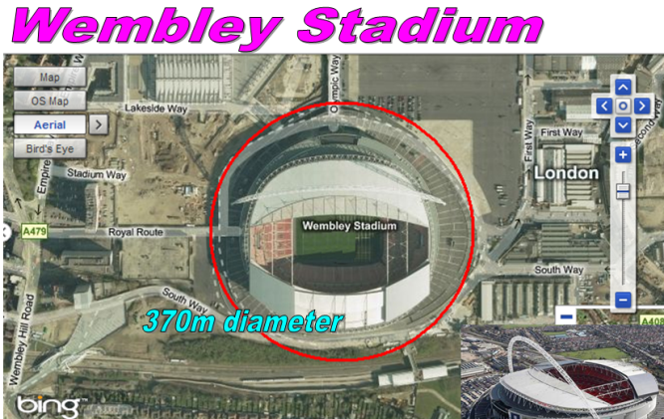
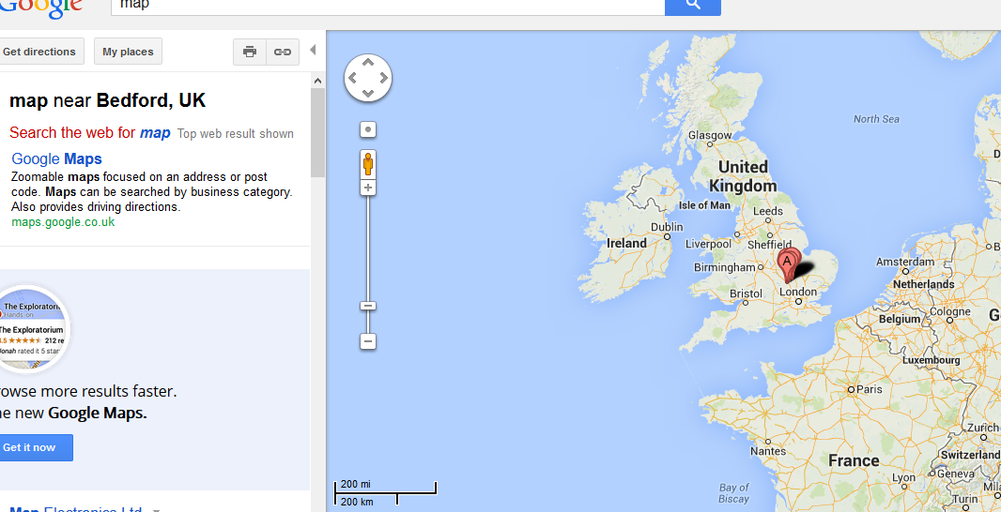
Lesson: Activity C - Computer
Computer based activity - Search online using sites such as Google Earth and find interesting places you would like to explore. Use the scales on the maps shown online, find the perimeter of the landmarks you have explored.
Google search maps
find interesting landmarks and places across the planet
eg.. statues, lakes, airports, famous cities/buildings, parks
Copy the screen onto ‘PAINT’ using the ‘screen print’ button on the keyboard
Draw a square/rectangle/circle et c around the landmark
Find the perimeter of the landmark (use the scale of the map)

Slide 25


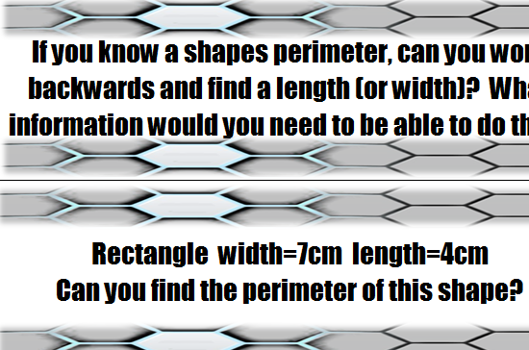
Lesson: Activity D - Discuss
Work in small groups
Take a question
Talk about it
Find answers
Record your discussions for feeback

Slide 26


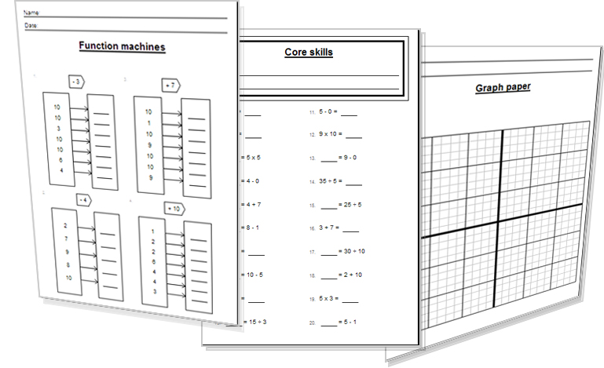
Lesson: Activity E - Solve
Try a variety of written practice
Worksheets
Workbooks
Practice Exam Papers
Maths Problems

Slide 27


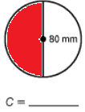

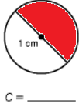

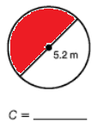

Lesson: Practice – just the numbers
Find the square perimeters
L = 4cm P = ?
L = 6m P = ?
L = 25m P = ?
L = 317mm P = ?
L = …….. P = 12cm
Find the rectangle perimeters
L = 6cm W = 4cm P = ?
L = 20m W = 10m P = ?
L = 7.2 m W = 3.5m P = ?
L = ? W = 3m P = 20m
L = 18in W = ? P = 100in
Find the perimeters
11)
Find the perimeters
12)
13)
14)
15)
Find the circumferences
Radius = 5cm
Radius = 25m
Diameter = 100miles
Diameter = 0.7 inches
Diameter = 14.3 km
Find the Diameters
21) Circumference = 70cm
22) Circumference = 1 km
23) Circumference = 2.5 m
24) Circumference = 31.4 mm
25) Circumference = 600 feet
Find the radius
26) Circumference = 5 m
27) Circumference = 87 cm
28) Circumference = 0.25 km
Find the circumferences
using the
29) diameters given
30)
31)
32)

Slide 28

Lesson: Practice – word problems
The Earth is 93M miles from the sun. Using this number as the radius find the circumference of a single orbit of the Earth around the sun.
A town has a length of 15miles and width of 8 miles. A ring road is to be build around the town in an approximately rectangular shape. What is a good estimation for the total length of the ring road?
A prison has a square perimeter fence around it. Three hundred and sixty metres of metal fencing was used in total to enclose the prison. What is the length of one side of the fence?
A motor racing track is a rough rectangle shape. A car completes 70 laps and the total distance driven is 350km. If the length of the racing track on both sides is 2km long, how wide is the track?
A pipe in a circular pool goes all the way round the edge and has holes in it to provide bubbles. If six metres of pipe was used to go round the pool once, how big is the pool (what is its diameter) ?
A hotel room has electrical wiring problems and needs a refit. The room is 7.3m x 5.8m. How much wiring is required to go all the way round the room?

Slide 29
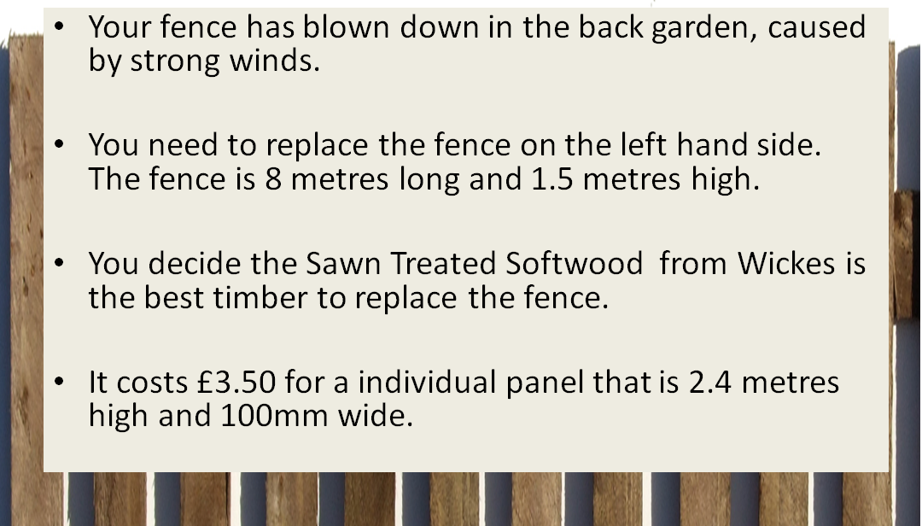
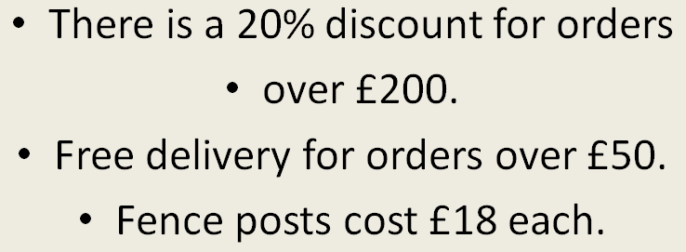
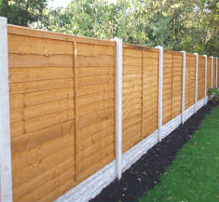
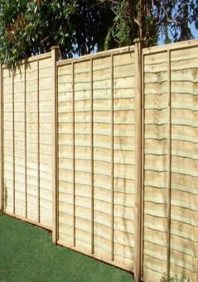
Lesson: Practice – Making it Functional 1
BB

Slide 30
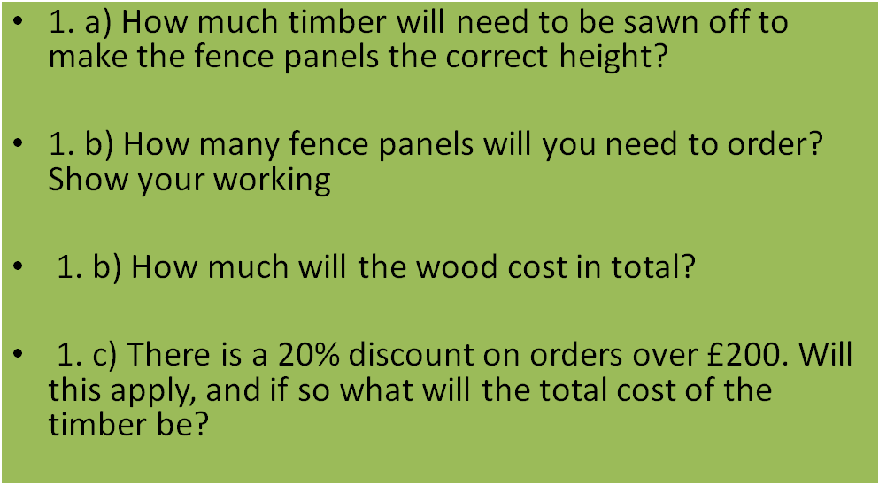
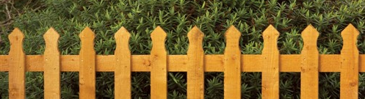
Lesson: Practice – Making it Functional 2
Use the information on the previous page
a

Slide 31
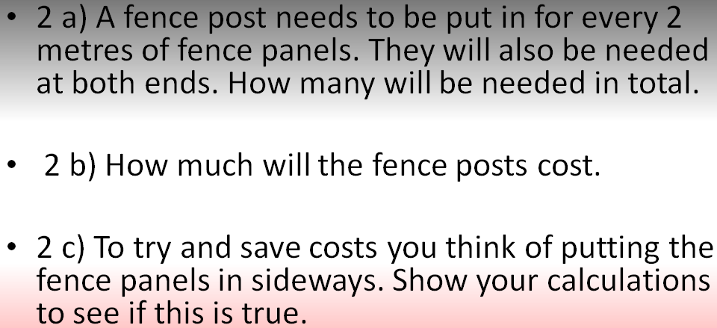
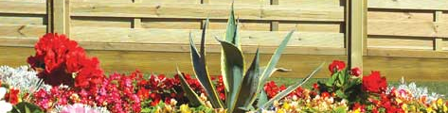
Lesson: Practice – Making it Functional 3
Use the information on the previous pages
a

Slide 32
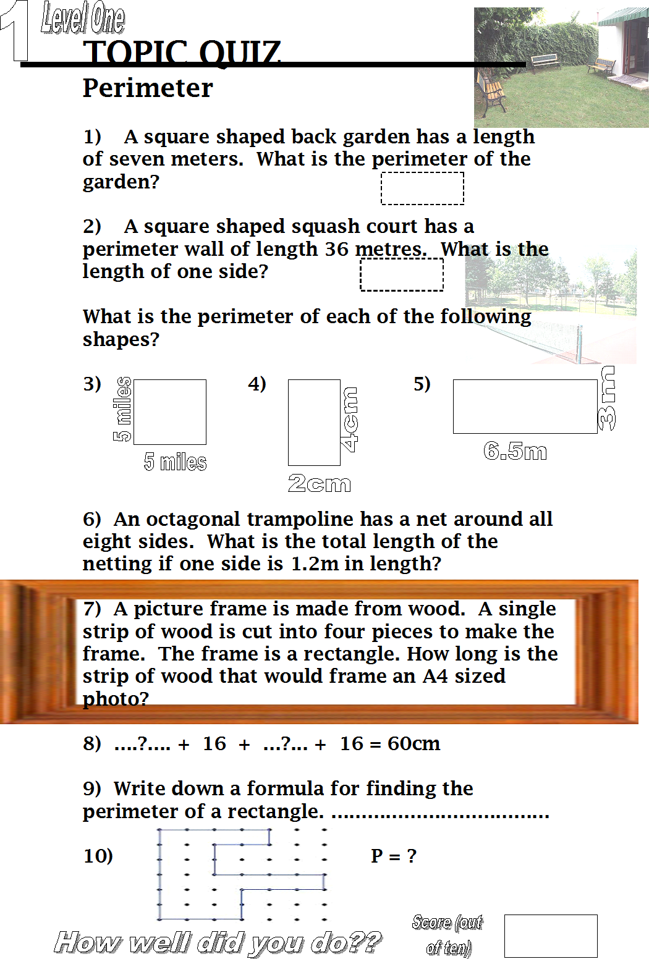

End of Session Quiz to assess LEVEL 1

Slide 33
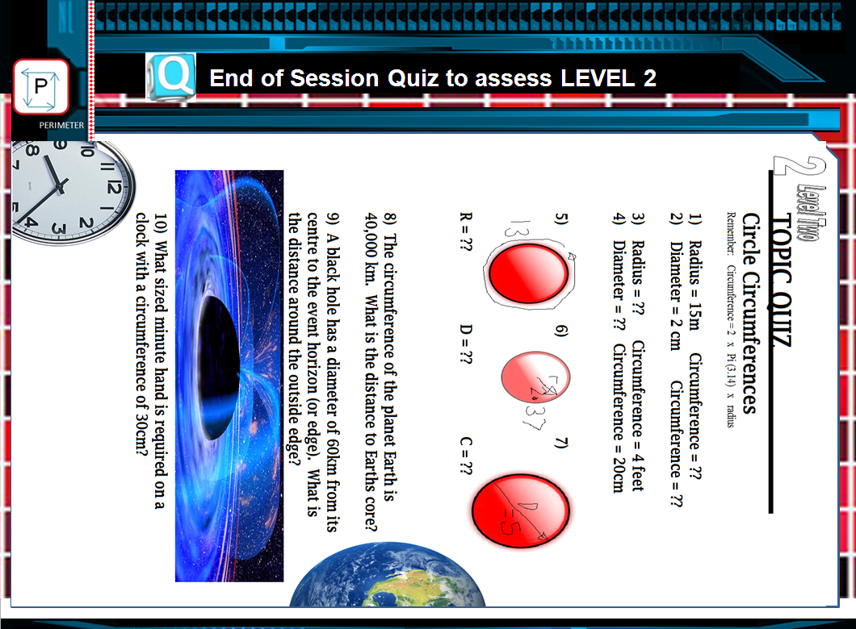
End of Session Quiz to assess LEVEL 2
C=13
R=2.37
radius
D=5

Slide 34


TOPIC ANSWERS 1 – just the numbers
Find the square perimeters
P = 16 cm
P = 24 m
P = 100 m
P= 1268 mm
L = 3 cm
Find the rectangle perimeters
P = 20 cm
P = 60 m
P = 21.4 m
L = 7 m
W = 32 in
Find the perimeters
20 units
28 units
16 units
14) 22 units
20 units
Find the circumferences
18.84 cm
157 m
314 miles
2.198 inches
44.902 km
Find the diameters
22.3 cm
0.32 km
0.8 m
10 mm
191.08 feet
Find the radius
0.8 m
13.85 cm
0.04 km
Find the circumferences
29) 9.42 cm
30) 251.2 mm
31) 3.14 cm
32) 16.328 m
Word problems
584.04 Million Miles
46 miles
90 metres
0.5 km wide
1.9 metre diameter
26.2 m

Slide 35

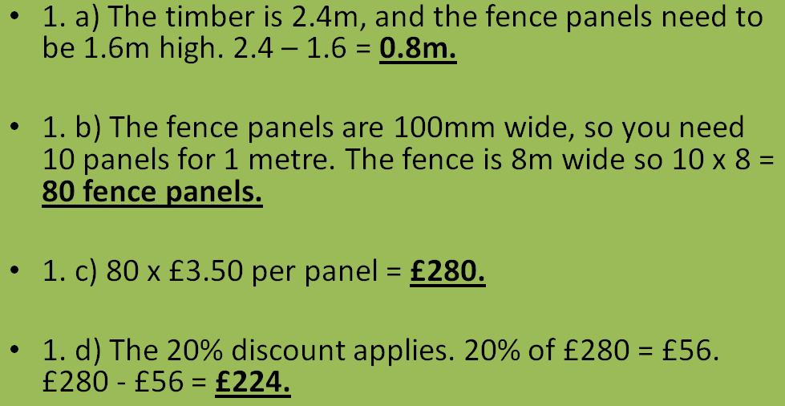
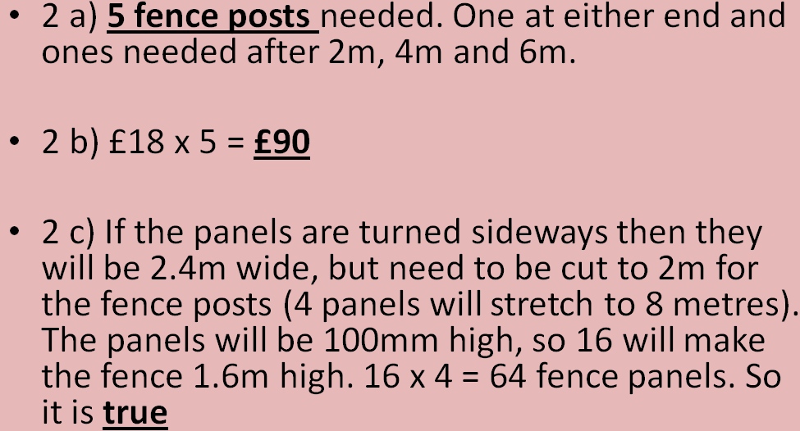
TOPIC ANSWERS 2

Slide 36

TOPIC ANSWERS 3
Level One - Quiz Answers
28 metres
9 metres
20 miles
12 cm
19 metres
9.6 metres
30cm + 21cm + 30cm + 21cm = 102cm
14 cm
P = L + L + W + W, or P = 2 ( L + W ) or P = 2L + 2W
28 units long
Level Two - Quiz Answers
94.2 m
6.28 cm
0.635 feet
6.34 cm
2.07 units
4.74 units
15.7 units
6,369 km
376.8 km
4.8 cm

Slide 37
Progress Checker 2
W
What do you now know about Perimeters of 2D shapes and WHAT HAVE YOU LEARNT? Show an example
How would you now rate your skills in Perimeters of 2D shapes ?
Excellent ability
Good ability, but working to improve
Ok, making a start but I know I have lots to still learn
My aims for today were…
A To find the perimeters of simple square and rectangular shapes
B Find the perimeter (circumference) of a circle
C Use perimeter formulae to solve practice problems

Slide 38
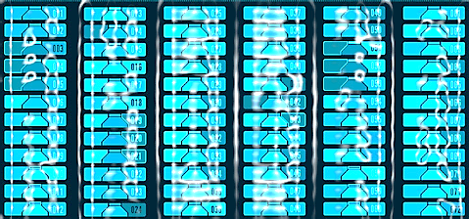

Continuing to Study and Learn
What else can you do to help yourself to learn and practice? Here are ten suggestions, record which you do each week and also record your progress.
Internet websites
Repeat the lesson, make notes, organise a folder, revise
Own maths workbook
Study together with a friend or family member
Finish activities in this book
Complete class handouts or tasks
Practice exams / past papers
Use maths skills learnt at home or at work in real situations
Play games
Experiment yourself, try new things ask yourself questions
Try making a graph of number of practice methods you use against your progress score in each topic. Are you showing more practice gives better results?

