Slide 1




Slide 2






Whole Number and Functions
Multiply and Divide

Slide 3




















Course Content: Choose your topic …
Whole Number and Functions
place
value
negative
numbers
add and
subtract
multiply
divide
round
numbers
ratio
scale
fraction
decimal
numbers
percent
percent
decimal
fraction
MATHS E3 to L2
Parts of a whole
metric
measure
imperial
measure
perimeter
area
volume
formulae
bodmas
charts
data
averages
prob-
ability
Measure and Shape
Handling Data

Slide 4













Home Warm up Progress Check 1 Video/Discuss Vocab / jobs Lesson Activities Quizzes Topic Answers Progress Check 2 Cont. Learning
Topic Introduction : Multiply and Divide
Multiplication is the another maths function that changes a value into another. It is another form of adding to a value but this time when adding you keep adding the same amount. You can learn the answers to some of these multiple adding sums to make multiplication of larger numbers easier (this is called learning your tables!).
Division is (again like add and subtract) very closely linked to multiplication as it simply asks the multiplication question in a different way. What if you start with the answer to a multiplication sum and want to know what you started with. Division splits up a number back into its groups, sets, multiples. Learning your multiplication tables will greatly help when dividing.
Choose an icon to select where to start
multiply
divide

Slide 5



Warm up exercise 1
Lets start today by revising ! Complete the above sums and multiplication grid

Slide 6


Warm up exercise 2

Slide 7
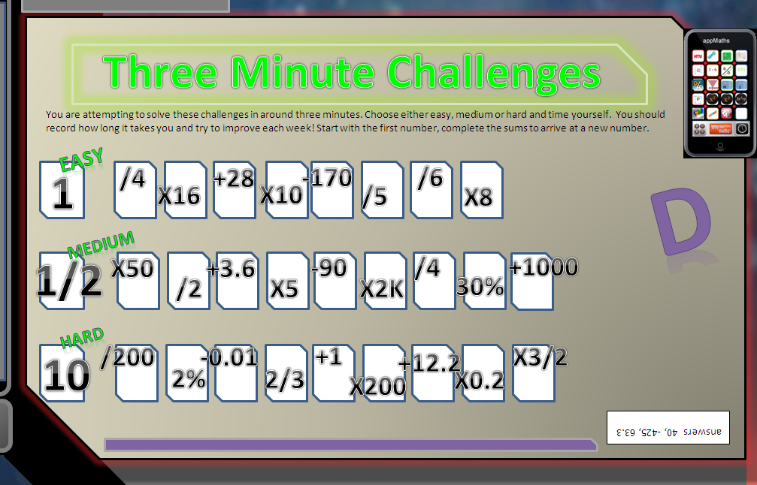

Warm up exercise 3

Slide 8

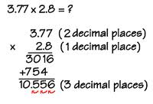
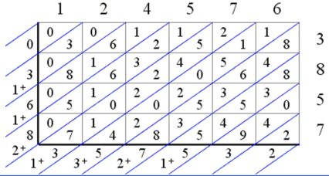


Progress Checker 1
What do you already know about multiplying and dividing ? What did you learn before todays session?
How would you rate your skills in multiplying and dividing ?
Excellent ability
Good ability, but working to improve
Ok, making a start but I know I have lots to still learn
The day I started studying in the week was: Todays session aims are…
A Multiply whole numbers with other whole numbers using large and negative values
B Divide large whole or negative numbers by other smaller or negative values
C Confidently use calculators, mental and written methods to solve practical problems
2.3Gb x 4
£0
-£358M /4

Slide 9




Introductory Video and Discussion
KHTU.
Does multiplying always make a number bigger ?
Can you divide up every number, fractions, decimals, neg etc..?
Do we need to learn our times tables to ten or 12 now..?
Is it still necessary to learn our times tables if we have calculators ?
What is the best method for multiplying (or dividing) ?
Is the order in which we multiply then divide important ?
Watch the introductory video and then discuss the above
Your thoughts..

Slide 10

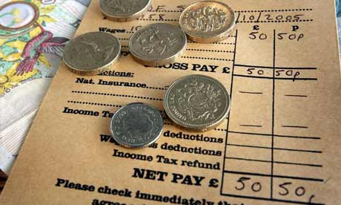


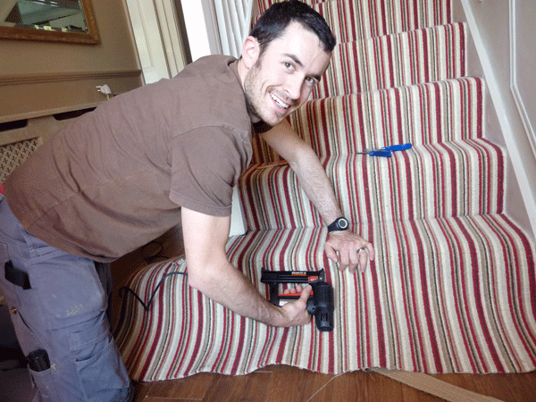

Vocabulary and Jobs
Groups
Sets
Multiply/Multiple
Times
Divide/Division
Split
Share
Factor
Prime number
Fraction
These are the words you will use in this topic
Internet Sales
Stock orders
Carpet Fitter
Gardener
Tiler
Wages
Cashier
…. Can you think of more?
…………………………………
…………………………………

Slide 11

Lesson: Concept Activity
Find as many different factors as you can to make these numbers
e.g. 42 = 2x7x3
÷∕x
factors
28
48
81
Find the definition of factor online
divide
59
196
division
multiple
products
multiplication
divide
multiply
times
share
What type of number are these factors?

Slide 12


Lesson: Main Teach
Multiple adding = Multiplication
Multiplication is just adding up lots of times
Eg 2+2+2+2 = 4 lots of 2 = 8
9+9 = 2 lots of 9 = 18
The answers to all the additions of single digits up to ten times are given in the grid on the right.
This will solve ‘SINGLE DIGIT’ problems , ie: one digit multiplied by another single digit
Example: 9 people have £3 each = £27
Main Learning Point : Learn all the answers on this grid

Slide 13


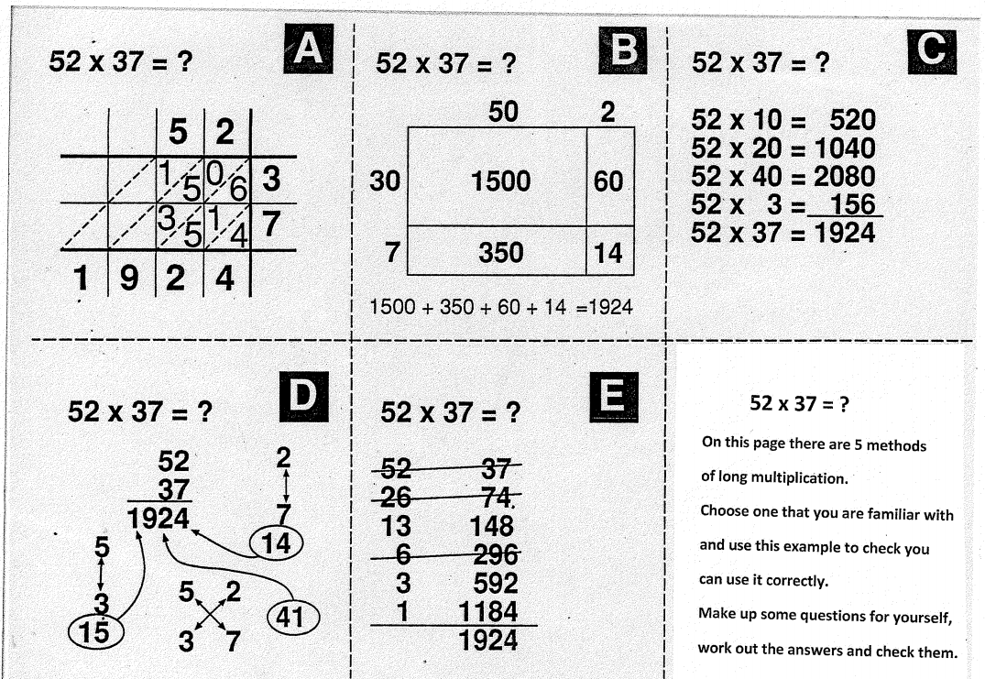
Lesson: Main Teach
Various Multiplication methods - see Moodle videos
Grid method
Lattice or Chinese Method
Chunking
Traditional method
Doubling and halving

Slide 14
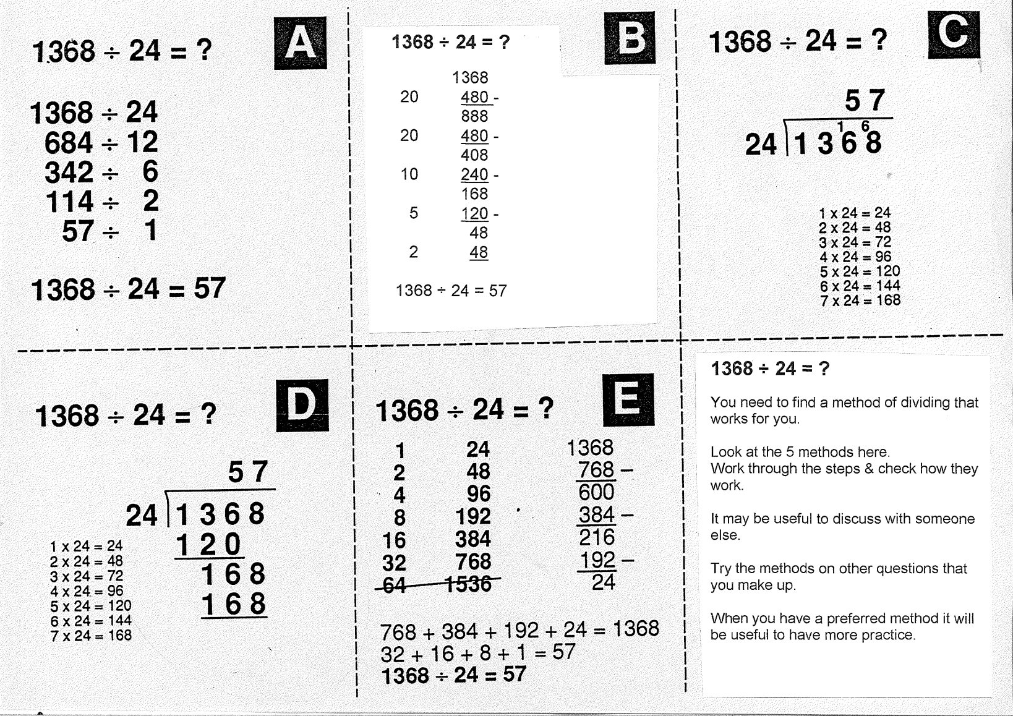

Lesson: Main Teach
Various Division methods - see Moodle videos
Chunking
Short Division
Simplifying / Equivalent Fractions
Egyptian
Long Division

Slide 15
Lesson: Try out
Block 1 : Watch tutor led demo (in class or on video)
Try these, 1) Multiply 8 x 4 2) Multiply 23 x 9 3) Multiply 58 x 34
4) Divide 18 by 6 5) Divide 120 by 8 6) 350 divided by 14
Block 2 : Watch tutor led demo (in class or on video)
Try these, 7) 90 x 10 8) 200 x 300 9) 2,974 x 8
10) Divide 22 by 7 11) Divide 230,721 by 3 12) 78 / 6 x 4
Block 3 : Watch tutor led demo (in class or on video)
Try these, 13) 250 x -16 14) 9,000 x 18,000 15) 471 x 952
16) -2 x 8 x -4 17) 15 x ( 6/3) x -4 18) 92M x 3K
19) 350,000 / 15 20) 792 / 314 22) 18B / 600M
Entry 3
Level 1
Level 2

Slide 16
Lesson: Websites and links
Challenging add/sub/mult/divide problems using positive and negative numbers
http://www.dositey.com/2008/addsub/Mystery11.htm
Spot the wrong part of the multiplication shown, with different levels of difficulty
http://www.topmarks.co.uk/Flash.aspx?f=WhatsWronggrid
Multiplication Bingo, select your numbers then press start and complete your board
http://www.topmarks.co.uk/Flash.aspx?f=bingotimesordivide
Recheck your knowledge of ‘Factors’ and revise basics of multiplying and dividing
http://lincs.skoool.co.uk/content/primary/maths/factors/index.html
Shows that multiplication of bigger numbers uses knowledge of multiples of ten, grid method used
http://lincs.skoool.co.uk/content/primary/maths/multiplication/index.html
A division sum shown with a number line as visual, helps to see how to break up the division sum
http://www.topmarks.co.uk/Flash.aspx?f=mentaldivisionv2
Online long division help, examples and try out
http://www.mathsonline.org/pages/longdiv.html

Slide 17

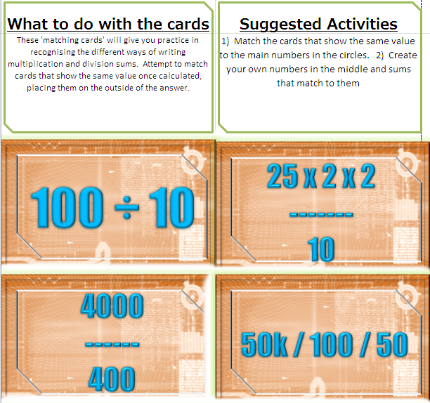

Lesson: Exploratory Activity A

Slide 18

Lesson: Exploratory Activity B
DISCUSSION TABLE
Use the green multiplication and division cards to prompt discussion between you.
Can you share your methods with each other on how to solve each sum
Do you know tricks to solve faster or checks for wrong answers on calculators

Slide 19


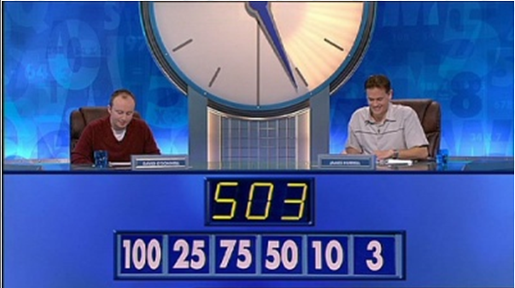
Lesson: Exploratory Activity B
Countdown Game
Take 3 digit cards to create a 3 digit target number
Take 4 single digit cards and two high value cards
Use the low and high value cards to get as close to the target number as possible to beat your team mates
Use + - x / to get to the target number but you can only use each digit once

Slide 20
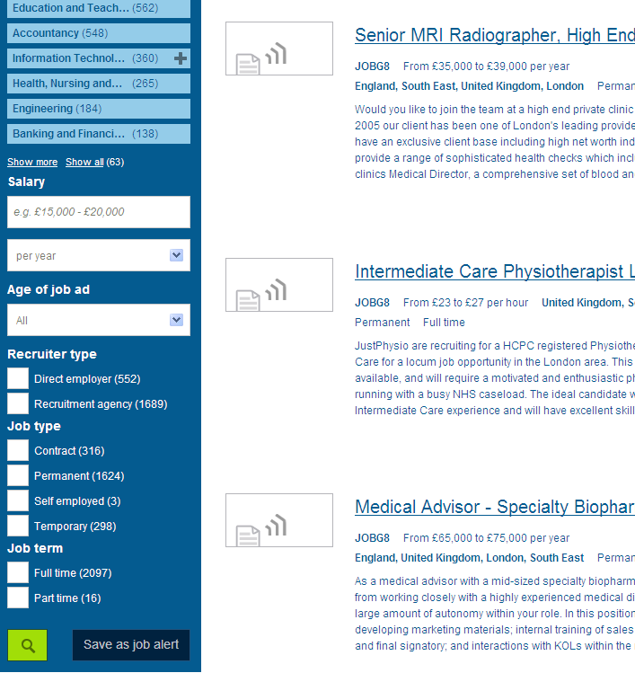


Lesson: Exploratory Activity C
Job Search……
1) Use computers to find job salaries.
2) Use spreadsheet to divide up the salaries
between each month to find monthly pay
/ weekly pay / daily pay/ hourly pay
3) Divide by 10 for pension
Divide by 5 for NI and TAX
Extension: use a wage rate and multiply up to find a salary

Slide 21


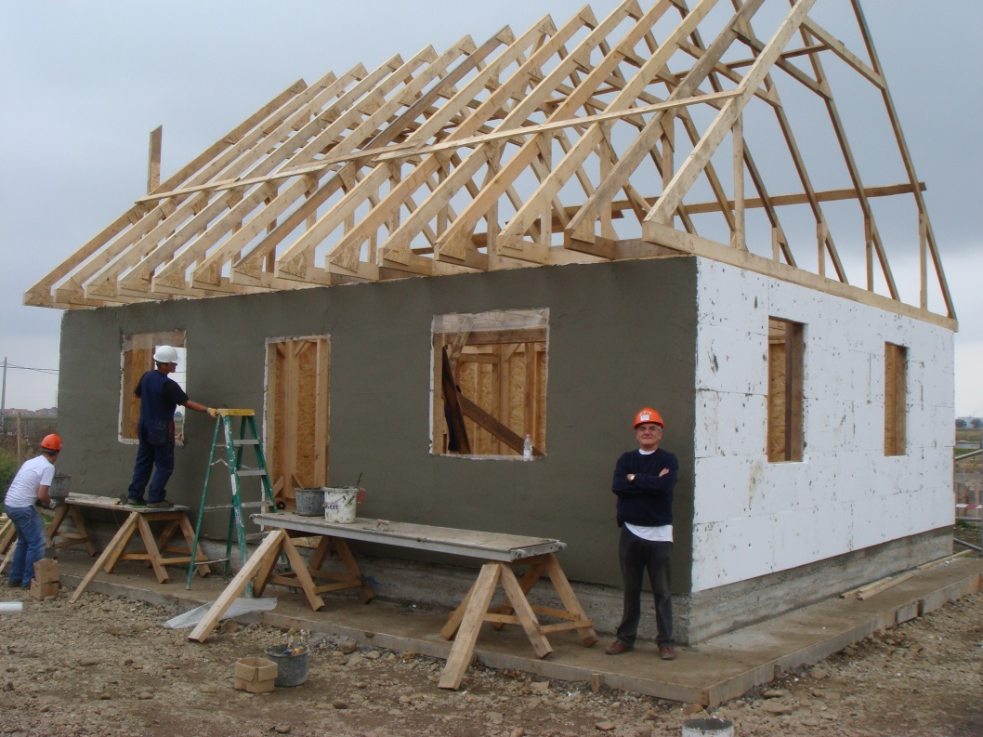
Lesson: Exploratory Activity D
Functional Questions:
Use the leaflet and question sheets

Slide 22

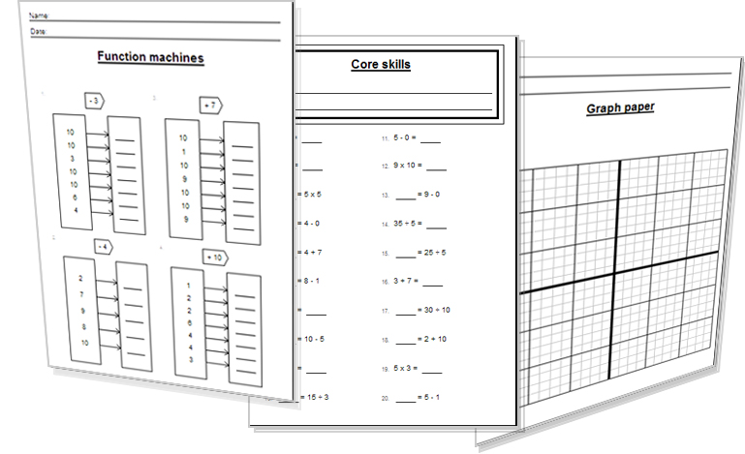

Lesson: Activity E
Try a variety of written practice
Worksheets
Workbooks
Practice Exam Papers
Maths Problems

Slide 23

Lesson: Practice – just the numbers
A Complete the following sums
18 x 9
54 x 7
23 x 5
60 x 9
6 x 120
27 / 9
60 / 5
100 / 10
75 / 25
32 / 8
230 x 9
450 x 7
672 x 5
904 x 3
888 x 4
240 / 8
450 / 9
217 / 7
230 / 5
852 / 4
B Complete the following powers of ten sums
10 x 200
400 x 30
5,000 x 70
80,000 x 300
100 x 20,000
90 x 90 x 60
25 x 50 x 100
10 x 10 x 1000
20 x 200 x 2000
17 x 300 x 400
C Try these divisions that have remainders
38 / 3
334 / 9
744 / 5
200 / 11
950 / 7
111 / 6
333 / 2
D Have a go at these multiplications of negative numbers
-2 x 4
6 x -3
14 x -5
30 x -2
-3 x -8
-1 x 10
-9 x 3 x -4
5 x 3 x -7
-(4 x 8)
3 x 10 x -100
E How about some negative division !
14 / -2
25 / -5
-30 / 3
250 / -50
88 / -4
-20 / -5
-140 / -7
F Try some multiplication of large numbers
3000 x 2
50,000 x 10 x 3
160k x 4k
80 x 100 x 3k
2k x 5k
G Heres some large number division
4k / 2
8M / 2k
3B / 60M
50,000 / 2500
H Large Negative Division
-15,000 / 5
-200k / 1500
6000 / -30
2M / -250k
-3B / -3M
Level 1
Level 1
Level 2
Level 2

Slide 24


Lesson: Practice – word problems
Level 1
1) A train ticket for £132 doubles in price. What is the new price of the ticket?
Debbie pays £18 per week for her gas. How much does she pay over a whole year?
I take forty pictures on my phone with a 5Mpixel setting. What is the total memory used for the forty pictures?
4) A virus infects an animal population of 70Billion. An experiment divides up this population into five groups to perform tests. How many animals are in each of the five groups?
5) A company loss of -£250M is produced over 3 months. Around how much money was lost each month?
6) 250k miles of fibre optic cable is used connecting up 1,800 towns to the internet. How much cabling is needed per town?
Level 2

Slide 25

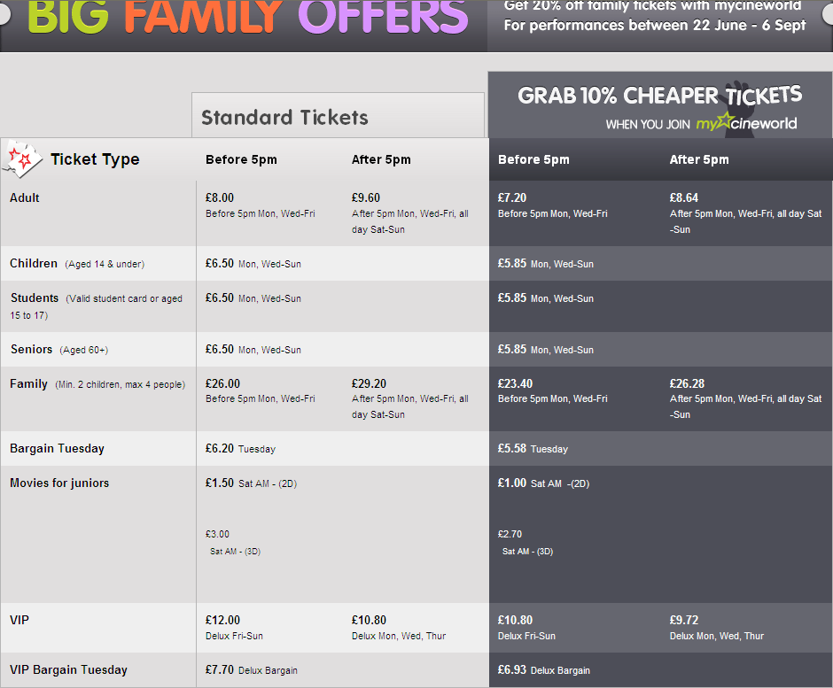





Lesson: Practice – Making it Functional

Slide 26



Lesson: Practice – Making it Functional
Use the information from the cinema price listings
Q1) a) I am going with four other friends to the cinema to see a movie at 4.30pm on Monday. We have no children with us and are not members of the cinema. Show how to calculate how much cheaper it would be if we were all members.
b) A big group of us are going to the cinema for a birthday. Our party consists of six children and ten adults. We are going on Wednesday at 3pm and want to take advantage of the family ticket. We are not members. Show how to calculate the total cost of the party using as many family tickets as possible.
Q2) a) A cinema takes £15,948 from sales of ‘Delux VIP’ tickets at 5pm showings. Show
how to divide up the money to find the number of adults that bought the delux VIP tickets.
b) Show how many normal adult tickets need to be sold before a cinema can make £1M
C) In 1993 Jurrasic Park made a record breaking $980M. Assuming that the ticket price in 1993 was the same as a child's ticket today, how many people saw the movie?
Level 1
Level 2

Slide 27
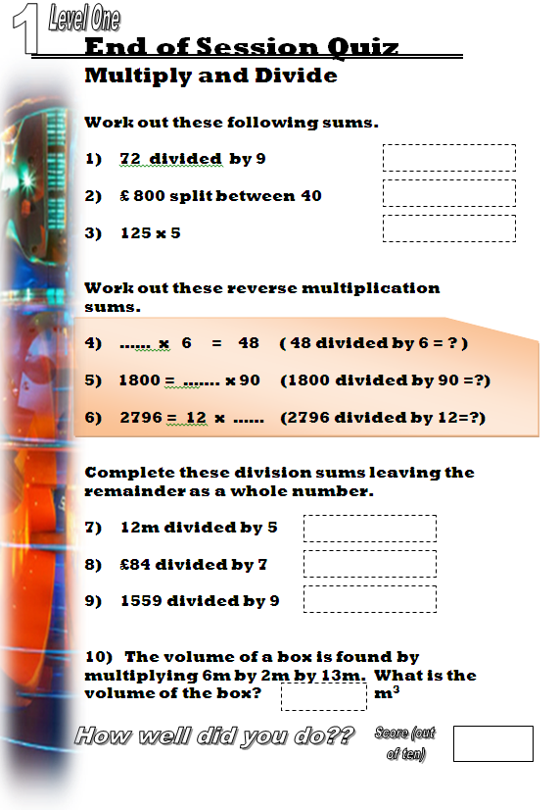

Quiz to assess LEVEL 1

Slide 28
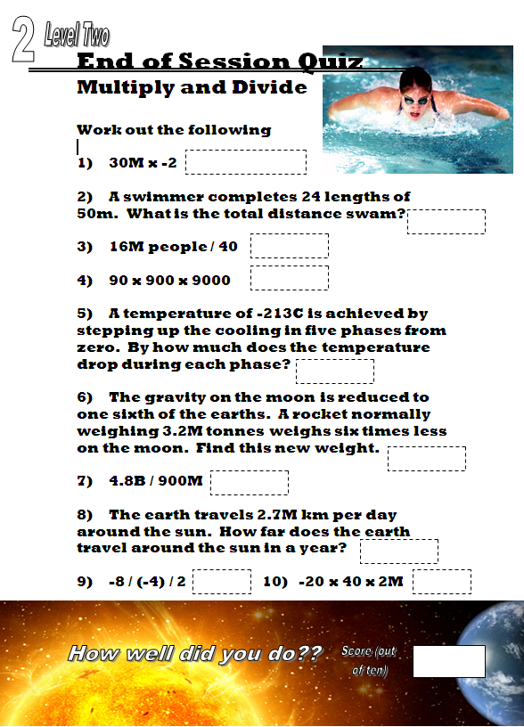
Quiz to assess LEVEL 2

Slide 29
TOPIC ANSWERS
B Complete the following powers of ten sums
2,000
12,000
350,000
24,000,000
2,000,000
486,000
25 x 50 x 100
100,000
8,000,000
2,040,000
C Try these divisions that have remainders
12 r2
37 r1
148 r4
18 r2
135 r 5
18 r 3
166 r1
D Have a go at these multiplications of negative numbers
-8
-18
-70
-60
24
-10
108
-175
-32
-3000
E How about some negative division !
-7
-5
-10
-5
-22
4
20
F Try some multiplication of large numbers
6,000
1,500,000
640M
24M
10M
G Here’s some large number division
2k
4k
50
20
H Large Negative Division
-3,000
-133 r500
-2000
-8
1k
Lesson Practice: word problems
£264
£936
200,000,000 or 200M
14B
-£83M each month
138.89… miles per town
Lesson Practice: Making it Functional
a) 5 adults at £8 = £40 , with member discount it would be 5 adults x £7.20 = £36. It is cheaper by £4 .
b) Buy 3 family tickets which will admit 6 children and 6 adults for 3 x £26 = £78, then as there are no more children we have to buy 4 more adult tickets at £8 each, 4 x £8 = £32. The total entry is therefore £78 + £32 = £110
a) Delux are £10.80 per ticket. So the total £15,948 is divided by £10.80 to find the number bought.
15,948 / 10.8 = 1477 tickets
b) £1,000,000 is divided by £8 adult tickets = 125k tickets bought
c) $980,000,000 is divided by $6.50 (price of a child’s ticket) = 150,769,231 people saw Jurassic Park (to the nearest whole person)
A Complete the following sums
162
378
115
540
720
3
12
10
3
4
2070
3150
3360
2712
3552
30
50
31
46
213

Slide 30


TOPIC ANSWERS
Level 1 End of Session Quiz
8
£20
625
8
20
233
2 r 2
12
173 r2
156 m3
Level 2 End of Session Quiz
-60M
1200m
400,000
729,000,000
42.6 C or approx 43 C
533,333 tonnes
5.33….
985.5M km
1
-1.6B

Slide 31
Progress Checker 2
What do you now know about multiplying and dividing ? What did you learn today? .. Show examples..
How would you now rate your skills in multiplying and dividing ?
Excellent ability
Good ability, but working to improve
Ok, making a start but I know I have lots to still learn
The date I finished studying : delete aims you have achieved…
A Multiply whole numbers with other whole numbers using large and negative values
B Divide large whole or negative numbers by other smaller or negative values
C Confidently use calculators, mental and written methods to solve practical problems
2.3Gb x 4
£0
-£358M /4

Slide 32
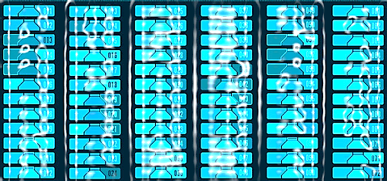

Continuing to Study and Learn
What else can you do to help yourself to learn and practice? Here are ten suggestions, record which you do each week and also record your progress.
Internet websites
Repeat the lesson, make notes, organise a folder, revise
Own maths workbook
Study together with a friend or family member
Finish activities in this book
Complete class handouts or tasks
Practice exams / past papers
Use maths skills learnt at home or at work in real situations
Play games
Experiment yourself, try new things ask yourself questions
Try making a graph of number of practice methods you use against your progress score in each topic. Are you showing more practice gives better results?

