Slide 1

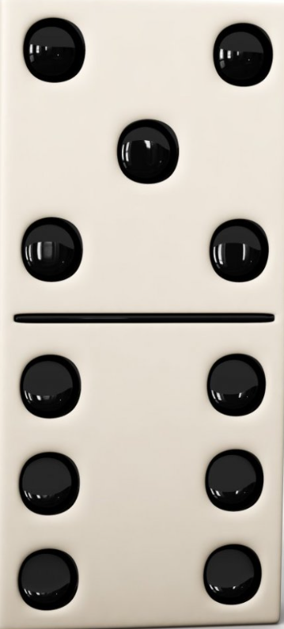
6
17
33
54
80
nth = a + (n-1) d
26
21
Σ= n/2[2a+(n-1)d]
16
11
6
1st
2nd
3rd
4th
5th

