Slide 1
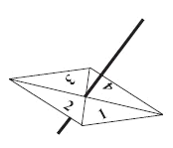
SCATTER DIAGRAMS
Learning Objectives
To be able to:
- Draw and interpret scatter diagrams and recognise positive and negative correlation
In a game, two fair spinners are spun and a score is found by adding the numbers obtained together.
Show the possible outcomes in a table
Use your table to find the probability of getting a score of 7
Find the probability of getting a score of 4 or less
(4 marks)

Slide 2
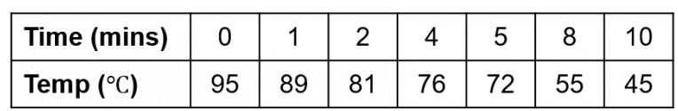
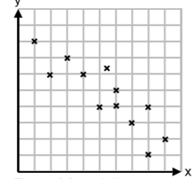
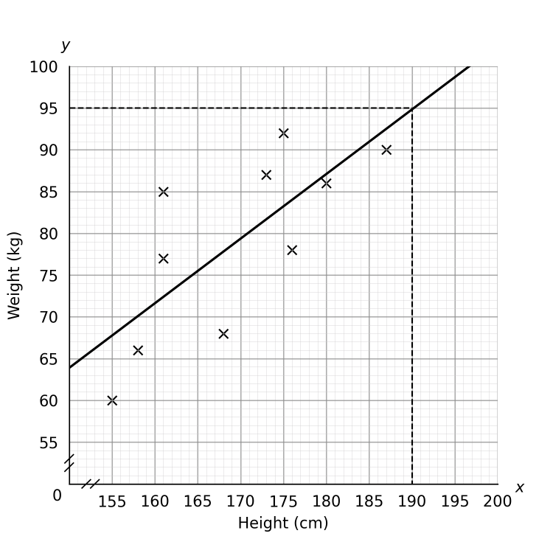
STARTER
Represent information
The temperature of a cup of tea is recorded over time. Display the results shown as a scatter diagram.
Correlation
Predict information
2) Describe the type of correlation shown.
3) What would be the approximate weight of a person 175cm tall?

Slide 3
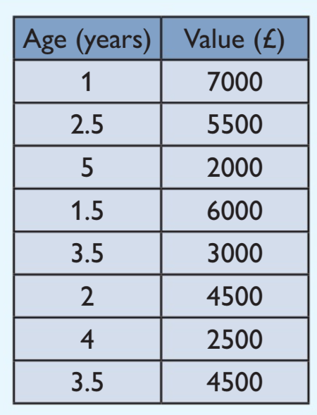
Representing Information
The table on the right shows the age and value of 8 cars.
Draw a scatter diagram for this data.

Slide 4
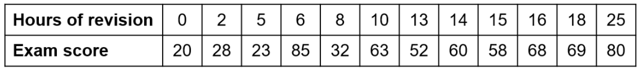
Your turn…
The table below shows the amount of time a group of students spent revising for an exam and the score they achieved
Draw a scatter diagram to represent the data.

Slide 5
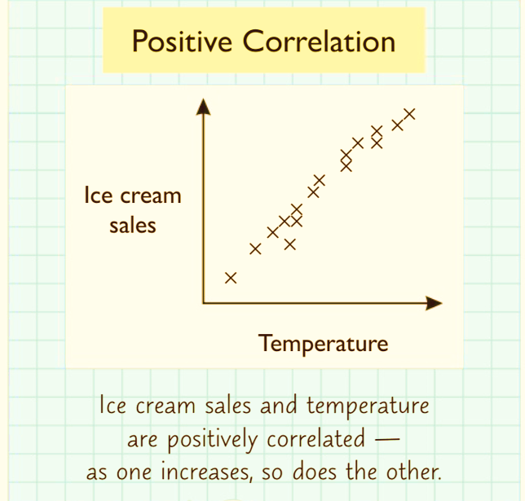
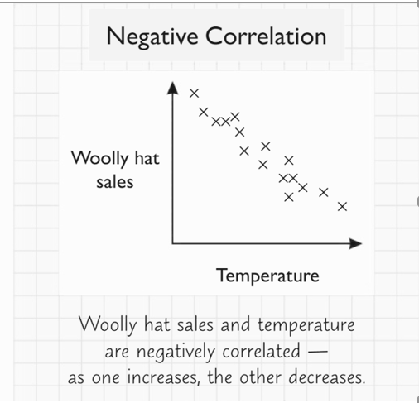
Scatter Diagrams - Correlation

Slide 6
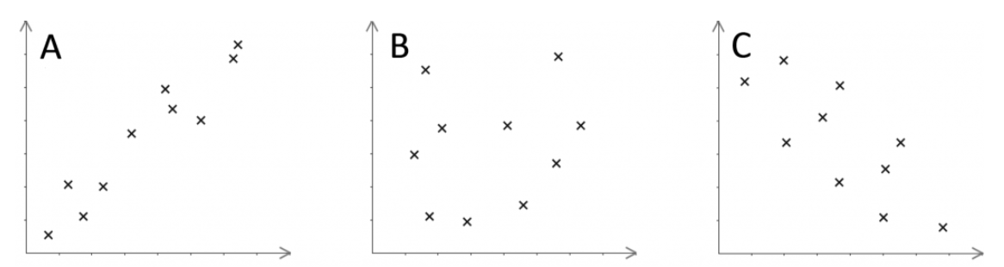
Your turn…
For each of the diagrams below, state whether or not there is correlation,
the strength and the type.

Slide 7
Interpreting Scatter Diagrams
Plot the scatter diagram using the table below for test marks achieved by 10 students completing two maths papers.
Number | 34 | 67 | 55 | 90 | 45 | 70 | 21 | 70 | 62 | 32
Algebra | 25 | 80 | 45 | 88 | 41 | 75 | 12 | 65 | 74 | 28
a) Draw a scatter diagram for the information above. (2 marks)
b) Does the diagram show any correlation, if so what type is it? (1 mark)
c) Draw a line of best fit onto the diagram. (1 mark)

Slide 8
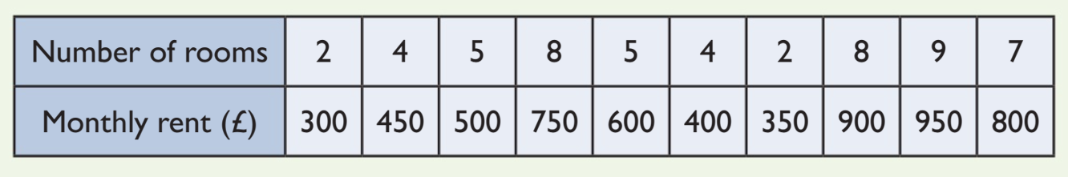
Your turn…
The table below shows some information about 10 flats available to rent.
Draw a scatter diagram for this information. (2 marks)
Add a line of best fit to your scatter diagram. (1 mark)
Use your diagram to estimate the monthly rent you might expect to pay for a flat with 6 rooms. (1 mark)

Slide 9

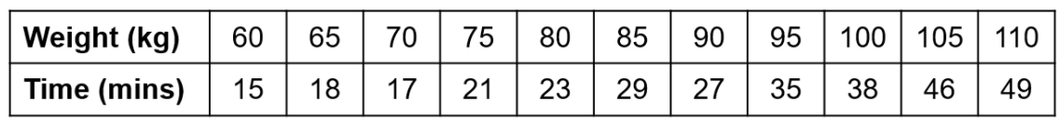
In a test, some runners of differing weights were asked to run 5Km as fast as they can. Their results are shown in the table below:
a) Draw a scatter graph to represent the above information. (3 marks)
b) Describe the correlation between the time taken and the weight of the runner. (1 mark)
c) Describe the relationship shown in the scatter graph. (1 mark)
d) Why might it not be appropriate to use the scatter graph to best estimate the 5Km time of someone who weighed 40 kilograms? (1 mark)

