Slide 1




Slide 2








Slide 3



















Course Content: Choose your topic …
Whole Number and Functions
place
value
negative
numbers
add and
subtract
multiply
divide
round
numbers
ratio
scale
fraction
decimal
numbers
percent
percent
decimal
fraction
MATHS L1 to L2
Parts of a whole
metric
measure
imperial
measure
perimeter
area
volume
formulae
bodmas
charts
data
averages
prob-
ability
Measure and Shape
Handling Data

Slide 4





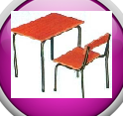






Home Revision Progress Check 1 Video/Discuss Vocab / jobs Lesson Activities Quizzes Topic Answers Progress Check 2 Cont. Learning
Topic Introduction : Probability
Probability deals with ‘events’, things that may or may not happen and how likely they are for taking place. Will a dice turn up a six, a horse win the race or radioactive atom decay, these probabilities can be studied and quantified in this topic.
To find out if an event is likely to occur or not a score is given. This score is a number between zero and one. The higher the score the more likely an event is to happen. Therefore this topic deals with numbers between 0-1 and you will have needed to study decimals, percentages and fractions first.
Choose an icon to select where to start
Probability

Slide 5
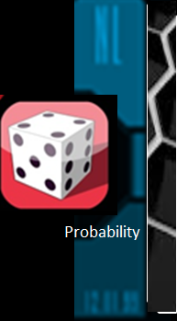



Warm up Exercise 1
Lets start today by revising ! Complete the above sums and multiplication grid

Slide 6
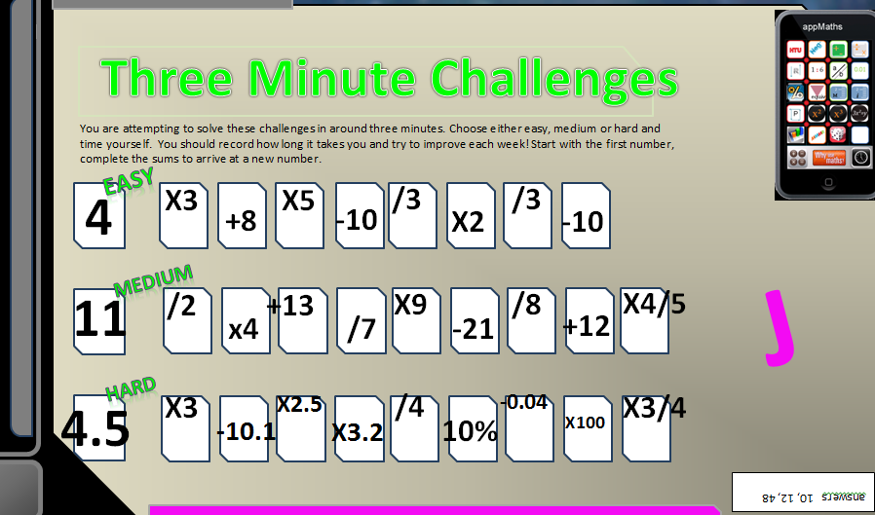
Warm up Exercise 2

Slide 7

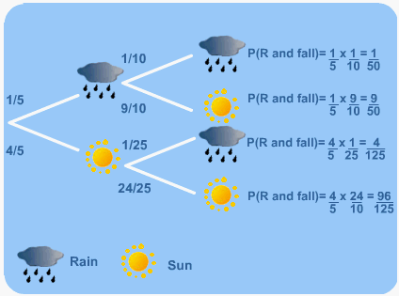
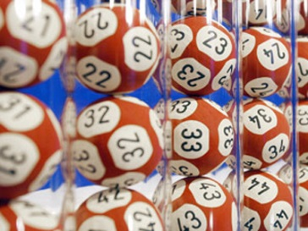
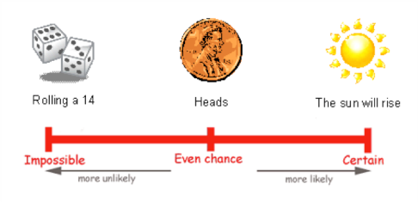
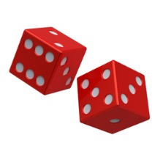
Progress Checker 1
W
What do you already know about Probability ?
How would you rate your skills in finding probability scores ?
Excellent ability
Good ability, but working to improve
Ok, making a start but I know I have lots to still learn
My aims for today are…
A To know when probability scores are used and what a probability score means
B To calculate a probability score and relate the score to the event/s taking place
C Use tree diagrams to list possibilities

Slide 8




Introductory Video and Discussion
KHTU.
What is a probability score and what does it mean ?
Can you be sure of something because of its probability score ?
Is there anything this has a score of 1 (will definitely happen) ?
How is probability used in games and gambling ?
How is ‘probability’ used in weather forecasting ?
Can you change things to make probability scores higher or lower ?
Watch the introductory video and then discuss the above
Your thoughts..

Slide 9

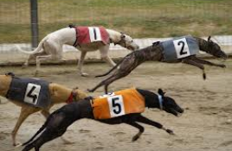
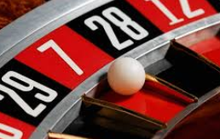
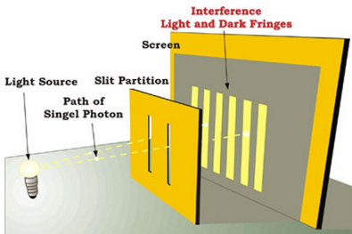
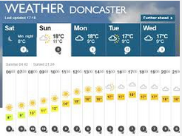

Vocabulary and Jobs
Likely
Chance
Probabilistic
Impossible
Definite
Certain
Bet
Contingent
Implausible
Prone
Eventuality
Mutually Exclusive
These are the words you will be using in this topic
Weather
Computing
Population Analysis
Casino
Games
Horse/Dog Racing
QED
Graphics
…. Can you think of more?
…………………………………
…………………………………

Slide 10
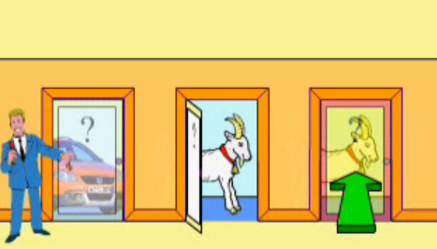
Lesson: Concept Activity
The Monty Hall Problem
Discuss: what are the chances of getting the car?
Or the goat? Can you change your probability of getting
the car?

Slide 11
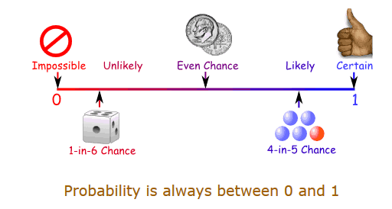
Lesson: Main Teach 1
Probability Scores

Slide 12

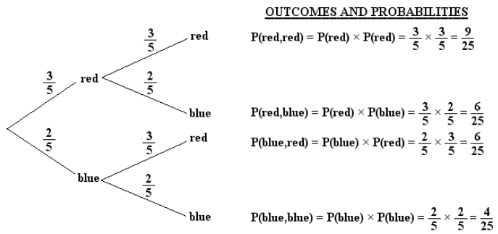
Lesson: Main Teach 1
Probability Tree Diagrams

Slide 13
Lesson: Try out
Block 1 : Watch tutor led demo (in class or on video)
Try these,
Block 2 : Watch tutor led demo (in class or on video)
Try these,
Block 3 : Watch tutor led demo (in class or on video)
Try these,

Slide 14
Lesson: Websites and links

Slide 15
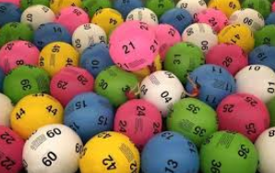
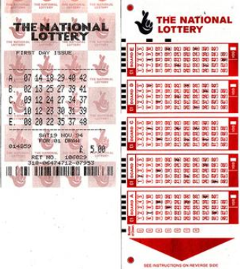
Lesson: Activity A
Can you work out the probability of winning the lottery
Matching all 6 numbers ? What about 5 or 6? What about
any of 3, 4, 5 or 6 numbers?

Slide 16
Lesson: Activity B
P

Slide 17

Lesson: Activity C
Computer based activity

Slide 18
Lesson: Activity D

Slide 19

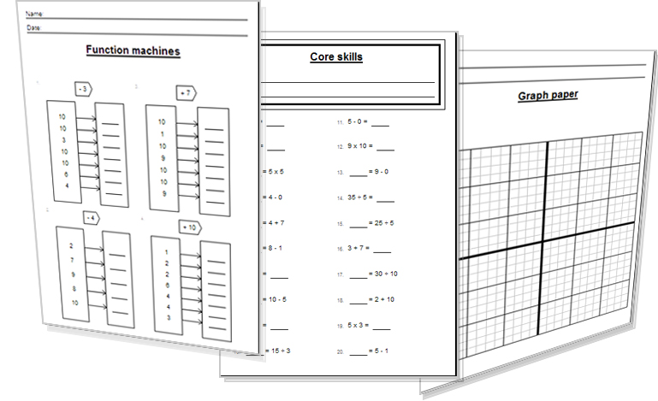
Lesson: Activity E
Try a variety of written practice
Worksheets
Workbooks
Practice Exam Papers
Maths Problems

Slide 20
Lesson: Practice – just the numbers
541

Slide 21
Lesson: Practice – Making it Functional 1
BB

Slide 22
Homework: Quiz to assess LEVEL 1

Slide 23
Homework: Quiz to assess LEVEL 2

Slide 24
TOPIC ANSWERS 1
Revision Exercises 1:

Slide 25

TOPIC ANSWERS 2

Slide 26
Progress Checker 2
W
What do you now know about Probability ? What have you LEARNT ?? Write and example…….
How would you now rate your skills in finding probability scores ?
Excellent ability
Good ability, but working to improve
Ok, making a start but I know I have lots to still learn
My aims for today date: were…
A To know when probability scores are used and what a probability score means
B To calculate a probability score and relate the score to the event/s taking place
C Use tree diagrams to list possibilities

Slide 27
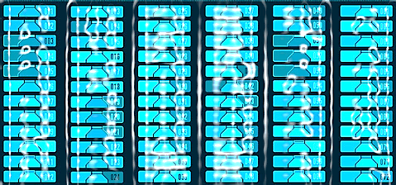

Continuing to Study and Learn
What else can you do to help yourself to learn and practice? Here are ten suggestions, record which you do each week and also record your progress.
Internet websites
Repeat the lesson, make notes, organise a folder, revise
Own maths workbook
Study together with a friend or family member
Finish activities in this book
Complete class handouts or tasks
Practice exams / past papers
Use maths skills learnt at home or at work in real situations
Play games
Experiment yourself, try new things ask yourself questions
Try making a graph of number of practice methods you use against your progress score in each topic. Are you showing more practice gives better results?

