Slide 1

Starter
3) Without a calculator, solve 427÷4
Solve:
2x + 9 = 12
4) Find the area of this shape:
2) Paulo and Rachel share £400 between them in the ratio 1:3. How much more does Rachel get than Paulo?
10m
15m
5) $\frac{2}{3}$ + $\frac{3}{5}$

Slide 2
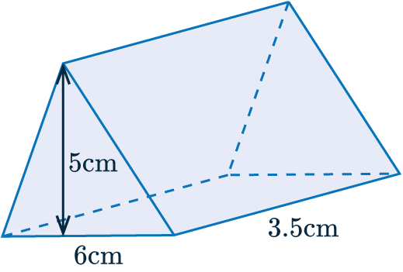
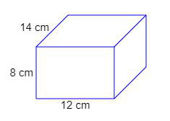
Intro To Angles
Learning Objectives
To be able to :
- Understand and use angle properties (sum of angles on a straight line, around a point, angles in triangles, quadrilateral)
- Understand and use alternate and corresponding angles on parallel lines
Find the volume of this shape: Find the surface area of this shape:

Slide 3
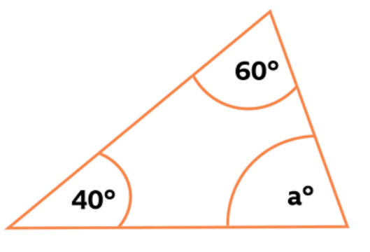
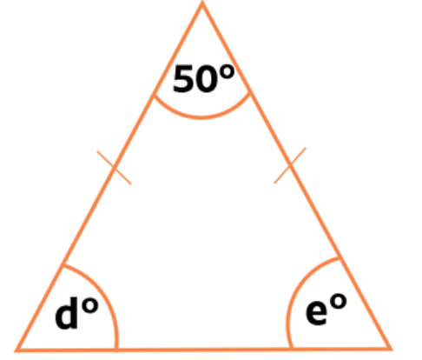
Angle Rules
160˚
x
125˚
z
y
x

Slide 4
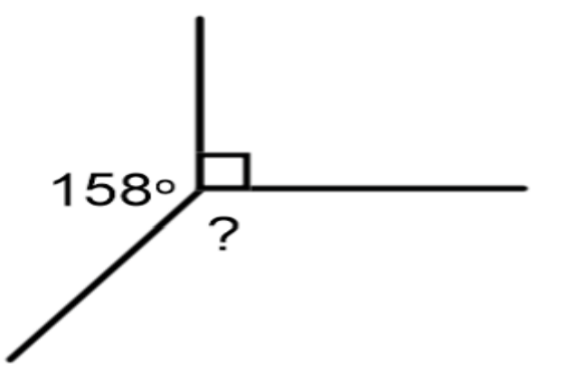
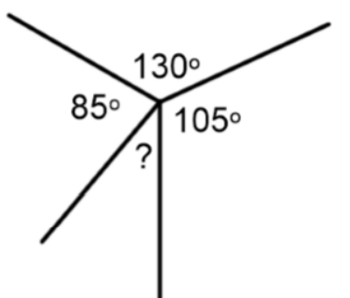
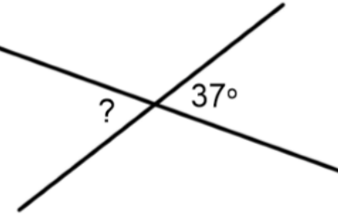
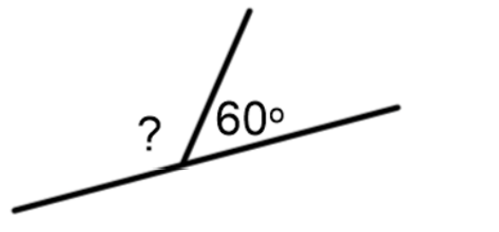
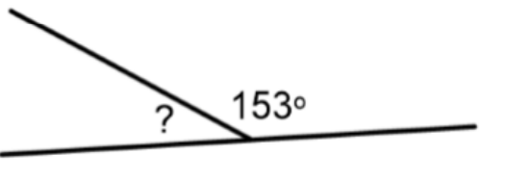
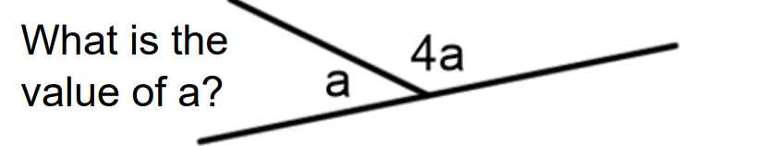
On The Whiteboards…

Slide 5
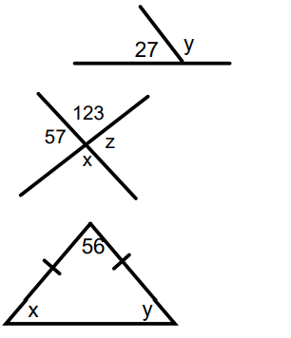


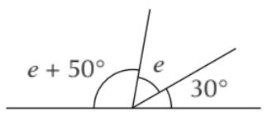
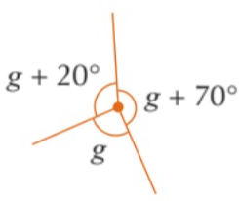
Your turn…
1.
2.
3.
4.
5.
1.
2.
3.

Slide 6
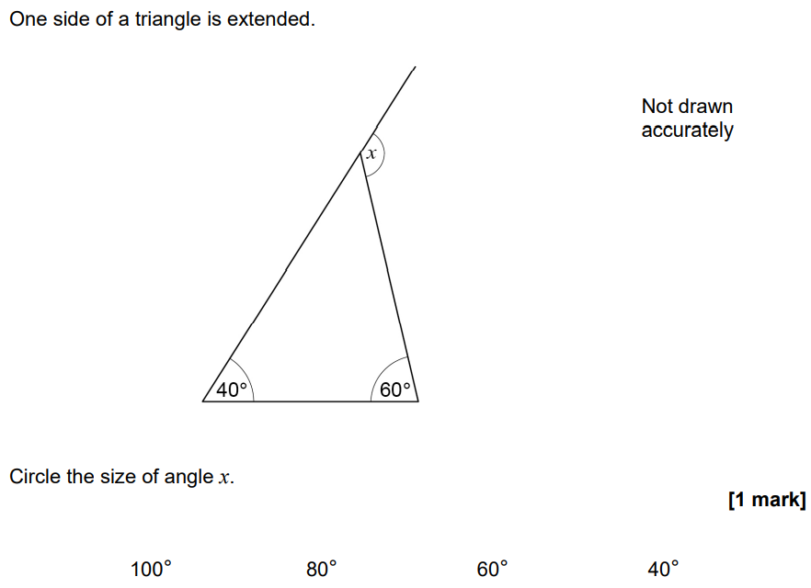

Exam Q

Slide 7
Parallel Lines
In your books/on the tables/on the whiteboards draw three sets of parallel lines. We’re going to label the following:
Corresponding angles
Alternate angles
Co-interior

Slide 8
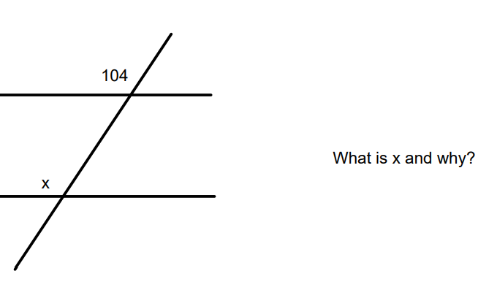
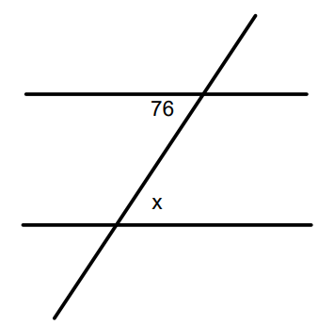
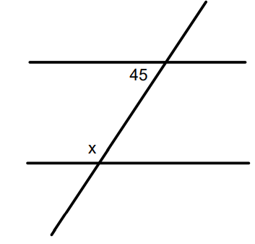
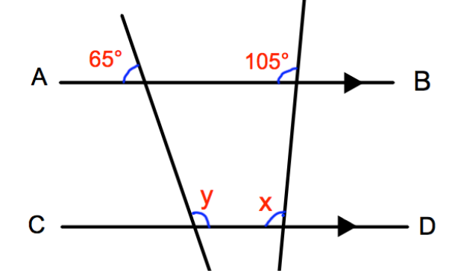
123
105
115
x
x
x
Find x and give a reason for your answer.
Find x and y, giving a reason for your answer.

Slide 9
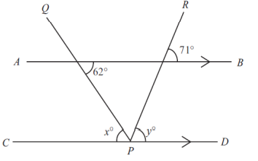
Your turn
Find x and give a reason for your answer.
Find x and y, giving a reason for your answer.

Slide 10
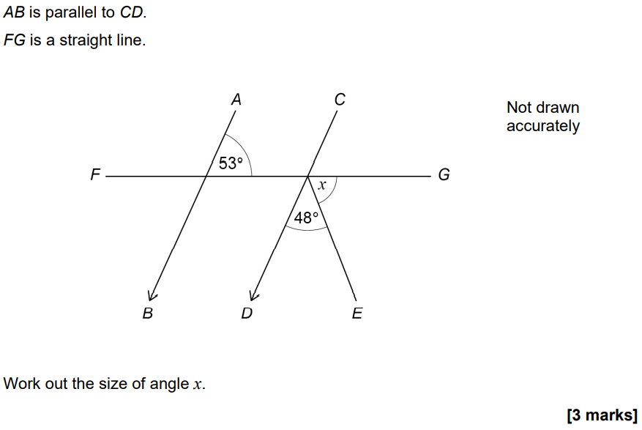
Exam Q

Slide 11
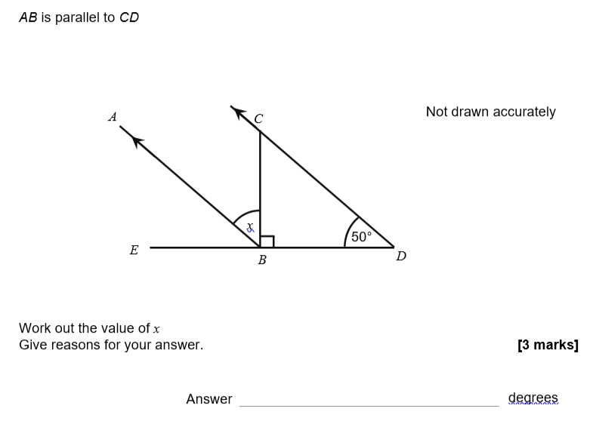
Exam Q

Slide 12
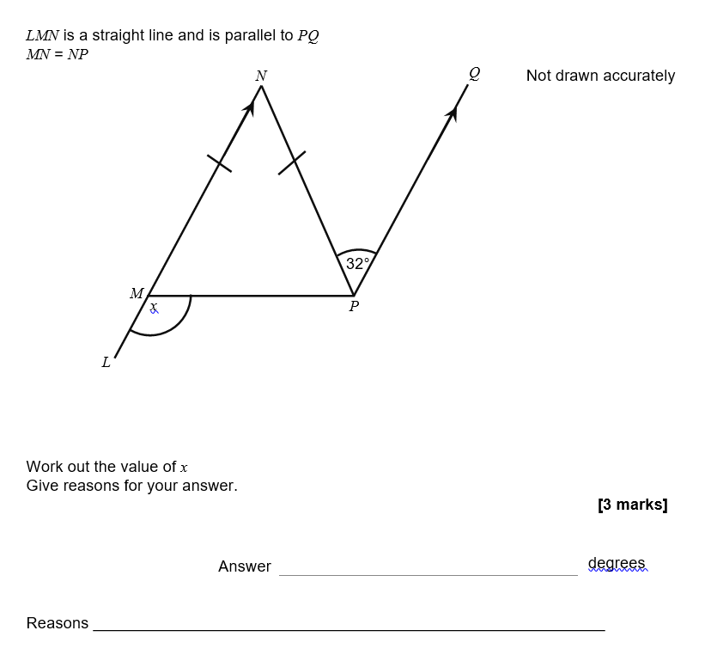
Exam Q

