Slide 1
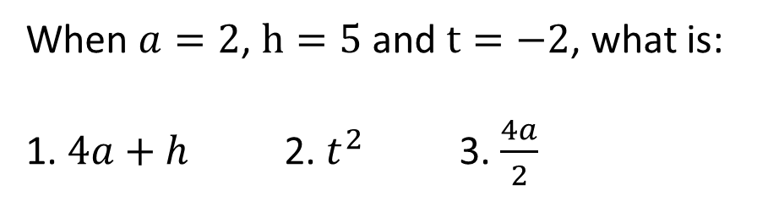
Probability Scale & Graphs
Learning Objectives
To be able to:
Identify fractions, decimals and percentages on a probability scale
Interpret and construct tables, charts and diagrams
When $a=2$, $h=5$ and $t=−2$, what is:
1. $4a+h$ 2. $t^{2}$ 3. $\frac{4a}{2}$

Slide 2
STARTER
Probability Scales
Vertical Line Graph
You have a bag of 2 red counters and 4 green counters. Place an A on the scale where the probability of selecting a red counter would be.
0
1
Pie Charts
Draw a pie chart for the table below
Favourite Fruit | Frequency
Apples | 4
Bananas | 10
Kiwi | 6
Raisin | 4
What is the modal day for ice creams sold?
What is the median number of ice creams sold?
Notes:
I don’t know what to do about Pictograms and about Vertical lines. Picto is so easy but I wanted to include it in the starter (not teach in the lesson) and I can’t figure out how to fit Vertical line graphs on this page…HELP

Slide 3
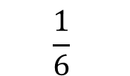
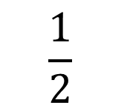
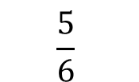
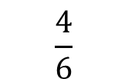
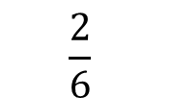
PROBABILITY SCALES
Place the letters on the probability scale:
A - P(flipping a head on a coin)
B - P(rolling a number less than 7 on a dice)
C - P(rolling a 5 on a dice)
0
$$\frac{1}{6}$$
$$\frac{2}{6}$$
$$\frac{1}{2}$$
$$\frac{4}{6}$$
$$\frac{5}{6}$$
1

Slide 4
Your turn:
Place the letters on the probability scale:
A - P(flipping a head or a tail on a coin)
B - P(rolling an odd number on a dice)
C - P(rolling a number less than 5 on a dice)
0
1
Place these letters on probability scale:
A - P(rolling a square number on a dice)
B - P(rolling a prime number on a dice)

Slide 5
PIE CHARTS
Draw a pie chart to show the favourite colour of 60 year 7 pupils
Colour | Frequency
Red | 17
Green | 8
Blue | 21
Yellow | 3
Other | 11
Total | 60

Slide 6
Your turn…
Draw a pie chart representing this data:
Vegetable | Frequency
Carrot | 13
Radish | 17
Marrow | 33
Potato | 5
Other | 4
Total | 60
On a pie chart representing people’s favourite colours, red is represented by 30˚. 5 people said red was their favourite colour.
How many people were asked in total?
Blue on the pie chart is 60˚. Write down the probability that someone selected at random has blue as a favourite colour.

Slide 7
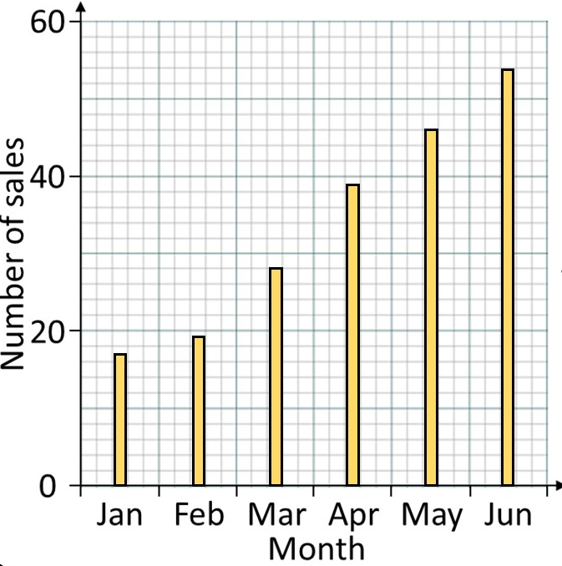
VERTICAL LINE GRAPHS
What is the mode for monthly sales?
What is the range?
What is the mean & median for the table?

Slide 8
Your turn…
1) a) Find the mode and range of the chart above.
b) Find the mean and median of the chart above
2) For every car sold, the dealership makes 15% profit. On Saturday and Sunday the dealership makes £1500 profit. How much money did they sell their cars for on these days?

Slide 9

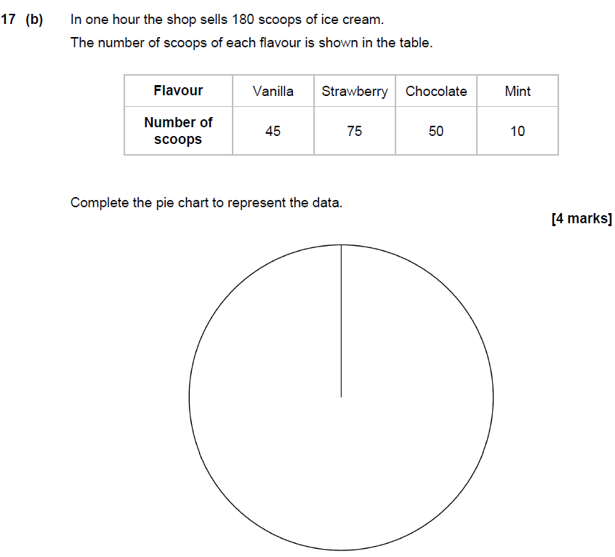
June 2019 Paper 3

Slide 10
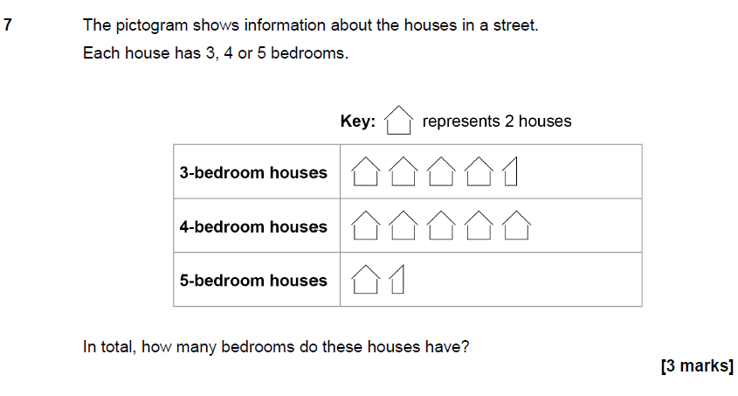
June 2019 Paper 3

Slide 11
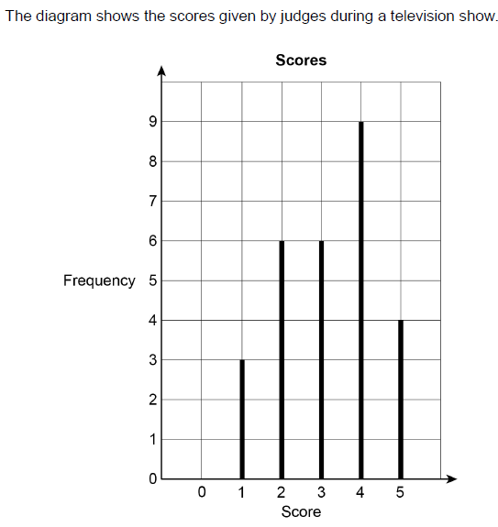
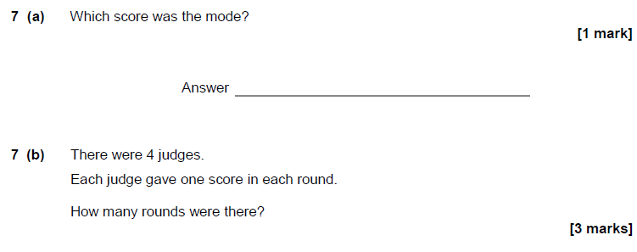
November 2017 Paper 1

