Slide 1
AVERAGES
Learning Objectives
To be able to :
To be able to find values for the mean, median, mode & range.
To be able to calculate the estimated mean of grouped data
Recap
1) Simplify 8f – 2u – 3f + 4u
2) Expand 3 ( 4x + 2y )
3) Factorise 18px + 12p

Slide 2
STARTER
Mean
Median
Find the Mean (average) of the following
18 15 25 35
Find the Median (average) of the following
1 0 2 1 3 5 2 1
Mode
Range
Find the Mode (average) of:
£3 £6 £2 £10 £10 £3 £4 £10
Find the Range of:
7 -2 4 -5 10 -6
Estimate Mean
0 < 2 | 2 < 4 | 4 < 6 | 6 < 8 | 8 < 10 | 10 < 12 | 12 < 14
5 | 11 | 9 | 5 | 3 | 1 | 1

Slide 3
Calculating the Mean
E.g.. Try to find the Mean of £300 £500 £250 and £600
300 + 500 + 250 + 600 = ?? Now divide your total by the 4 values = ??
Worked example
1) Find the Mean of
Monday | Tuesday | Wednesday | Thursday
350kg | 475kg | 290kg | 330kg

Slide 4
Your turn…
Find the Mean (Average) of:
250ml 400ml 600ml 500ml
£5000 £9000 £3700 £5700 £8000
1212 2112 2121
1, 1, -1, 0, 1
Extension:
Find the Mean (Average) of:
e) 15gb 14gb 10.7gb
f) 700K 1.5M 950K 2.1M
90cm 1.2m 75cm
-15 feet 16 feet -20 feet -1 feet

Slide 5
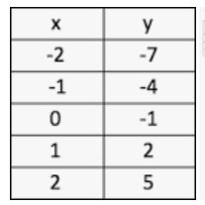
Calculating the Median
E.g.. Try to find the Median of £300 £500 £250 and £600
250 300 500 600 … So middle is ???
Worked example
Find the Median of values of x
Find the Median of values of y
Which of x or y has the largest Median value ?

Slide 6
Your turn…
Extension:
Find the Median (Average) of:
e) 1.5gb 14gb 10.7gb
f) 700K 1.5M 950K 2.1M
90cm 1.2m 75cm
-15 feet 16 feet -20 feet -1 feet
Find the Median (Average) of:
250ml 400ml 600ml 500ml
£5000 £4000 £3700 £5700 £3000
1212 2112 2121
1, 1, -1, 0, 1

Slide 7
Calculating the Mode and Range
Lets work out the MODE of
5 2 3 2 7 2
Lets work out the RANGE of
500 200 350 900 670
Worked example
What is the mode milk production? What is the Range ?
Week1 | Week2 | Week3 | Week4 | Week5 | Week 6 | Week7 | Week8 | Week9 | Week10
2070L | 2190L | 3010L | 2905L | 2070L | 2200L | 3100L | 1900L | 2700L | 2800L

Slide 8
Your turn…
Find the Mode (Average) of:
5 5 7 9 5 2 9 2 2 2 2 9
£17 £22 £30 £71 £20 £30 £34
0 1 2 1 3 1 5 3 6 2 5 1 3 1 1
AB7 AC2 AE3 AC2 AB7 AC2
Find the Range of:
14,278m -23,949m -15,015m 8007m
0.044 0.101 0.006 -0.088 -0.155
18.3C 19.4C 10.7C 11.5C 9C 20C
19Km 13.2Km 22.7Km 8Km 20.7Km

Slide 9
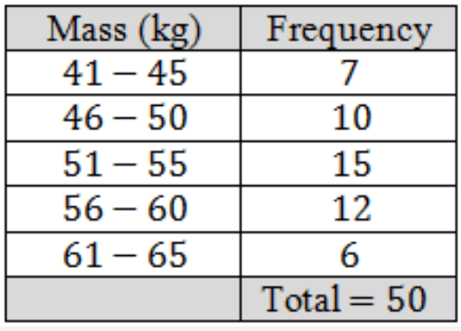
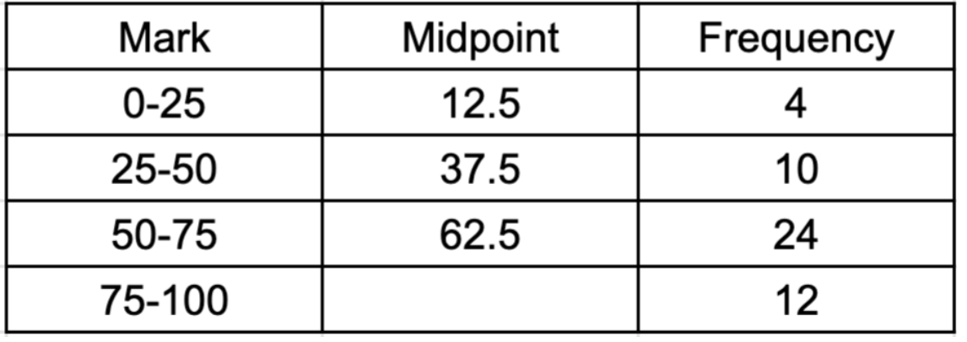
Estimated Mean of Grouped Data
E.g.. Try to find an estimate of the Mean for this grouped data.
Mid point of 41 – 45 is 43
43 x 7 = 301 continue……..
Worked example
Find an ‘Estimate’ of the Average (Mean) mark

Slide 10
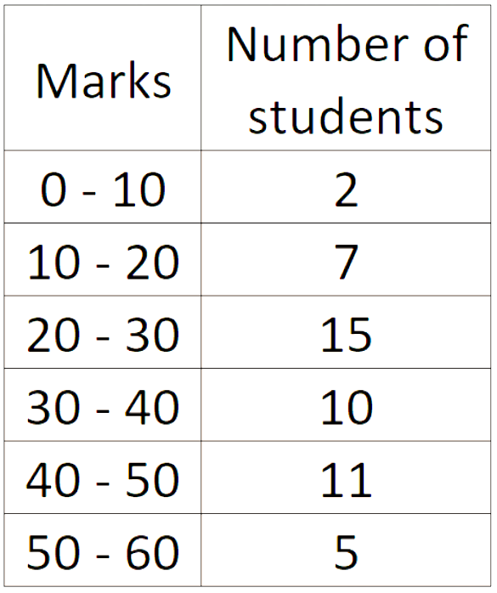
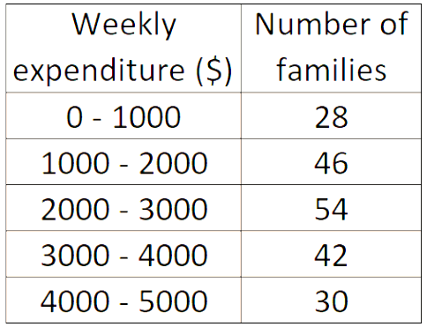
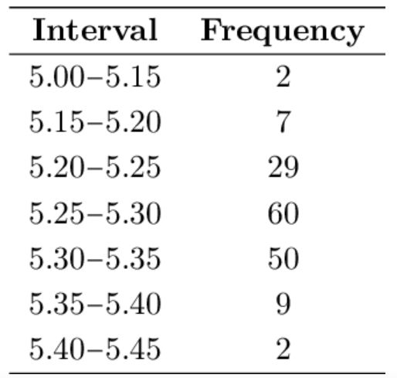
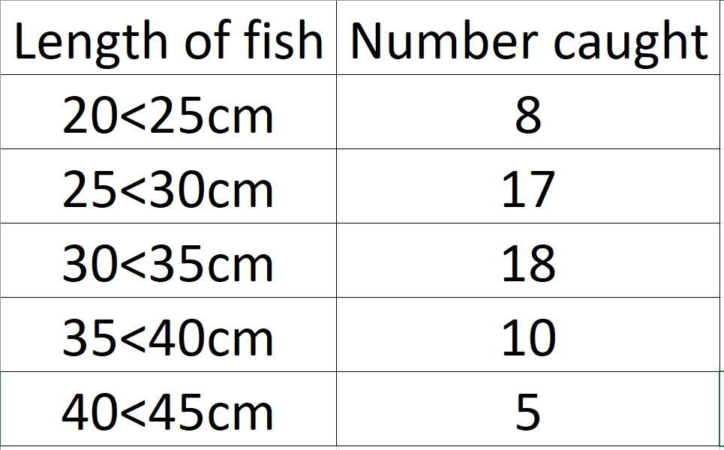
Your turn…find an estimated Mean
1)
1)
1)
1)

Slide 11

2.303 2.3 2.33 2.03
Find the Mean of the values
Answer _____________________________
[2 Marks]

Slide 12

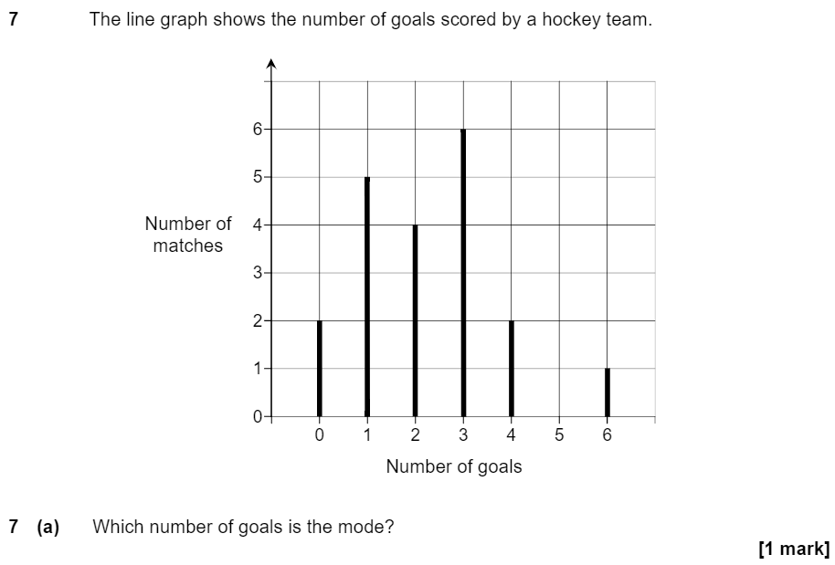

Slide 13
(a) The table of values for y = 3x + 1 is shown
Find the Median value of ‘y’
X | -3 | -2 | -1 | 0 | 1 | 2 | 3
Y | -8 | -5 | -2 | 1 | 4 | 7 | 10
[ 1 Mark ]

Slide 14

A new value is added to those shown to create a fifth value. This new value is 50x the current range of the first four values. What is the new range of all five values?
2449 2450 2495 2499 ………
[ 3 Marks ]

Slide 15
8 Estimate the Mean picture length.
picture length | sold
40<55in | 20
55<70in | 40
70<85in | 60
85<100in | 65
100<115in | 47
115<130in | 23
[ 3 Marks ]

