Slide 1

NUMBER
Learning Objectives
To be able to :
Read, write, order and compare positive and negative numbers of any size
Carry out calculations with numbers up to one million including strategies to check answers, estimating and approximating
What is 20 as a fraction of 100?
2. Work out $5\frac{1}{4}−3\frac{3}{8}$
3. The cost of hiring a van for number of days is calculated using the formula:
Hire Cost = 20 x Number of Days + 40
Calculate the cost of hiring a van for 5 days.
4. Sarah and her mother go for a meal. They pay for the meal in the ratio 1:2. John pays £20.
What is the total cost of the meal?
5. Work out 256.508 – 6.4595

Slide 2
STARTER
Read and write numbers
Calculation and rounding numbers
Write sixteen million, ten thousand and eleven point six in numbers
Write 1 090 930 007.08 in words
What is the value of the digit 2 in the number
32 801 768 ?
5) There are 180 156 maths learners and 180 165 English learners at college.
Calculate the difference between maths and English learners.
6) Rounding 180 156 to nearest thousand
Compare and order numbers
4) Order these numbers from smallest to biggest
-720, -4 567, 8 600 000, -345 879, 76, 800 702

Slide 3
Read, write, and order numbers (1)
1. Write down these numbers as digits
Two million, two hundred and sixty thousand, five hundred and forty-four
Two point four billion
Three million, one hundred and thirty thousand, four hundred and fifty-five
Nine billion, two million, one hundred and ninety nine
2. Now order these numbers from smallest to biggest
3. Write down these numbers as digits
Negative two million, two hundred and sixty thousand, five hundred and forty-four
Negative two point four billion
Negative three million, one hundred and thirty thousand, four hundred and fifty-five
Negative nine billion, two million, one hundred
and ninety nine
4. Now order these numbers from smallest to biggest

Slide 4
Your Turn…
1. Write down these numbers as digits
Four hundred and sixty two million, three hundred and sixty thousand, two hundred and four
Negative three point four million
Negative one billion, two million, two hundred and thirty thousand, four hundred and fifty five
Nine billion, two million, one hundred and ninety nine
Nine hundred and ninety nine
Negative three hundred and ninety five million, nine hundred and forty four thousand, and five
2. Now order these numbers from smallest to biggest

Slide 5
Read, write, and order numbers (2)
Write these numbers out in words
21 061 342 012
230 498 999
9 389 208
4 050 000 000
2. Now order these numbers from biggest to smallest
Write these numbers out in words
- 230 498 999
- 21 061 342 012
- 9 389 208
-4 050 000 000
2. Now order these numbers from biggest to smallest

Slide 6
Your Turn…
Write these numbers out in words
874
-2 007 345
-1 008 034 865
470 023 987
2 000 000 012
2. Now put the above these numbers in descending order:

Slide 7
Counting and compare numbers
1. Ann is counting to one million. She missed some numbers. Add the missing numbers in
the sequence.
___________, 3 582 245, ___________, 3 582 247, 3 582 248, ___________, ___________,
2. Fill the gaps below using the ‘ < ‘ and ‘ > ’ symbol inside the boxes.
34 834 389 34 734 399
9 999 999 999 9 000 000 000
- 789 345 - 780 321

Slide 8
Your turn…
1. Sidra had £359 in her bank account on Saturday.
On Sunday, Monday and Tuesday, she deposits £ 1 000 each day.
How does she have after the last deposit, made on Tuesday?
2. Fill the gaps below using the ‘ < ‘ and ‘ > ’ symbol inside the boxes.
476 835 689 476 835 399
-78 934 - 87 943
9 456 234. 56 9 456 234. 9

Slide 9
Carry out calculations with numbers and check the calculations using rounding (1)
Work out :
352 837 + 28 639 =
49 582 – 3 469 =
Check your calculation on the left side

Slide 10
Your turn…
Work out :
25 678 + 123 434 =
419 582 – 3 445 =
Check your calculation on the left side

Slide 11
Carry out calculations with numbers and check the calculations using rounding (2)
Work out :
562 X 849 =
4 068 ÷ 9 =
Check your calculation on the left side

Slide 12
Your turn…
Work out :
138 X 265 =
111 396 ÷ 3 =
Check your calculation on the left side

Slide 13
Rounding in Large Number word problems
1897 movies in a year each made £193M.
Estimate the total income from the movies for the year.

Slide 14
Your turn …
Use rounding to estimate the answers to the following
A bacterial population changes each hour.
Hour 1 8600 Hour 2 114 381 Hour 3 18 629 407 Hour 4 396 028 498
Calculate total the bacteria for the four hours.
Each month over a year 186 000 passengers use a train company and each paying £320 for their
monthly ticket.
Calculate the yearly income for the train company.
d

Slide 15

Set 1 Sep 2019
1.
(a) Write the number Seven hundred and four thousand, thirty five in figures.
______________
(1)
(b) Rounding the number 473 945 to the nearest ten.
______________
(1)
d

Slide 16
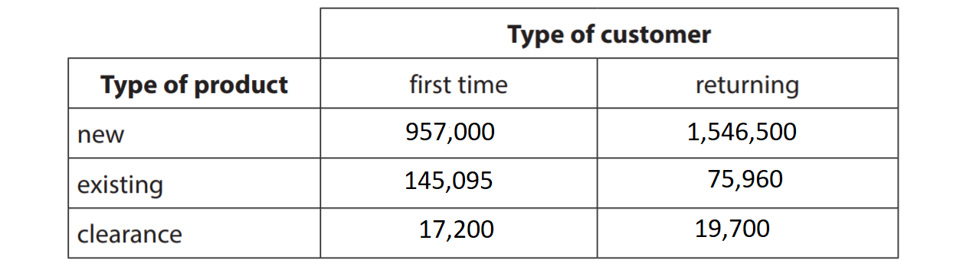
Set 1 Sep 2019
2. Laypin has this information about the number of sales the company made last month.
Use suitable rounding to re-write the information table. (3)

Slide 17
3. Matt is getting his first mortgage. He wants to check roughly how much in total.
He will pay back by estimating and using the below formula.
He will borrow £ 259 500 over 27 years
R =
R is the amount to pay back
V is the amount borrowed
Y is the number of years of the mortgage
Matt thinks he will pay roughly £315K back. Show how he arrived at this value. (4)
V x Y x 1.049
30

