Slide 1
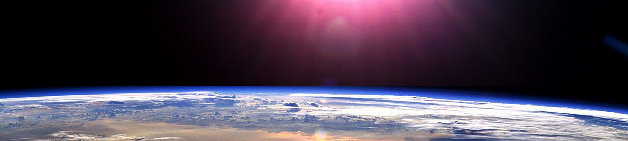
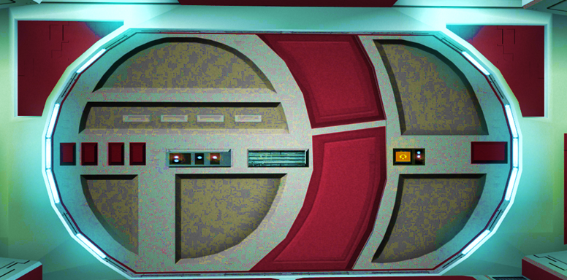


Slide 2

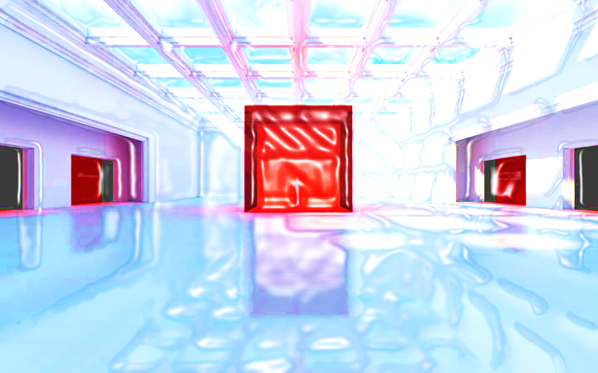





Whole Number and Functions
A R E A

Slide 3



















Course Content: Choose your topic …
Whole Number and Functions
place
value
negative
numbers
add and
subtract
multiply
divide
round
numbers
ratio
scale
fraction
decimal
numbers
percent
percent
decimal
fraction
MATHS L1 to L2
Parts of a whole
metric
measure
imperial
measure
perimeter
area
volume
formulae
bodmas
charts
data
averages
prob-
ability
Measure and Shape
Handling Data

Slide 4





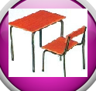





Home Revision Progress Check 1 Video/Discuss Vocab / jobs Lesson Activities Quizzes Topic Answers Progress Check 2 Cont. Learning
Topic Introduction : A r e a
A 2D surface such as a garden, wall, plot of land or even mobile phone screen can be measured using squares. Area is the number of squares you can put inside a 2D shape. Whether you are dealing with sheets of metal in a factory or carpets in your house, the topic of area becomes important.
Area measures two directions at the same time and a new piece of maths is introduced in this topic. An ‘Index’ number that is written small and raised to the side of the measurement unit, tells you how many directions you have measured at the same time. If this index number is 2 then you are measuring area which is length and width directions.
Choose an icon to select where to start
A R E A

Slide 5



Warm up Exercise 1
Lets start today by revising ! Complete the above sums and multiplication grid

Slide 6


Warm up Exercise 2
Calculate the instruction on the central number
Bubble maths
4:11
-876
+1471
1760
Round to nearest 1000
x36
/36
/100

Slide 7
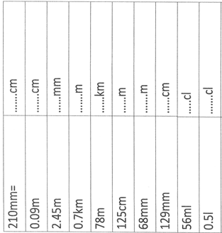

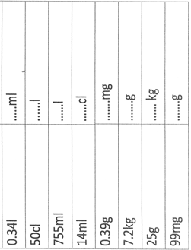
Warm up Exercise 3

Slide 8

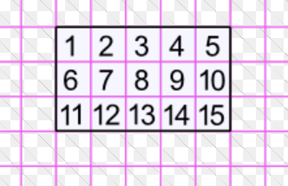
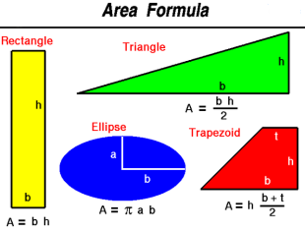
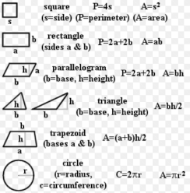
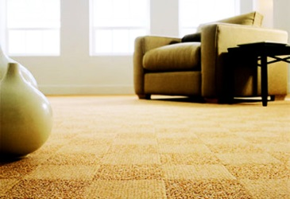
Progress Checker 1
W
What do you already know about Areas ?
How would you rate your skills in finding areas of 2d shapes ?
Excellent ability
Good ability, but working to improve
Ok, making a start but I know I have lots to still learn
My aims for today Date: are…
A Find the area of simple square and rectangular shapes
B Find the area of composite shapes and circles
C Use area formulae to solve practical problems involving areas
A=lw

Slide 9

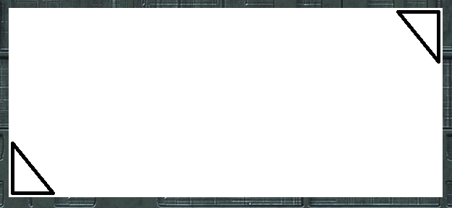
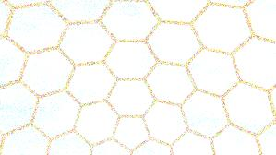

Introductory Video and Discussion
KHTU.
What are you counting when you find an AREA measurement ?
Can you find the area of any shape ?
What would you need to find the area of and why ?
What is land area and what unit/s is it measured in ?
What is an ‘index’ number and how is it used in units of area measurement ?
How do you convert sq ft to sq metres ?
Watch the introductory video and then discuss the above
Your thoughts..

Slide 10

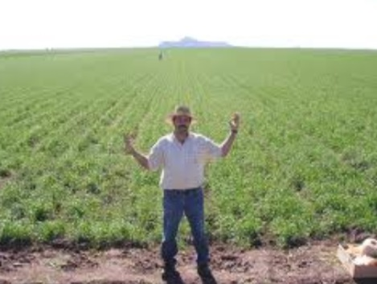
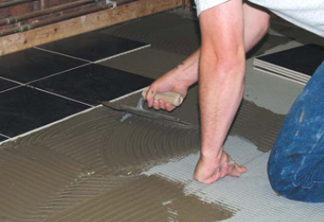

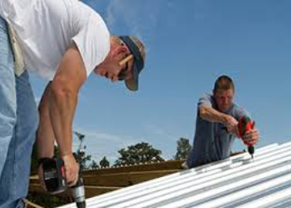

Vocabulary and Jobs
Area
Squared
Formula
Surface
2 Dimension (2D)
Plane
Length
Width
mm² cm² m² km²
in² ft² yd² mile²
Hectare
Acre
Compound
These are the words you will be using in this topic
Carpet Fitter
Tiler
Roofer/Slater
Road worker
Cloth/Fabric worker
Sheet Metal worker
Seating planner
Farming
Housing planner
…. Can you think of more?
…………………………………
…………………………………

Slide 11


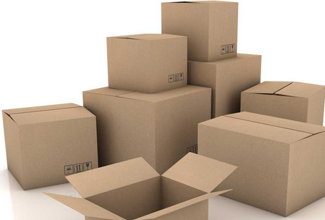
Lesson: Concept Activity
Fit the squares into the bottom of the boxes
How many will fit?
What about the gaps?

Slide 12
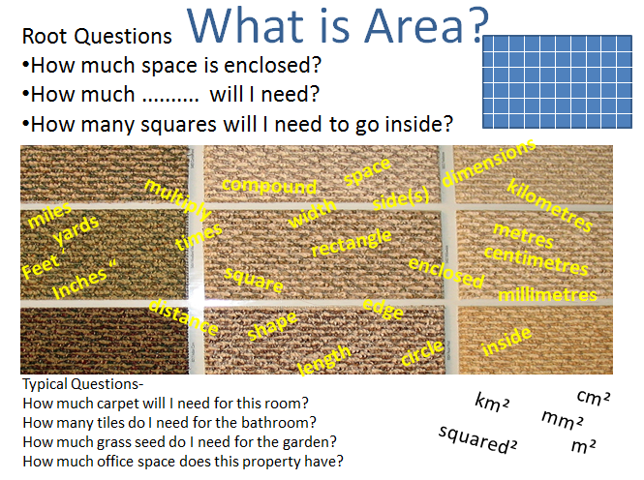
Lesson: Main Teach 1
tenth

Slide 13
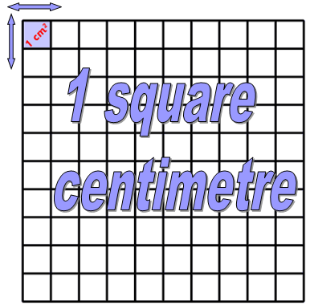
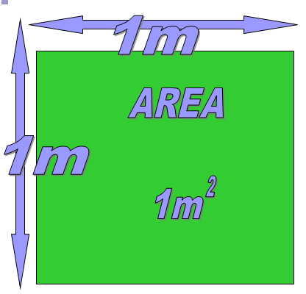
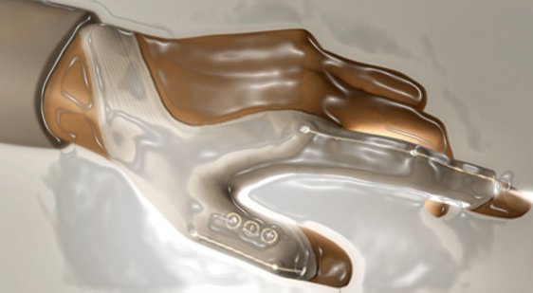
Lesson: Main Teach 2
The square metre is one metre in two directions and is the size of a household rug
10,000 sqcm
= 1 sqm
A square centimetre is one centimetre in two directions and would fit on your fingertip

Slide 14
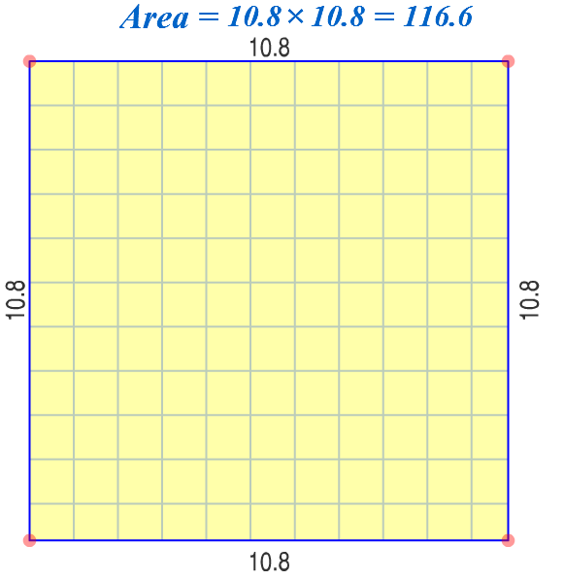
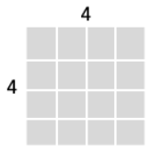
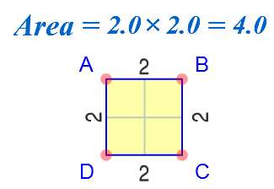

Lesson: Main Teach 3
Squared area occupies 2 directions at once, x and y
Like spreading paint along a wall and up or down at the same time!

Slide 15
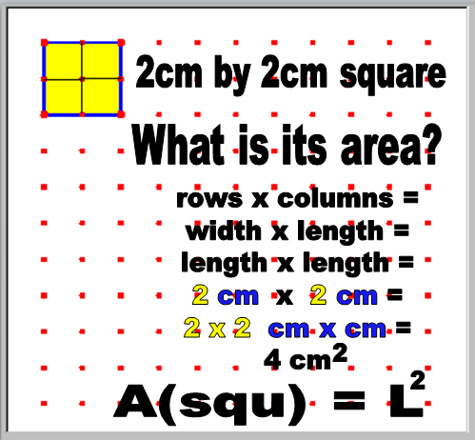
Lesson: Main Teach 4
The AREA of a square….
Measure a side length
Multiply this number by itself
Add the correct squared unit
eg cm² or maybe m²
That’s it..done !

Slide 16
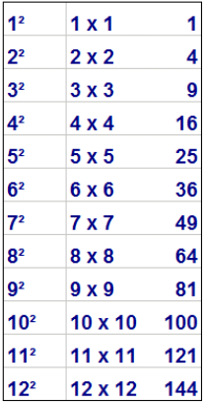
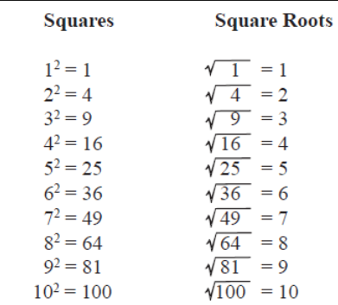
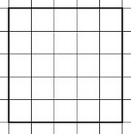

Lesson: Main Teach 5
Finding Square shaped Areas..
You will need to learn the answers to some basic questions such as the ‘Squared Numbers’
These are just numbers multiplied by themselves.
If you already have the answer ..ie.. the size of the Area … then you may have to work backwards.
The square root of a number tells you what number multiplied by itself will give you the Area
5
5
5x5=25
But √25=5

Slide 17

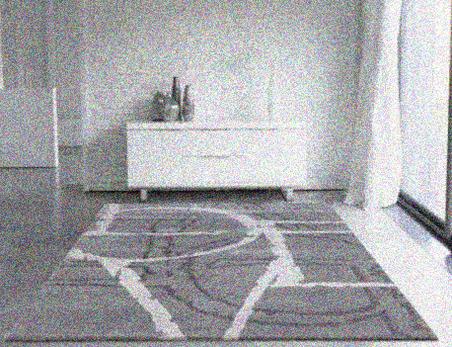
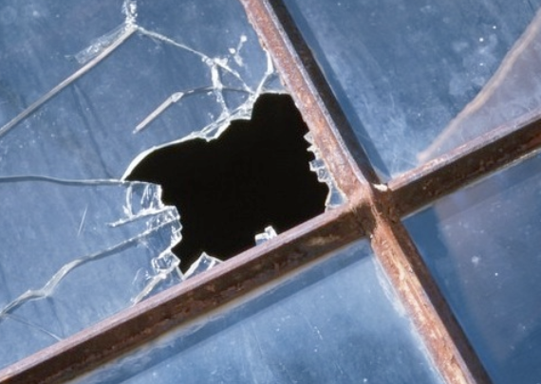
Lesson: Main Teach 6
Square Area examples:..
The length of a square rug is 2.5 metres long.
Find how many square metres of floor space the rug covers.
Answer….. Measure the rug…. This is already given as 2.5 m
Multiply the length by itself…. So .. 2.5 x 2.5 = 6.25
Add the unit…. Here it is metres x metres ..so m²
answer is 6.25 m²
A broken square window is replaced. 5000 sqcm is used. What is the size of the window (length?).
Answer…. Here we have the area already and need to work backwards.
Take the square root of the area… √5000 =70.7cm

Slide 18
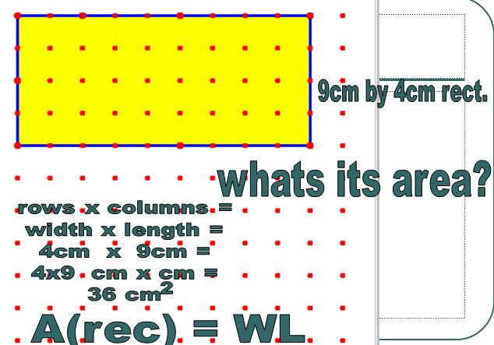
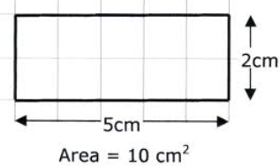
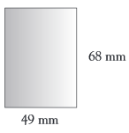
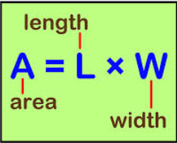
Lesson: Main Teach 7
Rectangular Areas…
A rectangle is just a longer square!
It has squares inside it in rows and columns
You ‘could’ count all the squares inside…or you could multiply the number of rows of squares by the number of columns of squares
Therefore the Area of a rectangle is its Length x Width
A = 68x49
= 3,332 mm²

Slide 19
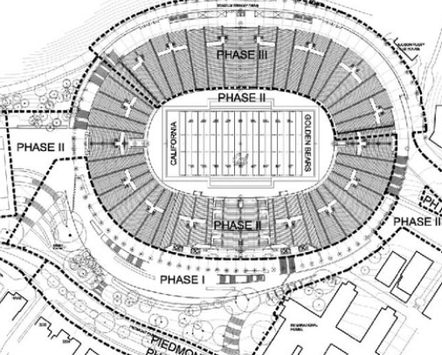

Lesson: Main Teach 8
Rectangle Area examples:..
The plans for a rectangular sports stadium lay out a 400m by 200m size area of land. Find the number of sqm of land.
Answer… Area of a rectangle is L X W … so 400m x 200m
this equals 80,000 m²
The area of glass for a new mobile phone screen is 50sqcm. If the width of the screen is 5cm, how long is the screen?
Answer… Now we know the Area is 50 and that A=LxW
So… 50 = ?? x 5, well only 10 x 5 can make 50
so the answer is ….the length is 10cm

Slide 20
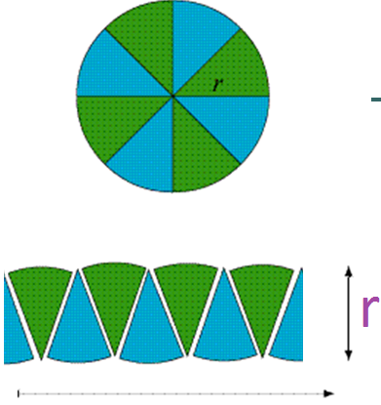

Lesson: Main Teach 9
Areas of circles..
The area of a circle can be found by cutting the circle up into pieces and turning it into a rectangle shape.
The area of the rectangle formed is just L x W
However the width of the rectangle is the same as the radius of the circle.
Also the length of the rectangle is half of the circumference length (ie half of 2 π r , which is π r )
Therefore the area of the rectangle (and also the circle) is r x π r which can be written π r²
Don’t forget that just like a rectangle area, you are counting squares. Therefore your answer must be in squared units such as cm² or m²
Area = π r²

Slide 21
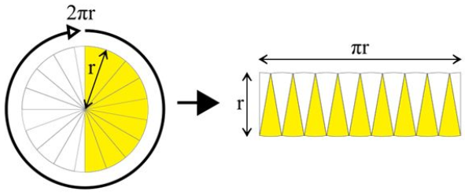
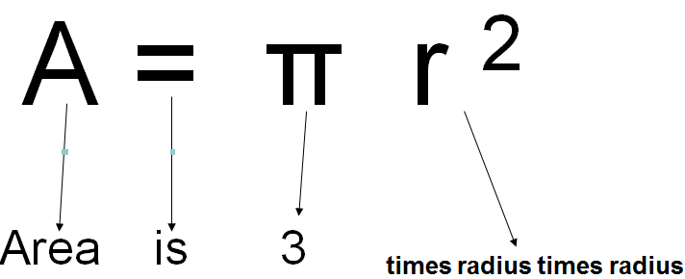
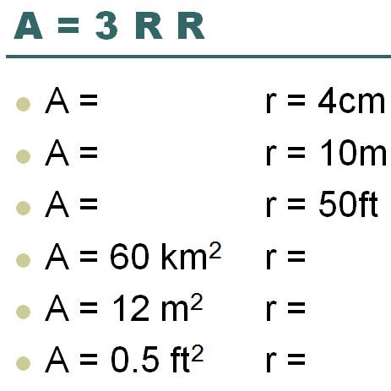
Lesson: Main Teach 10
Areas of circles..
Let’s try some…..
Radius is 4 cm .. So… 3.14 x 4 x 4 = 50.24 cm²
Radius is 10 m .. So… 3.14 x 10 x 10 = 314 m²
Radius is 50 ft .. So… 3.14 x 50 x 50 = 7850 ft²
Area is 60 km² ..so.. √(60 / 3.14) = 4.37 km
Area is 12 m² ..so.. √(12 / 3.14) = 1.95 m
Area is 0.5ft² ..so.. √(0.5 / 3.14) = 0.4 ft
Don’t forget that square roots are what you need to reverse the squaring process !

Slide 22
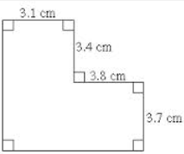
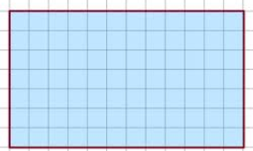
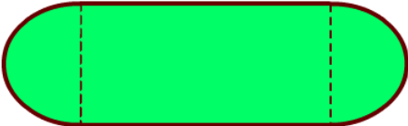
Lesson: Try out
Block 1 : Watch tutor led demo (in class or on video) ( sqm = square metres, sqcm = square centimetres )
Try these, 1) Find the area of a square with side length 5m 2) A = 20cm x 20cm
3) Rectangle 4m by 9m = Area ? 4) Area is 30 sqm, length is 5m, width = ?
Block 2 : Watch tutor led demo (in class or on video)
Try these, 5) 19.6cm x 8cm = ………….. 6) Area = 80 sqm , length = 35m, width = ?
7) Area = ? 8) Area = 17 sqcm
Block 3 : Watch tutor led demo (in class or on video)
Try these, 9) Circle Area is 40sqm, what is the Radius? 10) Circumference = 15cm, Area = ??
11) π r ² = 50 miles, r = ?? 12) What is the total area of the shape?
r=25m
L=30m
L=?
2cm

Slide 23
Lesson: Websites and links
An Area and Perimeter Geoboard
http://www.echalk.co.uk/maths/dfes_numeracy/Assets/area_flash.swf
Compare Area and Perimeter
http://www.shodor.org/interactivate/activities/ShapeExplorer/
Set of Area and Perimeter Card to match
like dominoes
http://www.greatmathsteachingideas.com/wp-content/uploads/2012/02/44255740-Area-and-Perimeter-Follow-Me-Card-Sort-Rectangle-Square-Triangle.pdf
Excellent visual circle applet to explore
Area of circle from its circumference
http://www.geogebratube.org/student/m279`
Explore simple squares, rectangles and
Triangle Areas, visuals and examples
http://www.mymaths.co.uk/samples/sampleLessonAreaRectangle.swf
Website page with area shapes and their
Formulae with examples
http://www.mathsisfun.com/area.html
Examples of finding areas of basic shapes
with questions to try
http://www.mathgoodies.com/lessons/vol1/area_rectangle.html
Get visual with circles and see how diameters
circumferences, radius and areas are connected
http://illuminations.nctm.org/Activity.aspx?id=3547

Slide 24
Lesson: Activity A
Area Link !!
Like a set of dominoes, find the answers to the Area problems
The answers will be on other cards !
Link them up to create a rectangle
4 cm
20m²
6 cm

Slide 25
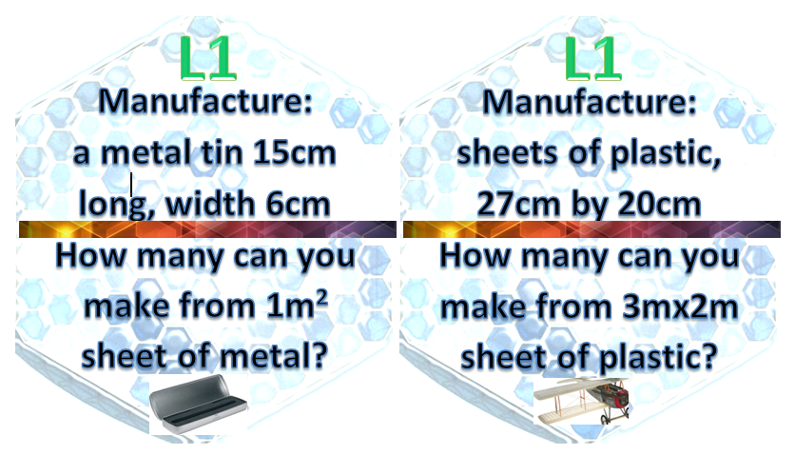
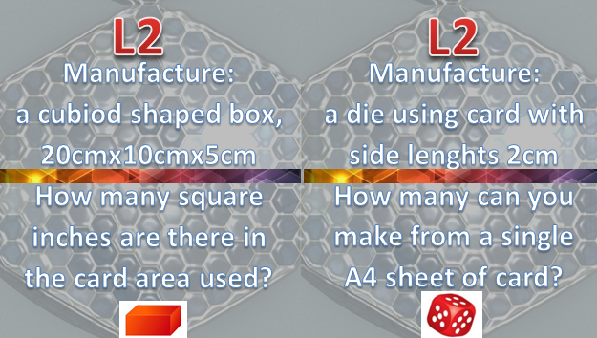
Lesson: Activity B
Use the materials provided to make the shapes and designs as per the cards

Slide 26


Lesson: Activity C
Computer based activity -
Design your own wallpaper pattern using a tessellating shape (shapes that do not have gaps when fitted together)
Can you figure out how many shapes can fit onto a single 1m2 area of material ?
L2 extension:
Can you create a pattern of circles that minimises wastage on a single 1m2 area of material ? Can you figure out how much is used and how much is wasted in the gaps between the circles?

Slide 27
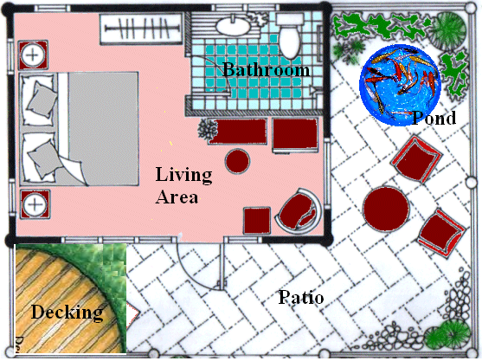
Lesson: Activity D
Complete the functional skills questions at L1 or L2

Slide 28

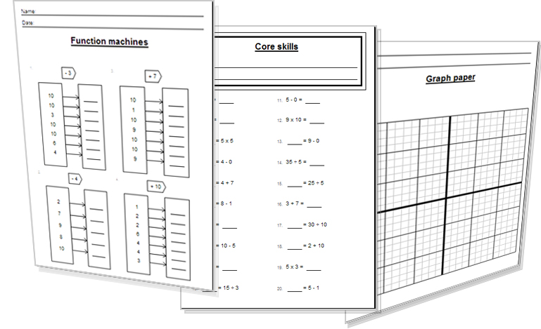
Lesson: Activity E
Try a variety of written practice
Worksheets
Workbooks
Practice Exam Papers
Maths Problems

Slide 29
Lesson: Practice – just the numbers
Find the areas of these rectangular shapes
L=2 W=7
L=5 W = 10
L=80m W=40m
L=15cm W=16cm
L=7.2 in W= 7.2 in
Find the lengths of the squares given their area
A= 16 cm²
A= 81 m²
A= 225 km²
A= 4000 ft²
A= 5m²
Find the areas of the shapes
11)
2.5km
12)
13)
14)
15)
Find the areas of the circles given their diameters or radius
16) r = 5cm
d = 10ft
r = 0.2mm
d = 23.7miles
r = half the area value! (difficult !!)
Find the circle radius given the area
A=40 cm2
A=900 m2
A=19.7 km2
Find the circle areas
24)
r = 2.3 cm
25)
r = 31 m
0.3km
4mm
9mm
7mm
3mm
8 in
0.4 in
15,920miles
2m
3000 miles
30cm

Slide 30

Lesson: Practice – word problems
A roof is covered in rectangular tiles 30cm x 15cm in size. The roof is 5m x 14m on the left side and the same on the right. How many tiles are needed to cover both sides of the roof?
A radiation leak forces an evacuation of a 40 mile radius from a town. What land area is now uninhabitable due to the leak?
A yacht is fitted with a new white triangular sail that is 3m long and 6.3m tall. What area of material was used to make the sail?
A sonar beep spreads out a circular area under the water detecting any movement in a 1 sqkm area on the sea floor. What is the distance the beep travels? (clue..the beep is the radius of the circle area)
A field of crops has a width that is half the length and covers 2 sqkm of land area. How wide and long is the field? (clue.. L = 2W, so… A = 2W x W)
A large red carpet for a movie premier extends out from the cinema down the road of a town. The carpet is 4m wide and 1.7 km long. How many square metres of carpet was used for the red carpet?
A rectangular piece of icing is used on the top of a circular cake. The icing is 30cm by 35cm long. How big can the circular cake be? (only consider the top of the cake, not the sides!)

Slide 31
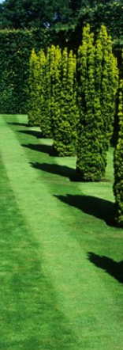
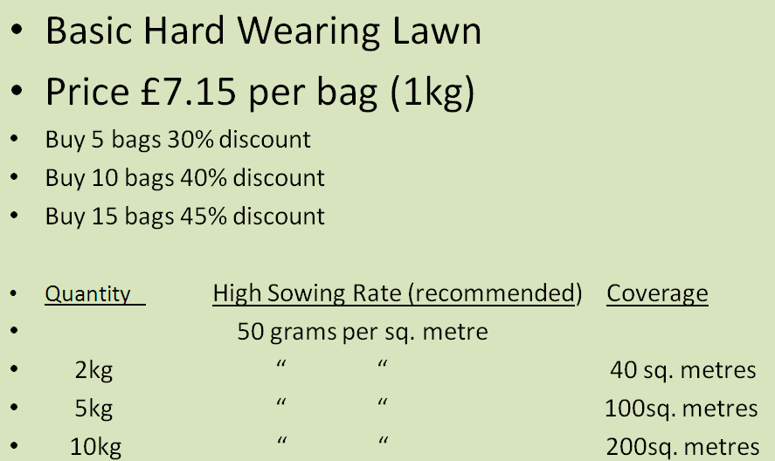
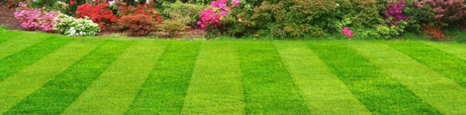
Lesson: Practice – Making it Functional 1
BB

Slide 32
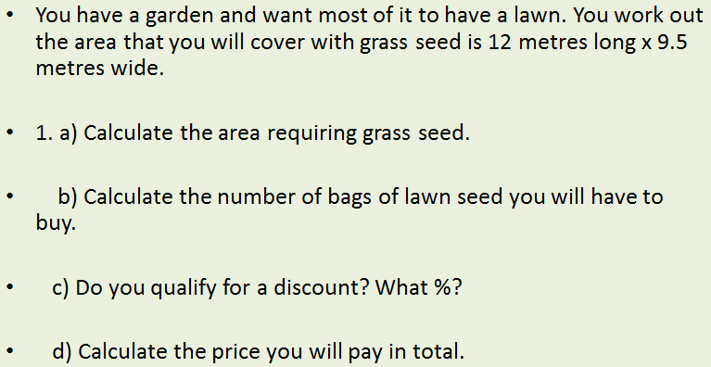
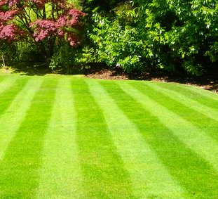


Lesson: Practice – Making it Functional 2
Use the information on the previous page
a
jj

Slide 33


End of Session Quiz to assess LEVEL 1

Slide 34

End of Session Quiz to assess LEVEL 2

Slide 35

TOPIC ANSWERS 1
Block 1 answers
25 sqm
400 sqcm
36 sqm
6m
Block 2 answers
156.8 sqcm
2.3m
36.07 sqcm
8.5 cm
Block 3 answers
3.6 m
17.9 cm
4 miles
3463 sqm
Just the sums
14
50
3200 sqcm
240 sqcm
51.84 sqin
4 cm
9 m
15 km
20 ft
2.23 m
6000 sqcm
0.75 sqkm
55 sqmm
3.2 sqin
47,760,000 sq miles
Just the sums cont.
16) 78.54 sqcm
17) 78.54 sqft
18) 0.126 sqmm
19) 441.15 sq miles
20) r=0.64, A=1.28
21) 3.57 cm
22) 16.93 m
23) 2.5 km
24)16.62 sqcm
25) 3019.1 sqm
Word problem - answers
3111 tiles
5026.5 sq miles
Word prob. Cont.
9.45 sqm
564 m
W=1km L=2km
6800 sqm
706.9 sqcm
(15cm long max!)

Slide 36





TOPIC ANSWERS 2

Slide 37

TOPIC ANSWERS 3
Quiz answers – Level One
20m
3000 sqcm
11.34 sqm
90 m
980,000 sqcm or 98 sqm
200 sqm
10m
100 sqcm
10 sqm
3 sqkm
Quiz answers – Level Two
26 sqcm
1018 sqcm
29 cm
37.7 miles
3000 sqcm
6
20,000
12.6 sqkm
0.79 sqkm
9 whole squares or 10.89 if you are able to cut them up

Slide 38
Progress Checker 2
W
What do you now know about Areas ? WHAT DID YOU LEARN. Write some examples…
How would you now rate your skills in finding areas of 2d shapes ?
Excellent ability
Good ability, but working to improve
Ok, making a start but I know I have lots to still learn
My aims for today Date: were…
A Find the area of simple square and rectangular shapes
B Find the area of composite shapes and circles
C Use area formulae to solve practical problems involving areas
A=lw

Slide 39


Continuing to Study and Learn
What else can you do to help yourself to learn and practice? Here are ten suggestions, record which you do each week and also record your progress.
Internet websites
Repeat the lesson, make notes, organise a folder, revise
Own maths workbook
Study together with a friend or family member
Finish activities in this book
Complete class handouts or tasks
Practice exams / past papers
Use maths skills learnt at home or at work in real situations
Play games
Experiment yourself, try new things ask yourself questions
Try making a graph of number of practice methods you use against your progress score in each topic. Are you showing more practice gives better results?

