Slide 1
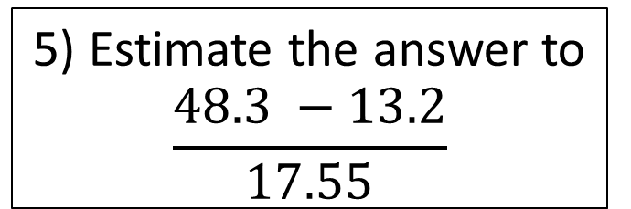
Starter
1a) 48 x 64
b) 4.8 x 6.4
c) 48 x 0.64
3) a) Simplify
4a + 7a – 2a
b) Simplify
5ab + 2b + 3ab + 6b
4) I throw a fair 6 sided dice. What is the probability of it landing on an even number?
5) Estimate the answer to
$$\frac{48.3 −13.2}{17.55}$$
2a) 784 ÷ 4
b) 784 ÷ 5

Slide 2
FRACTIONS
Learning Objectives
To be able to :
Convert mixed fractions to top heavy fractions and vice versa
Add, subtract, multiply and divide fractions
Find fractions of amounts
Compare fraction sizes
Recap:
Find the Highest Common Factor of 24 and 60.
Round 495 to 1 significant figure.
5 + 9 x 2³ – 3

Slide 3


Converting Mixed Numbers and Improper Fractions
$$1\frac{4}{7}$$
$$\frac{46}{8}$$

Slide 4
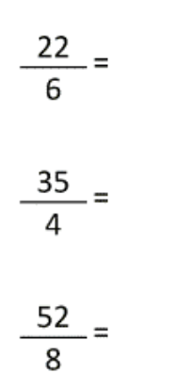
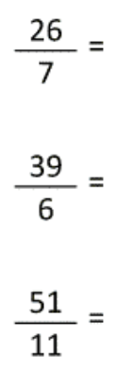
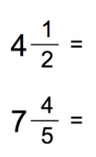



Your turn…
Convert to mixed fractions
Convert to improper fractions

Slide 5

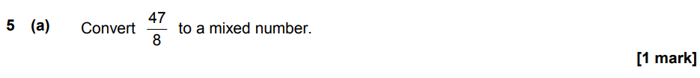
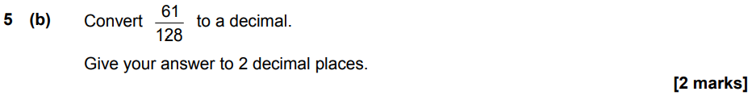
November 2021 P1

Slide 6


Fractions of Amounts
$$Find\frac{3}{4}of 20.$$
$$What is \frac{5}{3} of 90?$$

Slide 7
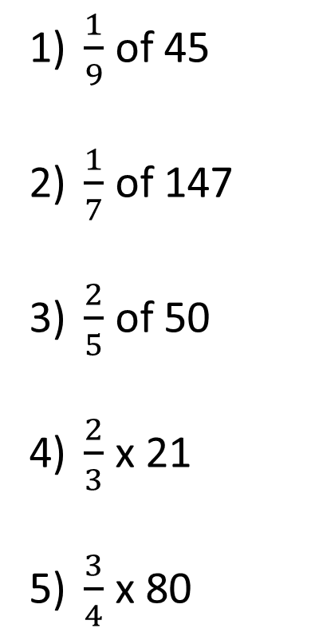
Your turn…
$\frac{1}{9}$ of 45
$\frac{1}{7}$ of 147
$\frac{2}{5}$ of 50
$\frac{2}{3}$ x 21
$\frac{3}{4}$ x 80
A pair of jeans normally costs £40. In the sales there is ¼ off. Work out how much the jeans are in the sales.
In January a baby elephant weighs 180kg. By March the weight of the baby elephant had increased by ⅜. Work out the weight of the baby elephant in March.
Bill is 80 years old. His son Max is ⅝ of his age. His granddaughter Jayne is ⅕ of his age. How many years older than Jayne is Max?

Slide 8
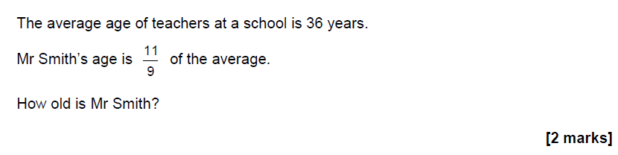
June 2017 Paper 2

Slide 9


Comparing Fractions
Which is bigger?
$$\frac{2}{5} OR \frac{3}{7}$$
Write the following in ascending order:
$\frac{2}{10} \frac{4}{5} \frac{3}{4}$ $\frac{11}{25}$

Slide 10


Your turn…
Put these fractions in order, from smallest to largest.
a) $\frac{3}{4} \frac{2}{3}$ $\frac{5}{6}$ $\frac{1}{3}$
b) $\frac{1}{4}$ $\frac{3}{8}$ $\frac{1}{6} \frac{5}{12}$
c) $\frac{1}{2}$ $\frac{2}{3}$ $\frac{7}{12}$ $\frac{5}{6}$
Larna receives these test results during her end of year test:
Art: $\frac{12}{20}$
Music: $\frac{4}{5}$
English: $\frac{7}{10}$
Latin: $\frac{23}{40}$
Which subject did she do the best on?

Slide 11
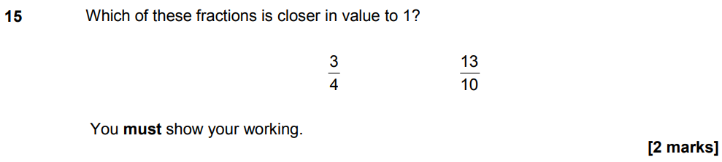
November 2021 P1

Slide 12



Adding and Subtracting Fractions
$$\frac{5}{9} + \frac{2}{9}$$
$$\frac{4}{5} + \frac{3}{8}$$
$$\frac{7}{4} − \frac{5}{8}$$

Slide 13








Your turn…
$$a) \frac{1}{3}+ \frac{2}{4}$$
$$b) \frac{2}{5}− \frac{2}{6}$$
$$c) \frac{1}{3}+ \frac{3}{5}$$
$$d) \frac{3}{5}− \frac{8}{15}$$
$$a) 3\frac{1}{3}+ 9\frac{2}{4}$$
$$b) 5\frac{1}{2}− 1\frac{2}{4}$$
$$c) 6\frac{1}{5}+ 8\frac{9}{10}$$
$$d) 5\frac{2}{3}− 3\frac{1}{2}$$

Slide 14
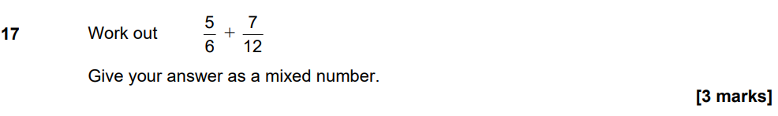
November 2021 P1

Slide 15


Multiplying And Dividing Fractions
$$\frac{7}{9} × \frac{2}{5}$$
$$\frac{5}{9} ÷ \frac{2}{7}$$

Slide 16








Your turn…
$$a) \frac{2}{3}÷\frac{1}{5}$$
$$b) \frac{3}{5}×\frac{1}{2}$$
$$c) \frac{4}{11}÷\frac{2}{9}$$
$$d) \frac{4}{8}×\frac{1}{12}$$
$$a) 3\frac{1}{3}÷2\frac{1}{5}$$
$$b) 2\frac{1}{3}×\frac{1}{4}$$
$$c) 2\frac{3}{4}÷1\frac{2}{3}$$
$$d) 1\frac{1}{3}×2\frac{1}{4}$$

Slide 17
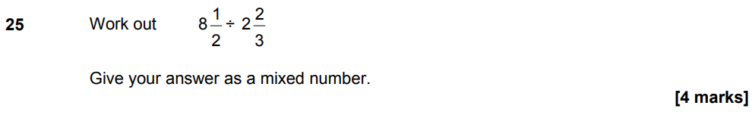
November 2021 P1

Slide 18
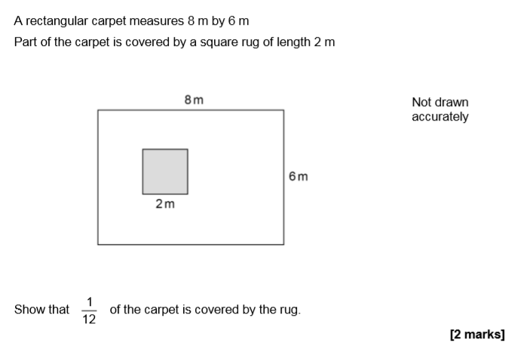
June 2018 Paper 1

