Slide 1
Starter
Find the side x.
3) Show -2 < x ≤ 3 on a number line
(draw it out in your books from -4 to 4)
x cm
6cm
4) There are 500 butterflies in a field. The number increases by 35%. How many butterflies are now in the field?
10cm
2) Solve 5x + 2 = 36
5) What is 1/4 ÷ 2/5?

Slide 2
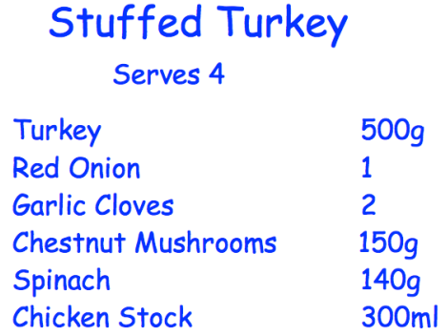
PERCENTAGE CHANGE
Learning Objectives
To be able to:
Solve problems involving percentage change
Percentage increase/ decrease
Reverse Percentage
How much of each ingredient is needed for 10 people?

Slide 3
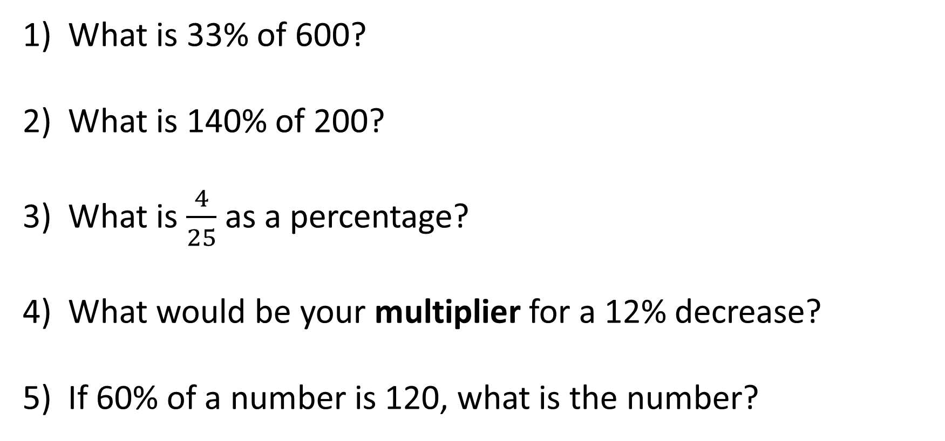
PERCENTAGE – RECAP
What is 33% of 600?
What is 140% of 200?
What is $\frac{4}{25}$ as a percentage?
What would be your multiplier for a 12% decrease?
If 60% of a number is 120, what is the number?

Slide 4
PERCENTAGE – RECAP
What is 33% of 600?
What is 140% of 200?
What is $\frac{4}{25}$ as a percentage?
What would be your multiplier for a 12% decrease?
If 60% of a number is 120, what is the number?
198
280
16%
0.88
200

Slide 5
PERCENTAGE INCREASE
The price of a train ticket increased from £50 to £60.
Calculate the percentage change.
Increase
Original Amount
x 100

Slide 6
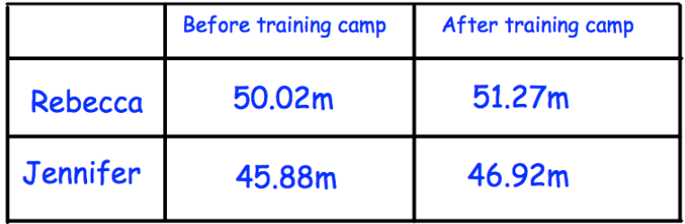
Your turn…
1) A population of 3000 bacteria increases in 3 hours to 3450. What is the percentage increase of the bacteria?
2) In 2000 the price of a house was £72,600. By 2010 the price of the house had increased to £125,598.
Find the percentage increase in the price of the house from 2000 to 2010.
3) The table below shows Rebeccaʼs and Jennifer's best javelin throw before and after the training camp. Which athlete had the biggest percentage improvement?

Slide 7
Your turn…
1) A population of 3000 bacteria increases in 3 hours to 3450. What is the percentage increase of the bacteria?
2) In 2000 the price of a house was £72,600. By 2010 the price of the house had increased to £125,598.
Find the percentage increase in the price of the house from 2000 to 2010.
3) The table below shows Rebeccaʼs and Jennifer's best javelin throw before and after the training camp. Which athlete had the biggest percentage improvement?
15%
73%
Rebecca = 2.49% Jennifer = 2.26%
So Rebecca has the largest % increase.

Slide 8
PERCENTAGE DECREASE
There were 160 smarties in the box yesterday, but now there are 116.
What is the percentage change?
Decrease
Original Amount
x 100

Slide 9
Your turn…
3) The average house price in London in 2017 was £474902. The average house price in London in 2018 was £469538. Calculate the percentage change in house prices between 2017 and 2018.
Give your answer correct to 1 decimal place.
4) Banana Computers sold 19.3 million computers in 2017. In 2018, they sold 18.2 million computers.
Work out the percentage decrease in the number of computers sold.
Give your answer to 3 significant figures.
1) Mel buys a house for £352 000. She sells the house for £325 600. Calculate the percentage loss Mel makes.
2) Last year Victoria paid £354 for her car insurance. This year she has to pay £329 for her car insurance. Work out the percentage decrease in her car insurance.
Give your answer to 1 decimal place.

Slide 10
Your turn…
3) The average house price in London in 2017 was £474902. The average house price in London in 2018 was £469538. Calculate the percentage change in house prices between 2017 and 2018.
Give your answer correct to 1 decimal place.
4) Banana Computers sold 19.3 million computers in 2017. In 2018, they sold 18.2 million computers.
Work out the percentage decrease in the number of computers sold.
Give your answer to 3 significant figures.
1) Mel buys a house for £352 000. She sells the house for £325 600. Calculate the percentage loss Mel makes.
2) Last year Victoria paid £354 for her car insurance. This year she has to pay £329 for her car insurance. Work out the percentage decrease in her car insurance.
Give your answer to 1 decimal place.
7.5%
1.1%
7.1%
5.70%

Slide 11

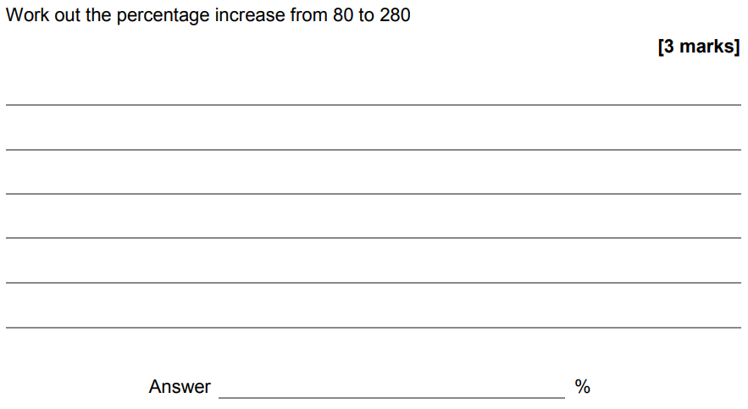

Slide 12
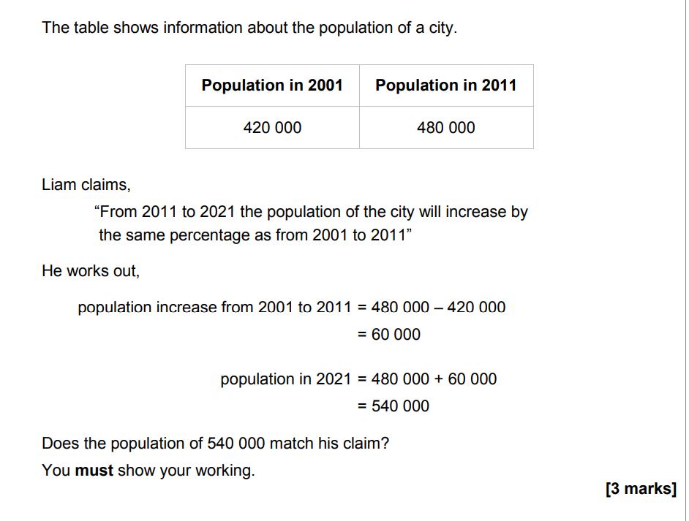

Slide 13
REVERSE PERCENTAGE
A bike was reduced by 20% in a sale.
If its sale price was £520, what was the original price?
Lauren is given a 12% pay rise. Her new salary is £24,080. What was Laurenʼs salary before the pay rise?

Slide 14
Your turn…
3) The price of all rail season tickets to London increased by 4%. The price of a rail season ticket from Cambridge to London increased by £121.60.
Work out the price before this increase.
4) In a sale, normal prices are reduced by 20%. A saddle for his horse in the sale. The sale price of the saddle was £220.
Calculate the normal price of the saddle.
1) In a sale, normal prices are reduced by 15%. The sale price of a CD player is £102.
Work out the normal price of the CD player.
2) A garage sells cars. It offers a discount of 20% off the normal price for cash. Dave pays £5200 cash for a car.
Calculate the normal price of the car.

Slide 15
Your turn…
3) The price of all rail season tickets to London increased by 4%. The price of a rail season ticket from Cambridge to London increased by £121.60.
Work out the price before this increase.
4) In a sale, normal prices are reduced by 20%. A saddle for his horse in the sale. The sale price of the saddle was £220.
Calculate the normal price of the saddle.
1) In a sale, normal prices are reduced by 15%. The sale price of a CD player is £102.
Work out the normal price of the CD player.
2) A garage sells cars. It offers a discount of 20% off the normal price for cash. Dave pays £5200 cash for a car.
Calculate the normal price of the car.
£120
£116.92
£275
£6500

Slide 16
