Slide 1
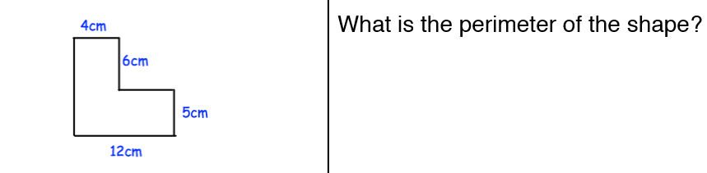
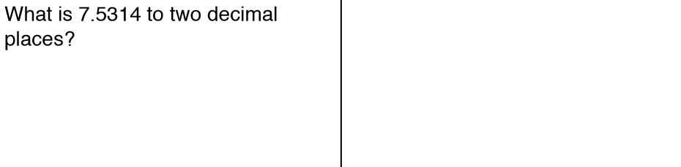
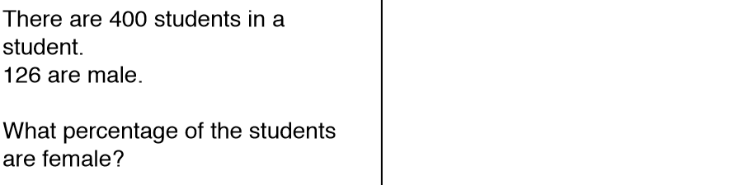






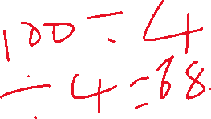






Starter

Slide 2

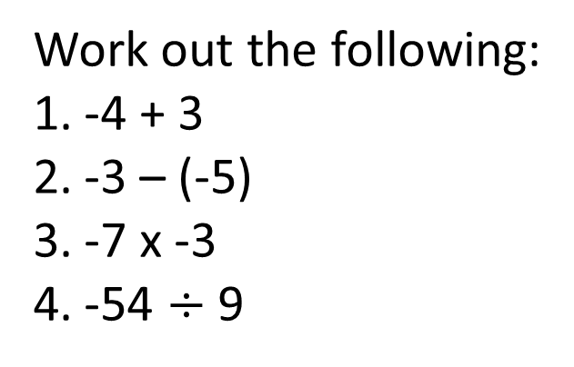
Fractions
- Order, add, subtract and compare amounts or quantities using proper and improper fractions and mixed numbers
- Express one number as a fraction of another
Recap
Recap
Work out the following:
-4 + 3
-3 – (-5)
-7 x -3
-54 $÷$ 9
Estimate:
$$\frac{\sqrt{8.67}}{3.32}$$

Slide 3
Equivalent Fractions - Recap
× 5
× 6
3
15
2
12
=
=
4
20
3
18
× 5
× 6

Slide 4
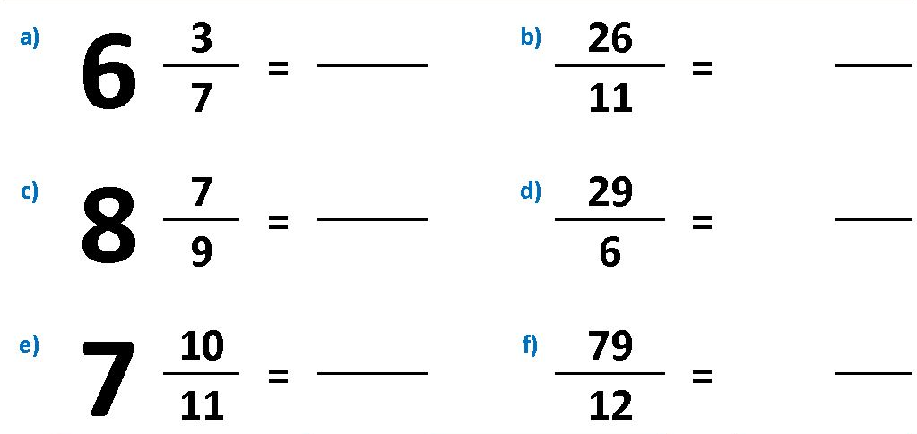










Mixed Numbers and Improper Fractions - Recap

Slide 5




Ordering Fractions
Put the following fractions in ascending order:
The common denominator is 24.
Each fraction needs to then be converted so that all the denominators are the same.
The numerators can then be compared.
3
4
5
7
4
6
8
12
$$×\frac{6}{6}$$
$$×\frac{4}{4}$$
$$×\frac{3}{3}$$
$$×\frac{2}{2}$$
18
16
15
14
24
24
24
24
7
5
4
3
,
,
,
12
8
6
4

Slide 6



Ordering Fractions
Put the following fractions in descending order:
The common denominator is 18.
Each fraction needs to then be converted so that all the denominators are the same.
The numerators can then be compared.
1
1
1
2
1
6
3
18
9
$$×\frac{3}{3}$$
$$×\frac{6}{6}$$
$$×\frac{2}{2}$$
3
6
19
4
18
18
18
18
1
1
2
1
1
,
,
,
18
3
9
6

Slide 7
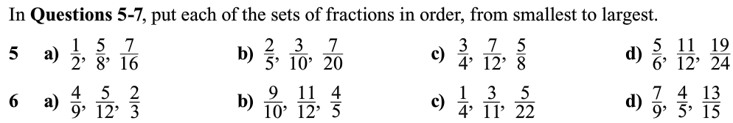
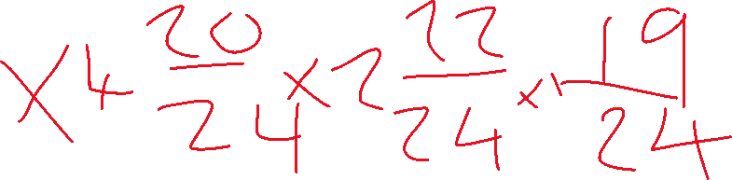
Ordering Fractions
Put each of the sets of fractions in ascending order.
Put each of the sets of fractions in descending order.

Slide 8





Adding Fractions
$$\frac{3}{4}+\frac{1}{3}=$$
$$\frac{9}{12}+\frac{4}{12}$$
x3
x4
x3
x4
$$= \frac{13}{12}$$
$$= 1\frac{1}{12}$$
You need to make the denominators the same!

Slide 9



Subtracting Fractions
$$\frac{6}{7}−\frac{3}{4}=$$
$$\frac{24}{28}−\frac{21}{28}$$
x4
x7
x4
x7
$$= \frac{3}{28}$$
You need to make the denominators the same!

Slide 10
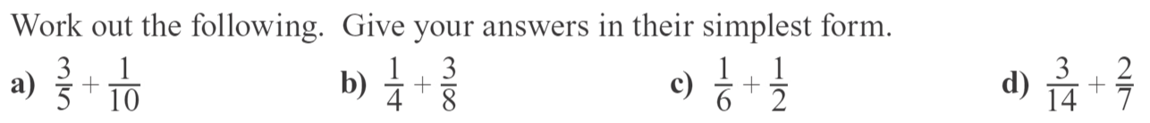


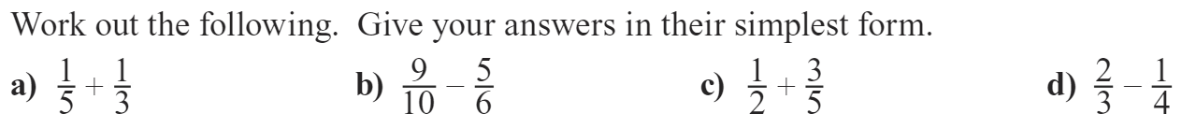
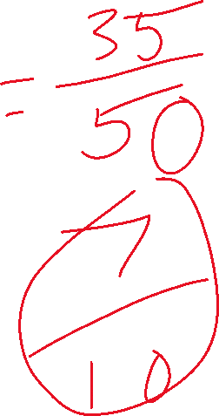
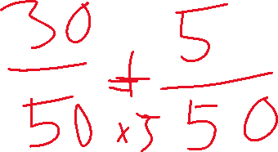

Adding and Subtracting Fractions

Slide 11
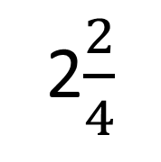

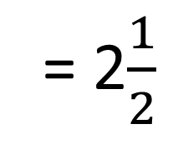
Mixed Numbers
Change the mixed number into an improper fraction before adding them together.
$1\frac{3}{4}$ + $\frac{3}{4}$ =
$\frac{7}{4}$ + $\frac{3}{4}$ =
$\frac{10}{4}$ =
CHECK! Are the denominators the same?
When they are, add the numerators together.
2$\frac{2}{4}$
= 2$\frac{1}{2}$
We can change the answer into a mixed number as the numerator is bigger than the denominator.

Slide 12
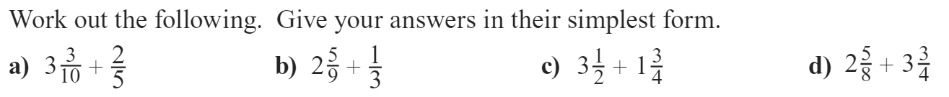
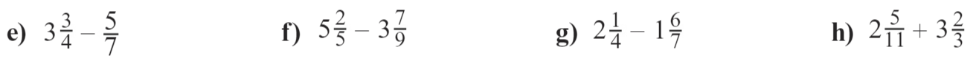
Adding and Subtracting Mixed Numbers

Slide 13


Write the first quantity as a fraction of the second
2cm, 6cm
4kg, 20kg
£8, £20
5hrs, 24hrs
e) 12days, 30days
50p, £3
4days, 2weeks
40minutes, 2hrs
$$\frac{1}{3}$$
$$\frac{1}{5}$$
$$\frac{2}{5}$$
$$\frac{5}{24}$$
$$\frac{2}{5}$$
$$\frac{1}{6}$$
$$\frac{2}{7}$$
$$\frac{1}{3}$$

Slide 14
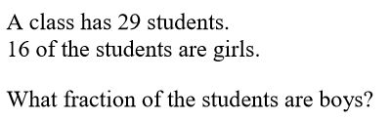

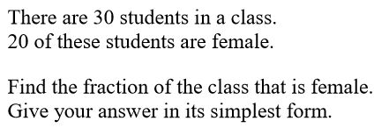
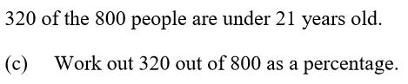
Exam Questions
Notes:
Questions from maths genie

Slide 15
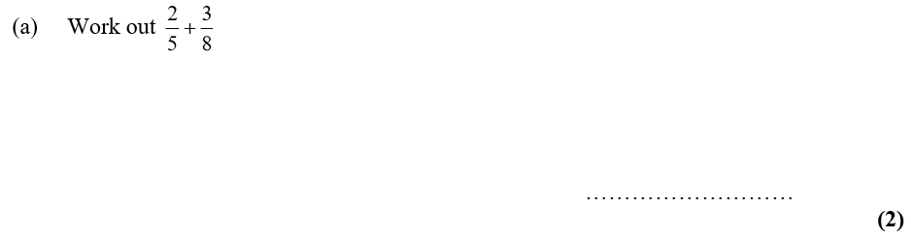
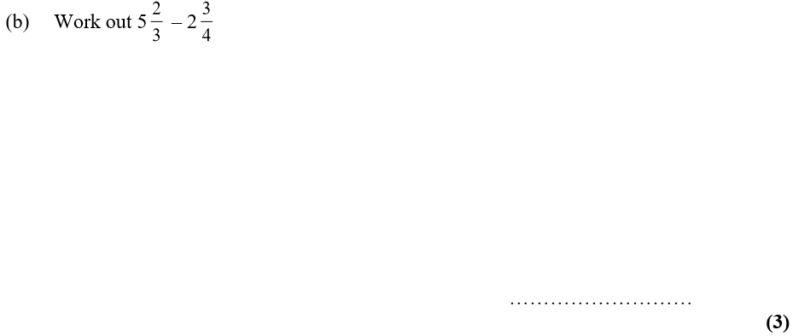
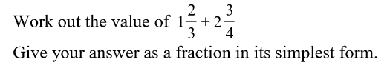
Exam Questions
Notes:
Questions from maths genie

