Slide 1
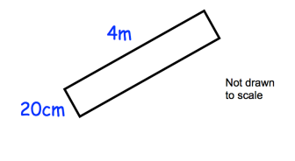

STARTER
1.
Write $3_{5}^{3}$ as a top heavy fraction.
Write $\frac{63}{5}$ as a mixed number.
A machine takes 45 seconds to fill and seal a bottle of water.
How many bottles can it fill and seal in 10 minutes?
3.
4.
Work out the perimeter in cm.
Workout the area. Give you final answer in m.
2.
Convert 9 centimetres into millimetres.
Convert 2 kilometres into centimetres.

Slide 2


Fs Maths L2- Money
Learning Objectives
Calculate amounts of money, compound interest, percentage increases, decreases and discounts including tax and simple budgeting
Recap
Q1. A hotel has 45 rooms in total. 36 of them are being used by guests. What percentage of the rooms are being used?
Q3. The local gym has 135 members this month. This is an 8% increase on last month. How many members did it have last month?
Q2. Pia has paid off 45% of a loan and now only has £1980 left to pay. How much was the original loan?

Slide 3
Recap
Worked Solutions
Q1. A hotel has 45 rooms in total. 36 of them are being used by guests. What percentage of the rooms are being used?
Q2. Pia has paid off 45% of a loan and now only £1980 left to pay. How much was the original loan?
Q3. The local gym has 135 members this month. This is an 8% increase on last month. How many members did it have last month?

Slide 4
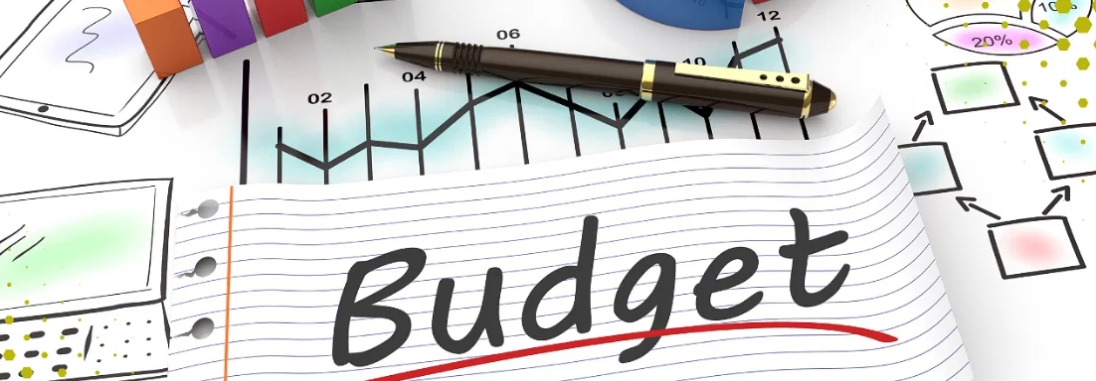
1) Company and Individual Budgeting

Slide 5
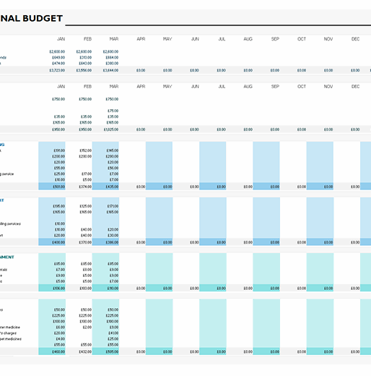
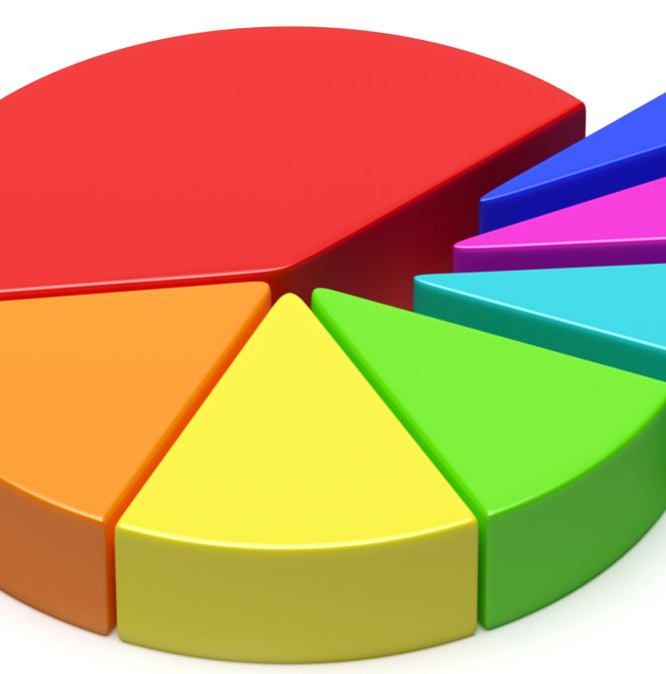

Slide 6
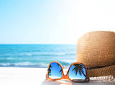
Budgeting
Q1. Deborah is planning a holiday. Her budget is shown in the table below.
What is Deborah’s total budget?
What percentage of Deborah’s total budget is set aside for shopping?
Item | Travel | Hotel | Shopping | Food & Drink
Amount(£) | 416 | 256 | 384 | 144

Slide 7
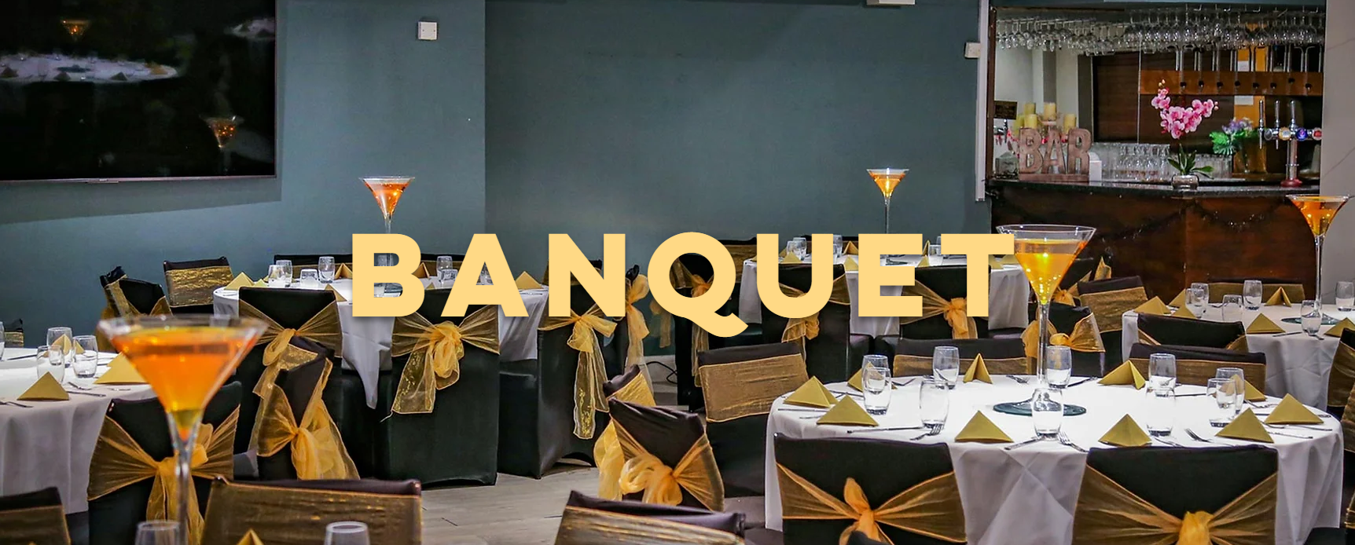
Budgeting
Q2. A social club is organising its annual banquet.
The club has 120 members and at least a quarter are expected to attend.
A catering company is hired to supply the food. They charge £24.50 per person.
What is the minimum amount of money that the club should budget for the food?

Slide 8
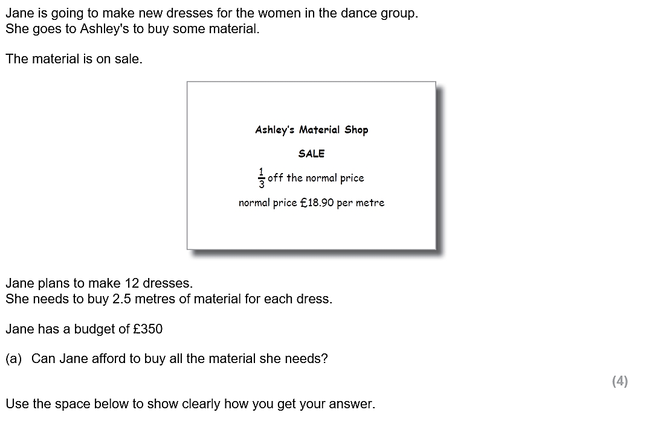
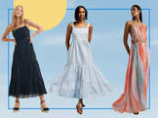
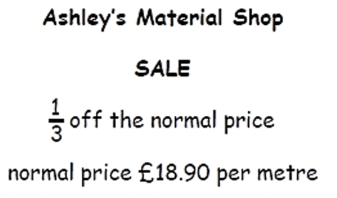

Slide 9

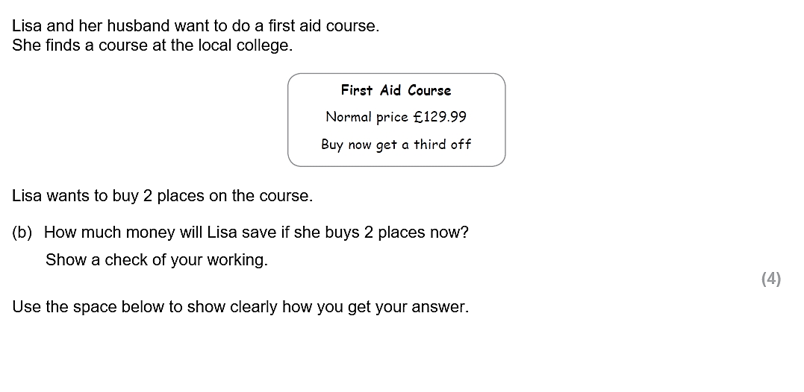

Slide 10
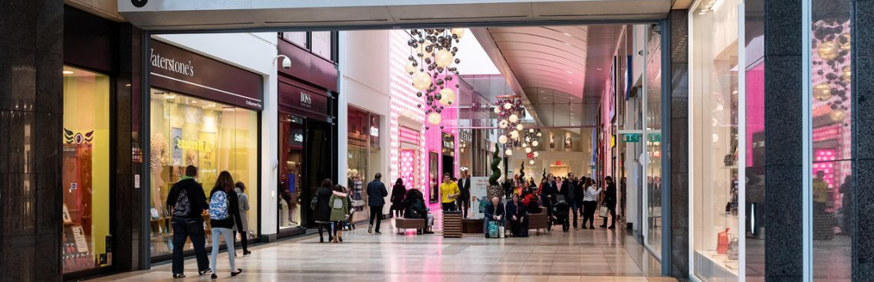
2) Shopping and Money

Slide 11
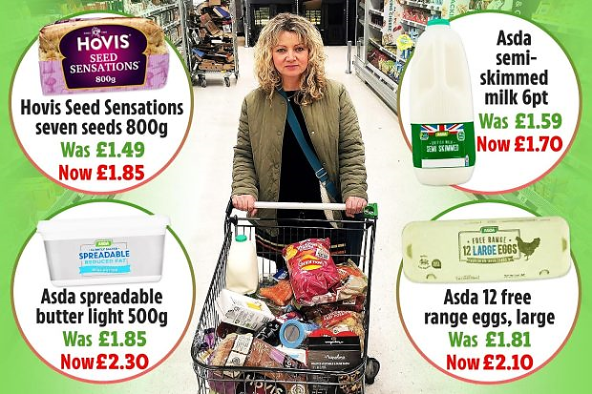

Slide 12
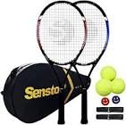
Money
Q1)
a) What is £19.35 in pence?
b) What is 2010p in pounds?
Q2)
Anna buys a tennis racket for £28.99, a sweatband for £8.99 and a bottle of water for 82p. She pays with 2 x £20 notes.
How much change does she get?
Extension
Q3) A shop is having a clearance sale. All items are 42% off.
A pair of designer shoe normally costs £325.
How much do you save when buying the shoes during the sale?
How much do the shoes cost during the sale?

Slide 13
Money
Extension
Q3) A shop is having a clearance sale. All items are 42% off.
A pair of designer shoe normally costs £325.
How much do you save when buying the shoes during the sale?
How much do the shoes cost during the sale?

Slide 14

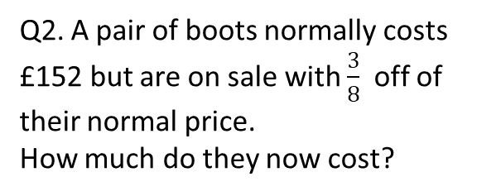
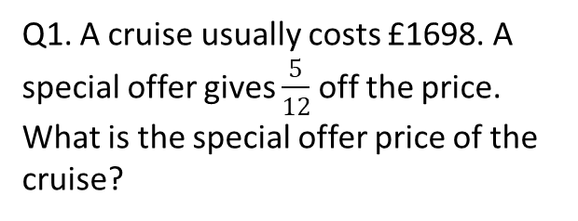

Money
Q1. A cruise usually costs £1698. A special offer gives $\frac{5}{12}$ off the price.
What is the special offer price of the
cruise?
Q2. A pair of boots normally costs £152 but are on sale with $\frac{3}{8}$ off of their normal price.
How much do they now cost?
Extension
Q3. Alex is deciding which of three new cars to buy.
The table on the right shows the discounts she would get
On each car.
Which car is the cheapest after the discounts?
Car | A | B | C
Price | £6872 | £6611 | £6480
Discount | $$\frac{3}{8}$$ | $$\frac{3}{11}$$ | $$\frac{2}{9}$$

Slide 15
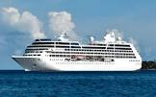
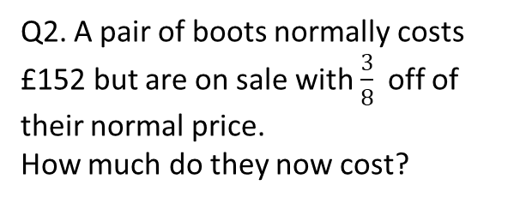
Money
Q1. A cruise usually costs £1698. A special offer gives $\frac{5}{12}$ off the price.
What is the special offer price of the
cruise?
Q2. A pair of boots normally costs £152 but are on sale with $\frac{3}{8}$ off of their normal price.
How much do they now cost?

Slide 16
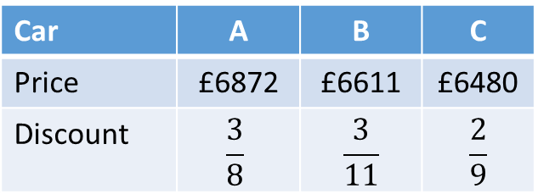
Money
Extension
Q3. Alex is deciding which of three new cars to buy.
The table on the right shows the discounts she would get
On each car.
Which car is the cheapest after the discounts?
Car | A | B | C
Price | £6872 | £6611 | £6480
Discount | $$\frac{3}{8}$$ | $$\frac{3}{11}$$ | $$\frac{2}{9}$$

Slide 17
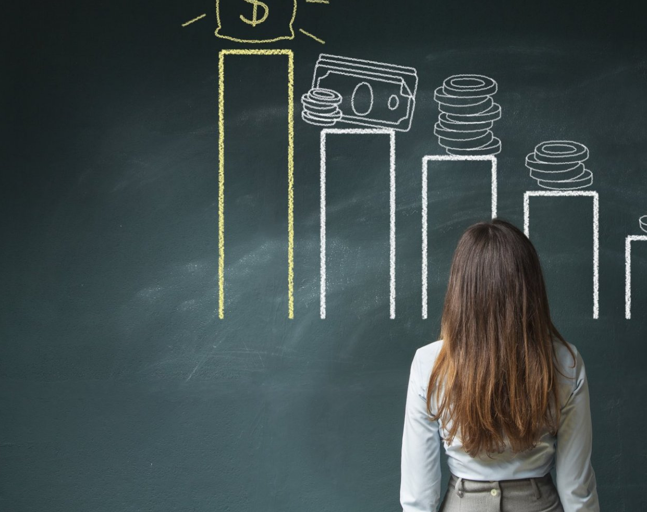
3) Profit: companies and Individuals

Slide 18
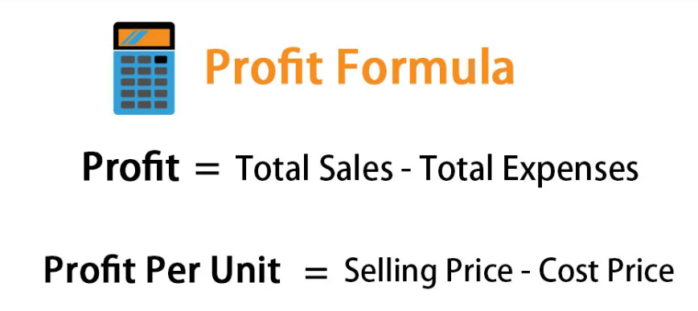

Slide 19
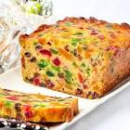
Profit as a Percentage
Q1. Chloe makes and sells toys.
The cost of making her last toy was £40. The toy sold on an auction website for £52.
How much profit did she make as a percentage of her costs?
Q2. David sells DVDs on a market stall.
He buys the DVDs for £2.60 and sells them for £3.90.
What is David’s percentage profit on each DVD?
Extension
Q3. Like makes fruit cakes for a stall at a village fete. It costs Luke £1.80 for the ingredients for each cake. If he wants to make exactly 35% profit on each cake, how much money should Luke charge for each cake?

Slide 20
Profit as a Percentage
Q1. Chloe makes and sells toys.
The cost of making her last toy was £40. The toy sold on an auction website for £52.
How much profit did she make as a percentage of her costs?
Q2. David sells DVDs on a market stall.
He buys the DVDs for £2.60 and sells them for £3.90.
What is David’s percentage profit on each DVD?

Slide 21
Profit as a Percentage
Q3. Like makes fruit cakes for a stall at a village fete. It costs Luke £1.80 for the ingredients for each cake. If he wants to make exactly 35% profit on each cake, how much money should Luke charge for each cake?

Slide 22
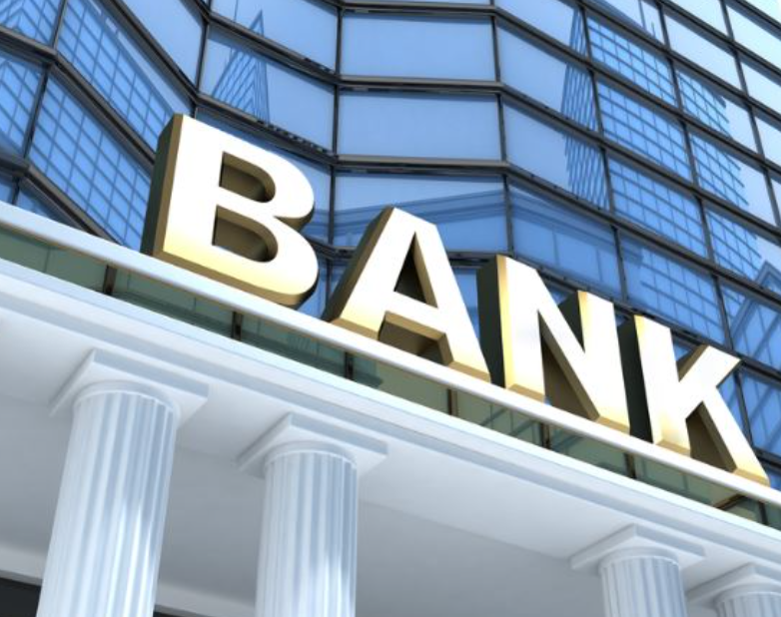
4) Compound Interest

Slide 23
Initial Investment | Year 1 | Year 2 | Year 3

Slide 24
Compound Interest
Q1. Yusuf puts £40 into a saving account that earns 5% compound interest per annum.
How much money will he have after 3 years?
Q2. Frank puts £1825 into a pension fund that earns 6% compound interest per annum.
How much is the pension fund worth after 2 years?
Extension
Q3. Zola takes out a loan of £750. She is charged 10% compound interest every month.
If Zola doesn’t pay back any money, how much will she owe after three months?

Slide 25
Compound Interest
Q1. Yusuf puts £40 into a saving account that earns 5% compound interest per annum.
How much money will he have after 3 years?
Q2. Frank puts £1825 into a pension fund that earns 6% compound interest per annum.
How much is the pension fund worth after 2 years?

Slide 26
Compound Interest
Extension
Q3. Zola takes out a loan of £750. She is charged 10% compound interest every month.
If Zola doesn’t pay back any money, how much will she owe after three months?

