Slide 1
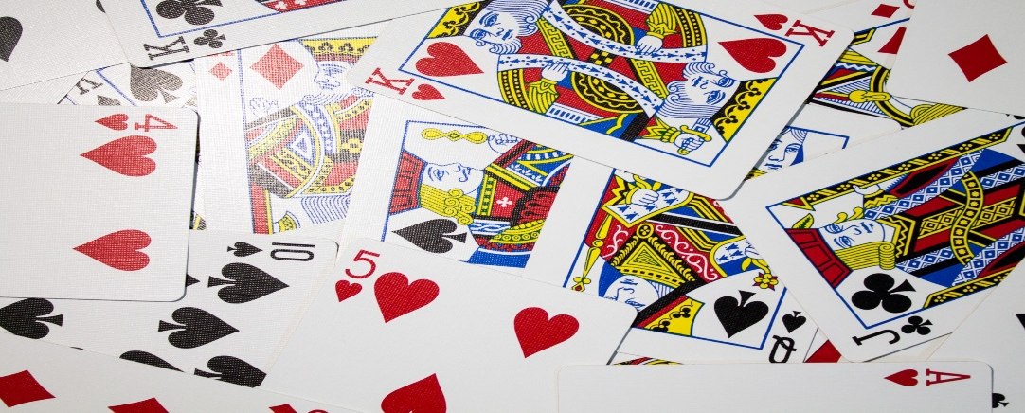
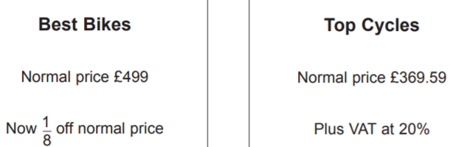
Probability
Learning Objectives
To be able to :
Work out the probability of combined events including the use of diagrams and tables, including two-way tables.
Express probabilities as fractions, decimals and percentages
2
Bradley wants to buy a bike to help with his training.
He sees these two offers for the same make of bike.
1.
The charity aims to provide recycled furniture to families in need.
In 2015 they supported 4478 families with recycled furniture.
Gary would like to increase the number of families in 2016 by 20 %
How many families would he like to support in 2016?
Show a check of your working.
Bradley wants to pay the least amount of money possible for the bike.
Which offer should he choose? Show why you think this

Slide 2

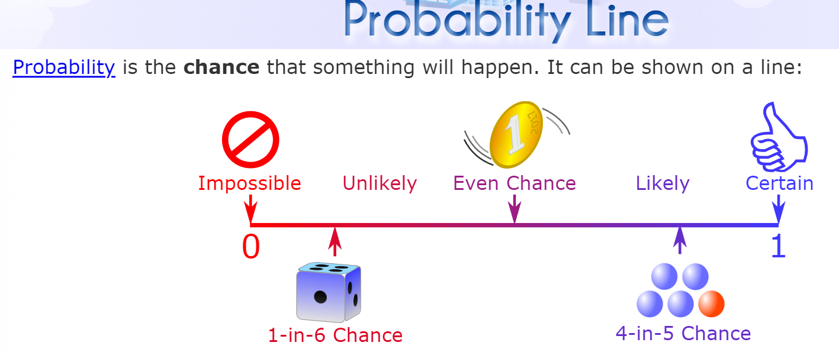
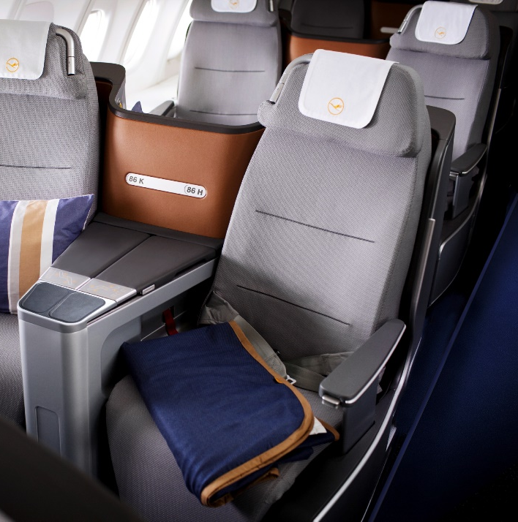
STARTER
Probability as a Fractions, Decimals and Percentages
Karen checks in for a flight and is given a seat at random.
There are four window seats, three aisle seats and nine centre seats available.
Calculate the probability that Karen is given a window seat.
Write your answer as: a) Fraction, b) Decimal c) Percentage
1
Notes:
To check understanding of topics being covered in the lesson. Some classes will know how to do majority of these, therefore you can skip some bits out and spend time on what your students need help with the most.

Slide 3
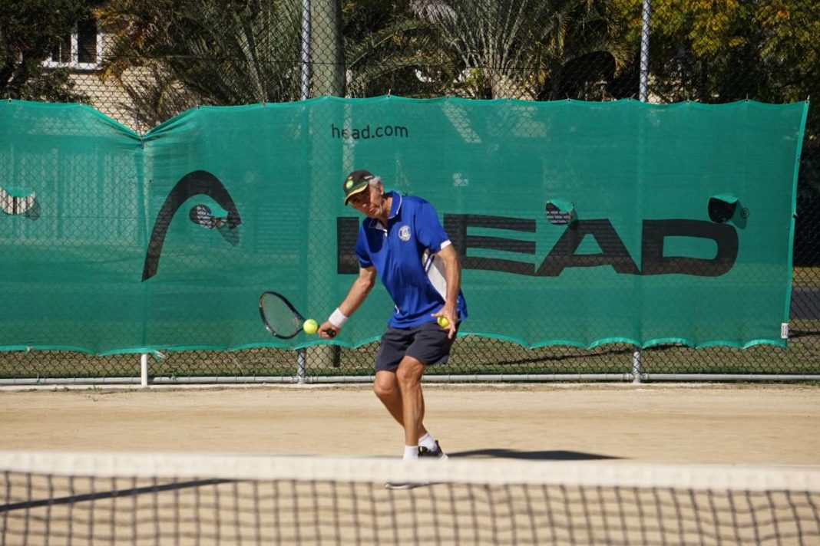

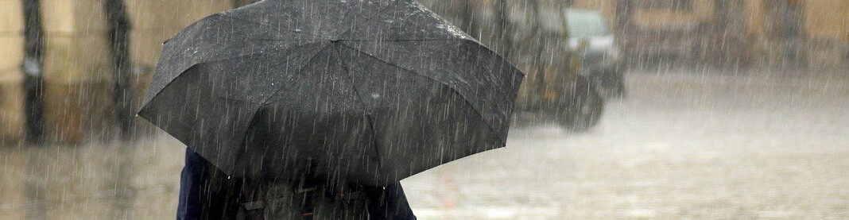

Probability as a Fractions, Decimals and Percentages
Elizabeth has a bunch of red, yellow and white roses.
She chooses a rose at random.
The probability that she chooses a yellow rose is 0.1 The probability that she chooses a white rose is 0.2
What is the probability that Elizabeth chooses a red rose?
The probability of it raining tomorrow is 60%.
Work out the probability of it NOT raining tomorrow.
The probability of Roger winning a tennis match is $\frac{7}{12}$
Work out the probability of Roger not winning the tennis match.
This Photo by Unknown Author is licensed under CC BY-ND

Slide 4

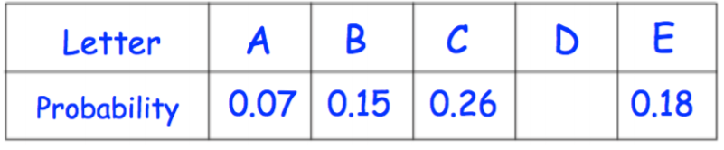
Your turn…
Exam Questions
Counters labelled A, B, C, D and E are placed in a bag. The table shows the probabilities of picking each letter at random.
Susan has some beads in a bag.
Mrs Jenkins is organising a charity raffle.
5 of the beads are orange. 3 of the beads are purple. The rest of the beads are pink.
She sells 300 tickets for £3 each.
The probability that someone wins a prize is 20%.
Each prize cost £8 The profit is donated to charity.
Susan takes a bead from the bag at random.
The probability that she takes a pink bead is ⅗
Calculate the missing probability in the table.
Work out how much money Mrs Jenkins donates to charity
How many pink beads are in the bag before Susan takes a bead?

Slide 5
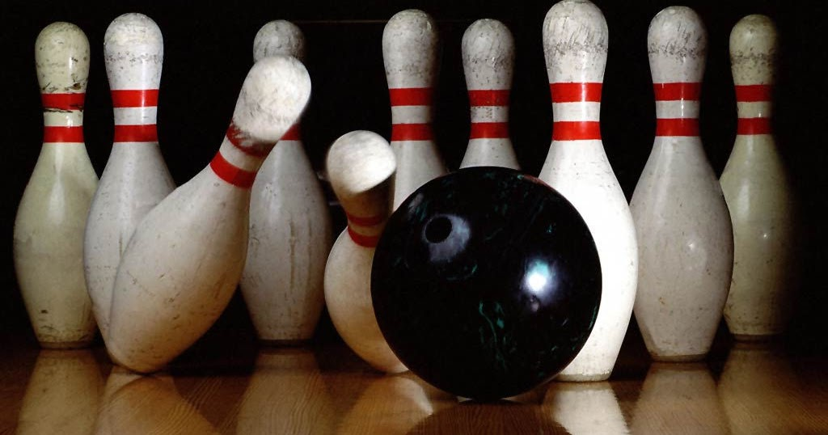
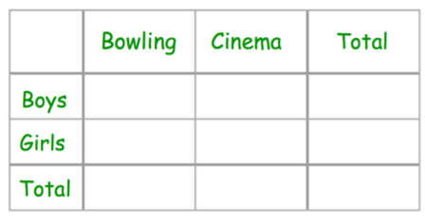
STARTER
Probability using Table
50 children were asked if they wanted to go bowling or to the cinema.
17 girls and 11 boys wanted to go bowling. 12 boys wanted to go to the cinema.
Use this information to complete the two-way table below.
How many children, in total, want to go to the cinema?
2
Notes:
To check understanding of topics being covered in the lesson. Some classes will know how to do majority of these, therefore you can skip some bits out and spend time on what your students need help with the most.

Slide 6
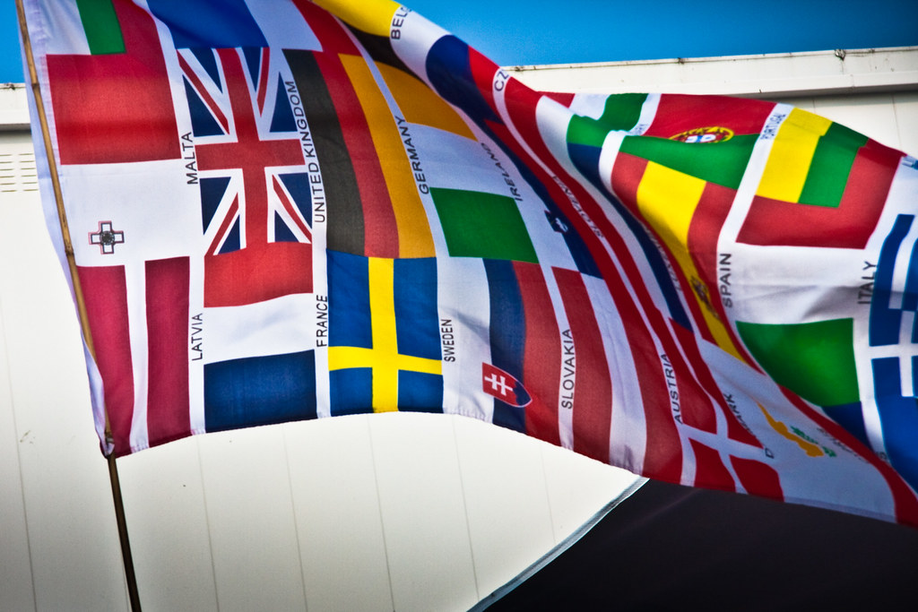
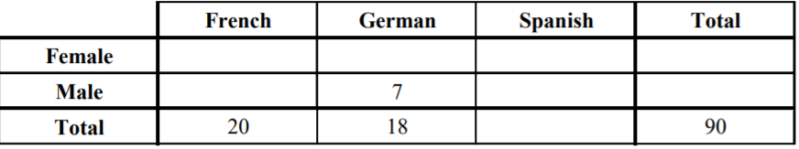
Probability using Tables
90 students each study one of three languages.
The two-way table shows some information about these students.
50 of the 90 students are male.
29 of the 50 male students study Spanish.
Complete the two-way table.
How many females study French?
How many people study Spanish?

Slide 7
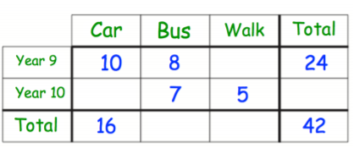
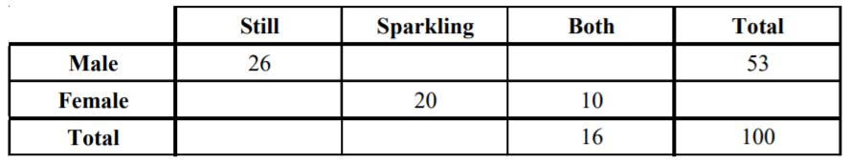
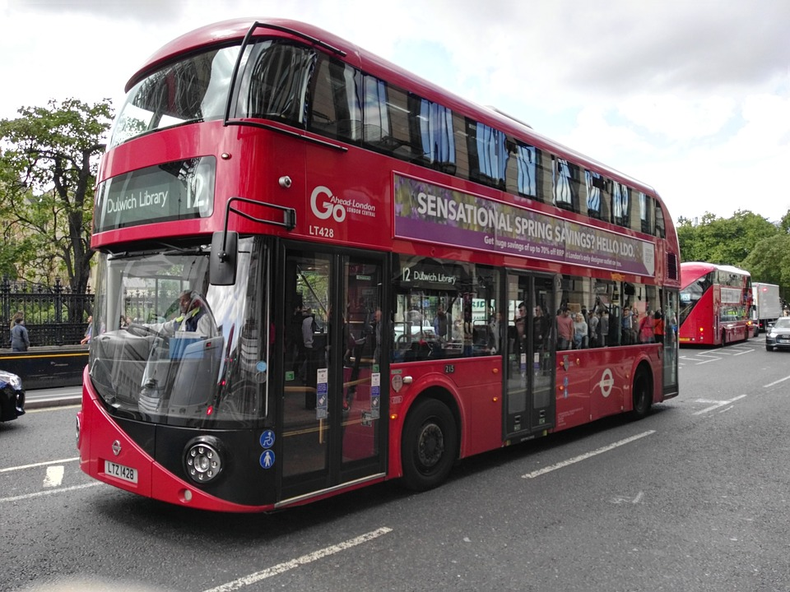
Your turn…
Billy has been carrying out a survey.
He asked 100 people the type of water they like to drink (still, sparkling or both).
Here are part of his results:
Complete the following two-way tables:
Complete the two-way table.
b) How many males were in the survey?
c) How many females drink only still water?
d) How many people drink only sparkling water?

Slide 8
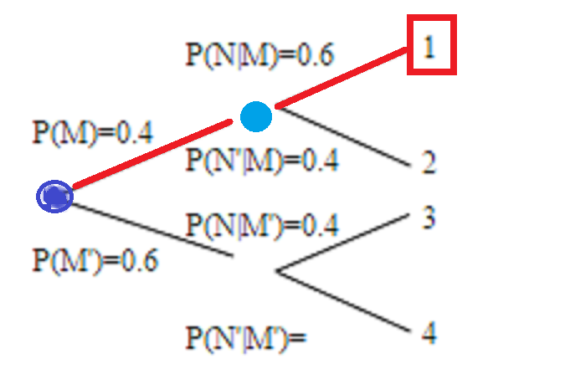
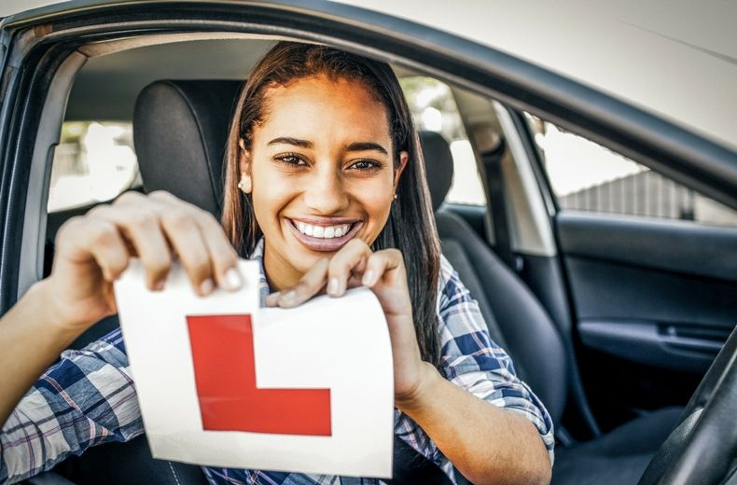
STARTER
Probability using Tree Diagram
Jim and Sue each take a driving test.
The probability that Jim will pass the driving test is 0.7, Sue will pass the driving test 0.6
a) Complete the probability tree diagram.
3
This Photo by Unknown Author is licensed under CC BY-SA
Notes:
To check understanding of topics being covered in the lesson. Some classes will know how to do majority of these, therefore you can skip some bits out and spend time on what your students need help with the most.

Slide 9
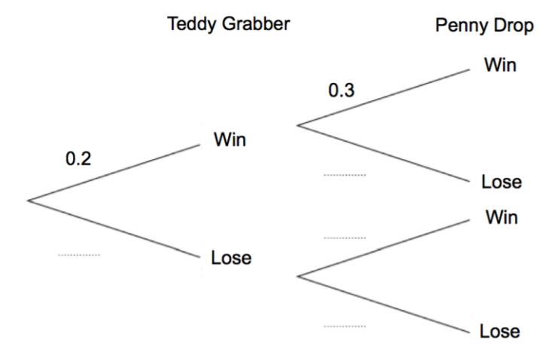
Probability using Tree Diagram
James goes to an arcade. He has one go on the Teddy Grabber and one go on the Penny Drop.
The probability that he wins on the Teddy Grabber is 0.2.
The probability that he wins on the Penny Drop is 0.3.
Prime
Notes:
To check understanding of topics being covered in the lesson. Some classes will know how to do majority of these, therefore you can skip some bits out and spend time on what your students need help with the most.

Slide 10
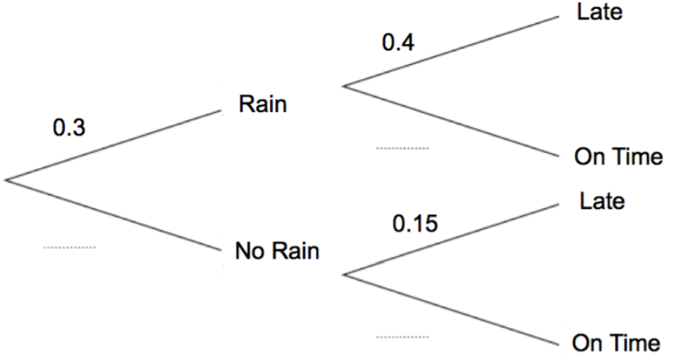
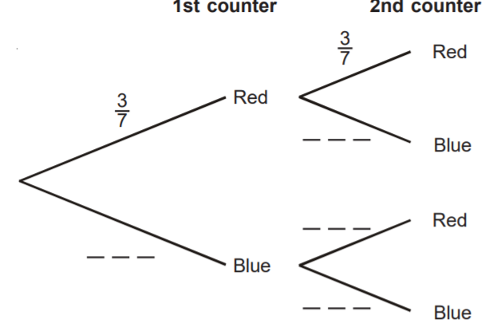
Your turn…
In a small village, one bus arrives a day.
The probability of rain in the village is 0.3.
If it rains, the probability of a bus being late is 0.4.
If it does not rain, the probability of a bus being late is 0.15.
Tim puts 3 red counters and 4 blue counters in a bag.
He takes at random a counter from the bag.
He writes down the colour of the counter. He puts the counter in the bag again.
He then takes at random a second counter from the bag.
Complete the tree diagram
Complete the tree diagram

Slide 11
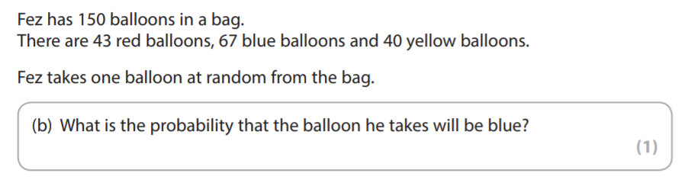
Exam Questions
FSM02/01 30 April – 4 May 2018

Slide 12
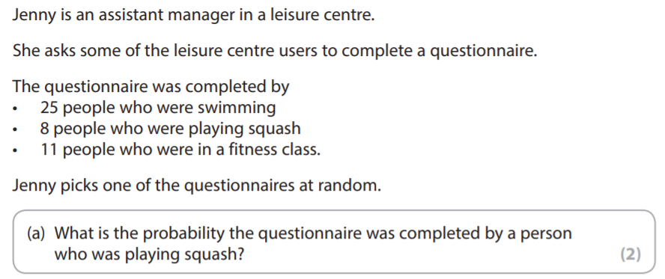
Exam Questions
FSM02/01 13-17 March 2017

Slide 13
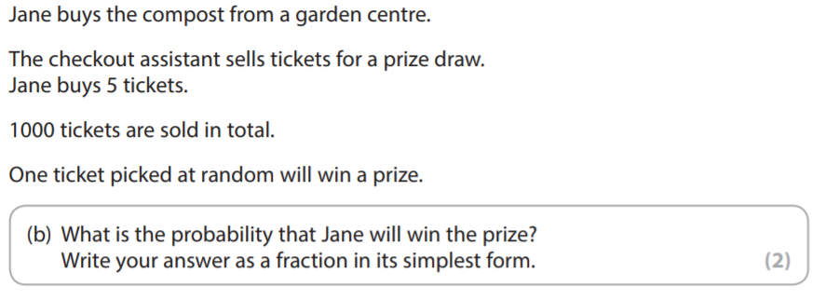
Exam Questions
FSM02/01 9 – 13 January 2017

Slide 14
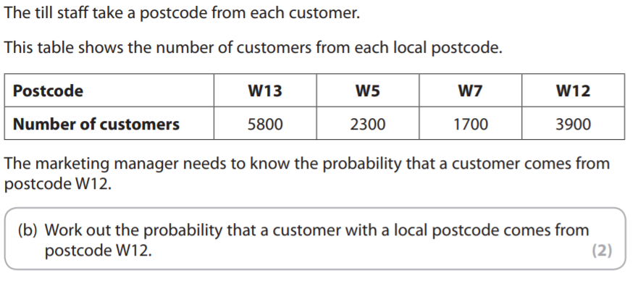
Exam Questions
FSM02/01 18 – 22 July 2016

