Slide 1
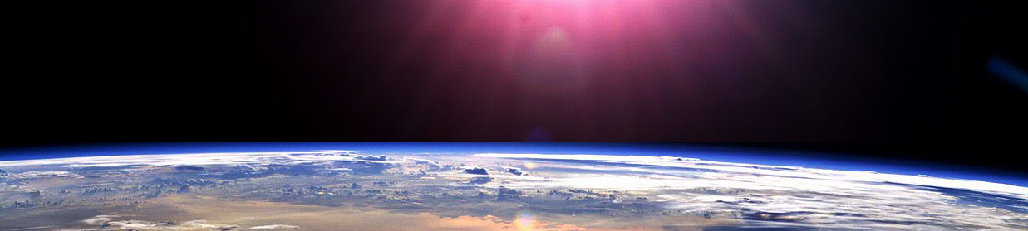


Slide 2







Place Value

Slide 3












Course Content: Choose your topic …
Whole Number and Functions
place
value
add and
subtract
multiply
divide
round
numbers
fraction
decimal
numbers
MATHS E1 E2 E3
Parts of a whole
Time
temperature
2d and 3d Shapes
metric
measure
money
charts
data
Measure and Shape
Handling Data

Slide 4





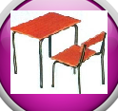







Home Warm up Progress Check 1 Video/Discuss Vocab / jobs Lesson Activities Quizzes Cont. Learning Topic Answers Progress Check 2
Topic Introduction : Place Value
The first topic you need to know before all others! This is where maths starts, its all about digits and where you ‘Place’ them that gives a number its ‘Value’
If you want to tell someone how many, how much, how far, how big.. this is the essential maths to start your journey off!
This topic is the building block of all other maths topics and includes learning all about whole amounts up to the thousands place. Each column of digits will give values in blocks of TEN, building up to produce numbers that describe a quantity and form the ‘Decimal’ system of counting.
Choose an icon to select where to start
place
value

Slide 5
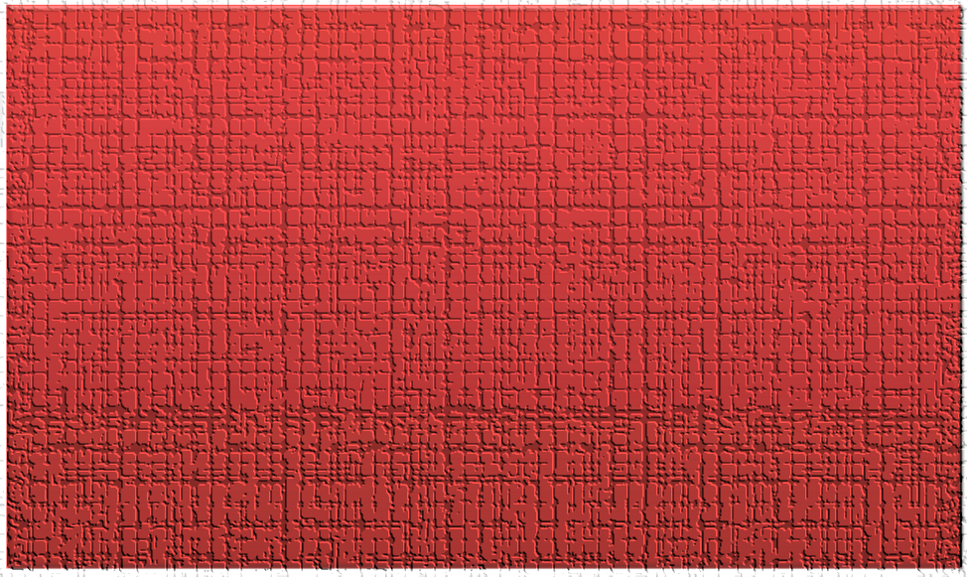

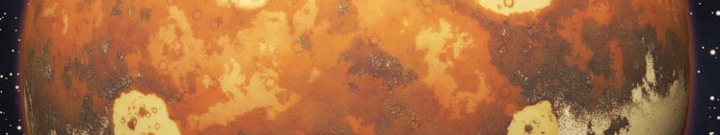
Warm up Exercises 1
Lets start today by revising ! Complete the above sums and multiplication grid

Slide 6


Warm up Exercises 2

Slide 7
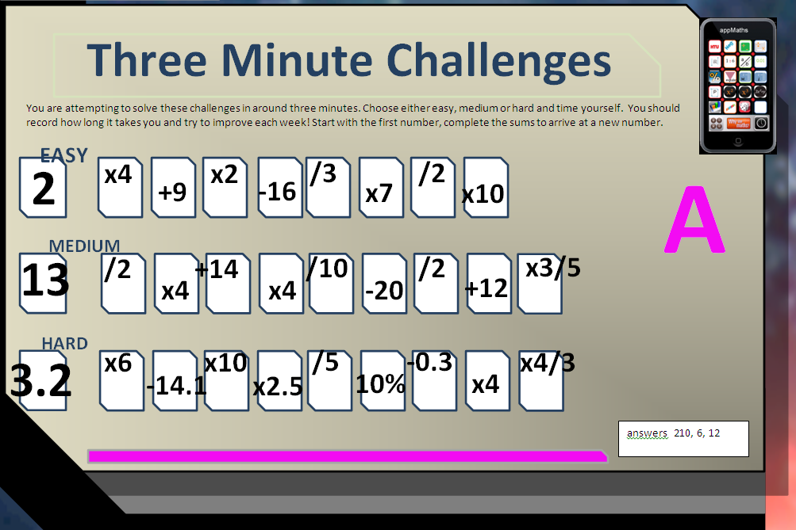

Warm up Exercise 3

Slide 8
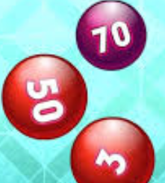

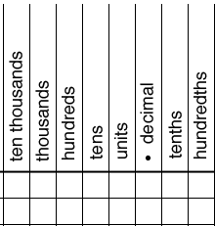
Progress Checker 1
W
What do you already know about place value ? What did you learn during the week? Examples….
How would you rate your skills in reading and writing numbers?
Excellent ability
Good ability, but working to improve
Ok, making a start but I know I have lots to still learn
The date I started studying: My aims are…
A Learn how to read and write numbers to represent values
B Learn the names of each column of digits
C Know what the ‘Decimal Point’ is used for and decimal place values
14,623 fourteen thousand, six
hundred and twenty three
70.896
Tk K H T U .

Slide 9

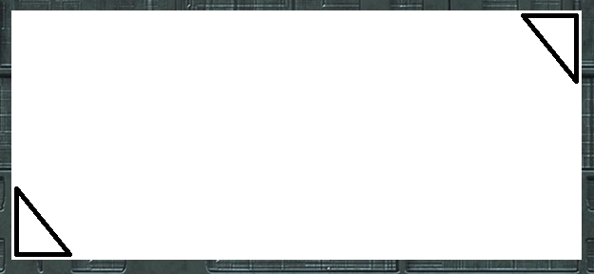


Introductory Video and Discussion
KHTU.
What is the largest number you can think of ?
What comes after the thousandth place value ?
Why do we count in sets of ten ?
We write digits from the right side to the left getting bigger, why?
What does the decimal point do in a number ?
What is the maximum value you can count up to in each place value?
Watch the introductory video and then discuss the above
Your thoughts..

Slide 10


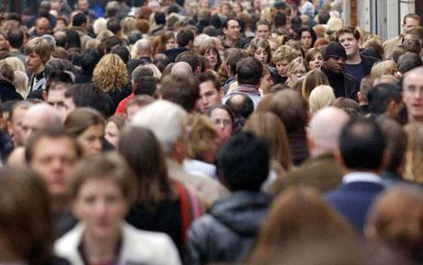



Vocabulary and Jobs
Unit
Place Value
Decimal Point
Decimal System
Powers of ten
Tenth
Hundredth
Thousandth
Thousand
Million
Billion
Hundred
Ten
Accountants
Statistical Analysis
Banker
Scientist
Sales and Retail
Warehouse
Media
IT / Tech
Transport …. Can you think of more?
…………………………………
…………………………………

Slide 11

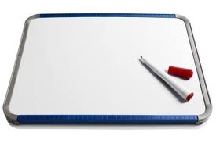
1 Lesson: Concept Activity
You need two small white boards and
pens … and two people!
Try any of the following activities
One person writes three or four numbers down. The other needs to write them in order of size, smallest to largest.
One person writes down any number using digits, the other writes it in words
One person writes a number on their board and keeps it hidden, the other attempts to guess the number using questions with yes or no answers only
One person writes a number on their board, the other asks them to write a new value, ten (or a hundred, or a thousand) times smaller or bigger.
One person writes down a number of digits, the other needs to order them so they produce the largest (or smallest) number possible

Slide 12

Lesson: Main Teach 1
Ten thousand
unit
tenth
ten
hundred
thousand
,
,
,
hundredths
Decimal
point
K
U
Decimals
Main learning points:
‘Place value’ means the value a number has when placed in a particular place. Starting with the column called ‘unit’ we count from 0 to 9 to show how many units we have. When reaching a value or count of more than 9 the next column ‘ten’ should be used. 1 in the ten column shows either a) one set of ten or… b) ten sets of one unit. The decimal place can be moved to any of the columns and values in the new column can be read.
For larger values, digits can be placed in multiple columns to show the number of each set counted. Each column to the left shows values ‘Ten times larger’ than the previous. Columns on the right show values ‘Ten times smaller’.
L E A R N each column name and its position on the above table of place values off by heart

Slide 13


Lesson: Main Teach 2
Here we go, lets write some numbers!
We place numbers in place value columns to show how many units we have.
Lets try 4 cars. Here the unit is ‘CARS’, the item we are counting, so…. 4
We put the digit 4 in the column called ‘unit’ to show we have four cars
Lets try another. What about six hundred and twenty pounds. The unit is ‘pounds’ so… 6 2 0
This number shows that you have a large set of six hundreds plus two smaller sets of ten
So far so good lets try another. Lets write eighteen thousand, one hundred and seven people.
The unit is people so…. 1 8 , 1 0 7
Here there is a large set of ten thousand people, another set of eight thousand people, a single
set of one hundred people, no tens (so we insert a zero to show this), lastly a set of seven individual people.
We have now started to insert a COMMA in-between the second PERIOD of numbers called thousands and the
first period of numbers (the hundreds, tens and units). This is so the value is easier to read.
IMPORTANT ! Commas are not compulsory in a number and any number can be written without commas, however, if you decide to start using them to help break up a number, you must use them correctly. Commas are inserted in-between periods of THREE digits only…so make sure you use them correctly !
unit
hundred
ten
unit
Ten thousand
thousand
hundred
unit
ten

Slide 14

Lesson: Try out
Block 1 : Watch tutor led demo (in class or on video)
Try these, 1) three in the tens and six in the units is the number …………………………………………………………………………………………
2) Eight in the tens and five in the units is the number………………………………………………………………………………………………………………………..
3) Zero in the tens and nine in the units is the number …………………………………………………………………………………………………………………………
4) A number ten times bigger than four is …………………………………….. 5) A number ten times smaller than thirty is ……………………………………………….
Block 2 : Watch tutor led demo (in class or on video)
Try these, 6) Seven in the hundreds, five in the tens and eight in the units is the number ……………………………………………..
7) One hundred times bigger than six in the units is ……………………………………………….
8) Fifteen tens is the number ………………………………………. 9) A number a hundred times smaller than 850 is ……………………………
10) Nine in the hundreds, three in the tens and six in the units is the number …………………………………………………………………………….
Block 3 : Watch tutor led demo (in class or on video)
Try these, 11) A number ten times bigger than 0.4 is …………………… 12) A hundred times bigger than forty three is ………………………………..
13) Six in the ten thousands, one in the tens is the number ……………………………………..
14) Five in the tens and five in the tenths is the number ………………………………………….. 15) A nine in the first five place values………………………….
16) 89,427 is written as …………………………………………………………………………………………………………………………………………………………………………………………………………………

Slide 15
Lesson: Websites and links
Visualising numbers on number lines
https://apps.mathlearningcenter.org/number-line/
Place value numbers in hundreds tens and units
https://www.smartickmethod.com/blog/math/number-operations-in-base-ten/place-value/units-tens-hundreds/
Place value using arrow cards to 9999
http://www.ictgames.com/arrowcards.html
Practice with tens and units
http://www.ictgames.com/partition.html
Numbers to 100, find patterns and explore, count in sets
http://nlvm.usu.edu/en/nav/frames_asid_337_g_1_t_1.html?from=topic_t_1.html

Slide 16

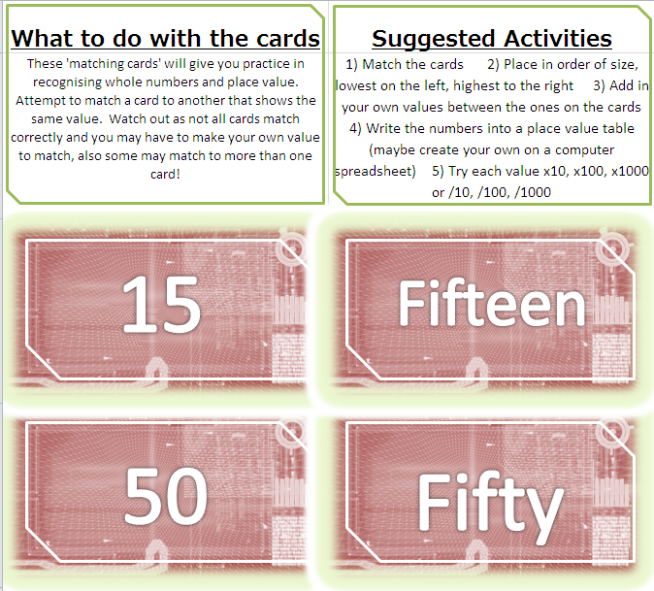

Lesson: Activity A

Slide 17


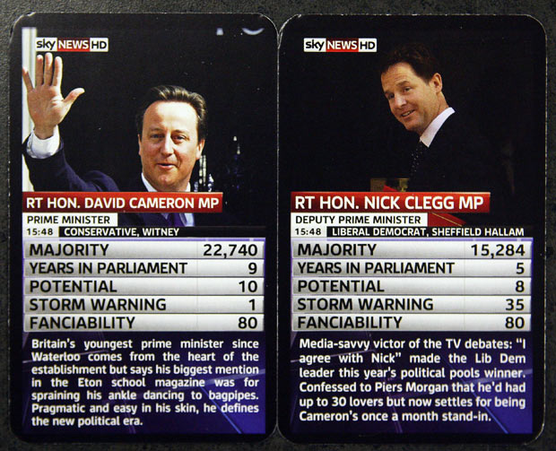
Lesson: Activity B
Practice Reading and Writing Large Numbers by having a go at ‘Top Trumps’.

Slide 18

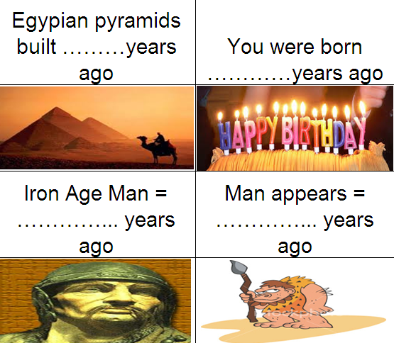
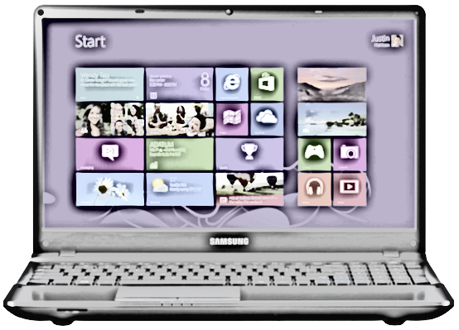
Lesson: Activity C
Computer based activity - a) find the answers to each card on the computer b) produce a ‘place value table’ on a spreadsheet c) copy the answers found onto the spreadsheet in the correct columns ….extension: d) order the values e) convert the values f) write each value in words on the spreadsheet

Slide 19

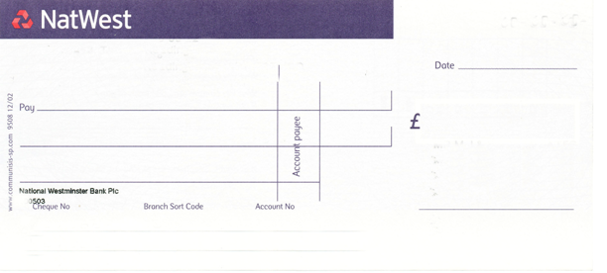

Lesson: Activity D
Write a cheque for a lottery win using your telephone number on LARGE FLIP CHART PAPER
Write the largest cheque you can and beat the other teams !!
Write a cheque for a charity fundraiser
Write a cheque for a lottery win

Slide 20

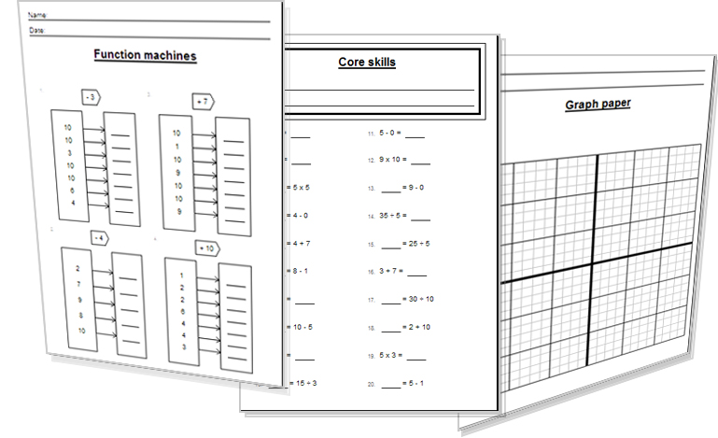

Lesson: Activity E
Try a variety of written practice
Worksheets
Workbooks
Practice Exam Papers
Maths Problems

Slide 21
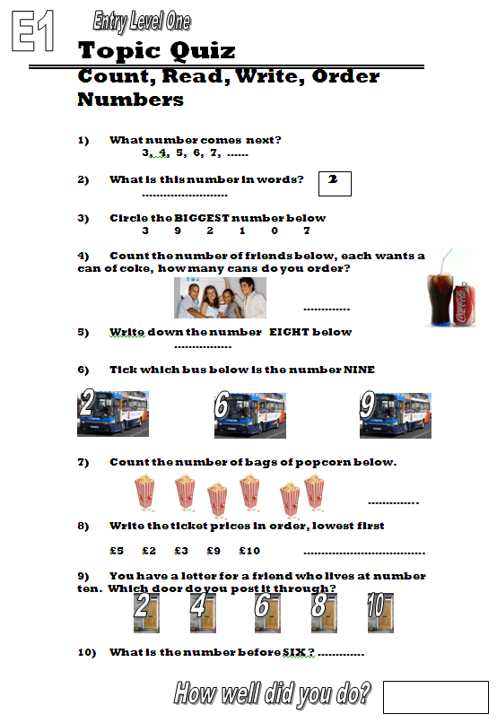

Quiz to assess ENTRY 1

Slide 22
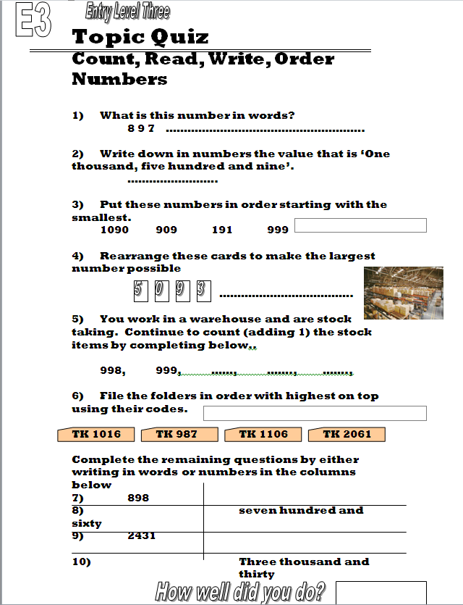

Quiz to assess Entry 3

Slide 23
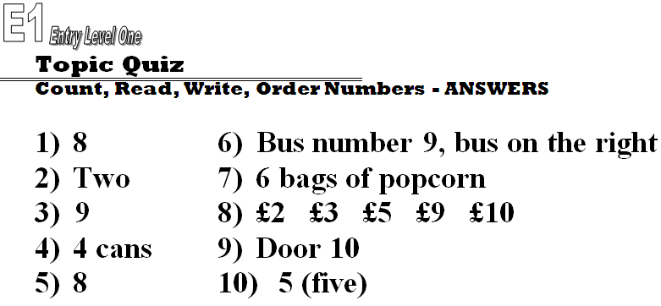
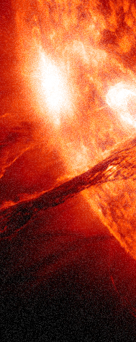
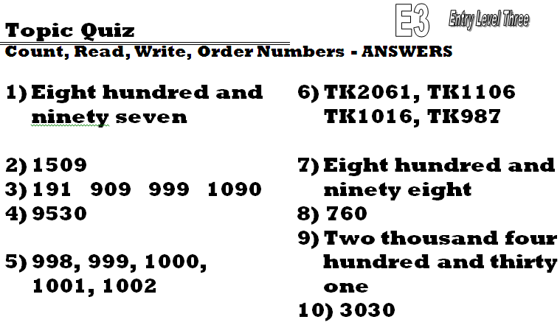

14 – TOPIC ANSWERS

Slide 24
Progress Checker 2
W
What do you now know about place value ? What did you learn in the session? Examples….
How would you now rate your skills in reading and writing numbers?
Excellent ability
Good ability, but working to improve
Ok, making a start but I know I have lots to still learn
The date I finished studying: My aims were…
A Learn how to read and write numbers to represent values
B Learn the names of each column of digits
C Know what the ‘Decimal Point’ is used for and decimal place values
14,623 fourteen thousand, six
hundred and twenty three
70.896
Tk K H T U .

Slide 25
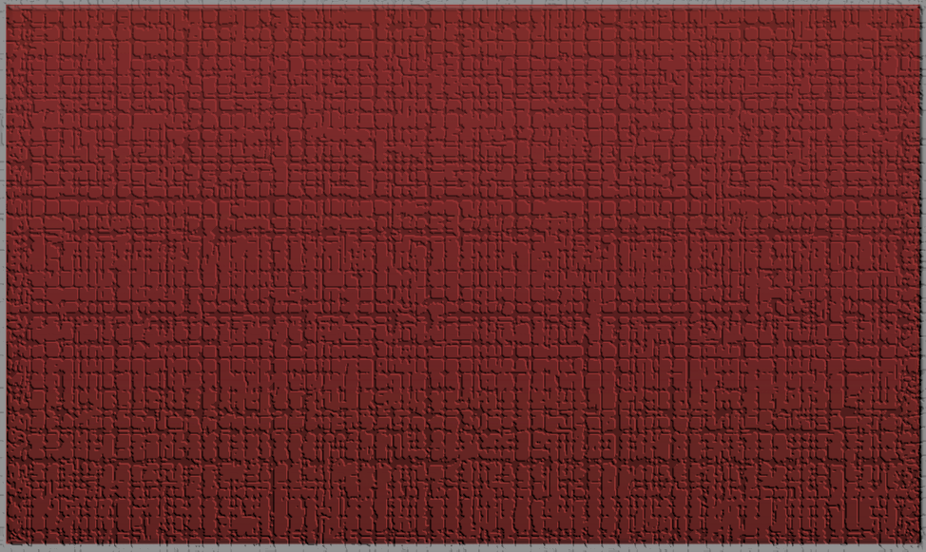
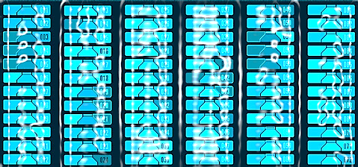

Continuing to Study and Learn
What else can you do to help yourself to learn and practice? Here are ten suggestions, record which you do each week and also record your progress.
Internet websites
Repeat the lesson, make notes, organise a folder, revise
Own maths workbook
Study together with a friend or family member
Finish activities in this book
Complete class handouts or tasks
Practice exams / past papers
Use maths skills learnt at home or at work in real situations
Play games
Experiment yourself, try new things ask yourself questions
Try making a graph of number of practice methods you use against your progress score in each topic. Are you showing more practice gives better results?

