Slide 1
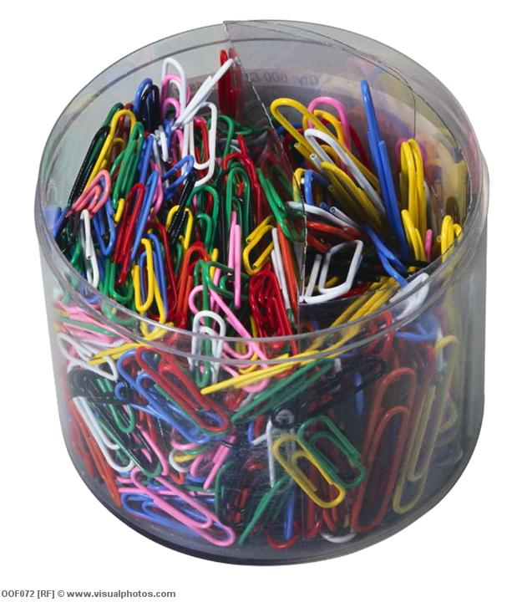
Maths with Letters
Z
Learning Objectives (each skill leads to the next)
Understand how letters can be used in Maths
Identify and write algebraic expressions
Collect and simplify like algebraic terms
Starter: How many paperclips?
How many paperclips are there in the pot?
Write your guess down
GCSE Algebra

Slide 2

Paperclips
How many paperclips in the pot?
n

Slide 3
Paperclips
What if I took 2 out?
n-2

Slide 4
Paperclips
What if I added 4?
n+4

Slide 5
Paperclips
What if I took 12 out?
n-12
n+12

Slide 6
Paperclips
What if I added 100?
n+100

Slide 7
Paperclips
What if I added another pot?
n+n
2xn
2n

Slide 8
Paperclips
What if I added another 2 more pots?
3xn
n+n+n
3n

Slide 9

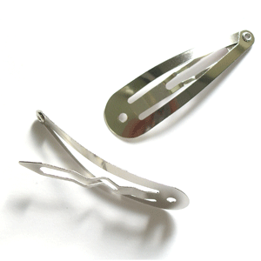

Your Turn: Hair Clips
Elizabeth has a box of hair clips at home
How can we represent the number of hair clips in the box?

Slide 10
Your Turn: Hair Clips
Elizabeth has a box of hair clips at home
She takes 5 clips out to wear, how many left?

Slide 11
Your Turn: Hair Clips
Elizabeth has a box of hair clips at home
She adds in 15 new clips that she bought at Primark

Slide 12
Your Turn: Hair Clips
Elizabeth has a box of hair clips at home
She is given a new box of clips, with t clips in it

Slide 13
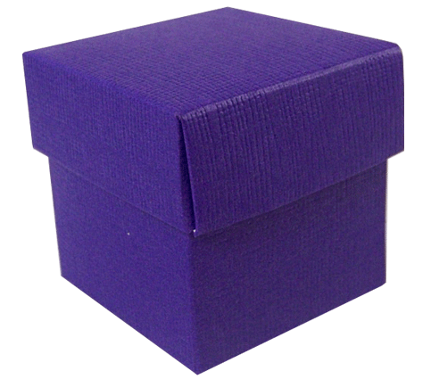
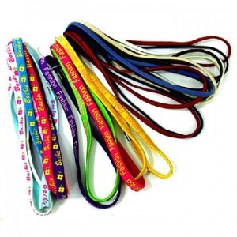
Your Turn: Hair Bands
Laurelle has a box of hair bands at home, all different colours
How can we represent the number of hair band in the box?

Slide 14
Your Turn: Hair Bands
Laurelle has a box of hair bands at home, all different colours

Slide 15
The Actual Number of Paperclips
If there are 300 paperclips in a full pot, how many paperclips did we have each time?
Expression
Number Paperclips
The full pot | n | 300
Take 2 out of full pot | n – 2 | 300 – 2 = 298
Add 4 to full pot | n + 4 | 300 + 4 = 304
Take 12 out of full pot | n – 12 | 300 – 12 = 288
Add 100 to full pot | n + 100 | 300 + 100 = 400
Add one full pot to the full pot | n + n = 2n | 2 x 100 = 200
Add two full pots to the full pot | n + 2n = 3n | 3 x 100 = 300

Slide 16
The Actual Number of Paperclips
If there are 300 paperclips in a full pot, how many paperclips did we have each time?
Expression
Number Paperclips
The full pot | n | 300
Take 2 out of full pot | n – 2 | 300 – 2 = 298
Add 4 to full pot | n + 4 | 300 + 4 = 304
Take 12 out of full pot | n – 12 | 300 – 12 = 288
Add 100 to full pot | n + 100 | 300 + 100 = 400
Add one full pot to the full pot | n + n = 2n | 2 x 300 = 600
Add two full pots to the full pot | n + 2n = 3n | 3 x 300 = 900

Slide 17
Number of Paperclips
?
We have just discovered that the full pot only had 270 paperclips in it…
Description | Expression | 300 in full pot | 270 in full pot
The full pot | n | 300
Take 2 out of full pot | n – 2 | 300 – 2 = 298
Add 4 to full pot | n + 4 | 300 + 4 = 304
Take 12 out of full pot | n – 12 | 300 – 12 = 288
Add 100 to full pot | n + 100 | 300 + 100 = 400
Add one full pot to the full pot | n + n = 2n | 2 x 100 = 200
Add two full pots to the full pot | n + 2n = 3n | 3 x 100 = 300
Repeat for 276 in the full pot

Slide 18
Hair Clips & Bands
?
We have just discovered that the full pot only had 270 paperclips in it…
Description | Expression (in box) | Value
Number of clips in the box
Take 5 clips out of the box
Buy 14 new clips & add to box
Add t clips to the box
Number bands in the box
Add in 3 descriptions of your own
Create another scenario

Slide 19
Differentiated
Hair Clips & Bands
?
Complete the blanks
Description | Expression (in box) | Value
Number of clips in the box | c | 20
Take 5 clips out of the box | c – 5 | 20 – ___
Buy 14 new clips & add to box
Add t clips to the box |  | 20 + t
Number bands in the box | b | 35
Take 12 bands out of the box
Add another b bands to the box
Add in a description of your own
Create another scenario

Slide 20
Algebraic Expressions
Write an expression for:
There are c cars in a car park, then 5 more cars arrive
There are s sweets in a box, then someone eats 6 of them
There are 4 pupils in the canteen, then n more arrive
Mrs Comber is r years old, her brother is 2 years younger
c + 5
s - 6
4 + n
r - 2
Create your own question (and answer)

Slide 21


Z
Learning Objectives
Understand how letters can be used in Maths
Identify and write algebraic expressions
Collect and simplify like algebraic terms

Slide 22

Collecting Like Terms
Shaneil
Georgia
Firoza
Fatmata
How many green paperclips are there?
3 + 3 + 4 + 2
= 12

Slide 23
Like Terms
Each green paper clip is worth g pence
Shaneil
Georgia
Firoza
Fatmata
3g
3g
4g
2g
How much are they all worth?
3g + 3g + 4g + 2g
= 12g
collected like terms
simplified

Slide 24
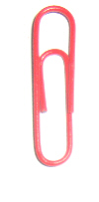
Like Terms
Red paperclips are worth r pence
Zaime
Yaimun
Poppy
Sophie
Took away
r
4r
3r
-2r
1r
-2r
4r + 3r + r
= 6r
collected like terms
simplified

Slide 25
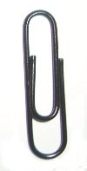
Collecting Like Terms
Write a long expression and then the simplified expression for:
If g = 2, r = 5 and b = 6, work out the
value of your answers for questions 1 to 3
3g + 2g + 2g + 4g =
11g
22
2r – r + 5r – 2r
=
Take away
Take away
4r
20
3b + 3b – 2b + b
=
Take away
5b
60
Ask for the extension sheet

Slide 26
Extension Work
1.
2.
Take away
Take away
3.
Take away

Slide 27
Plenary: True or False?
You can use any
letters in algebraic expressions

Slide 28
Plenary: True or False?
5 more than n is
n + 5
n + 5 is the
same as 5 + n

Slide 29
Plenary: True or False?
Bob is t years old
Rob is 5 years
older than Bob
So, Rob is t – 5 years old
My dad is twice as old as me.
If I am y
years old, how old
is my dad?

