Slide 1
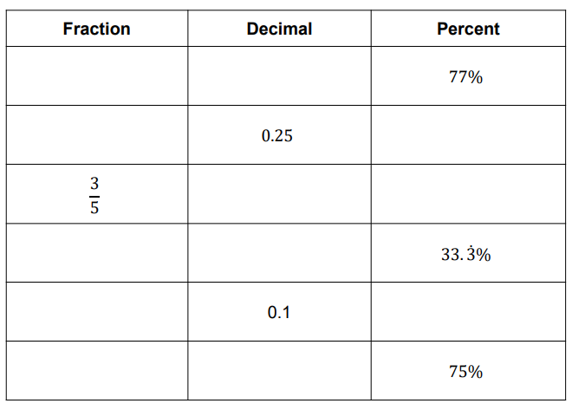
COORDINATES
Learning Objectives
To be able to :
Use coordinates in 2-D, positive and negative, to specify the positions of points
Calculate values of angles and/or coordinates with 2-D and 3-D shapes
Complete the table

Slide 2
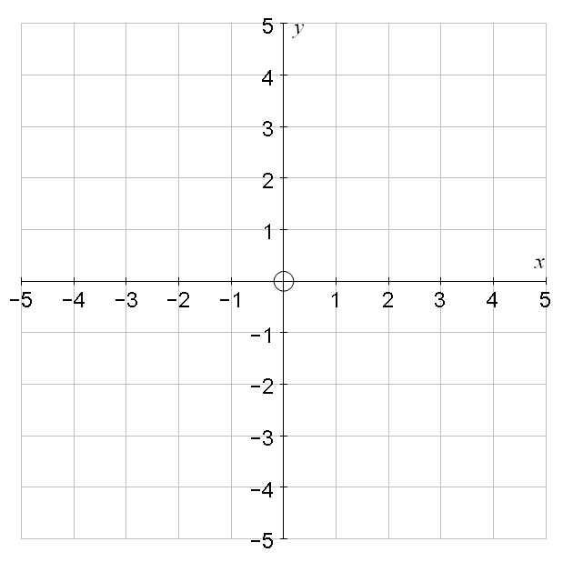
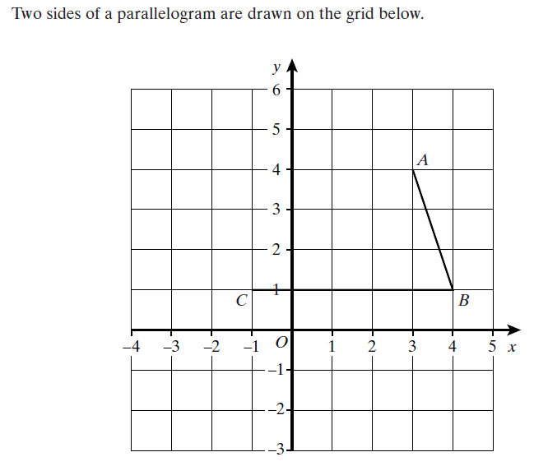
STARTER
Coordinates
Coordinates of 2D Shapes
A
D
B
C
Write down the coordinates of:
A, B, C and D
Write down the coordinates of A and C
Draw two more lines to compete the parallelogram ABCD

Slide 3
COORDINATES
Plot the points shown on a coordinate grid..(draw an appropriately scaled grid)
( 8, -4 )
( -10, 0.5 )
( 3 , -20 )
( -15.5 , 11 )
E) ( 0, -17 )
F) ( 1, 16.5 )
G) ( -5 , -6 )
H) ( 14, 1/2 )

Slide 4
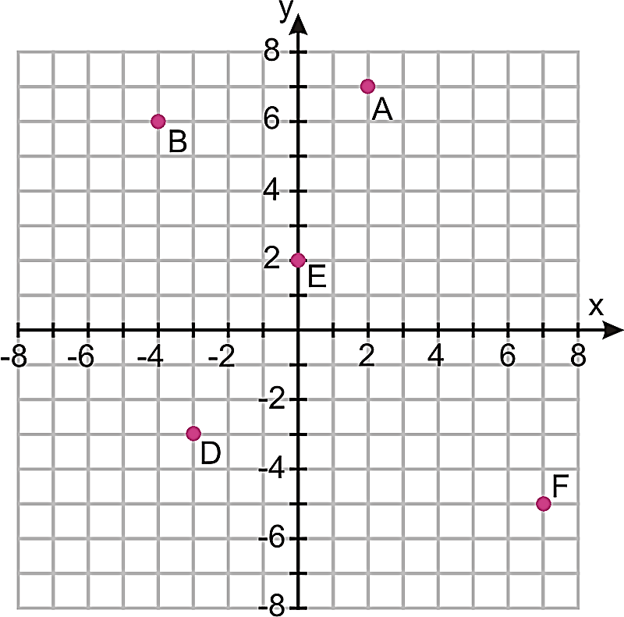
Your turn…
Read from the coordinate grid shown and write the coordinates of the points
Remember to read the ‘x’ direction first and write it in the left part of the coordinate bracket (x, … )
.. Then read the ‘y’ coordinate (… , y )
A)..
B)..
C)..
D)..
E)..
F)..

Slide 5
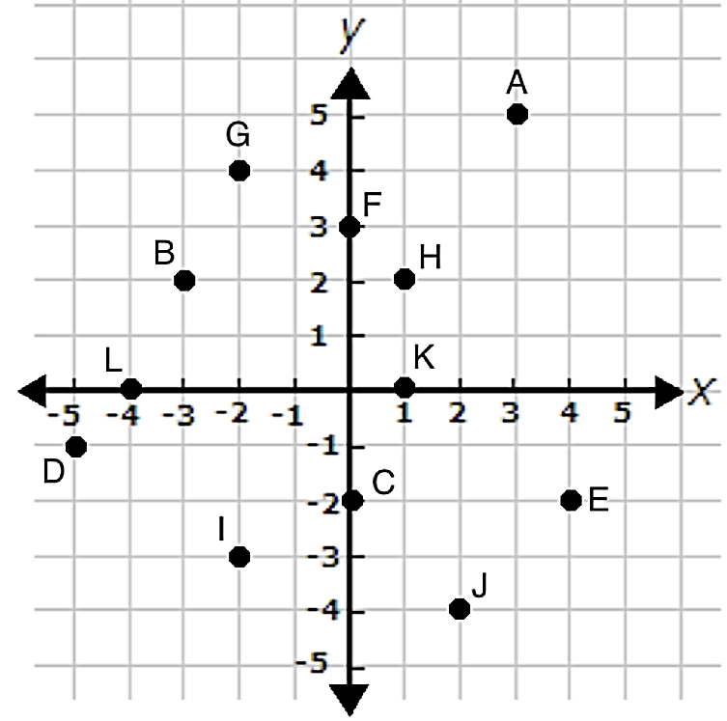
Reading Coordinates - Questions
Read the coordinates shown.. Write the coordinates below..
A ( , ) B
C D
E F
G H
I J
K L

Slide 6
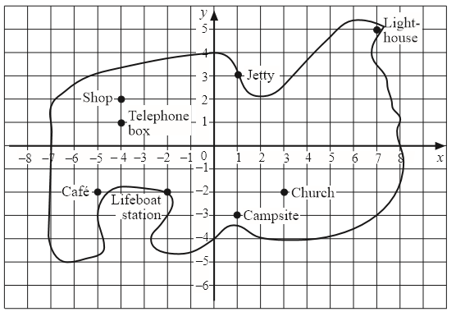
Writing coordinates continued
Light House
Jetty
Shop
Telephone Box
Café
Lifeboat Station
Church
Campsite

Slide 7
Your turn…Problem Solving with coordinates
(a) The point K is halfway between points B and C. What are the coordinates of point K?
(b) Shape ABCD is a rectangle.
What are the coordinates of point D?

Slide 8
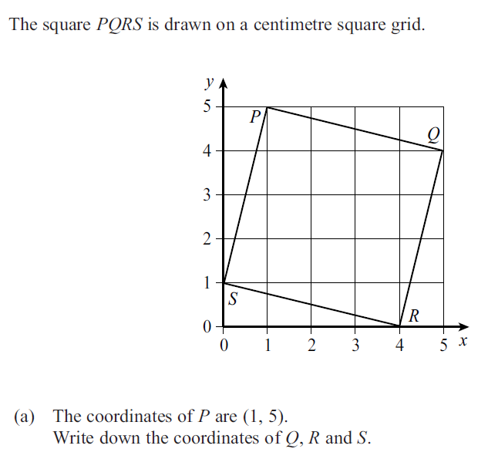
Your turn…

Slide 9




Slide 10
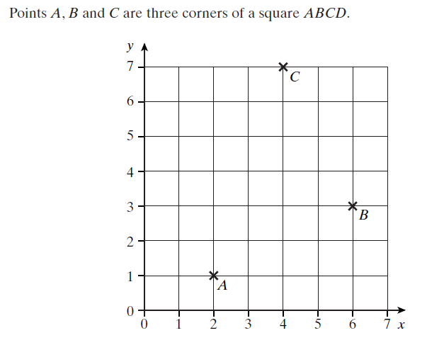



Slide 11
2D Shapes on Coordinate Grid – Word Qs
Square ABCD has coordinates A (2, 5) B (5,5) C (2, 2) and D ( ?,?). Find D.
A right angled triangle is made with coordinates S ( -2, -2) T ( 3, -2) and the point U which is five units above point T. Find U.
A rectangle rests on the X axis and lies solely in the positive y quadrants with its two bottom corners at A(-5,0) and B(5,0). Its width is half its length. Find the missing top corners C and D.
The vertex of an isosceles triangle sits at coordinate M (0,7). The width of the base of the triangle is 8 units long. Find the coordinate of the bottom corner N (?,?) if the other is P (-4,0)

Slide 12
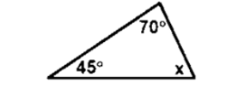
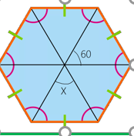
2D SHAPE ANGLES
Square/Rectangles are 4 sided shapes and part of the ‘Quadrilaterals’ that have interior angles that sum to 360 degrees
All types of Triangles have angles that sum to 180 degrees
Regular ‘Polygons’ have all the same side lengths and interior angles the same size.
Q1 Find the missing angle
Q2 Find the missing angle

Slide 13
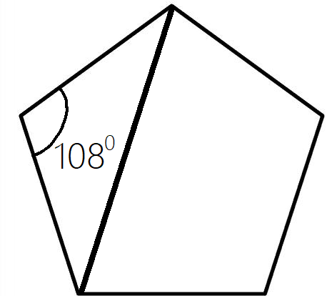
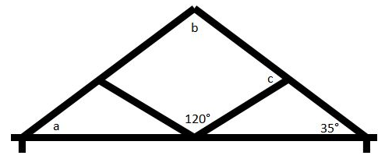
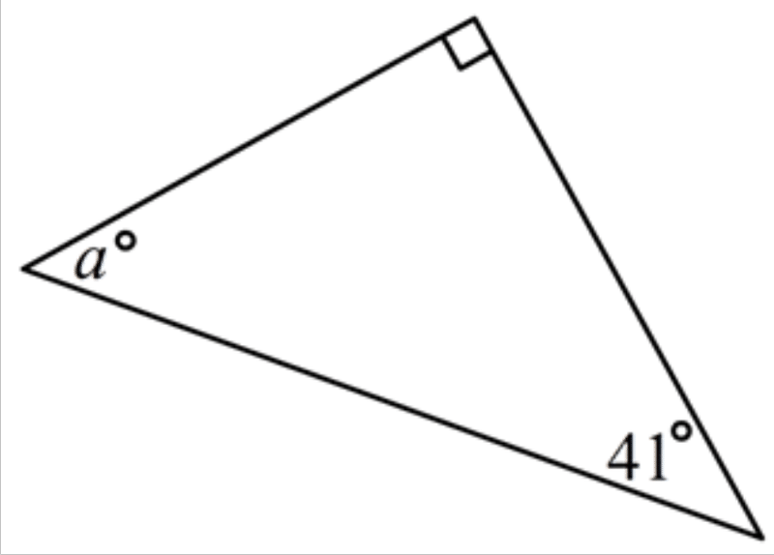
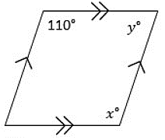
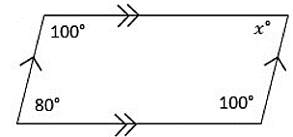
Your Turn….2D Shape Angles
Find the missing angles in the 2D shapes shown
5)
This shape has an isosceles triangle in a regular pentagon
Y
1) This shape is symmetrical left to right
X
2)
3)
4)

Slide 14
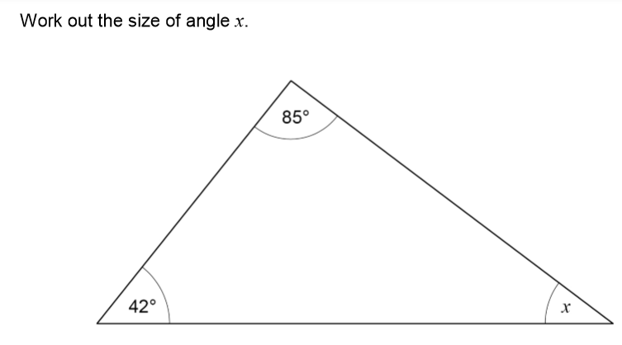
Exam Questions

Slide 15
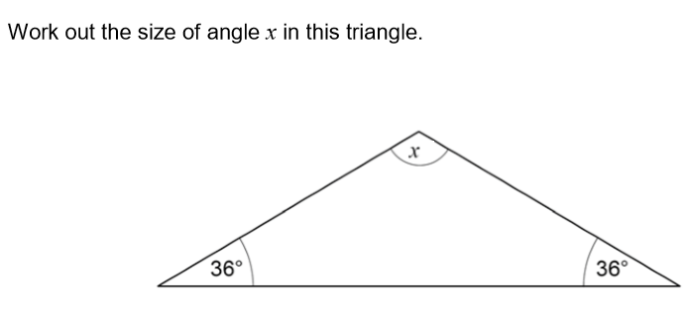
Exam Questions

Slide 16
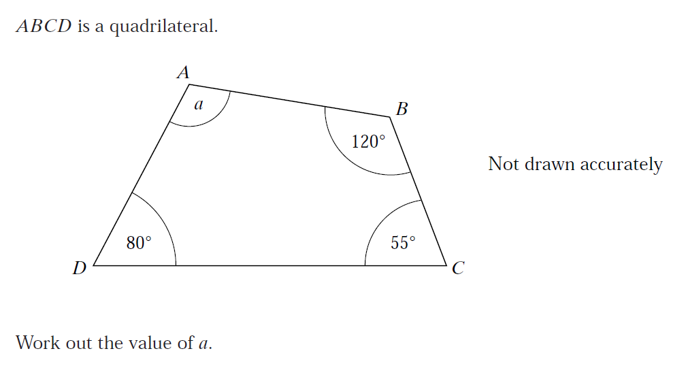
Exam Questions

