Slide 1






Starter
Adding and Subtracting
Comparing Fractions
$$\frac{3}{4}+\frac{1}{3}$$
$$\frac{6}{7}−\frac{3}{4}$$
Write these fractions from smallest to biggest:
1 $\frac{2}{5}$ , $\frac{5}{4}$ , 1 $\frac{1}{2}$ , $\frac{8}{10}$
$$2\frac{3}{5}−\frac{2}{3}$$
$1\frac{3}{4}$ + $\frac{3}{4}$
Fractions of Quantities
Improper and Mixed Numbers
What is $\frac{13}{3}$ as a mixed number?
What is 2 $\frac{2}{5}$ as an improper fraction?
Find 5cm as a fraction of 15cm
Find 7 days as a fraction of 4 weeks

Slide 2
Fractions
Learning Objectives
To be able to :
Read, write, order and compare fractions and mixed numbers
Express numbers as a fraction of another
Work out 4.2 x 2.1
On Friday, Lorenzo’s bank account had –£58.65 in. On Monday he got paid £276.50. How much does he have in his account once he gets paid?
Xi gets a new job. She gets paid £7.54 per hour. In a year she works 8 hours a week. Estimate how much she earns in a year.
d) Rachel needs to buy food. She needs to buy 18 packets of crisps. One pack costs £0.89. A multipack of 4 costs £3.40. Which option is cheaper, and by how much?

Slide 3
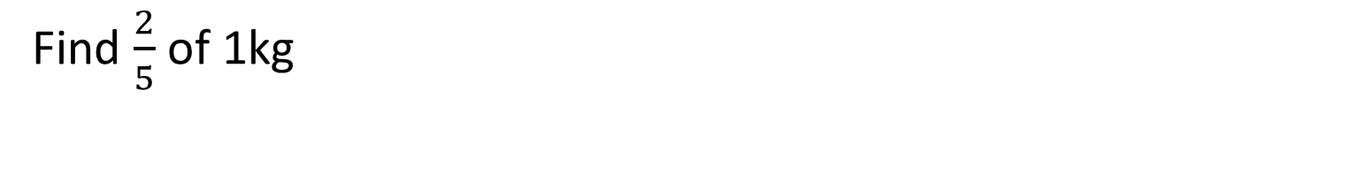
Fractions of Amounts
Find $\frac{1}{3}$ of £450
Find $\frac{2}{5}$ of 1kg

Slide 4


Your turn…
Find:
1) $\frac{1}{5}$ of 500
2) $\frac{4}{7}$of 630g
3) $\frac{2}{3}$ of 90
4) $\frac{4}{5}$of 90
5) $\frac{12}{100}$of 300
Find $\frac{9}{10}$ of 3 litres
Freddie needs to deposit $\frac{1}{4}$ of the value of a car he wants, before he buys. The car costs £5200. How much does he need to deposit?

Slide 5
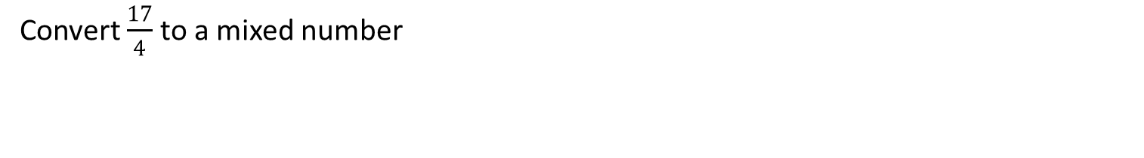
Mixed Number & Top Heavy
Convert 1 $\frac{3}{4}$ to an improper fraction
Convert $\frac{17}{4}$ to a mixed number

Slide 6


Your turn…
Convert the following to a mixed number:
$\frac{12}{5}$
$\frac{25}{3}$
$\frac{87}{9}$
$\frac{62}{7}$
Convert the following to an improper fraction:
3 $\frac{2}{3}$
4 $\frac{1}{7}$
6 $\frac{2}{5}$
4 $\frac{7}{16}$

Slide 7
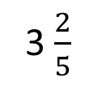






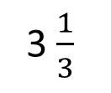
Comparing Fractions
Put these fractions in ascending order:
$$\frac{4}{6}$$
$$\frac{3}{4}$$
$$\frac{7}{12}$$
$$\frac{5}{8}$$
Put these fractions in descending order:
3 $\frac{2}{5}$
$$\frac{13}{4}$$
3 $\frac{1}{3}$
$$\frac{7}{2}$$

Slide 8
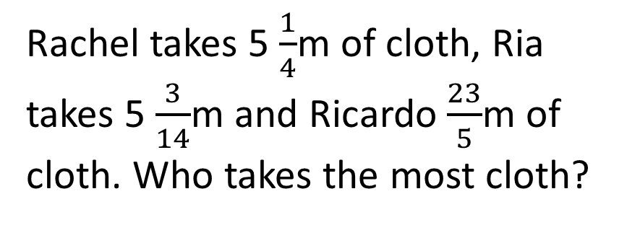

Your turn…
Put these fractions in ascending order.
a) $\frac{1}{2} \frac{5}{8}$ $\frac{7}{16}$
b) $5\frac{2}{5}$ $\frac{53}{10}$ $4\frac{10}{15}$
c) $2\frac{3}{4}$ $\frac{27}{12}$ $\frac{25}{8}$
Rachel takes 5 $\frac{1}{4}$m of cloth, Ria takes 5 $\frac{3}{14}$m and Ricardo $\frac{23}{5}$m of cloth. Who takes the most cloth?

Slide 9




Adding and Subtracting Fractions
$$\frac{3}{4}+\frac{1}{3}=$$
$$\frac{6}{7}−\frac{3}{4}=$$
$$3\frac{3}{4}+1\frac{1}{3}=$$
$$2\frac{6}{7}−\frac{9}{4}=$$

Slide 10
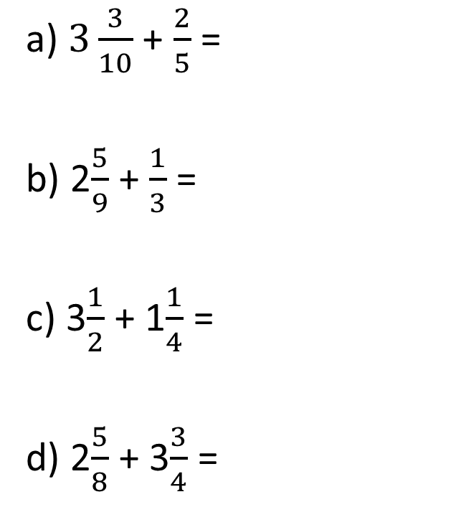
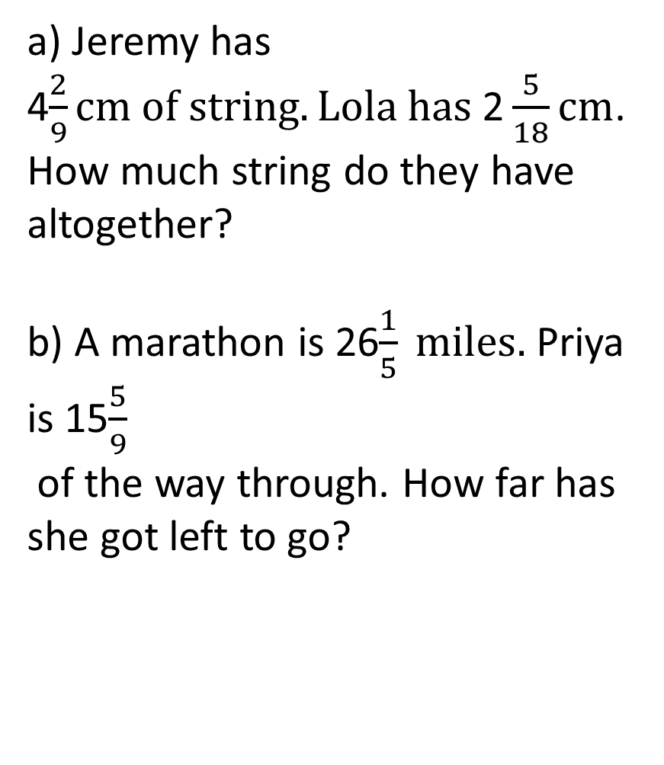
Your turn…
a) $3\frac{3}{10}$ + $\frac{2}{5}$ =
b) 2$\frac{5}{9}$ + $\frac{1}{3}$ =
c) 3$\frac{1}{2}$ + 1$\frac{1}{4}$ =
d) 2$\frac{5}{8}$ + 3$\frac{3}{4}$ =
a) Jeremy has 4$\frac{2}{9}cm of string. Lola has \text{2}\frac{5}{18}cm$.
How much string do they have altogether?
b) A marathon is 26$\frac{1}{5} miles.$Priya is 15$\frac{5}{9}$
of the way through. How far has she got left to go?

Slide 11
Expressing as a Fraction
Express 4cm as a fraction of 20cm.
Express 10 days as a fraction of 2 weeks.

Slide 12
Your turn…
Express the first as a fraction of the second:
2 cm, 6 cm
4 kg, 20 kg
£ 8, £ 20
5 hrs, 24 hrs
e) 12 days, 30 days
50p, £3
4 days, 2 weeks
40 minutes, 2 hrs

Slide 13

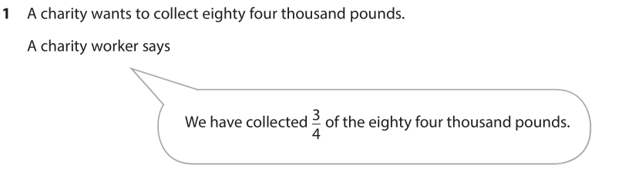

**Past Paper 2**

Slide 14

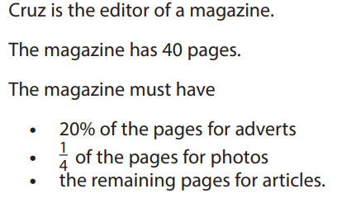
Practice Set 2

Slide 15
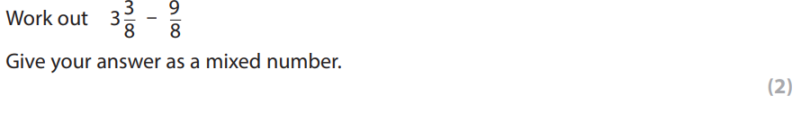
Past Paper 1

Slide 16
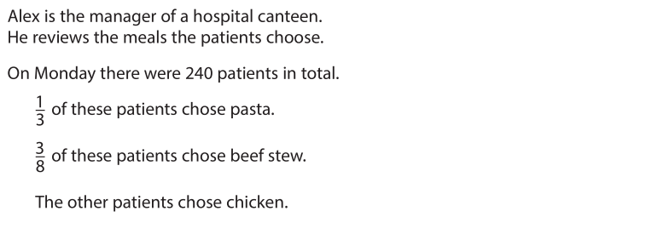
*** Past Paper 2 ***

