Slide 1

Co-ordinates and Angles
Use coordinates in 2D, positive and negative, to specify the position of points
Calculate the values of angles and/or coordinates within 2D and 3D shapes.
Recap
Put the following in ascending order
0.143 $\frac{1}{7}$ 115% $\frac{5}{4}$ 0.060
I need to find 1.5 % of £ 100,000 What is 1.5 % converted into a decimal, so that I can multiply this by £100,000 to find the stamp duty.

Slide 2
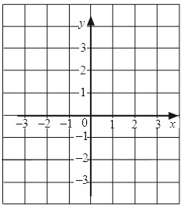
Coordinates
The coordinates of a point are written as a pair of numbers (x,y) which describe where the point is on a set of axes.
x-axis is always horizontal (across)
y-axis is always vertical (up/down)

Slide 3
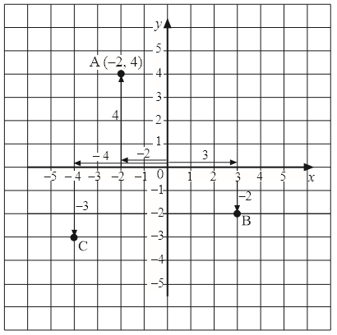
Worked Example
A (-2, 4)
B (3, -2)
C (-4, -3)

Slide 4
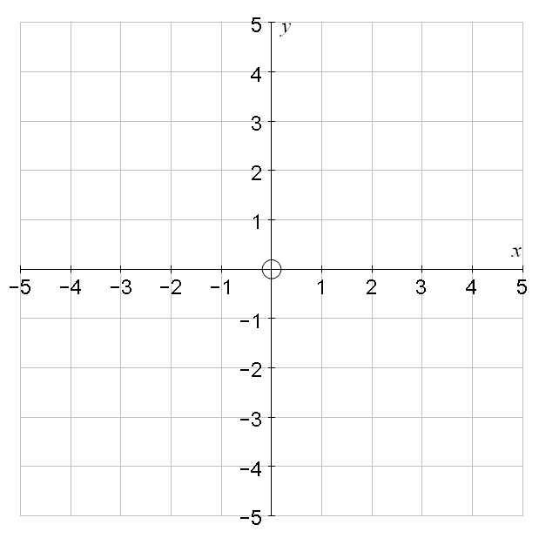
Writing coordinates
A =
B =
C =
D =
A
D
B
C

Slide 5
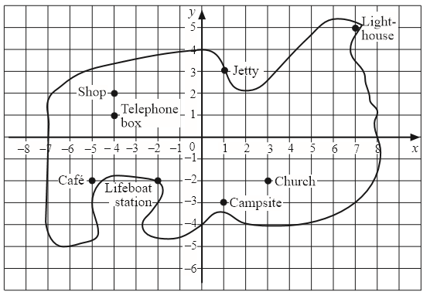
Writing coordinates continued
Light House
Jetty
Shop
Telephone Box
Café
Lifeboat Station
Church
Campsite

Slide 6
Solutions Writing coordinates continued
Light House (7,5)
Jetty (1,3)
Shop (-4,2)
Telephone Box (-4,1)
Café (-5,-2)
Lifeboat Station (-2,-2)
Church (3,-2)
Campsite (1,-3)

Slide 7
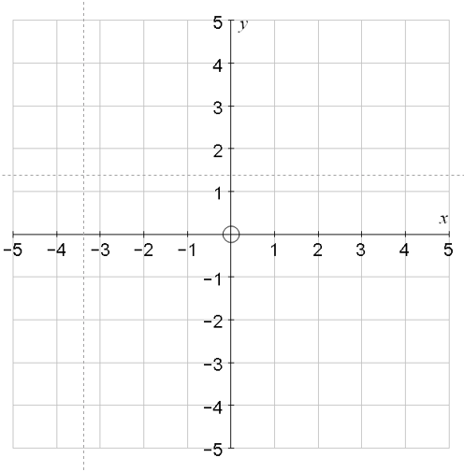
Plotting coordinates
Draw a grid and plot
the following points
A (3,4)
B (1,2)
C (-5,-3)
D (-3.2)
E (4,1)
F (0,4)
G (-2,-1)
H (4, -4)

Slide 8
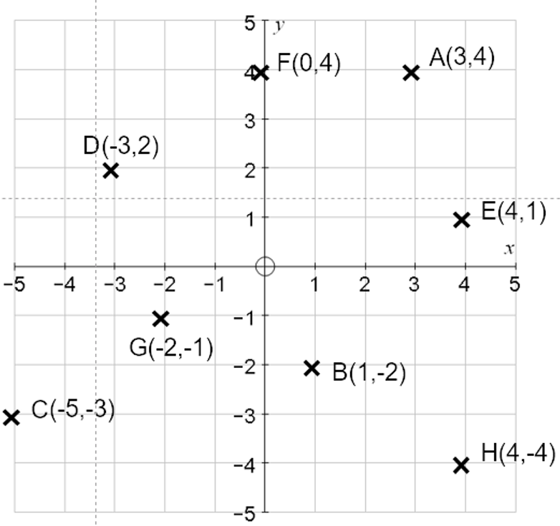
Solutions to plotting coordinates

Slide 9
Problem Solving with coordinates
(a) The point K is halfway between points B and C. What are the coordinates of point K?
(b) Shape ABCD is a rectangle.
What are the coordinates of point D?

Slide 10
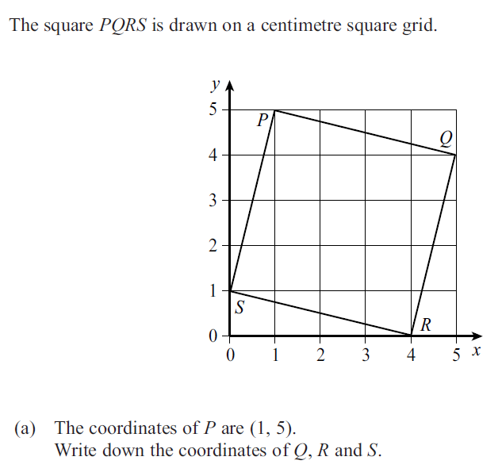

Slide 11
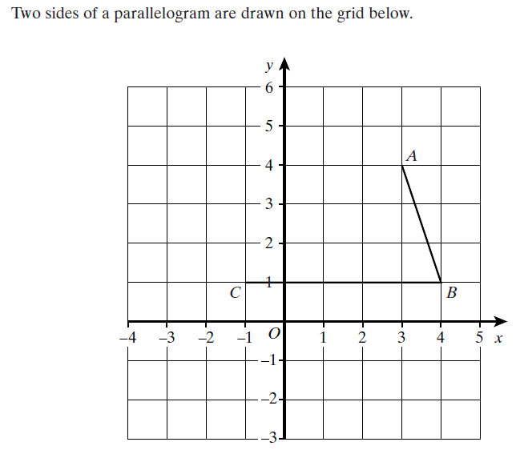




Slide 12
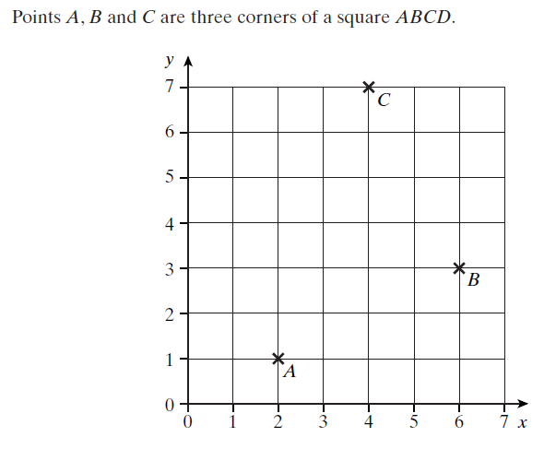



Slide 13
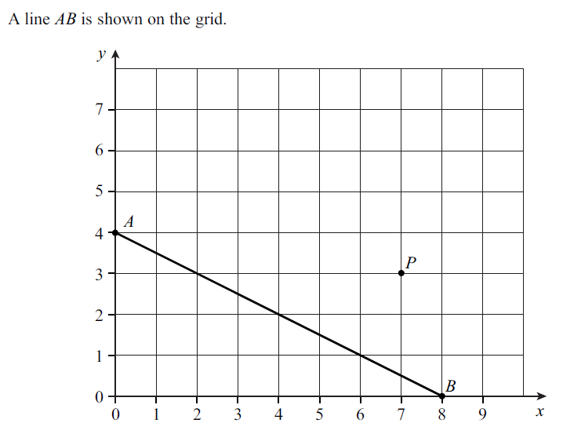




Slide 14
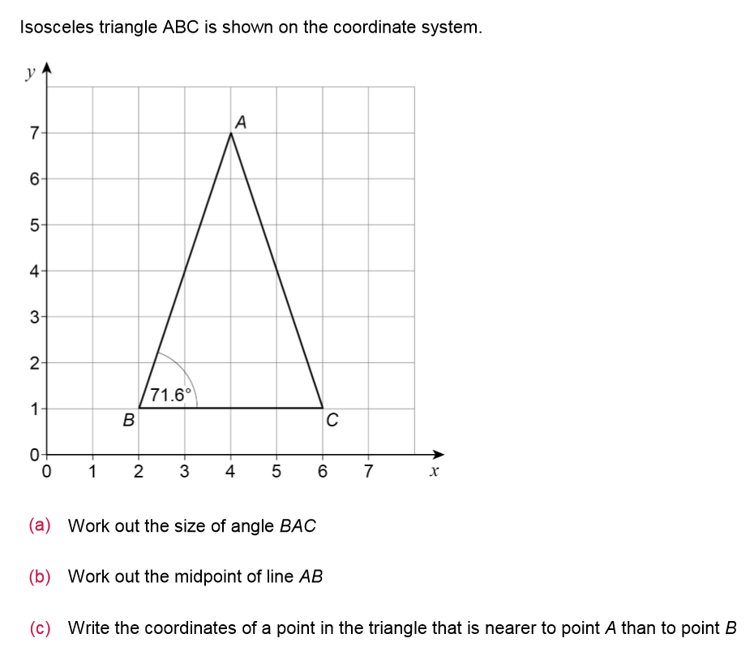

Slide 15
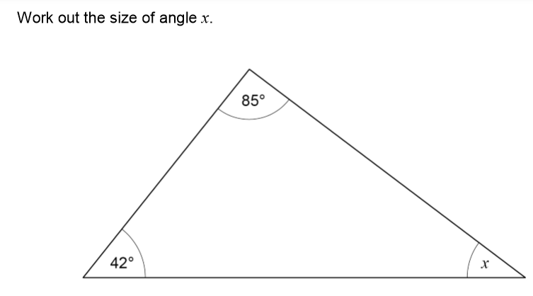

Slide 16
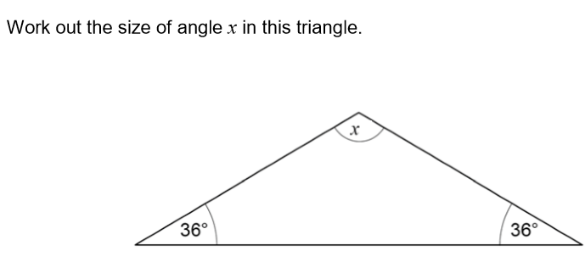

Slide 17
