Slide 1
Area and Surface Area
Learning Objectives
To be able to :
Identify properties various 3D shapes
Label and define parts of a circle
Find the area and circumference of a circle
Calculate the surface area of 3d shapes
Find the area of various 2D shapes
Recap:
298.75 + 23.46 – 121.72
2) a) 27 x 54 b) 0.27 x 5.4
3) 658 ÷ 5

Slide 2
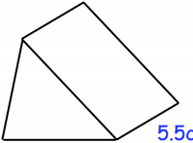
STARTER
Properties of a 3D Shape
Area of a Triangle
How many edges, vertices and sides does this shape have:
What is the area of:
7cm
6cm
Parts of a Circle
Area and Circumference
On a circle, draw and label a sector, arc and the radius.
Find the area and circumference of:
3cm
Area of a Rectangle
Surface Area
What is the area of:
Find the surface area of:
7cm
7cm
3cm
12cm
10cm

Slide 3
Area of 2D Shapes
Find the area of these shapes:
7cm
9cm
8cm
5cm
4cm
5cm
6cm
6cm
10cm
Find the area of these shapes:
3ft
8m
4ft
12m
5ft

Slide 4
Your turn…
Find the area of these shapes:
Find the area of these shapes:
1)
1)
6cm
4cm
8cm
5cm
4m
2)
2)
7mm
3m
11mm
6m

Slide 5
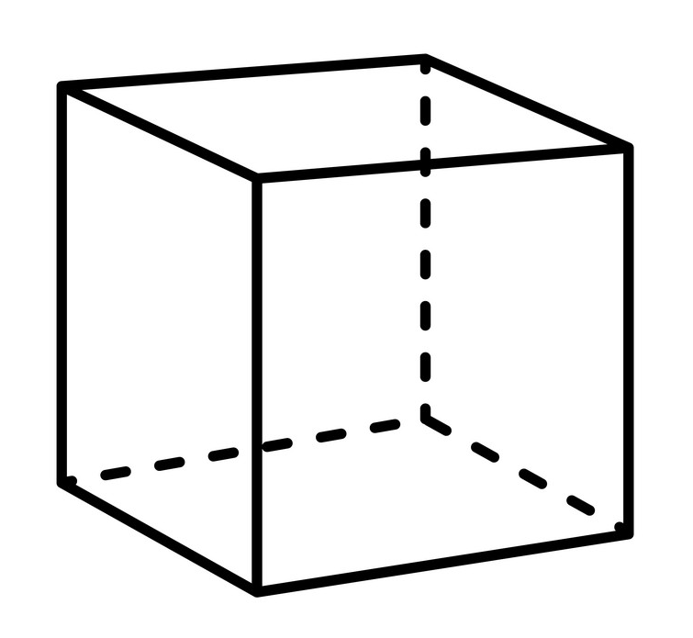
3D Properties

Slide 6
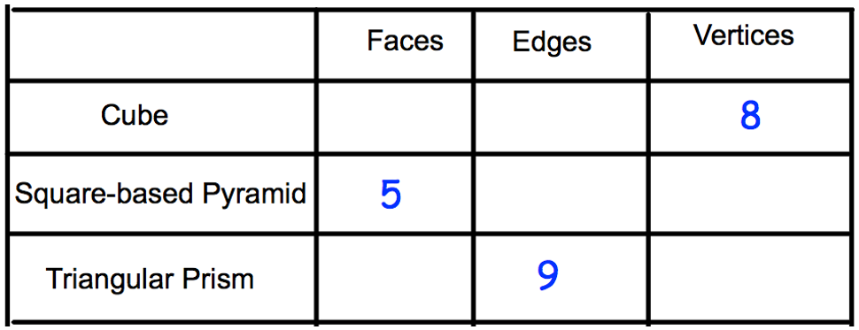
Your turn…
Complete the table below.
6
12
8
5
5
6

Slide 7
Surface Area
8cm
8cm
8cm
5cm
4cm
3cm

Slide 8
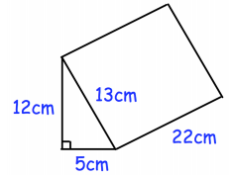
Your turn…
Find the surface area of the cuboid.
Find the surface area of the triangular prism.
6cm
13cm
12cm
3cm
20cm
8cm
5cm

Slide 9
Parts of a Circle
Label this circle with a:
Radius
Diameter
Sector
Segment
Chord
Tangent
Arc
Circumference

Slide 10
Parts of a Circle
Tangent
Arc
Radius
Sector
Diameter
Circumference
Chord
Segment

Slide 11
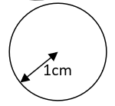
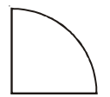
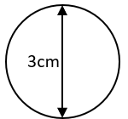
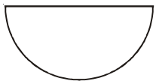
Area and Circumference of Circles
Area
1)
2)
10cm
Circumference
1)
2)
12cm

Slide 12
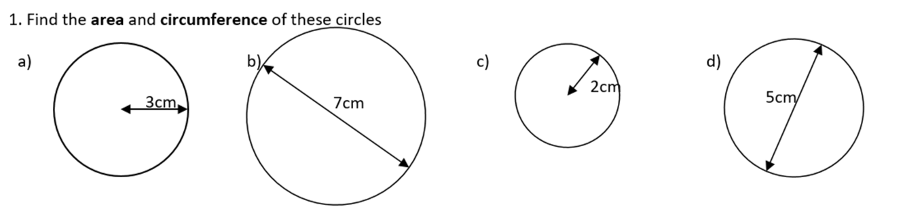
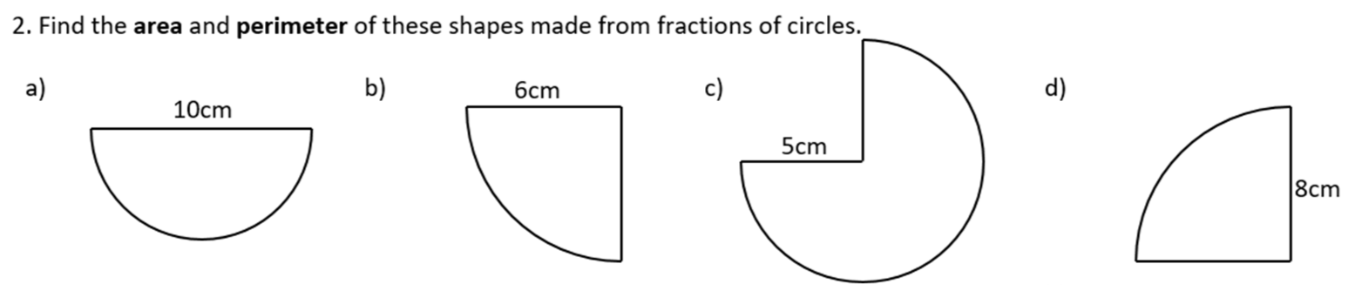
Your turn…

Slide 13

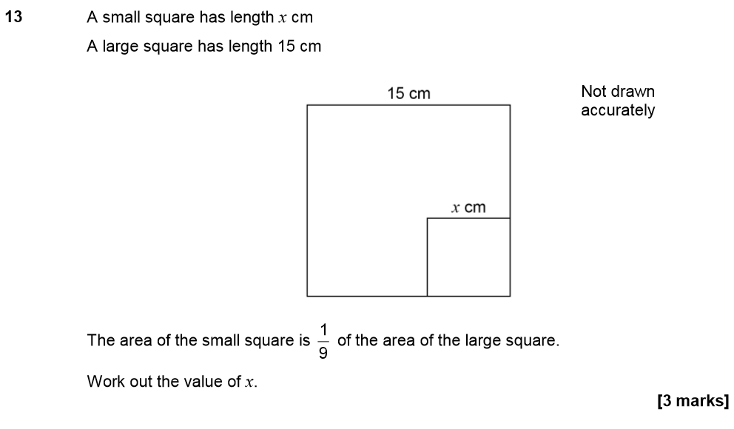
Nov 18 Paper 3

Slide 14
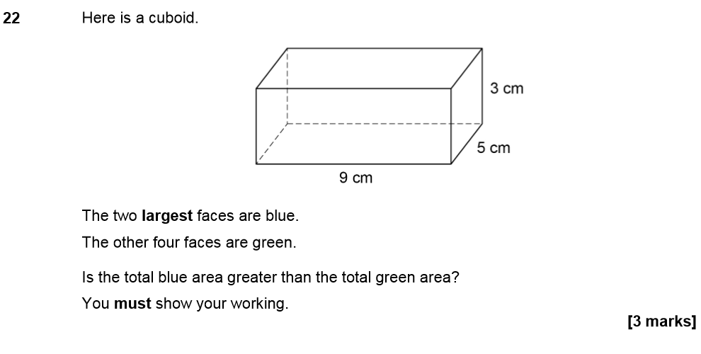
Nov 19 Paper 2

