Slide 1
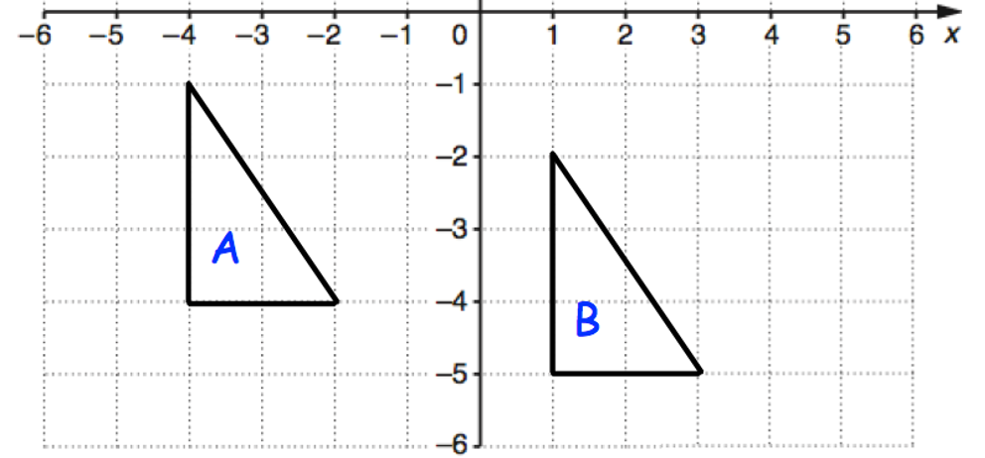
Transformations
To be able to identify, describe and construct congruent and similar shapes, including on coordinate axes, by considering rotation, reflection, translation and enlargement
To be able to apply addition and subtraction of vectors, multiplication of vectors by a scalar, including fractional scale factors
Describe fully the single transformation that maps shape A onto shape B.

Slide 2
Reflection
Reflect shape S in the x-axis.
y
To draw the reflection, first draw the mirror line.
6
Now draw a perpendicular line from one corner of the original shape to the mirror line, and extend it for the same distance on the other side. Repeat with the other corners.
4
S
5
4
2
3
x
-6
-4
-2
0
2
4
6
5
3
4
-2
Finally, draw in your transformed shape…
-4
S’
-6

Slide 3
Reflection
y
Reflect shape T in the line x=2
3
3
6
5
5
Where is the line x=2?
Hint: Where is ‘2’ on the x-axis?
T
T’
4
4
4
2
Using the line x=2 as your mirror line, draw in your perpendicular lines.
x
-6
-4
-2
0
2
4
6
-2
-4
Finally, draw in your transformed shape…
-6

Slide 4
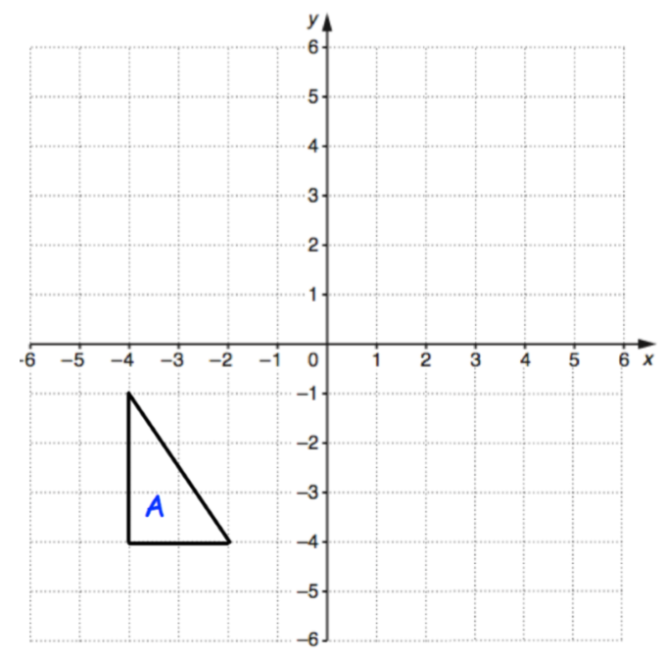
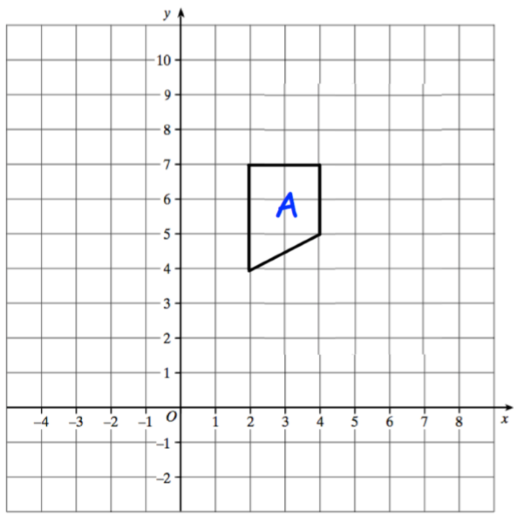


Your turn…
Reflect triangle A in the $x$ – axis.
Reflect shape A in the line $y$ = 3.
Label the new shape B.

Slide 5
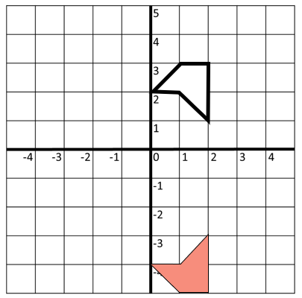
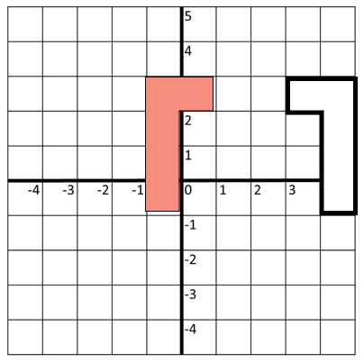
Your turn…
Describe fully the transformation that maps white onto red.
Describe fully the transformation that maps white onto red.

Slide 6
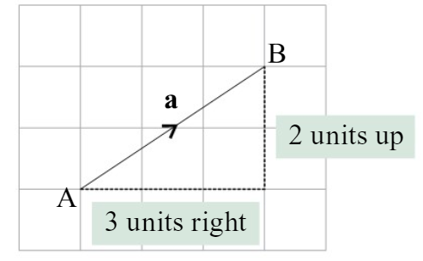



VECTORS
A vector has length and direction.
A vector can be written as a column vector or drawn as an arrow.
Column vector: $a=\left(\begin{matrix}3 \\ 2\end{matrix}\right)$
$x$-component: 3 units right
$y$-component: 2 units up

Slide 7
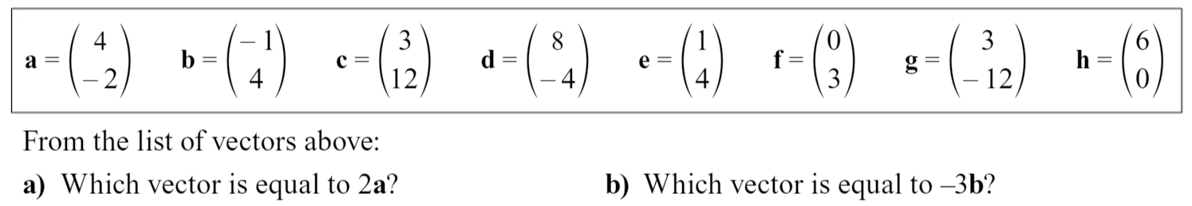

Your turn…
1. If $q=\left(\begin{matrix}−1 \\ 3\end{matrix}\right)$, find the following vectors.
a) $3q$ b) $5q$ c)$\frac{3}{2}q$ d) $−2q$
2.

Slide 8

Your turn…
If $a=\left(\begin{matrix}2 \\ 3\end{matrix}\right), b=\left(\begin{matrix}0 \\ −2\end{matrix}\right)$ and $c=\left(\begin{matrix}−1 \\ 4\end{matrix}\right)$, work out:
a) $b+c$ b) $c−a$ c) $2c+a$ d) $3a+b$
e) $a−2c$ f) $a+b−c$ g) $5b+4c$ h) $4a−b+3c$

Slide 9
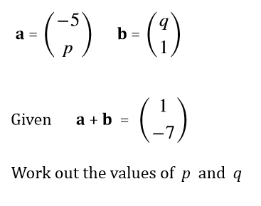
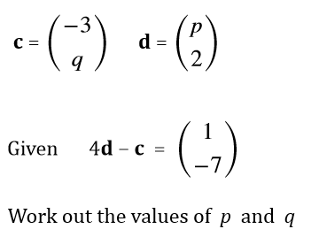
Your turn…

Slide 10
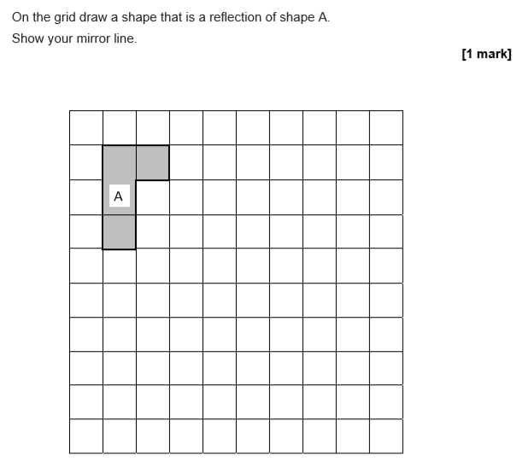
Exam questions - Q3

Slide 11
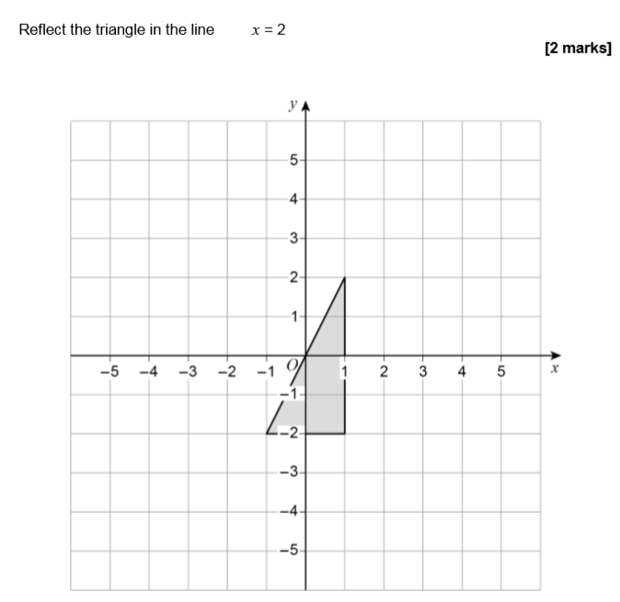
Exam question – Q4a

Slide 12
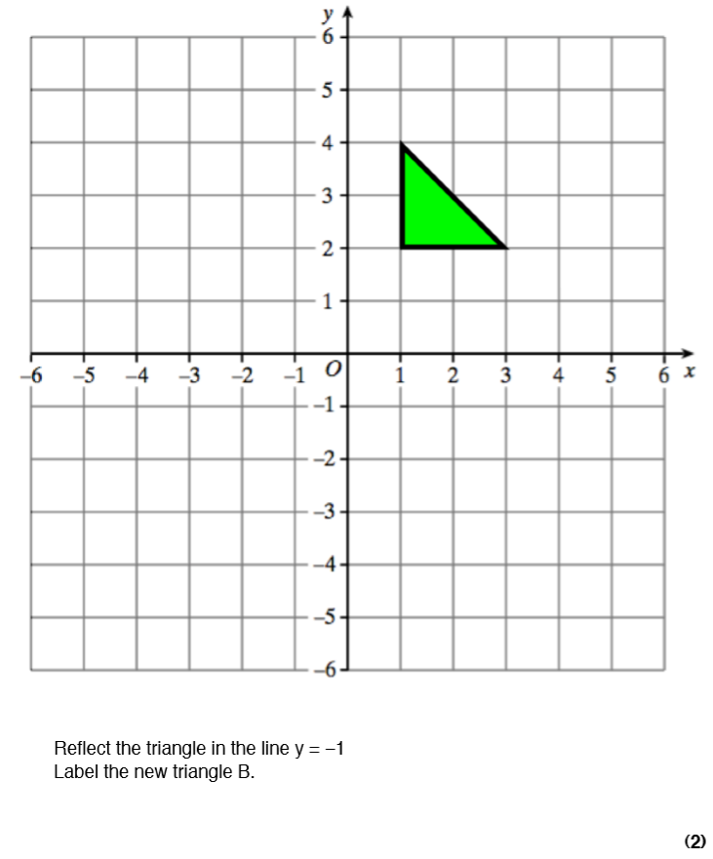

Slide 13
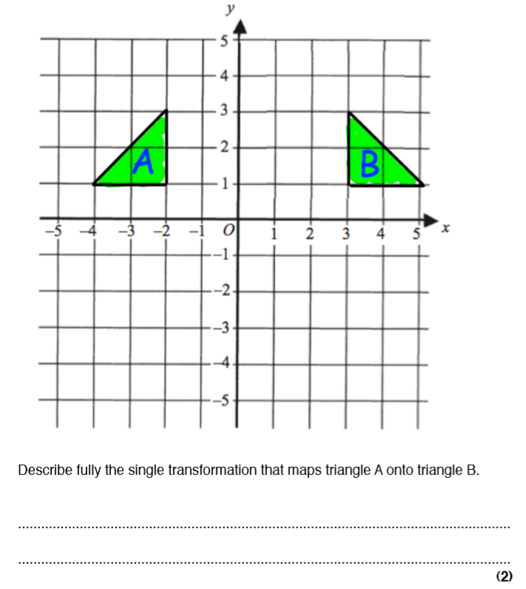

Slide 14
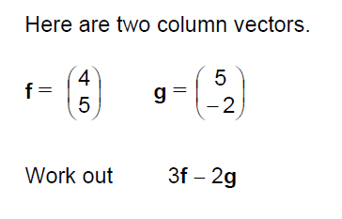

Practice Paper 2 - Set 1

Slide 15
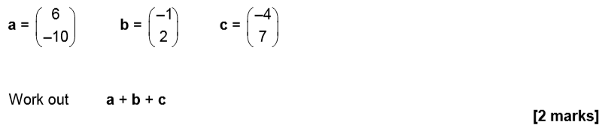
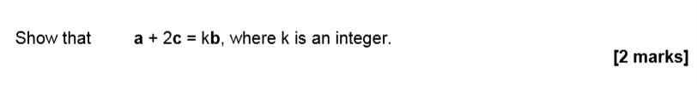
June 2018 - Paper 3

