Slide 1
PERCENTAGE
Learning Objectives
To be able to :
To be able to express one quantity as a percentage of another
To be able to compare two quantities using percentages
To be able to work with percentages greater than 100%
To be able to solve problems involving simple interest
Complete the table
Fraction | Decimal | Percentage
½
 | 0.23
 | 0.45
 |  | 20%

Slide 2
STARTER
Quantity
Simple interest
How much money would be in a savings account that pays simple interest if:
£500 was invested for 2 years in an account which pays 10% interest each year.
£900 was invested for 6 years in an account which pays 5% interest each year.
1a) Express 15 as a percentage of 50
1b) There are 300 counters in a bag, 45 of which are green. Express the amount of green counters as a percentage.
1c) What is 12% of 68 kg?
Greater than 100%
1a) Find 130% of 90
1b) Find 180% of 70
1c) Find 221% of 370

Slide 3
QUANTITY
A chess club has 25 members. 12 of these members are female. Express the number of female members of the club as a percentage.
Out of 24 pupils in a class, 18 walk to school. What percentage of the class:
Walk to school?
Do not walk to school?

Slide 4
Your turn…
Write each of the following amounts as a percentage.
15 out of 24
221 out of 260
661 out of 500
A school has 875 pupils. 525 are boys. What is this as a percentage?
171 out of 180 raffle tickets were sold for a summer fete. What percentage of the tickets were sold?
Write each of the following amounts as a percentage.
116.6 out of 212
53.5 out of 428
226.8 out of 210
2) The jackpot for a lottery was £10250. John won £1896.25. What percentage of the total jackpot did he win?

Slide 5
CALCULATING SIMPLE INTEREST
Deposit of £50 at 3% for 2 years
Deposit of £70 at 2% for 5 years

Slide 6
Your turn…
Deposit of £20 at 4% for 3 years
Deposit of £3270 at 4% for 15 years
Deposit of £80 at 2% for 4 years
Deposit of £4760 at 9% for 12 years

Slide 7
SIMPLE INTEREST
Sally deposits £600 into an account with interest rate of 5% per year. Calculate the interest that Sally received in one year and find how much money she has in the account after one year.
Jamie’s bank account pays interest at a rate of 10% per year. If he puts £850 into his account, how much will Jamie have after a year?

Slide 8
Your turn…
Deposit of £20 at 4% for 3 years
Deposit of £3270 at 4% for 15 years
Deposit of £80 at 2% for 4 years
Deposit of £4760 at 9% for 12 years

Slide 9

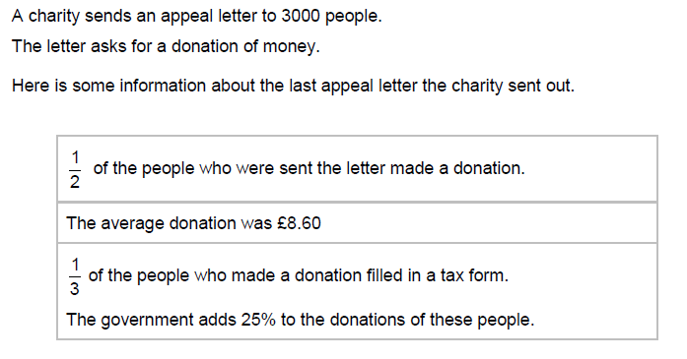
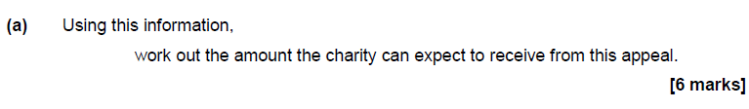
November 2018 Paper 2

Slide 10
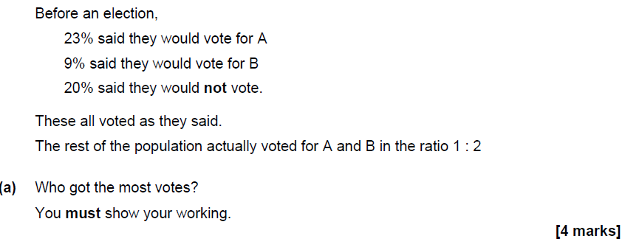
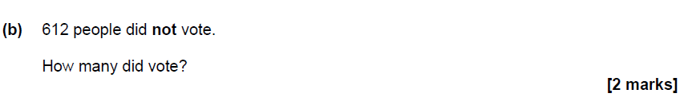
Practise paper set 4 Paper 2

