Slide 1
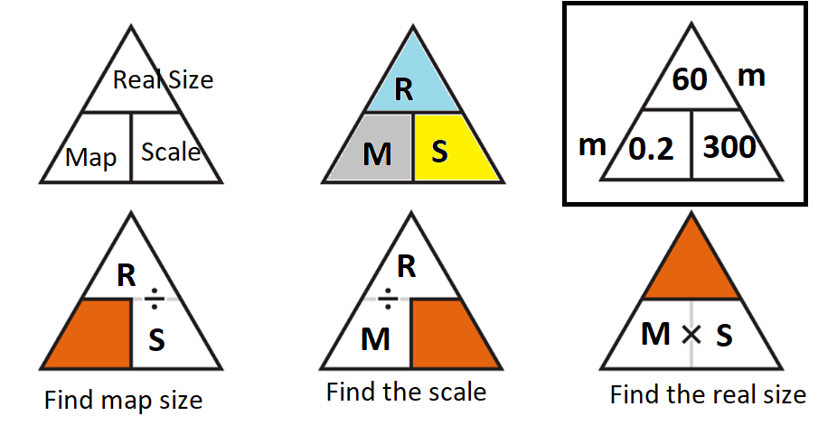
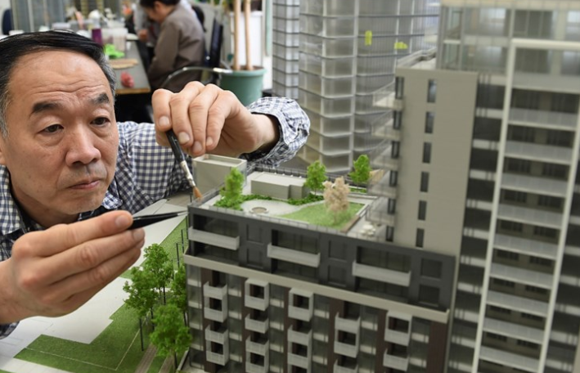
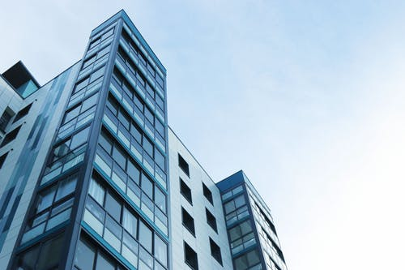

20cm
The real building is x300 bigger than the model

Slide 2
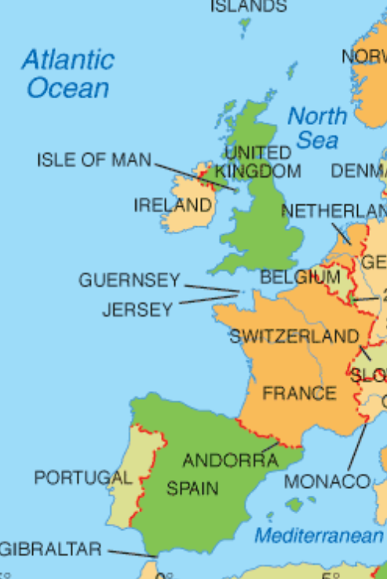
Exam Style Questions - Scale
Lara is flying from London (England) to Madrid (Spain) as shown on the map.
The distance on the map is 7.4cm
The map scale is 1: n
The actual distance is 1300km
Find ‘n’ the missing value in the map scale.
7.4cm

Slide 3
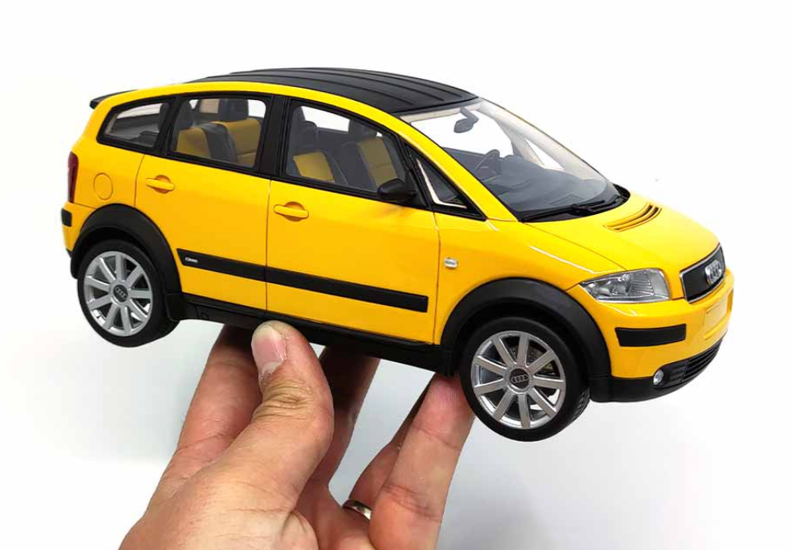
Exam Style Questions - Scale
The model car shown is a 1 : 18 scale
This car measures 15cm long.
Find the cars real length in metres
Find length of a model of this car if the real car is 2.5m long (still using 1:18)

Slide 4

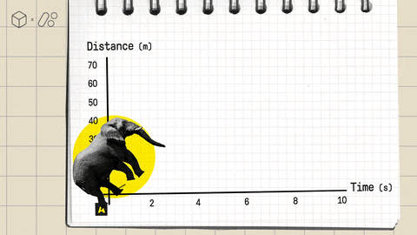
L2 Fskills Maths
Mean Median Mode Range and Percentage Change Revision

Slide 5

Percentage Change

Slide 6
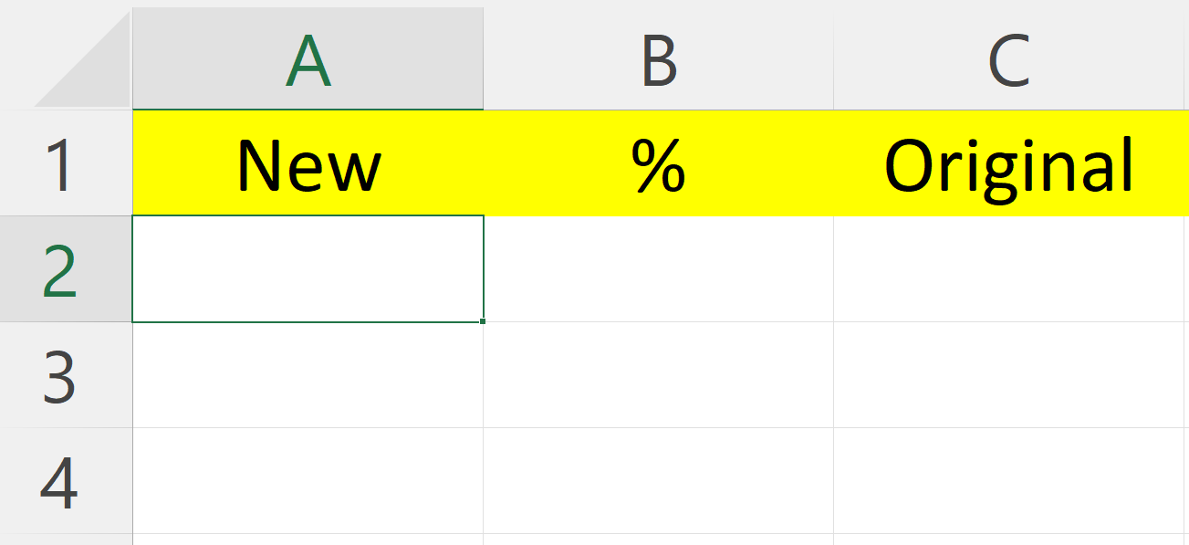
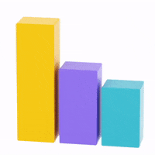
__ = 1 x 4 __ = 1 x 15 people 30 = __ x 40
__ = 1 x 2.3 __ = 1.5 x £20 £6 = __ x £5
__ = 1 x £8 __ = 1.10 x 80g 200m = __ x 150m
__ = 0.5 x 16m __ = 1.75 x 1.2ml 8p = __ £2
__ = 0.2 x 8L __ = 1.06 x £2 £1870 = 1.02 x __
__ = 0.05 x £200 __ = 1.9 x 40 93 = 0.89 x __

Slide 7
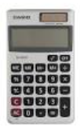
Exam Style Questions - %
A business wishes to increase their percentage profits by at least 3% from 2022 to 2023.
They have already increase prices for tickets from £17.50 to £18.
Show if the business has increased prices enough yet.
Find the 2024 ticket price if the business wishes to increase profits from 2022 by 4% by 2024

Slide 8

Exam Style Questions - %
An item on ebay is reduced in price on its second listing. It was first listed as £25.95 and was reduced to £21.
Ebay takes 2% of the sale price when sold.
Find the total value the lister received and the amount taken by ebay.
____________lister, ______________ ebay

Slide 9
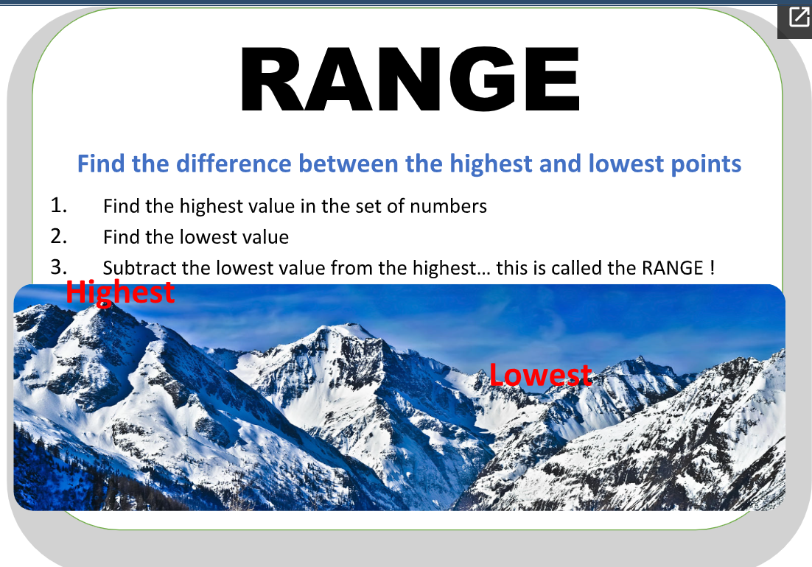
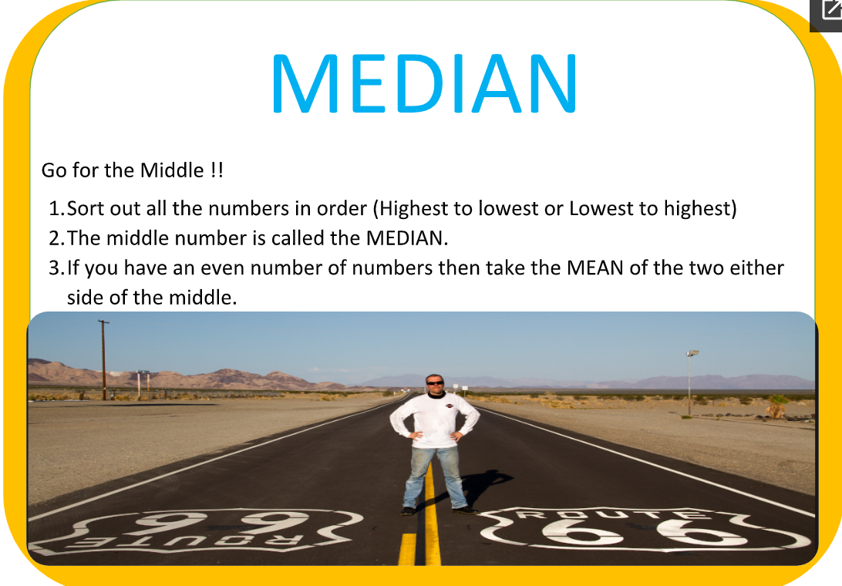
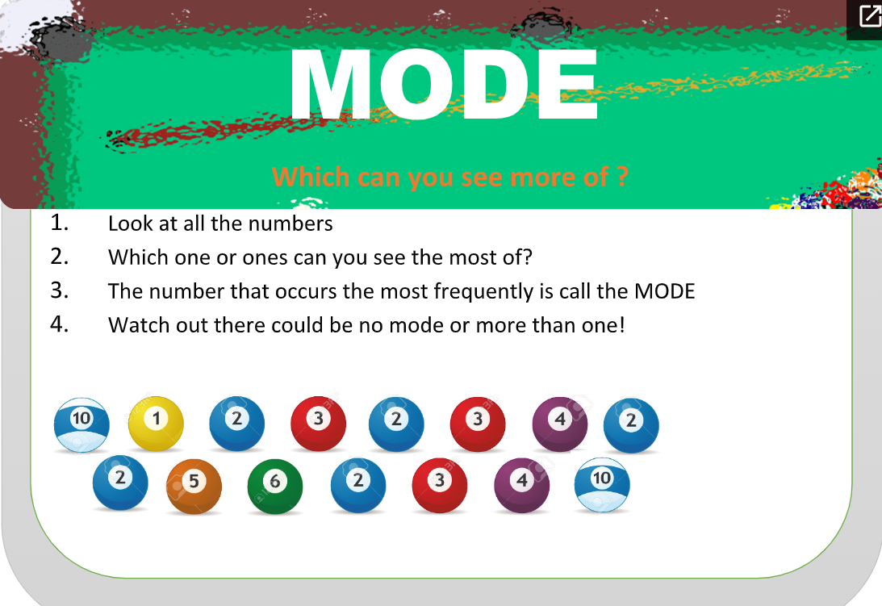
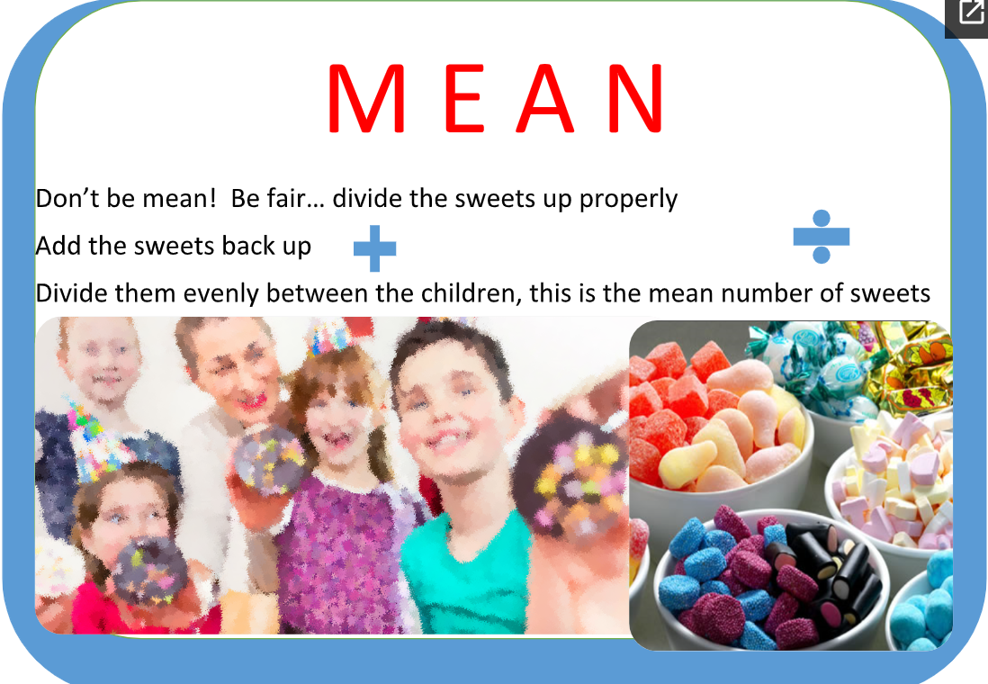
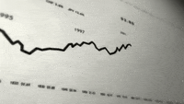
The three types of Average plus Range

Slide 10
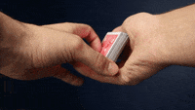
3, 8, 5, 7, 6, 7, 3, 7, 2
Find the Mean
Find the Mode
Find the Median
Find the Range

Slide 11
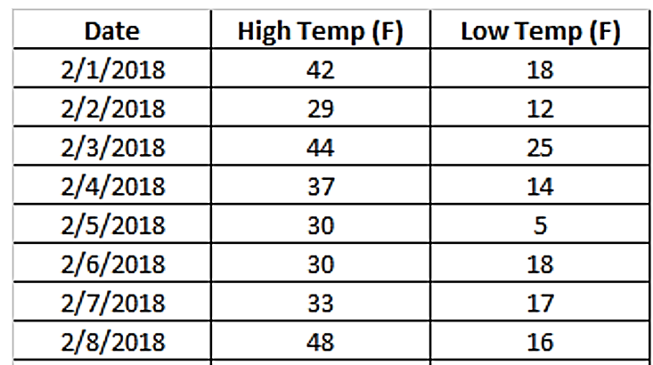
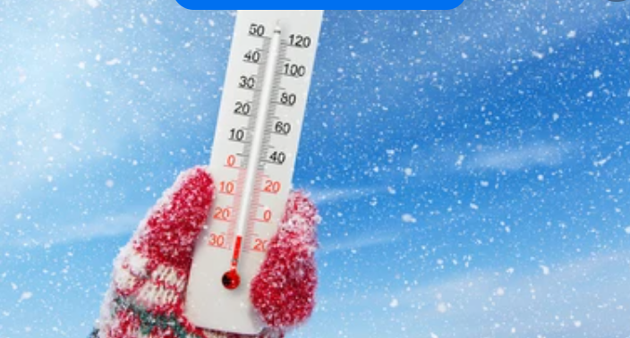
Exam Style Questions - MMMR
A weather forecaster wishes compare temperature ranges to see if this is affected as daily temperatures rise and fall. Use a suitable graph to compare range to a temperature over eight days in February. You must clearly be able to show any outliers in your data and only need to show one temperature either high or low.

Slide 12


Slide 13
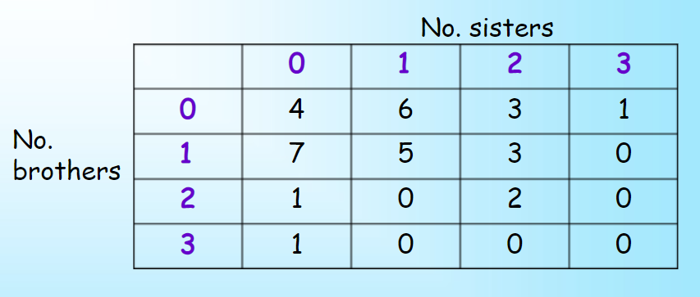
Exam Style Questions - MMMR
A company needs to find the average number of people answering a survey per category about how many brothers and sisters they have. They do not need data on those that have the same number of brothers and sisters. Use a Median and Mean calculation and state which is the higher average.

