Slide 1
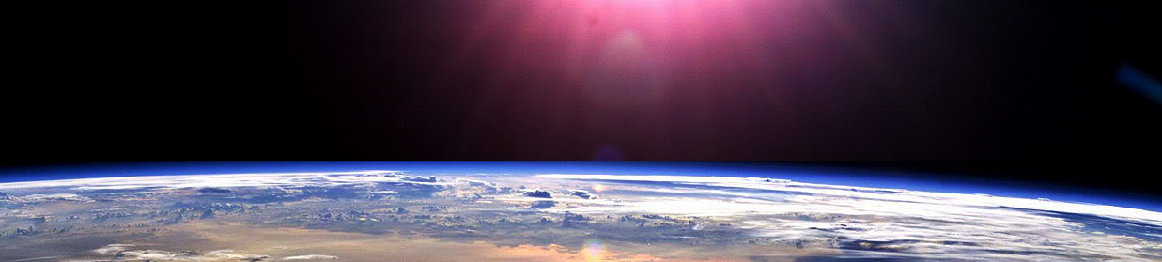


Slide 2







Whole Number and Functions
Place Value

Slide 3



















Course Content: Choose your topic …
Whole Number and Functions
place
value
negative
numbers
add and
subtract
multiply
divide
round
numbers
ratio
scale
fraction
decimal
numbers
percent
percent
decimal
fraction
MATHS L1 to L2
Parts of a whole
metric
measure
imperial
measure
perimeter
area
volume
formulae
bodmas
charts
data
averages
prob-
ability
Measure and Shape
Handling Data

Slide 4





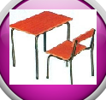







Home Revision Progress Check 1 Video/Discuss Vocab / jobs Lesson Activities Quizzes Topic Answers Progress Check 2 Cont. Learning
Topic Introduction : Place Value
The first topic you need to know before all others! This is where maths starts, its all about digits and where you ‘Place’ them that gives a number its ‘Value’
If you want to tell someone how many, how much, how far, how big.. this is the essential maths to start your journey off!
This topic is the building block of all other maths topics and includes learning about whole amounts, a decimal point and decimal amounts. Each column of digits will give values in blocks of TEN, building up to produce numbers that describe a quantity and form the ‘Decimal’ system of counting.
Choose an icon to select where to start
place
value

Slide 5
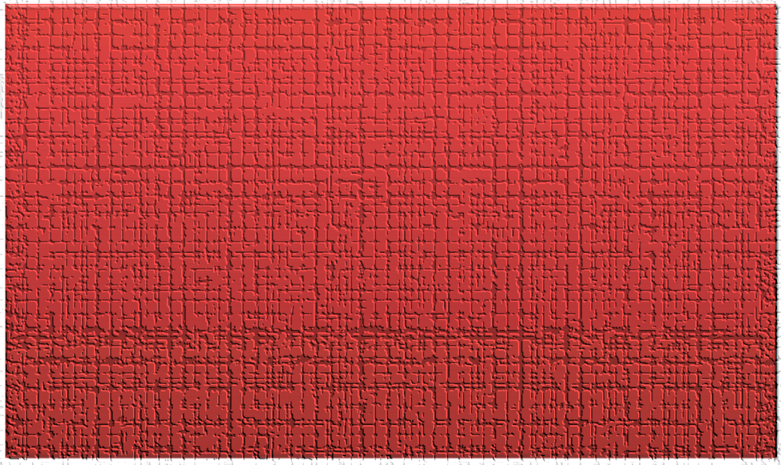

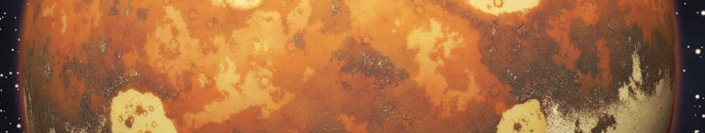
Warm up Exercises 1
Lets start today by revising ! Complete the above sums and multiplication grid

Slide 6


Warm up Exercises 2

Slide 7
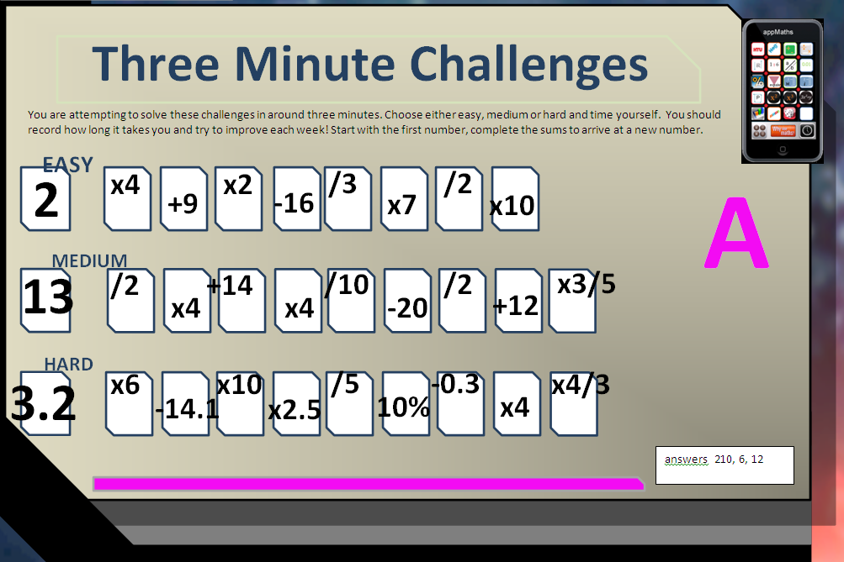

Warm up Exercise 3

Slide 8
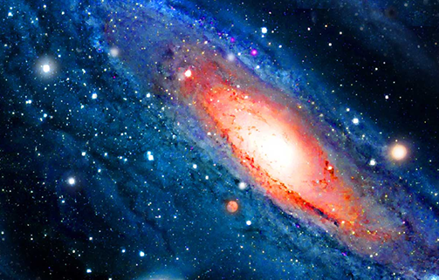

Progress Checker 1
W
What do you already know about place value ? What did you learn during the week, show examples…
How would you rate your skills in reading and writing numbers?
Excellent ability
Good ability, but working to improve
Ok, making a start but I know I have lots to still learn
The day I started studying this topic: My aims for today are….
A Learn how to read and write numbers to represent values
B Learn the names of each column of digits
C Know what the ‘Decimal Point’ is used for and decimal place values
£89.5Bn
14,623 fourteen thousand,
six hundred and twenty three
70.896M
Tk K H T U.

Slide 9

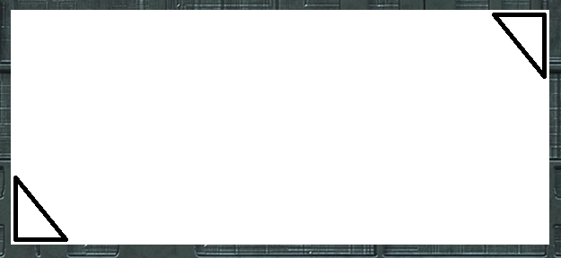


Introductory Video and Discussion
KHTU.
What is the largest number you can think of ?
What comes after the thousandth place value ?
Why do we count in sets of ten ?
We write digits from the right side to the left getting bigger, why?
What does the decimal point do in a number ?
What is the maximum value you can count up to in each place value?
Watch the introductory video and then discuss the above
Your thoughts..

Slide 10


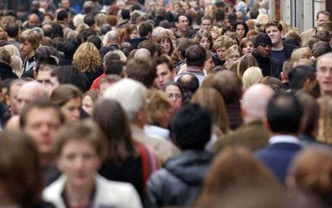



Vocabulary and Jobs
Unit
Place Value
Decimal Point
Decimal System
Powers of ten
Tenth
Hundredth
Thousandth
Thousand
Million
Billion
Hundred
Ten
These are the words you will be using in this topic
Accountants
Statistical Analysis
Banker
Scientist
Sales and Retail
Warehouse
Media
IT / Tech
Transport …. Can you think of more?
…………………………………
…………………………………

Slide 11

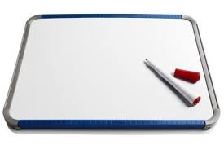
Lesson: Concept Activity
You need two small white boards and
pens … and two people!
Try any of the following activities
One person writes three or four numbers down. The other needs to write them in order of size, smallest to largest.
One person writes down any number using digits, the other writes it in words
One person writes a number on their board and keeps it hidden, the other attempts to guess the number using questions with yes or no answers only
One person writes a number on their board, the other asks them to write a new value, ten (or a hundred, or a thousand) times smaller or bigger.
One person writes down a number of digits, the other needs to order them so they produce the largest (or smallest) number possible

Slide 12

Lesson: Main Teach 1
Hundred thousand
Ten thousand
unit
tenth
ten
hundred
Hundred million
ten million
thousand
billion
Million
thousandth
,
,
,
hundredth
Decimal
point
B
M
K
U
Decimals
Main learning points:
Continuing on from ‘Entry level Maths’ the above place values should be learnt. Starting with the column called ‘unit’ we count from 0 to 9 to show how many units we have. When reaching a value or count of more than 9 the next column ‘ten’ should be used. 1 in the ten column shows either a) one set of ten or… b) ten sets of one unit. The decimal place can be moved to any of the columns and values in the new column can be read.
For larger values, digits can be placed in multiple columns to show the number of each set counted. Each column to the left shows values ‘Ten times larger’ than the previous. Columns on the right show values ‘Ten times smaller’.
L E A R N each column name and its position on the above table of place values off by heart

Slide 13


Lesson: Main Teach 2
Here we go, lets write some numbers!
We place numbers in place value columns to show how many units we have.
Lets try 4 cars. Here the unit is ‘CARS’, the item we are counting, so…. 4
We put the digit 4 in the column called ‘unit’ to show we have four cars
Lets try another. What about six hundred and twenty pounds. The unit is ‘pounds’ so… 6 2 0
This number shows that you have a large set of six hundreds plus two smaller sets of ten
So far so good lets try another. Lets write eighteen thousand, one hundred and seven people.
The unit is people so…. 1 8 , 1 0 7
Here there is a large set of ten thousand people, another set of eight thousand people, a single
set of one hundred people, no tens (so we insert a zero to show this), lastly a set of seven individual people.
We have now started to insert a COMMA in-between the second PERIOD of numbers called thousands and the
first period of numbers (the hundreds, tens and units). This is so the value is easier to read.
IMPORTANT ! Commas are not compulsory in a number and any number can be written without commas, however, if you decide to start using them to help break up a number, you must use them correctly. Commas are inserted in-between periods of THREE digits only…so make sure you use them correctly !
unit
hundred
ten
unit
Ten thousand
thousand
hundred
unit
ten

Slide 14
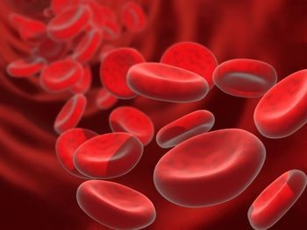
Lesson: Main Teach 3
Lets continue with more numbers…getting bigger!!
Now we have learnt the ‘thousands’ lets change the word to ‘kilo’ which is latin for
thousand. Therefore thousand = K (kilo), ten thousand = TK (ten kilo) and hundred
thousand = HK (hundred thousand).
Ok lets write two million, seven hundred thousand houses. Houses is the unit so…. 2 7
2 is placed in the million place value to show two million houses, 7 is placed in the
hundred thousand place value to show seven hundred thousand. But because the = 2 , 7 0 0 , 0 0 0
unit is ‘house’ we need to fill in all the other place values up to the unit column to
show we do not have any of the other values (eg, we have no ten house sets).
Ok, so thousands are K, what about Millions? Well, we can use a capital
M for both the word millions and for the latin word ‘Mega’ which means
millions.
Lets create even bigger numbers ! Lets have a go writing ninety
four billion, five hundred million blood cells. The unit is ‘blood cell’ so…. 9 4 , 5 0 0 , 0 0 0 , 0 0 0
Notice TM is just ten millions, HM is hundred millions.
Lastly, can we shorten this number. Well that is where the all important 9 4 . 5 Billions
DECIMAL POINT is used. We can move the decimal point to the Billions
place value and read ‘Billions of blood cells’ as our new unit
Now the number is much shorter than before.
Now watch the tutor video
HK
TK
Million
K
hundred
unit
ten
HK
TK
K
Ten Billion
HM
TM
M
hundred
Billions
unit
ten

Slide 15

Lesson: Try out
Block 1 : Watch tutor led demo (in class or on video)
Try these, 1) The place value 100 times bigger than ‘Ten’ is ……………………….. 2) 478 in words is …………………………………………………………………..….
Eight thousand and forty two in digits is ……………………………. 4) The place value 1000 times smaller than ten is ………………………………..
6 hundreds, 5 tens and 3 units is written …………………………..
Block 2 : Watch tutor led demo (in class or on video)
Try these, 6) 94,307 is read as ……………………………………………………………………………………………………………………………………………………………………………………………….
The place value 2 places to the left of the thousands is ……………………………………………………………….
Six million is written as …………………………………………… or …………………………………………………..
To change 3.28M to 3,280,000 the decimal point moves ……………………places to the right / left ?
Block 3 : Watch tutor led demo (in class or on video)
Try these, 10) 16, 482, 596 is written in words as ……………………………………………………………………………………………………………………………………………………………….
………………………………………………………………………………………………………………………………………………………………………………………………………………………………………………………………………
Shortening four billion, eight hundred thousand you can write ……………………………………………………
A thousand times smaller than six is …………………………………………………..
13) 00003293819753.27700 is written as ….. ………………………………………………………………………………………………………………………………………………………………………………..
………………………………………………………………………………………………………………………………………………………………………………………………………………………………………………………………………
Level Two only

Slide 16
Lesson: Websites and links
Number Recognition to 100,000
http://www.emaonline.org.uk/ema/client_files/resources_ftp/netmedia/digitwize/english/digit_wize.cfm
Numberlines
Place value recognition to 1000
Place value recognition to 9000
using arrow cards
http://www.amblesideprimary.com/ambleweb/mentalmaths/numberlines.html
http://www.ictgames.com/arrowcards.html
http://www.primaryresources.co.uk/online/numberboard2.swf
multi and div by 10, 100, 1000
interactive applet
http://www.taw.org.uk/lic/itp/itps/moving_digits_08.swf
http://www.ngfl-cymru.org.uk/vtc/phase4_20030829/Mathematics/Keystage2/Numbers/Tenthsandhundre/Introduction/whiteboard1.htm
divide by 10, 100
Reading and writing large numbers
http://www.mathcats.com/explore/reallybignumbers.html
Large number counter
http://www.math.com/school/subject1/lessons/S1U1L1GL.html#sm2

Slide 17
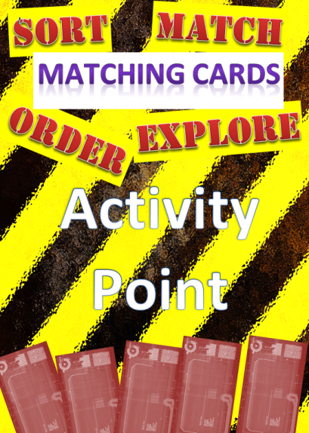

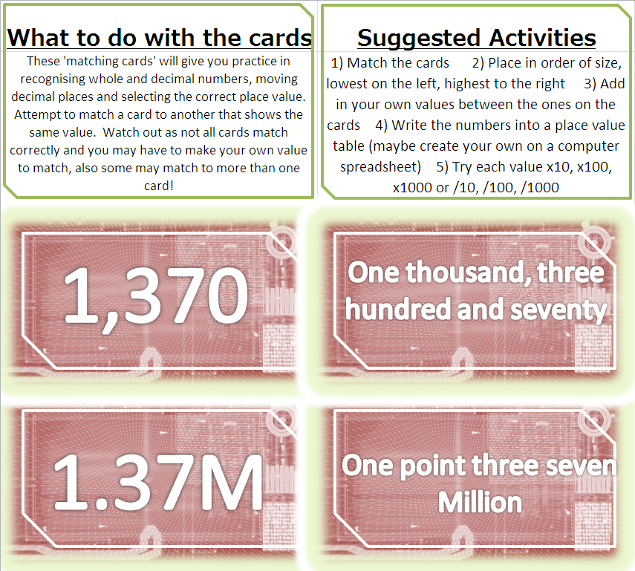

Lesson: Activity A - matching

Slide 18

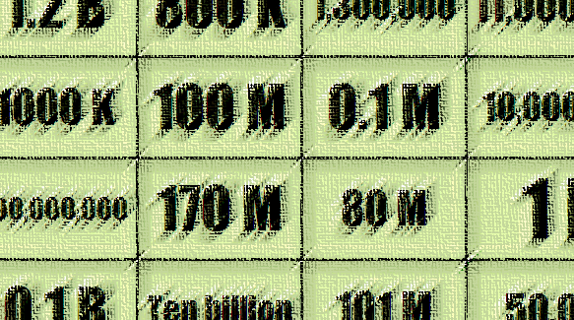
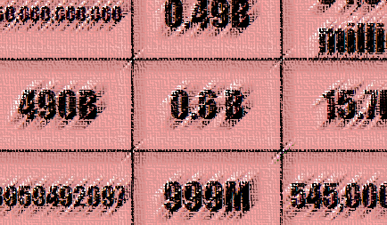
Lesson: Activity B - Build
HIDDEN ANSWERS GAME !
Play in pairs or 2 teams
Race each other to find the hidden correct answers before the other team find them all !!
Fastest team/pair score the number of correct
answers found
Extension:
Play the harder L2 game with larger numbers !!

Slide 19



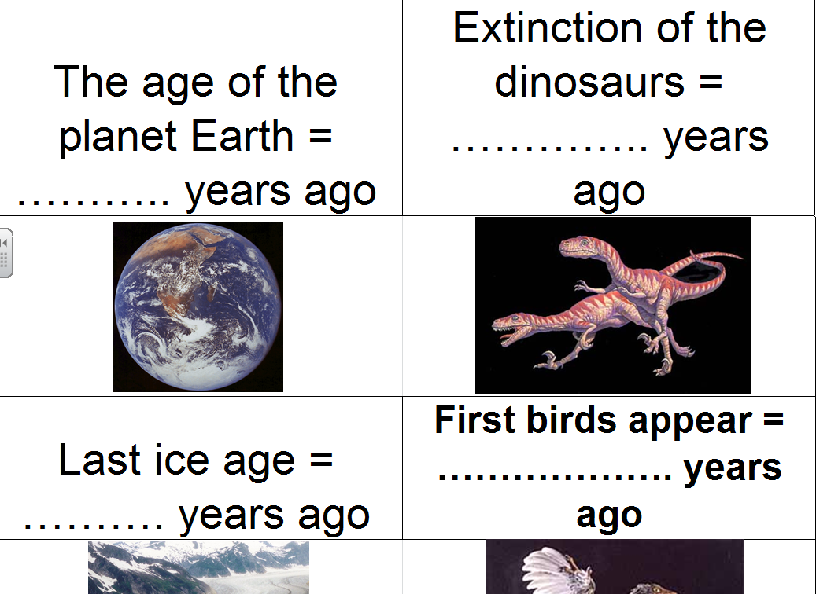
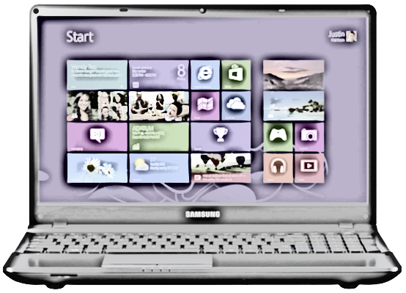
Lesson: Activity C - computer
Computer based activity - a) find the answers to each card on the computer b) produce a ‘place value table’ on a spreadsheet c) copy the answers found onto the spreadsheet in the correct columns ….extension: d) order the values e) convert the values f) write each value in words on the spreadsheet

Slide 20



Lesson: Activity D - Discussion
Discussion Table
Open a discussion
Ask a question
Focus in on solving a question
Record results for feedback to the whole group
1,842,000
3.4 Bn

Slide 21
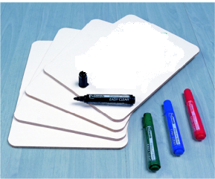

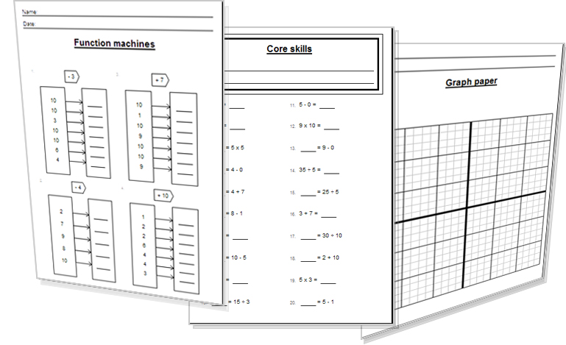


Lesson: Activity E
Try a variety of written practice
Worksheets
Workbooks
Practice Exam Papers
Maths Problems
Tutor Explanations
Tutor

Slide 22


Lesson: Practice – just the numbers
541 in words
7,528 in words
14,950 in words
846,923 in words
1,604,072 in words
25,800,040 in words
909,031,287 in words
655,505,420 in words
1,840,000,000 in words
6,400,050,000 in words
Eight hundred and thirty in digits
Four thousand and ninety two in digits
Sixteen thousand and fifty nine in digits
Two hundred and seventy thousand and five in digits
Seven hundred and thirty three thousand, four hundred and twenty eight in digits
Three million, sixty thousand and seven in digits
Nineteen million, seven hundred thousand in digits
Three hundred and fifty two million in digits
Five billion, fifty million, five hundred and fifty in digits
Eight hundred and sixty billion, four hundred million in digits
Level 2 only
Level 2 only

Slide 23

Lesson: Practice – Large Numbers (Decimals)
1.7 in words 21 ) Circle the largest 1,900 or 2.8 K
153.23 in words 22) Circle the largest 560 or 0.7 K
1,000.50 in words 23) Circle the largest 0.8 K or 950
3.4 K in words 24) Circle the largest 572 K or 0.57 M
96.47 K in words 25) Circle the largest 0.2 M or 300 K
2.3 M in words 26) Circle the largest 2.7M or 27 K
0.48 M in words 27) Circle the largest 18,030,000 or 18.3M
18.6 B in words 28) Circle the largest 8.25 B or 5,200 M
476.002 B in words 29) Circle the largest 0.03B or 140 M
0.05 B in words 30) Circle the largest 0.21 B or 320 M or 3,200 K
Convert 1.3 K into units
Convert 16.72 K into units
Convert 186 K into millions
Convert 8.2 M into K
Convert 645.82 M into units
Convert 1,200 M into billions
Convert 0.3 M into units
Convert 2.4 B into M
Convert 0.18 B into units
Convert 164.3 B into M
Level 2 only
Level 2 only

Slide 24


Lesson: Practice – word problems
Solve the word problems by either completing in the boxes the digits that show the value or write the value shown in the boxes in words.
Malcolm travelled on a high speed train one thousand, six hundred and twenty two kilometres between two countries.
……………………………………………………………………………………………………… people attended the concert
A company deposited one point two five million pounds into their bank
The film took eight hundred and forty nine million dollars on its first day
The new 3D HD TV is £………………………………………………………………………………………………………………………………..………..
Debbie advertised her car for £……………………………………………………………………………………………………..
7) Mike’s house was bought for two hundred and sixty thousand five hundred pounds
8) A galaxy has one hundred billion stars
9) The world population could reach …………………………………………………………………………….. by the year 2100 !
1
0
4
7
3
1
2
5
9
5
0
8
5
Level 2 only
1
6
0
0
0
0
0
0
0
0
0

Slide 25
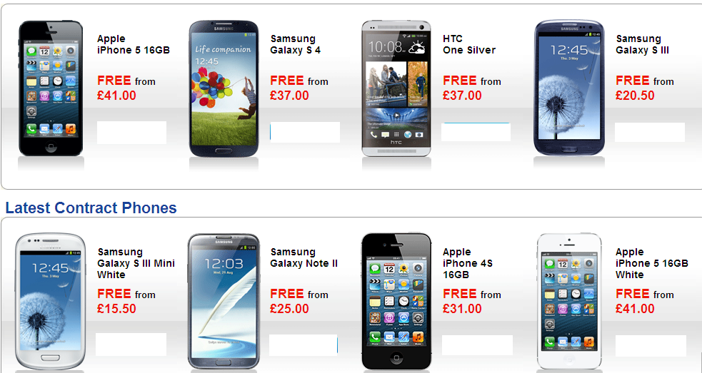

Lesson: Practice – Making it Functional 1
BB
12GB
3.5GB
2000MB
1800MB
3.2GB
6GB
9GB
15GB
GB = Gigabyte = Billion bytes 1,000,000,000
MB = Megabyte = Million bytes 1,000,000
KB = Kilobyte = Thousand bytes 1,000
B = byte 1

Slide 26
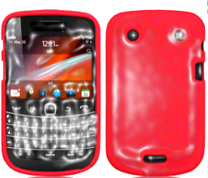
Lesson: Practice – Making it Functional 2
Use the information on the previous page
a
Q1
a) List the phones in a chart showing the price and the memory
b) Which phone has the most memory?
c) Which phones are the most expensive ?
Q2
a) Write in digits (in full) the memory for each phone, from cheapest to most expensive.
b) You do not want to spend more than £35 per month. Which phone would you choose?
Explain your reason.

Slide 27
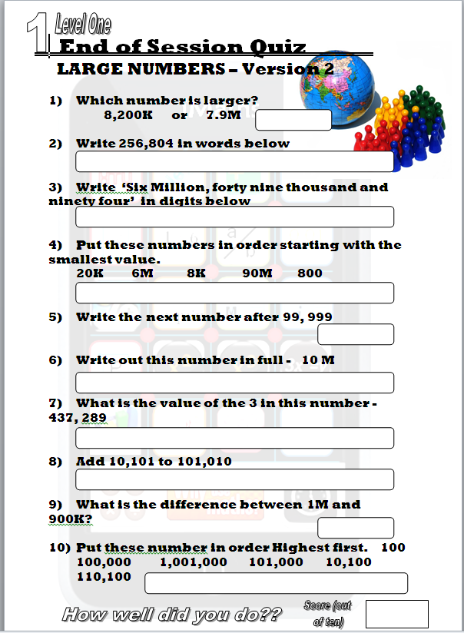
Homework: Quiz to assess LEVEL 1

Slide 28
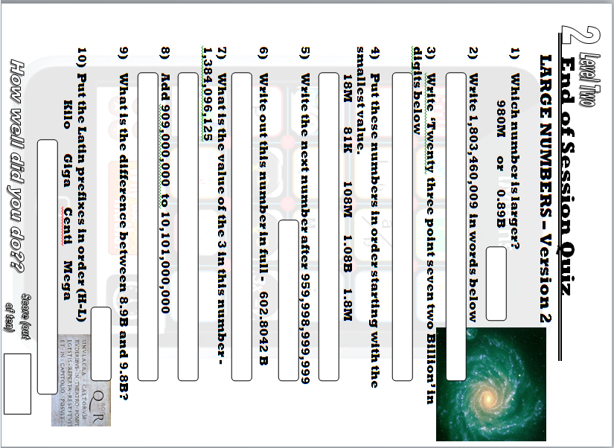
Homework: Quiz to assess LEVEL 2

Slide 29

TOPIC ANSWERS 1
Warm up Exercises 1: 5, 10,15, 20, 25, 30, 35, 40, 45, 50.
Warm-up Exercises 2: 150, 215, 250, 2130, 5120
15, 75, 130, 830, 730
Discussion answers: numbers continue to infinity. After thousandths comes ‘ten thousandths’. We count in sets of tens probably because of our ten fingers! We write digits starting on the right due to the origin of numbers from Arabic. The decimal point shows where whole amounts are and where the decimal amounts start. Each place value can be counted to a maximum of 9 before a new place value is required for 10.
Lesson try out: BLOCK 1)…. 1) 1000 2) four hundred and seventy eight 3) 8042 4) hundredth 5) 653
BLOCK 2)…. 6) Ninety four thousand, three hundred and seven 7) hundred thousands 8) 6M or 6,000,000
Move decimal 6 places to the right
BLOCK 3)…. 10) Sixteen million, four hundred and eighty two thousand, five hundred
and ninety six 11) 4.8B 12) six thousandths 13) Three billion, two hundred and ninety three million, eight hundred and nineteen thousand, seven hundred and fifty three point two seven seven
Lesson Practice, Just the numbers:
1 Five hundred and forty one
2 Seven thousand five hundred and twenty eight
3 Fourteen thousand, nine hundred and fifty

Slide 30
TOPIC ANSWERS 2
Lesson Practice, Just the numbers:
4 Eight hundred and forty six thousand, nine hundred and twenty three
5 One million, six hundred and four thousand and seventy two
6 Twenty five million, eight hundred thousand and forty
7 Nine hundred and nine million, thirty one thousand, two hundred and eighty seven
8 Six hundred and fifty five million, five hundred and five thousand, four hundred and twenty
9 One billion, eight hundred and forty million
10 Six billion, four hundred million and fifty thousand
11) 830 12) 4092 13) 16,059 14) 270,005 15) 733,428 16) 3,060,007
17) 19,700,000 18) 352,000,000 19) 5,050,000,550 20) 860,400,000,000
Lesson Practice, Large numbers (Decimals):
1) One point seven 2) One hundred and fifty three point two three 3) One thousand point five zero
Three point four thousand 5) Ninety six point four seven thousand 6) Two point three million 7) zero point four
eight million 8) Eighteen point six billion 9) Four hundred and seventy six point zero zero two billion 10) zero point zero five billion
1,300 12) 16,720 13) 0.186M 14) 8,200K 15) 645,820,000 16) 1.2B 17) 300,000 18) 2,400M
180,000,000 20) 164,300M
2.8K 22) 0.7K 23) 950 24) 572K 25) 300K 26) 2.7M 27) 18.3M 28) 8.25B 29) 140M 30) 320M
10 Lesson Practice Word Problems: 1) 1,622Km 2) Ten thousand, four hundred and seventy three 3) 1.25M or 1,250,000 4) 849,000,000 5) One thousand, two hundred and fifty nine pounds 6) Five thousand and eighty five pounds 7) 260,500 8) 100,000,000,000 9) Sixteen billion

Slide 31
TOPIC ANSWERS 2
Lesson Practice, Functional:
1a. As per image 3x8 grid, headed phone name, price, memory
1b. Apple iphone 5 White with 15GB
1c. Apple iphone 5 B/W
2a. 3,200,000,000. 1,800,000,000. 6,000,000,000. 9,000,000,000. 2,000,000,000. 3,500,000,000. 12,000,000,000. 15,000,000,000.
2b. Apple iphone 4S at £31 it is less £35 and has the largest memory

Slide 32
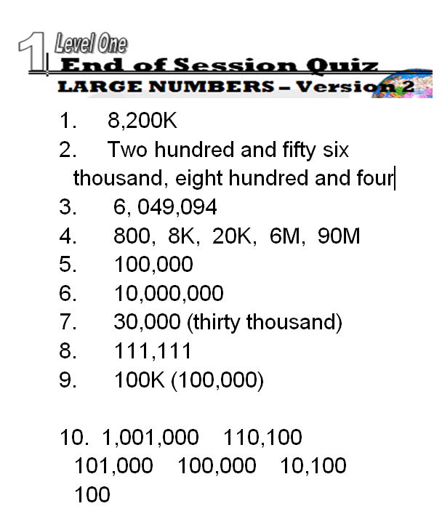
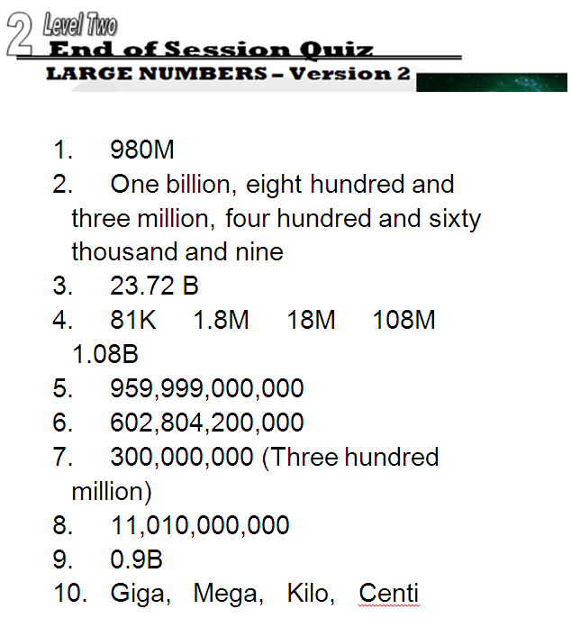
TOPIC ANSWERS 3

Slide 33
Progress Checker 2
W
What do you now know about place value ? What did you learn in the session, show examples…
How would you now rate your skills in reading and writing numbers?
Excellent ability
Good ability, but working to improve
Ok, making a start but I know I have lots to still learn
The day I finished studying this topic: My aims for today were….
A Learn how to read and write numbers to represent values
B Learn the names of each column of digits
C Know what the ‘Decimal Point’ is used for and decimal place values
£89.5Bn
14,623 fourteen thousand,
six hundred and twenty three
70.896M
Tk K H T U.

Slide 34
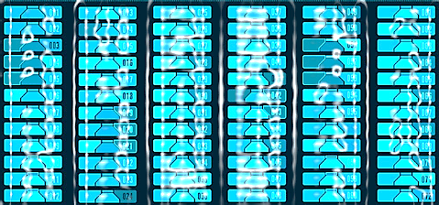

Continuing to Study and Learn
What else can you do to help yourself to learn and practice? Here are ten suggestions, record which you do each week and also record your progress.
Internet websites
Repeat the lesson, make notes, organise a folder, revise
Own maths workbook
Study together with a friend or family member
Finish activities in this book
Complete class handouts or tasks
Practice exams / past papers
Use maths skills learnt at home or at work in real situations
Play games
Experiment yourself, try new things ask yourself questions
Try making a graph of number of practice methods you use against your progress score in each topic. Are you showing more practice gives better results?

