Slide 1

Decimals
- Order, approximate and compare decimals
- Add, subtract, multiply and divide decimals up to three decimal places
Recap
Recap
1. What is the value of 2 x 4 + 8 – 1?
2. What is the value of 14 + 8 ÷ 2?

Slide 2
Ordering Decimals
All decimals have place values. You need these to order decimals.
T H Th
1.351
When you want to compare two decimals, line them up at the decimal places.
1.34
0
If the numbers aren’t the same length, replace empty spaces with a zero, then read the numbers.
What’s bigger? 351 or 340?

Slide 3
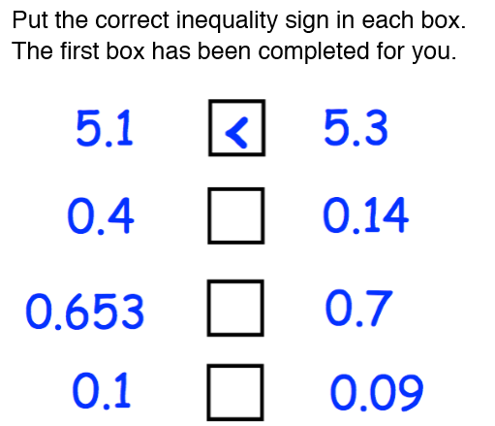
Order these decimals
Write the following numbers in order of size. Start with the smallest number. 0.42, 0.4, 0.415, 0.48, 0.469
Write the following numbers in order of size. Start with the smallest number. 0.08, 0.25, 0.81, 0.2, 0.68
Five boys take part in a long jump competition. The distances jumped were:
4.31m, 4.08m, 4.1m , 4.093m, 4.51m
Write down the distance of the longest jump
Put the jumps in order, starting with the shortest.

Slide 4
Adding and Subtracting Decimals
12.472 + 1.35
Line it up like you would with normal addition – make sure the decimal places are in line.
12.472
+
1.35
0
Again – when there’s an empty place, make sure you put a 0 in there. Then – just add like normal.
Subtraction is exactly the same. You just subtract instead.

Slide 5
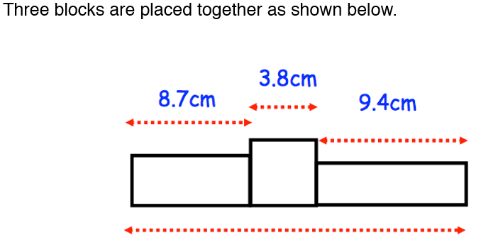
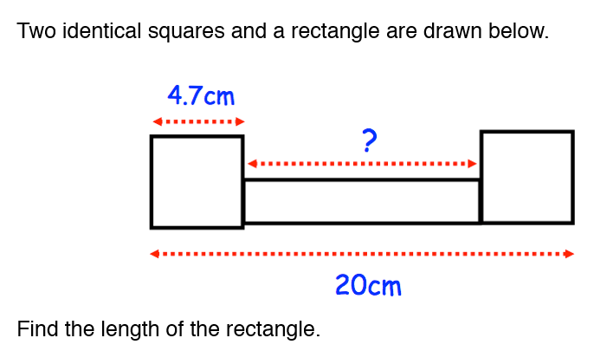

Add and Subtract these Decimals
(c) 10.4 - 2.2 (d) 9.44 - 3.05

Slide 6
Multiplying Decimals
0.4 x 0.5
First of all turn them into whole numbers by multiplying by ten, a hundred, a thousand etc. Keep track of what you multiplied the numbers by.
0.4 x 0.5
4 x 5 = 20
x10
x10
Because you multiplied by 10 twice – we divide by 10…twice!
20.
Answer: 0.20!
Notes:
There's two you have to remember: Circumference & area...
Which is which?
Circumference = the distance around a circle (or the perimeter). To get Circumference you do π x diameter. Or πd!
Area = the inside! to get the area you do π x radius²
So for this circle…
Area: π x ${10}^{2}$ = π x 100 = 314.159$m^{2}$ (AREA)
Circumference: π x diameter (or 2 x 10) so π x 20 = 62.83cm
In terms of π...
The non calculator paper might ask you to do the area of a circle and
'leave it in terms of π.' What does this mean?
Easy. Don't do anything. Just leave π alone!

Slide 7
Multiplying Decimals
4.8 x 0.9 (b) 2.4 x 3.2
(c) 0.94 x 0.02 (d) 0.18 x 1.5

Slide 8
Dividing Decimals
1.5 ÷ 0.03
First of all turn them into whole numbers by multiplying by ten, a hundred, a thousand etc. If one number is multiplied by more do the same to the other number!
1.5 ÷ 0.03
150 ÷ 3 = 50
x100
x100
The balance is the same – so the answer is 50!
Notes:
There's two you have to remember: Circumference & area...
Which is which?
Circumference = the distance around a circle (or the perimeter). To get Circumference you do π x diameter. Or πd!
Area = the inside! to get the area you do π x radius²
So for this circle…
Area: π x ${10}^{2}$ = π x 100 = 314.159$m^{2}$ (AREA)
Circumference: π x diameter (or 2 x 10) so π x 20 = 62.83cm
In terms of π...
The non calculator paper might ask you to do the area of a circle and
'leave it in terms of π.' What does this mean?
Easy. Don't do anything. Just leave π alone!

Slide 9
Divide these Decimals
48 ÷ 0.6 (b) 24 ÷ 0.03
(c) 0.14 ÷ 2 (d) 54 ÷ 0.09

Slide 10

Exam Questions
June 2018

Slide 11
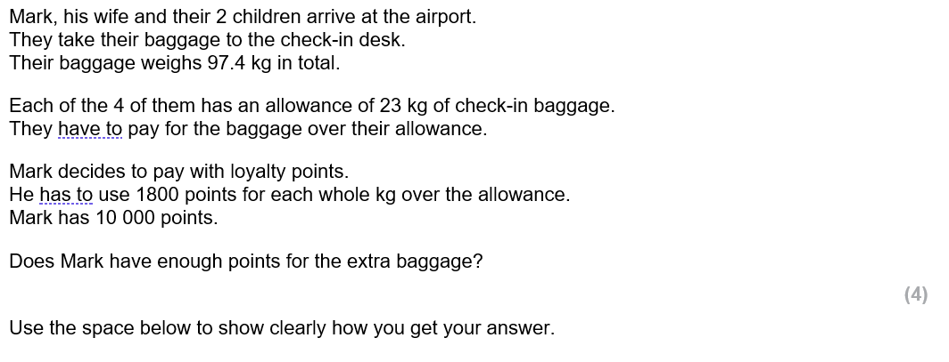
Exam Questions
Oct 2015 (Baggage)

Slide 12
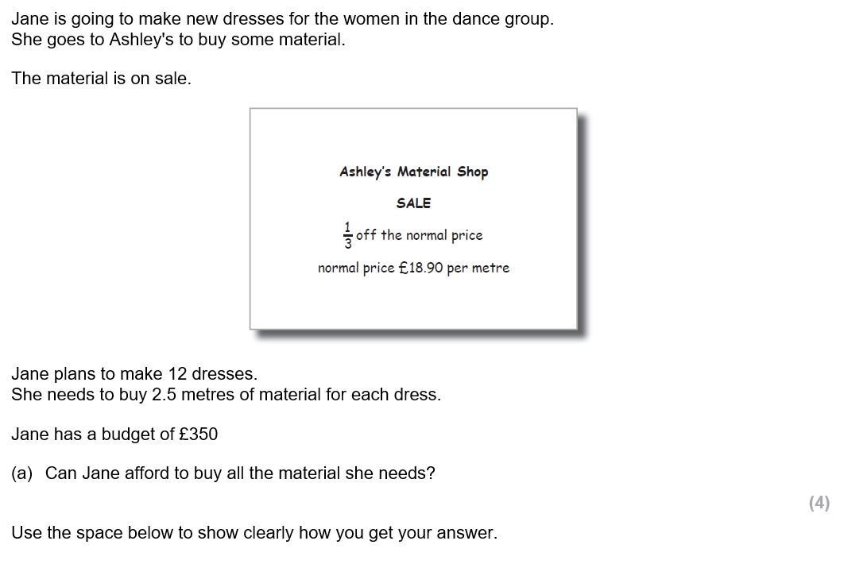
Exam Questions
Jul 2015

Slide 13
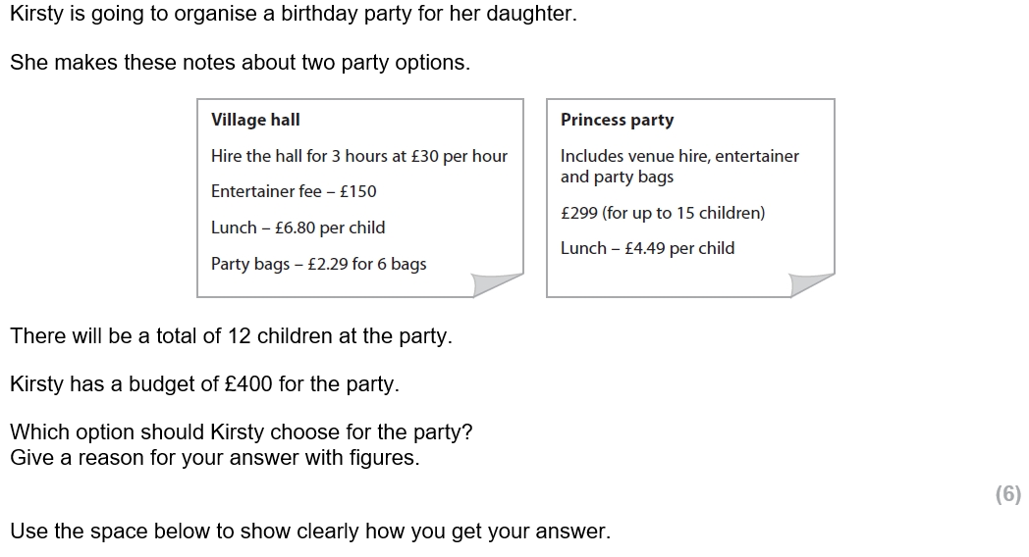
Exam Questions
July 16 – birthday party

Slide 14
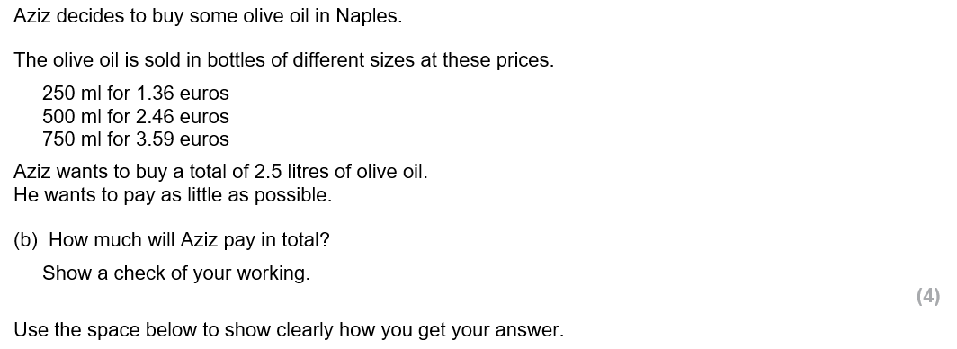
Exam Questions
Oct 2017

