Slide 1





Whole Number and Functions
02 . Negative numbers

Slide 2











Home Warm up Progress Check 1 Video/Discuss Vocab / jobs Lesson Activities Quizzes Topic Answers Progress Check 2 Cont. Learning
Topic Introduction : Negative Numbers
1
This topic starts to look at numbers as appearing on a line starting at zero (you have nothing) and continuing getting larger until infinity. But some values can actually go below zero and the ‘Negative Numbers’ allow you to continue to count and put values to these situations.
So negative numbers are just numbers, 1,2,3,4 etc but sort of travelling in a different direction (getting smaller rather than larger) and so can be called ‘directed numbers’ also. Often appearing on a line of values such as a scale, they are used in measuring, scoring and counting past zero.
Choose an icon to select where to start
negative
numbers

Slide 3



Warm up Exercises 1
2
Lets start today by revising ! Complete the above sums and multiplication grid

Slide 4



Warm up Exercises 2
3

Slide 5

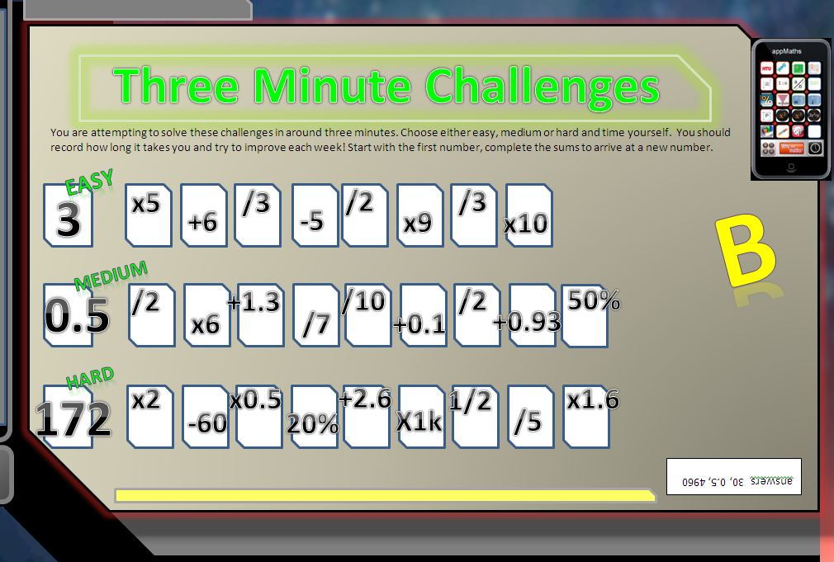

Warm up Exercises 3
4

Slide 6

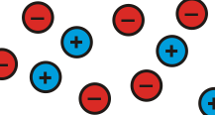
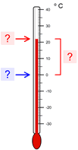
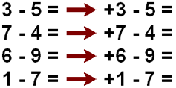

Progress Checker 1
5
What do you already know about ‘Negative Numbers’ ?
How would you rate your skills in handling negative numbers?
Excellent ability
Good ability, but working to improve
Ok, making a start but I know I have lots to still learn
My aims for today are…
A to subtract past zero and recognise negative numbers
B read, write, order and calculate using negative numbers including negative decimals
C find the difference between negative/positive whole and decimal numbers

Slide 7




Introductory Video and Discussion
6
KHTU.
Fractions and Negatives represent small values, how are they different ?
Can you add, subtract, multiply and divide negatives ?
Can you have less than nothing ?
Why do we need brackets when writing negative numbers ?
Where did the ‘minus sign’ come from in front of the negative numbers ?
How small do negative numbers get ?
Watch the introductory video and then discuss the above
Your thoughts..

Slide 8


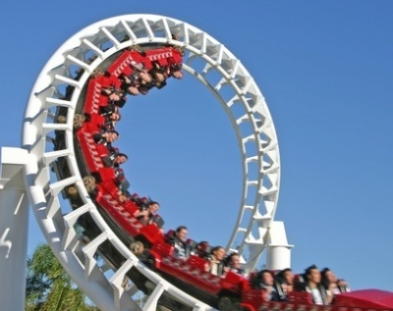
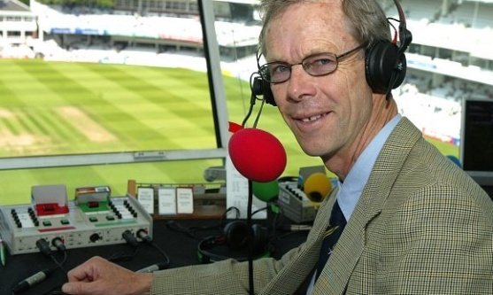
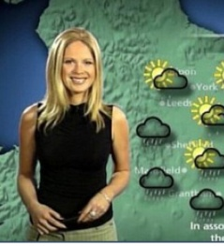

Vocabulary and Jobs
7
Negative
Subtraction
Zero
Direction/Directed
Positive
Minus
Less
Difference
Lower
Sign
Number Line
X and Y axis
These are the words you will use in this topic
Accountants
Weather forecaster
Scientist
Optician
Theme park designer
Bank and Cashier
Sportsman
Quiz host
Politics
…. Can you think of more?
…………………………………
…………………………………

Slide 9
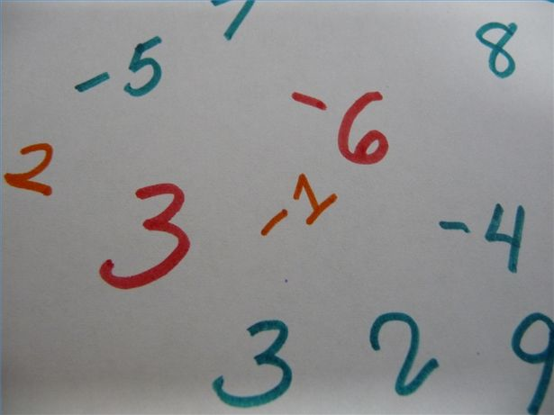

Concept Activity
8
On a number line put these numbers in order of lowest to highest
-5
11
-17
0
3
-1
19

Slide 10
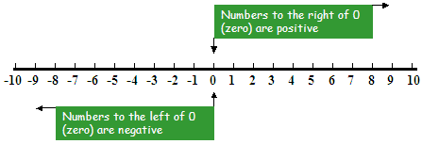
Lesson: Main Teach
9
Definition: A negative number is a way of continuing to count below ‘zero’ (0)
A negative number is the distance (often shown to the left or below on number lines) the number is away from zero
So, …. -5 is five steps from zero, -9 is how many steps? Good, nine steps is correct. Therefore -679 is ………….? from zero. Yes, its just 679 steps away from zero!
Try… -10 is …… steps from zero -0.5 is ………. steps from zero -1.87M is …….steps from zero
Good, -10 is ten steps from zero, -0.5 is 0.5 steps away from zero, -1.87M is 1.87 million steps away from zero
So we have learnt that negative numbers work in the same way as positive numbers. They just show how many (a value) but just in a different direction to the positive numbers.

Slide 11
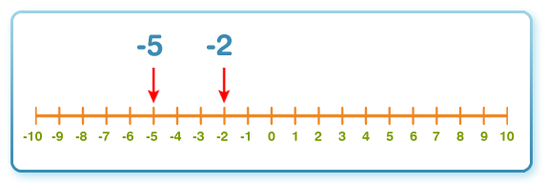
2 Lesson: Main Teach
10
To find the difference between two positive numbers we simply take the largest from the smallest e.g. 9-2 = 7.
To find the difference between two negative numbers we simply (???) do the same!
But which is the largest and which is the smallest?
That gives (-2) – (-5) , (RULE) when two minuses come together this turns to a plus (+).
Therefore it becomes -2 +5 , thus five is bigger than -2 by 3, the difference is 3
We can rearrange this to get 5-2=3
This simply means it takes 3 positive steps to get from -5 back to -2
Activity: With a partner find the difference between two negative numbers

Slide 12
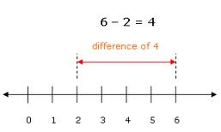
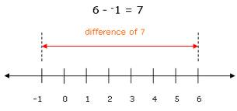
2 Lesson: Main Teach
11
To find the difference between two positive numbers we simply take the
largest from the smallest e.g. 6-2 = 4.
How do we find the difference between a positive and negative number?
From our diagram we can see it takes 7 steps to get from -1 to plus 6, one step to get back to zero and 6 more steps to get to six.
Mathematically that is 6 – (-1) , Do you remember the rule?
(RULE) when two minuses come together this turns to a plus (+).
Therefore this becomes 6 + 1 = 7
(Rule) Add the two numbers together to find the difference between a positive and negative number.
Activity: With a partner using the playing cards find the difference between positive and negative numbers

Slide 13
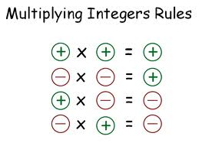
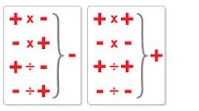
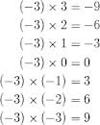

2 Lesson: Main Teach
12
Lets look at multiplying and dividing with negative numbers
Do you remember the rule?
(RULE) When two minuses come together this turns to a plus (+).
(Rule) When multiplying or dividing with a positive and negative number it always turns negative.
Activity: With a partner using the playing cards multiply and divide some positive and negative numbers Now watch the tutor video

Slide 14

Lesson: Try out
13
Block 1 : Watch tutor led demo (in class or on video)
Try these, 1) -11 is written as ………………………………………………………………….. 2) -3 is bigger/smaller than 4
3) -8 is bigger/smaller than 6 4) From smallest to largest, order these numbers 8, -5, 12, -2
Block 2 : Watch tutor led demo (in class or on video)
Try these, 5) The difference between 7 and -9 is ……………………… 6) -19 is ………………………… below 20
7) …………………………..is worth sixteen more than -4 8) 50 and -25 are …………………………places away from each other
Block 3 : Watch tutor led demo (in class or on video)
Try these, 9) -2K is …………………... below -500 10) 5M is above -700K by ……………………………………..
11) 9.6B is above -2.5B by ………………………… 12) -£2.3M is written as ……………………………………………………………………………………………..

Slide 15
Lesson: Websites and links
14
Roll the dice, add and subtract small pos and neg numbers
http://nrich.maths.org/content/id/5911/ConnectThreePM.swf
Use a number line to help solve sums involving negative numbers
http://www.bbc.co.uk/bitesize/ks3/maths/number/negative_numbers/activity/
Play against the computer to score higher, choose positive or negative numbers -10 to 10
http://www.mymaths.co.uk/samples/sampleBoosterFour.swf
Click on the balls in the correct order to practice ordering positive and negative numbers
http://themathgames.com/our-games/arithmetic-games/order-positive-negative-integers/
Use the runner to visualise moving in the positive or negative direction
http://www.mathsisfun.com/numbers/casey-runner.html
Simple negative number ordering game with numbers from -10 to +10
http://www.wmnet.org.uk/wmnet/custom/files_uploaded/uploaded_resources/851/Higher&Lower-Reveal&Orderv4.swf
Use of a number line and ‘jumps’ left and right to visualise moving in neg and pos directions
http://www.ictgames.com/numberlineJumpMaker/index.html

Slide 16

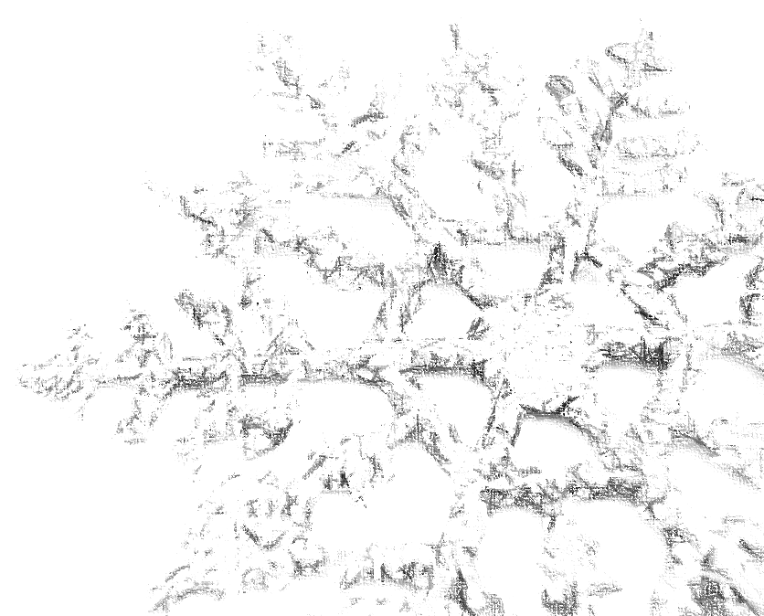
Lesson: Practice – just the numbers
15
Order the following lowest to highest
-2 7 -3 4
6 -9 0 11 2
-1 -2 -8 2 8
-7 3 16 0 -4 -20
-1 -14 -20 25 -25 14
Order the following from highest to lowest
-65 -100 150 65
700 400 -800 -400 -700
350 1000 -530 800 -150
-72 -36 -29 -84 -100
-89 -600 1200 -250 75
Find the difference between the following numbers
5 and 17
12 and 2
14 and 0
17 and -4
20 and -20
4 and -16
1 and -2
16 and -17
Find the difference between the following numbers
19) -10 and -2
-15 and -7
5 and -13
-19 and -6
-14 and -10
Find the difference between the following numbers
180 and -230
-160 and 500
-30 and -200
40 and 420
-90 and -700
1000 and -2000
600 and -1
Find the difference
16M and -200K
2B and -6M
-100K and -2M
-43K and 40K
-0.6M and 1.2M
-16.3B and -2,300M
0.03M and -200K

Slide 17


Lesson: Practice – word problems
16
Q1
Mike drives away from a town 15km. Malcolm drives in the opposite direction 25km away from the same town. How far way from each other are Mike and Malcolm ?
Q2
Last week in my bank account I was owing £65 (overdrawn). I got paid and now I have £250 showing in my bank. How much was I paid?
Q3
My score in a quiz game was minus twelve as I kept getting the answers wrong! The winner scored plus fifteen points. By how much did the winner of the game beat me by?
Q4
Debbie was scuba diving at a depth of thirteen metres below Mike. Mike was at a depth of twenty metres below the surface. What depth was Debbie diving at?
Q5
The temperature during the day was five degrees Celsius. From day to the night the temperature went down by seven degrees. What was the new night time temperature?

Slide 18
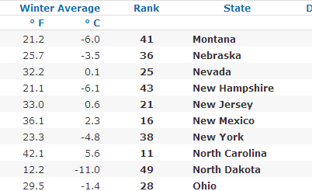
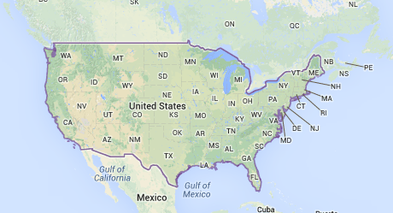
Lesson: Practice – Making it Functional
17
T
1
a) How many States average temperatures are below zero degrees Celsius?
b) Rewrite the chart, putting the States in order of temperature starting with the coldest.
c) What do you notice about both the F (Fahrenheit) and C (Celsius) temperatures once they are ordered?
2
a) Using Celsius temperature values, what is the difference between the highest and lowest states temperatures?
b) Explain what a temperature below zero degrees C means.
c) What would cause this ?

Slide 19
TOPIC ANSWERS
18
Block 1 answers
Minus or Negative eleven
-3 is smaller than 4
-8 is smaller than 6
-5, -2, 8, 12
Block 2 answers
5) Difference is 7+9 = 16
6) -19 is 39 below 20
12 is worth sixteen more than -4
50 and -25 are .. 75 places away
Block 3 answers
-2K is .. 1500.. below -500
5M is above -700k by…. 5,700,000
9.6B is above -2.5B by… 12 .1 B
12) Minus or Negative two point three million pounds

Slide 20

TOPIC ANSWERS
19
Lesson Practice : Just the numbers
-3, -2, 4, 7
-9, 0, 2, 6, 11
-8, -2, -1, 2, 8
-20, -7, -4, 0, 3, 16
-25, -20, -14, -1, 14, 25
150, 65, -65, -100
700, 400, -400, -700, -800
1000, 800, 350, -150, -530
-29, -36, -72, -84, -100
1200, 75, -89, -250, -600
12
10
14
21
40
20
3
33
8
8
18
13
4
410
660
170
380
610
3000
601
16,200,000 or 16.2M
2,006,000,000 or 2.006B
1,900,000 or 1.9M
83,000 or 83K
1,800,000 or 1,8M
14,000,000,000 or 14B
230,000 or 230K
Lesson Practice: Word Problems
Q1… Mike and Malcolm are 40km from each oth er
Q2… I was paid £315

Slide 21

TOPIC ANSWERS 2
20
Lesson Practice: Word Problems cont.
Q3… there is 27 points difference
Q4… Debbie is diving at 33metres below the surface
Q5…. The new night temperature is -2C
Lesson Practice: Making it Functional
a) 6
b) North Dakota -11
New Hampshire -6.1
Montana -6.0
New York -4.8
Nebraska -3.5
Ohio -1.4
Nevada 0.1
New Jersey 0.6
New Mexico 2.3
North Carolina 5.6
C) The states are in the same order where you use Fahrenheit or Celsius temperature scales to order them
a) 16.6 C
b) When a temperature value is below zero it means that water will freeze causing ice, snow, frost weather conditions
c) Normal time of the year fluctuations between summer and winter, winter is usually colder as there is less sunshine. Differences between North Dakota and North Carolina could be their position across America, one state receiving more or less sun that another.

Slide 22
Progress Checker 1
21
What do you already know about ‘Negative Numbers’ ?
How would you rate your skills in handling negative numbers?
Excellent ability
Good ability, but working to improve
Ok, making a start but I know I have lots to still learn
My aims for today are…
A to subtract past zero and recognise negative numbers
B read, write, order and calculate using negative numbers including negative decimals
C find the difference between negative/positive whole and decimal numbers

Slide 23
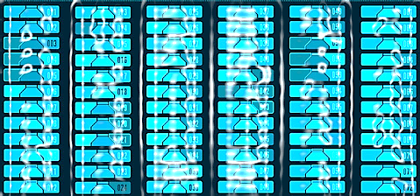

Continuing to Study and Learn
22
What else can you do to help yourself to learn and practice? Here are ten suggestions, record which you do each week and also record your progress.
Internet websites
Repeat the lesson, make notes, organise a folder, revise
Own maths workbook
Study together with a friend or family member
Finish activities in this book
Complete class handouts or tasks
Practice exams / past papers
Use maths skills learnt at home or at work in real situations
Play games
Experiment yourself, try new things ask yourself questions
Try making a graph of number of practice methods you use against your progress score in each topic. Are you showing more practice gives better results?

