Slide 1

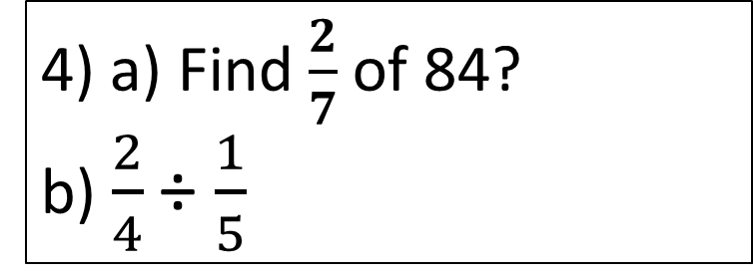
Starter
1) Expand 3y(2 -4y)
3) a) – 9 + 12
b) –8 – 7
c) – 9 x – 2
3
-15
6y -12y²
+18
2a) 1638 ÷ 7
b) 42.5 ÷ 5
234
4) a) Find $\frac{2}{7}$ of 84?
b) $\frac{2}{4}$ ÷ $\frac{1}{5}$
24
$$\frac{10}{4}$$
8.5
5) Increase 80 by 15%.
92

Slide 2
Maps, Scales and Bearings
Learning Intent
To be able to :
Understand and use scale factors and scale diagrams
Interpret maps and scale drawings and use bearings
Understand bearings
  What do we know about scale factors and bearings?
  How confident are on a scale factors 1 – 10

Slide 3
Bearings
Bearings are used in maps to show the direction in degrees from the north point 0⁰s through the circle to 360⁰s
Due north can be either 000 or 360
Bearings are measured looking north FROM the start point TO the target point, in degrees of a circle.
Bearings are always expressed as a 3-digit number from 001⁰ to 360⁰
Bearings are a direction, not a distance.

Slide 4

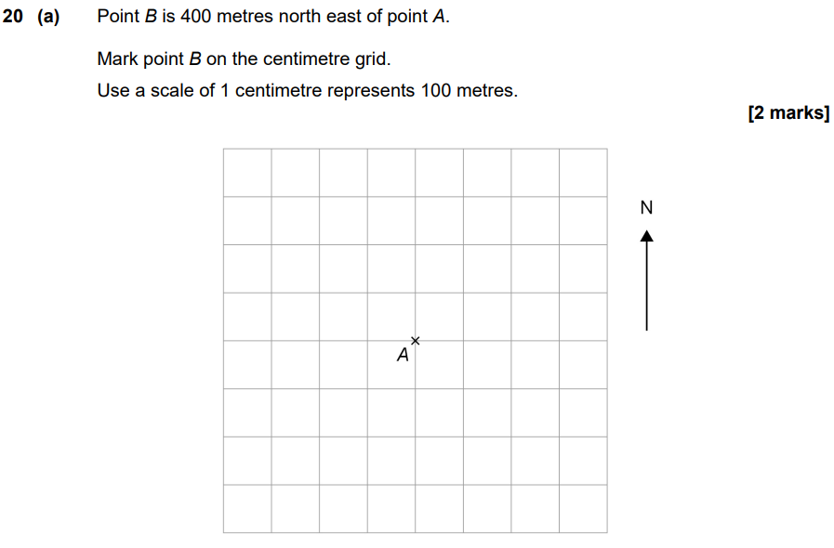
x

Slide 5
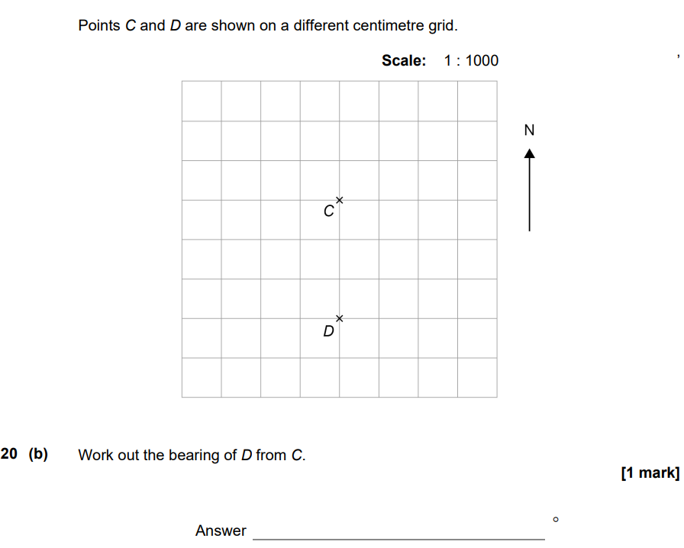
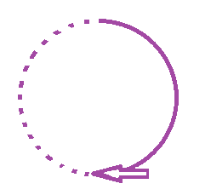
north
:
:
:
:
:
:
:
:
:
180⁰

Slide 6
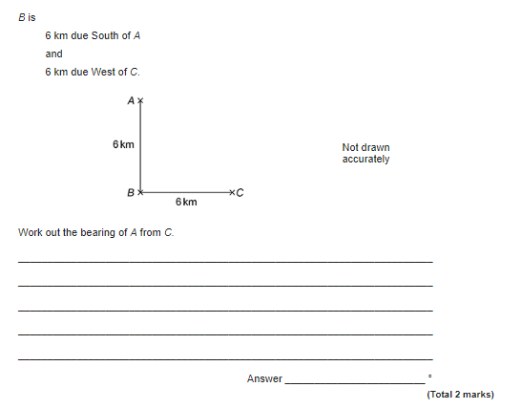
315⁰

