Slide 1
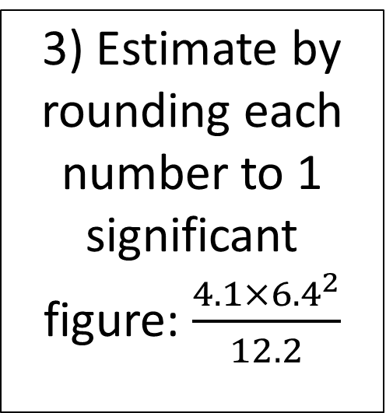
Starter
1a) 94 x 12
b) 9.4 x 12
3) Estimate by rounding each number to 1 significant figure: $\frac{4.1×{6.4}^{2}}{12.2}$
2a) 662÷4
b) 5 friends go on a coach trip. The total cost of the trip is £84. Work out the cost for each person.
4) a) what is 2/5 of 60?
b) 3/8 + 1/5?

Slide 2
Ratio
Learning Objectives
To be able to :
To be able to use ratio notation, including reduction to simplest form
To be able to divide a given quantity into two parts in given part : part or part : whole ratio
To be able to write ratios in the form 1:n
Without a calculator, find 17% of 80
With a calculator, find 192% of 76.8
If Claude invests £500 in a bank account at an interest rate of 6% per year, how much will he have in his account at the end of 2 years?

Slide 3
HOOK

Slide 4
Simplify
Isabel and Sophia share a bag of 42 sweets. Isabel has 16 sweets, and Sophia has the rest. Find the ratio of Sophia’s sweets to Isabel’s sweets, giving your answer in its simplest form.
Write the ratio 1 m : 40 cm in its simplest form.
Nigel makes a smoothie by mixing half a litre of blueberry juice with 100 millilitres of plain yoghurt. Write the amount of blueberry juice to plain yogurt in its simplest form.

Slide 5
Your turn…
Write these ratios in their simplest form.
10p : £1
20 mm : 4 cm
2 weeks : 7 days
18 mins : 1 hour
30 cm : 2 m
1 m : 150 mm
1. Emma’s mass is 54 kg. Her award-winning pumpkin has a mass of 6000g. Find the ratio of the pumpkin’s mass to Emma’s mass. Give your answer in its simplest form.
2. The icing for some cupcakes is made by mixing 1.6 kg of icing sugar with 640g of butter. Find the ratio of butter to icing sugar. Give your answer in its simplest form.
1:10
1:2
1:9
2:5
2:1
3:10
3:20
20:3

Slide 6

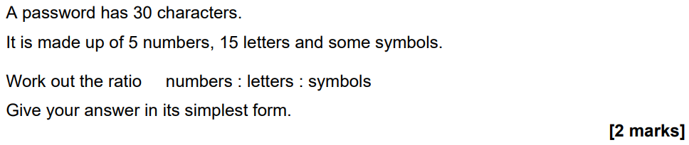
November 21 Paper 1

Slide 7
Simplify to 1:n
Simplify the ratio 4:8 in the form 1:n.
Simplify the ratio 5:3 in the form 1:n.

Slide 8
Your turn…
Write down the following ratios in the form of 1 : n.
6 : 18
5 : 25
4 : 27
10 : 54
7 : 44
1 : 3
1 : 5
1 : 6.75
1 : 5.4
1 : 6.3

Slide 9
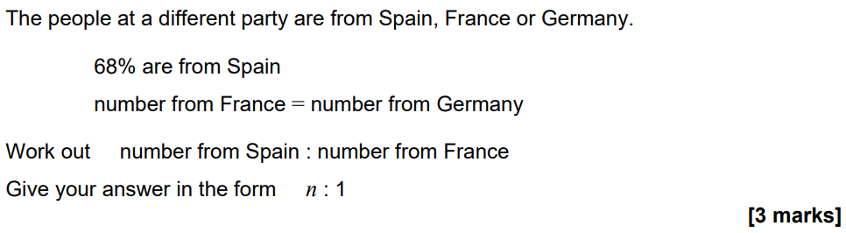
June 22 Paper 2

Slide 10
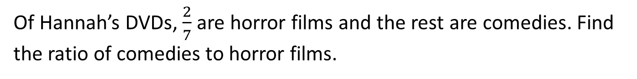
Ratios and Fractions
A box of doughnuts contains jam doughnuts and chocolate doughnuts in the ratio 3 : 5. What fraction of the doughnuts are chocolate flavoured?
Of Hannah’s DVDs, $\frac{2}{7}$ are horror films and the rest are comedies. Find the ratio of comedies to horror films.

Slide 11

Your turn…
1. In a bag of red sweets and green sweets, $\frac{1}{3}$ are red. Find the ratio of red to green sweets.
2. Al watched $\frac{3}{10}$ episodes in a series. Find the ratio of episodes he watched to the ones he didn’t.
3. $\frac{1}{8}$ of some counters are red, $\frac{5}{8}$ are blue and the rest green. Find the ratio of red to blue to green.
1. A tiled floor has blue and white tiles in the ratio 9 : 4. What fraction of the tiles are blue?
2. In a tournament the number of home wins and draws were in the ratio 7 : 2 What fraction of the games were draws?
3. Amy’s sock drawer has spotty, stripy and plain socks in the ratio 5 : 4 : 1. What fraction are stripy?
9/13
2/9
4/10
1:2
3:7
1:5:2

Slide 12
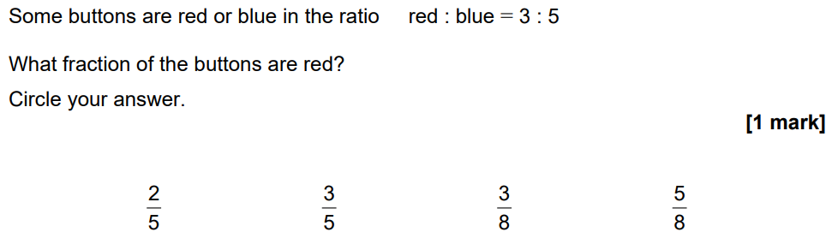
November 21 Paper 2

Slide 13
Dividing in a Given Ratio
Share £15 in the ratio 2:3
Share £420 in the ratio 1:5

Slide 14
Your turn…
1. The angles in a triangle are in the ratio 2 : 1 : 3. Find the sizes of three angles.
2. The four angles in a quadrilateral are in the ratio 1 : 5 : 2 : 4. Calculate the sizes of all four angles.
3. A rope is cut into three pieces in the ratio 2 : 1 : 4. The third piece is 22cm longer than the first piece. What is the length of the second piece?
1. Find the largest share when each amount below if divided in the given ratio.
£30 in the ratio 1 : 4
42g in the ratio 4 : 2
150kg in the ratio 3 : 7
2. There are 121 dogs at a show. For every 11 dogs at the show, 9 are male. How many male and how many female dogs are at the show?
60:30:90
£24
28g
105kg
30:150:60:120
99:22
11cm

Slide 15
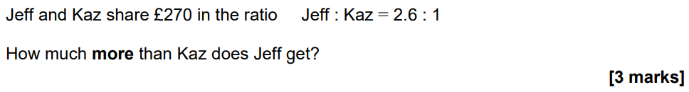
November 21 Paper 3

Slide 16
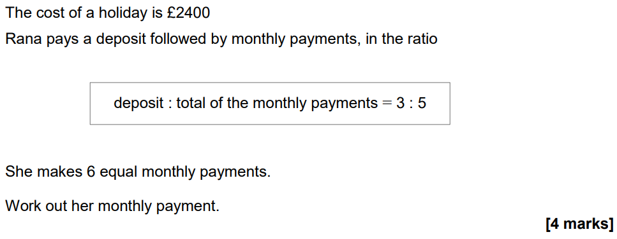
November 20 Paper 1

