Slide 1
Formula
- To be able use simple formulae expressed in words for a one or two-step operation.
Recap
Recap
Find 2 of 60
10
2) Find 3 of 135
5
Put the following fractions in order.
Small to large.
7 4 3 1
9 9 6 6

Slide 2
Formula
Singular –Formula
Plural - can be formulas or formulae

Slide 3
Formula
Quite often in maths exams you are given a formula to follow and calculate the answer.
This could be something you have not covered in class or maybe something you have never heard of.
First you have to substitute the letters with numbers, then follow the formula in the correct sequence.

Slide 4
Maths rules recap
Just like in BODMAS/BIDMAS maths orders still apply
(4+7) x 2 ³ + 8 ÷ 2 - 4 =

Slide 5
BIDMAS
What do the letters represent?
Brackets
Indices
Division
Multiplication
Addition
Subtraction
( )
2²
÷
X
+
-

Slide 6


Indices - Recap
Powers tell us how many times to multiply a number by itself.
Examples:
$$3^{2}=3×3=9$$
$$5^{3}=5×5×5=125$$
Try these:
$4^{2}=$
$7^{2}=$
$2^{3}=$
$3^{3}=$

Slide 7

BIDMAS
Example: $10×5−{\left(4+2\right)}^{2}$
A)
(3 + 3) x 4
4 x 2 – 5
(5 + 7) ÷ 6
5 x 3 + 5
(9 – 4)² + 5
2 x (15 – 2)
(5 x 4) + 2²
(8 + 2) ÷ 10
B)
(1 + 14) – (5 x 3)
(10 + 6) ÷ (4 x 2)
(1 + 2)² x (6 – 3)
(2 x 6) – (14 ÷ 2)
(7 x 2) ÷ (20 – 6)
(3 x 10) – (2 x 2)²
(9 x 5) – (2 x 10)
C)
(3 x 3 – 4) x (2² + 2)
2 x (13 – 4) – (23 ÷ 23)
3² x (1 + 4) + (5 x 2)
4 x (3 + 2) – (24 – 5)
7 x (4 ÷ 2)² ÷ (3 x 5 – 1)
((9 + 7 x 3) ÷ 10)² – 1

Slide 8
Maths rules recap
The difference between BODMAS and formula is that there are usually letters in formula A=LWH which is Area = Length X Width X height
and
12+ 3 this line means divide, but you must solve the top first
5

Slide 9
Letters in formula
In shapes
Seen in upper or lowercase
A=Area
P=Perimeter
V=volume
L=length
W=width
H= height
B= Base

Slide 10
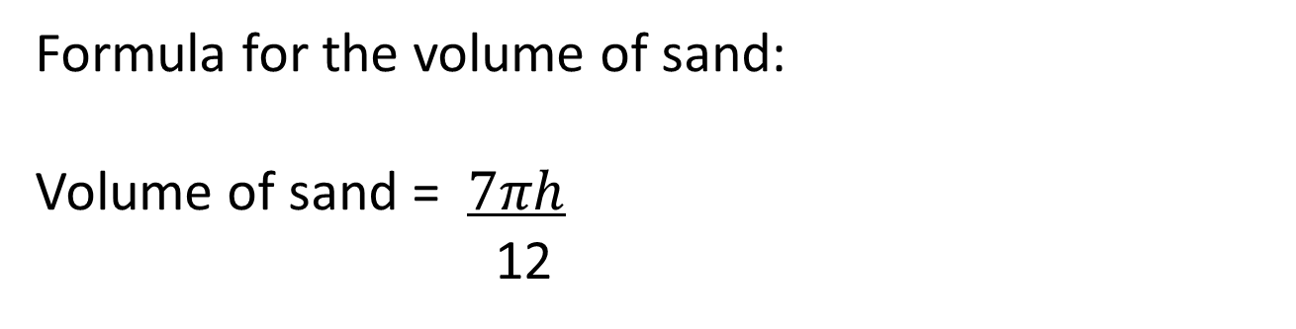
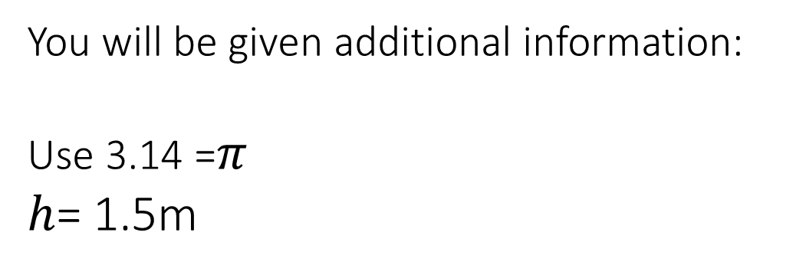
Example
Formula for the volume of sand:
Volume of sand = $7πh$
12
You will be given additional information:
Use 3.14 =$π$
$h$= 1.5m

Slide 11
Practice
Sally has driven 1,457 miles this year. On average her car does 56.5 miles per gallon.
f= d x 4.5
r
f is the number of litres of fuel used
d is the number of miles driven in a year
r is miles per gallon
She wants to know how much it has cost her to drive her car this year, so first she has to find the amount of fuel she has used.
She uses this formula
How much fuel has she used?
Fuel is 143.8p per litre. How much has she spent on fuel this year?

Slide 12
Function machines
Sometimes, instead of a formula to follow you are given a function machine. This is easer than a formula as it gives you the order.
Looking at the previous question in a function machine you would have:
Miles driven
X 4.5
÷ miles per gallon
Fuel used
Sally has driven 1,457 miles this year. On average her car does 56.5 miles per gallon.

Slide 13
Exam questions
Magda works at a charity for homeless people.
She needs to make lunch for 15 people.
Magda knows this rule to find the amount of rice she needs to cook.
Magda thinks she needs to cook 10 cups of rice for 15 people.
Is Magda correct? (3)

Slide 14

Exam questions
Jon sees this information about starlings.
In 2015 there were 2 472 888 starlings. In 2016 the number of starlings had decreased by 74 186
He uses this rule to calculate the percentage decrease.
.
Jon thinks the percentage decrease in the number of starlings is 5%
(b) Is Jon correct? (3)

Slide 15
Exam questions
Tim wants to hang curtains along all 4 walls of his shed.
He uses this formula to work out the amount of material he needs to buy.
The length of the shed is 7.25 m and the width is 3.75 m. Tim thinks he needs to buy 44 m of material.
(b) Does Tim need to buy 44 m of material? (3)

Slide 16
Exam questions
Mikael plays football.
Mikael wants to know how fit he is. He measures his heart rate in beats per minute (bpm).
Mikael uses this formula to work out his fitness value
f = m X 15
r
f = fitness value
m = maximum heart rate
r = resting heart rate
Mikael has a
Maximum heart rate of 192 bpm Resting heart rate of 50 bpm.
A footballer should have a fitness value greater than 54
Does Mikael have a fitness value greater than 54? (3)

Slide 17
Exam questions
Jenny goes swimming at the fitness centre to burn calories. She uses this formula to work out how many lengths of the pool she needs to swim.
L = c x 64
300
L = lengths to swim
c = calories to burn
Jenny wants to burn 350 calories.
Jenny thinks she needs to swim 65 lengths to burn 350 calories.
Is she correct? (3)

Slide 18

Plenary
Donna and her friend Martin are training for a sponsored run. The sponsored run is 26 miles.
They find this rule to calculate how many calories are used to run 1 mile.
Donna weighs 136 pounds. Martin weighs 152 pounds.
Martin thinks he will use 300 more calories on the sponsored run than Donna.
Is Martin correct? (5)

